Slide 1
CMSC 438/691
Antialiasing

Slide 2
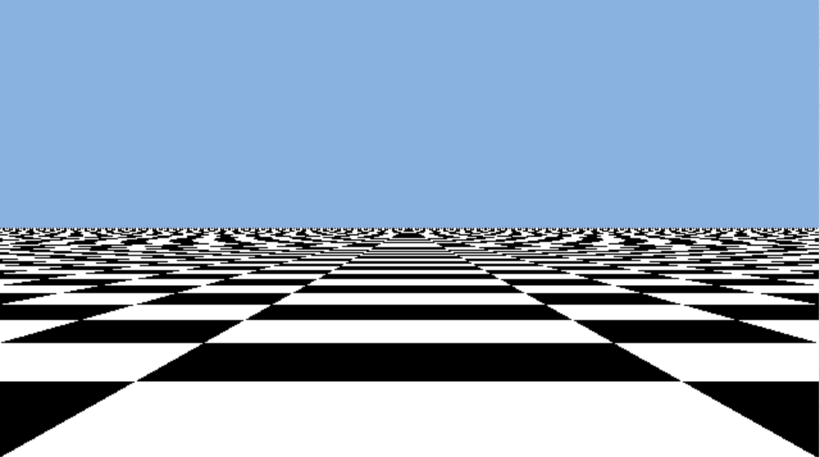
Aliasing
Rendering artifacts due to sampling
  Render just what’s at pixel center
Happens at high frequency places,
sharp edges & small features
Temporal aliasing too
  Frames are discrete instants in time
  Things moving too fast for frame
  sampling rate appear to stutter
  or move backwards

Slide 3
Antialiasing
Blur away frequencies that would alias
  Blur preferable to aliasing
  Blur = weighted average of nearby samples
  Filter Kernel = Weights as a function of distance from result point
Temporal Aliasing: Motion Blur
Spatial Aliasing: Numerical approximation to filter kernel
  … with more samples!

Slide 4
Common Antialiasing Techniques in Games
SSAA
MSAA
MLAA / FXAA
TAA

Slide 5
SSAA: Supersampled Antialiasing
Render higher resolution
  N x per-pixel rasterization samples
  N x pixel shading samples
  N x buffer sizes
Filter & resample
Described as 4-sample SSAA or 4x SSAA

Slide 6
MSAA: Multisample Antialiasing
N-sample rasterization and visibility, only shade one
  N x per-pixel rasterization samples
  1 x pixel shading samples
  1 x buffer sizes (except N x depth samples)
Hardware support
including sample placement
Need depth resolve before using
depth buffer as texture

Slide 7
MLAA: Morphological Antialiasing
Postprocessing pass on aliased image
  1 x per-pixel rasterization samples
  1 x pixel shading samples
  1 x buffer sizes
Algorithm
  Look for jaggy edges
  Infer original edges
  “Fix” image
FXAA is a popular variant
  Available shading code

Slide 8
DLAA: Deep Learning Antialiasing
Postprocessing pass on aliased image
  1 x per-pixel rasterization samples
  1 x pixel shading samples
  1 x buffer sizes
Algorithm
  Train neural network on aliased & high sample-count SSAA images
  Later, give new aliased image and have network produce antialiased result
  Like MLAA, but less hacky
Fast enough on new hardware
Can produce strange results if images are too far from training data

Slide 9
TAA: Temporal Antialiasing
Despite name, this is using temporal data to remove spatial aliasing
  Does not address temporal aliasing
Share samples across frames
  N x rasterization samples (1 per frame)
  N x shading samples (1 per frame)
  2 x buffer sizes (add history buffer)
Exponential weighted average
Must find previous data for “this” pixel in history

Slide 10
Exponential Average
Regular average
Incremental average

Slide 11
Exponential Average
Incremental
Exponential: don’t change weight

Slide 12
History
Account for motion
  Camera motion: current and
  previous transform
  Object motion: velocity buffer
    Also useful for motion blur
Resampling
  Land between pixels
  Avoid blurring history data (filter should include some sharpening)
Rejection
  Occlusion, Disocclusion = stuff in buffer may be a different object
  Color clamping

Slide 13
TAA problems
Start-up aliasing
  Alias until you get enough samples
Disocclusion aliasing
  No history when things appear from behind something else
Ghosting
  Rejection/clamping failure on noisy backgrounds
Pulsing
  Cycle of reject/average
Fireflies
  Single bright sample should average in, but might reject or pulse instead

Slide 14
Between Sample Aliasing
Attempt to antialias shader results between AA samples
Mipmap: pre-filtered versions of texture at power-of-2 scales
  Bilinear: choose closest to 1 texel/sample: lerp x, lerp y
  Trilinear: choose two closest to 1 texel/sample: lerp x, lerp y, lerp levels
  Non-color data needs different filtering
    Normals: Toksvig, LEAN; Shadows: PCSS, Variance Shadow Maps
Noise: use noise that averages to 0, drop high frequency components
Other: shader dependent, usually manual

