Slide 1
CMSC 491/635
Volume Rendering

Slide 2
Volume data
3D Scalar Field: F(x,y,z) = ?
Implicit functions
Voxel grid
Scalar data
Density
Temperature
Wind speed
…

Slide 3
Implicit functions
Blobs [Blinn 82]
Metaballs [Nishimura 83]
Soft Objects [Wyvill 86]
Polynomial approximation for exp()
Philo Vivero http://faemalia.org
Notes:
Equations:
e^{-a r^2}
\begin{array}{ll}1-3(r/R_i)^2 & 0 \le r \le R_i/3\\3(1-r/R_i)^2/2 & R_i/3 \le r \le R_i\\0 & r < R_i\end{array}

Slide 4
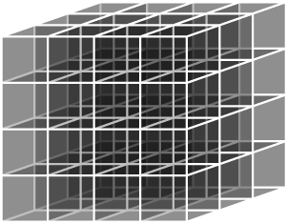
Voxels
Sampled volume
Usually in a grid
Measured
MRI, CT scan, …
Computed
Sample geometric model
Finite element simulation
…

Slide 5
Isosurface rendering
F(x,y,z) – c = 0 (for some given c)
Isosurface normal: ∇F
Implicit: Point repulsion [Witkin 92]
Voxel: Marching cubes [Lorensen 87]

Slide 6
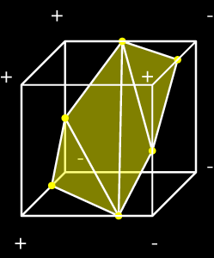
Marching cubes
Estimate intersection point on each edge
Same criteria (e.g. linear interpolation)
Polygons will match
Use template for polygons
2⁸ possibilities, 15 “unique”
Store templates in table

Slide 7
Marching tetrahedra
Decompose volume into tetrahedra
Avoids ambiguous “opposite corner” cases
2⁴ = 16 cases, 3 unique
0 or 4 points inside (0 triangles)
1 or 3 points inside (1 triangle)
2 points inside (2 triangles)

Slide 8
Direct volume rendering
Model as translucent material
Color and extinction ,
Attenuation along ray
Attenuated color at
Accumulate attenuated colors along ray
Notes:
Equations
C(\vec{p})
\tau(\vec{p})
\vec{p}=\vec{r}(t)
\alpha(t)=e^{-\int{\tau(s) ds}}
\vec{r}(t)
C(t) \alpha(t)
I=\int{C(t) \alpha(t) dt}

Slide 9
Simplify volume integral
Numeric integration, step size d
Color of ray segment
Back to front composite
Notes:
Equations:
e^{-¥int{¥tau dt}} ¥approx e^{-¥sum{¥tau_i d}} = ¥prod{e^{-¥tau_i d}} = ¥prod{(1-¥alpha_i)}
i ¥approx ¥alpha_i C_I
I ¥approx ¥sum{¥alpha_i C_i ¥prod{(1-¥alpha_j)}}
C'_i = ¥alpha_i C_i + (1-¥alpha_i) C'_{i+1}

Slide 10
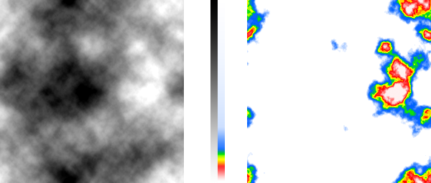
Transfer functions
Map scalar to color and/or opacity

Slide 11
Appearance
Additive / pseudo-XRay
Volume lighting: ,
Directional derivative
Notes:
Equations
¥hat{n}¥bullet¥hat{l}
(¥hat{n}¥bullet¥hat{h})^e
¥vec{n}¥bullet¥vec{v} = ¥nabla F ¥bullet ¥vec{v} = F_{¥vec{v}}
F_{¥vec{v}} ¥approx (F(¥vec{p}+k¥vec{v}) - F(¥vec{p}-k¥vec{v}) )/ 2k

Slide 12
Rendering methods
Ray casting
Splatting
Texture accumulation
Shear-warp
Fourier volume rendering

Slide 13
Ray casting
Straightforward numerical integration
Uniform steps along ray
Resample volume to sample points
Before classification and/or shading
After classification and/or shading

Slide 14
Splatting [Westover 90]
Resample directly onto screen
Each voxel contributes kernel footprint
Reconstruction + pixel filter
Accumulate back-to-front

Slide 15
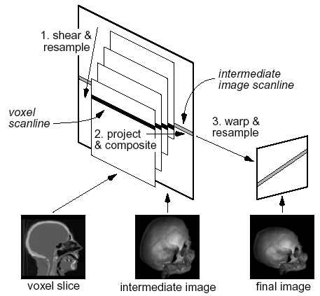
Shear-warp [Lacroute 94]

Slide 16
Texture accumulation
Let texturing hardware resample
Accumulate back-to-front
3D textures
Render slices parallel to image plane
Shift accesses for ,
2D texture slices
Slice sets perpendicular to each axis
Choose set most parallel to image plane
Notes:
Equations
¥nabla F ¥bullet ¥hat{l}
¥nabla F ¥bullet ¥hat{h}

Slide 17
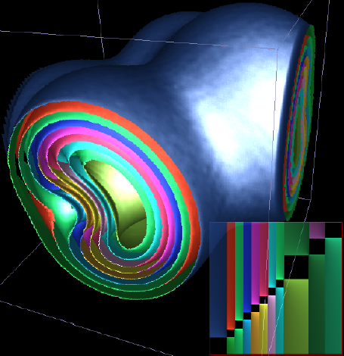
Pre-integrated texture [Engel 01]
Improve approximation for and
Lookup(start value, end value, d)
Dependent lookup
3D texture
2D texture
linear in d
constant d
Notes:
Equations
C_I
¥alpha_i

Slide 18
Pre-integrated texture
a: shading before resampling
b: shading after resampling
c: b with interpolated slices
d: pre-integrated, same slice set as b

Slide 19
Dividing cubes
Find voxels that cross isosurface
Subdivide to pixel-sized sub-voxels
Find sub-voxels that cross isosurface
Plot as shaded points / kernel footprints

