Slide 1
CMSC 635
Ray Tracing

Slide 2
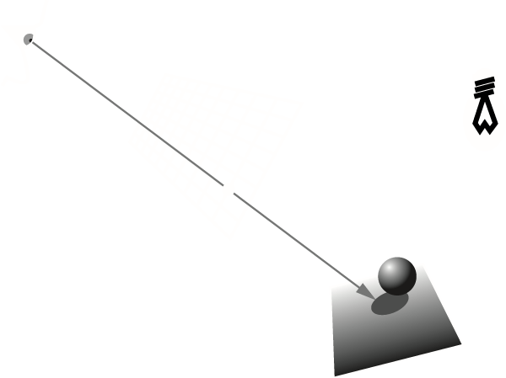
Basic idea

Slide 3
How many intersections?
Pixels
  ~10³ to ~10⁷
Rays per Pixel
  1 to ~10
Primitives
  ~10 to ~10⁷
Every ray vs. every primitive
  ~10⁴ to ~10¹⁵

Slide 4
Speedups
Fewer intersections
Faster intersections

Slide 5
Fewer Intersections:
Algorithmic improvements
Object-based
  Decide ray doesn’t intersect early
  Still intersect along full ray length
Space-based
  Partial order of intersection tests
  Terminate ray early
Image-based
  Ray-to-ray coherence

Slide 6
Object: bounding hierarchy
Bounding spheres
AABB
OBB
K-DOP

Slide 7
Bounding spheres
Very fast to intersect
Hard to fit
Poor fit

Slide 8
AABB
Fast to intersect
Easy to fit
Reasonable fit

Slide 9
OBB
Pretty fast to intersect
Harder to fit
  Eigenvectors of covariance matrix
  Iterative minimization
Good fit

Slide 10
K-DOP
K-Dimensional Oriented Polytope
All objects use same K parallel planes
Creation & test cost between AABB and OBB

Slide 11
Space: partitioning
Uniform grid
BSP
Octtree
K-D tree

Slide 12
Uniform Grid
Fast to traverse
  Steps in X, Y & Z
Scale problems
  “teapot in a stadium”
Same object in multiple cells
  Mailboxing

Slide 13
BSP : Binary Space Partition
Binary Tree
Arbitrary Planar Splits
Body
Arm
Head
Arm
Leg
Leg

Slide 14
Octree
Axis-aligned cells
8-children per node
2D: Quadtree

Slide 15
K-D Tree
Axis-aligned splits
Arbitrary locations

Slide 16
Image
Coherence
  Light buffer (avoid shadow rays)
  Pencil tracing/cone tracing
Image approximation
  Truncate ray tree
  Successive refinement
  Contrast-driven antialiasing

Slide 17
Faster intersections
Store partial precomputation with object
Stop early for reject
Postpone expensive operations
  Reject then normalize
If a cheap approximate test exists, do it first
  Sphere / box / separating axes / …
Project to fewer dimensions
Cache results from previous tests
  Mailboxing

Slide 18
Intersection approaches
Plug parametric ray into implicit shape
Plug parametric shape into implicit ray
Solve implicit ray = implicit shape

Slide 19
Making it easier
Transform to cannonical ray
  (0,0,0)–(0,0,1)
Transform to cannonical object
  Ellipsoid to unit sphere at (0,0,0)
Compute in stages
  Polygon plane, then polygon edges
Numerical iteration

Slide 20
Parallel intersections
Distribute pixels
Distribute rays
Distribute objects
Distribute space

Slide 21
Parallel intersections
Load balancing
  Scattered rays, blocks, lines, ray queues
Culling
Communication costs
  Database
  Ray requests
  Ray results

Slide 22
Assigned papers
Cook et al. 1984
Amanatides and Woo 1987
Wald et al. 2006 (or 2007?)
Popov et al. 2009
Pantaleoni and Luebke 2010

Slide 23
Cook et al. 1984
Distributed Ray Tracing
Explosion of samples
  Antialiasing, Glossy reflections, Translucency, Soft shadows, Depth of field, Motion blur
Ray makes a random choice for each
Version of Monte Carlo integration

Slide 24
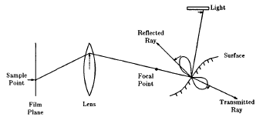
Cook et al. 1984

Slide 25
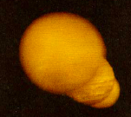
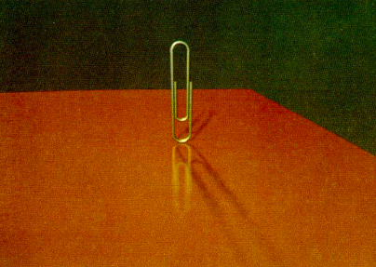
Cook et al. 1984

Slide 26
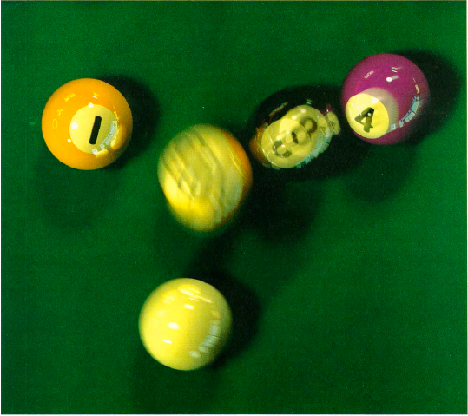
Cook et al. 1984

Slide 27
Amanatides and Woo 1987
Steps along each axis are uniform
  Just need to pick which one
Don’t repeat intersection computations
  Ray IDs, store with object

Slide 28
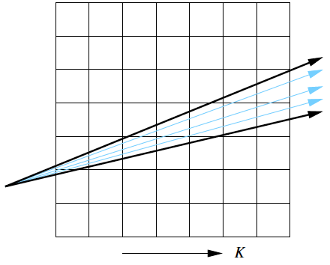
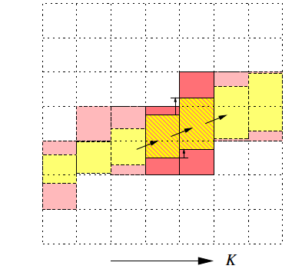
Wald et al. 2007
Trace a collection of rays through a grid
  Use frustum of ray packet
  Trace one slice at a time

Slide 29
Popov et al. 2009
Compare AABB to K-D tree
  Surface Area Heuristic
Nest, share or split between nodes?
Grid for speed
Axis aligned sweeps

Slide 30
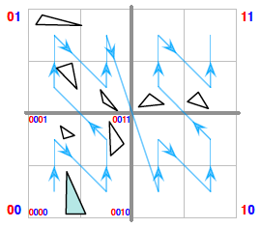
Pantaleoni and Luebke 2010
Morton code (also called Z order)
  Naturally nests
Talks about surface area heuristic
Dynamic geometry
  Full resort every frame

