Slide 1
CMSC 635
Course Topics

Slide 2
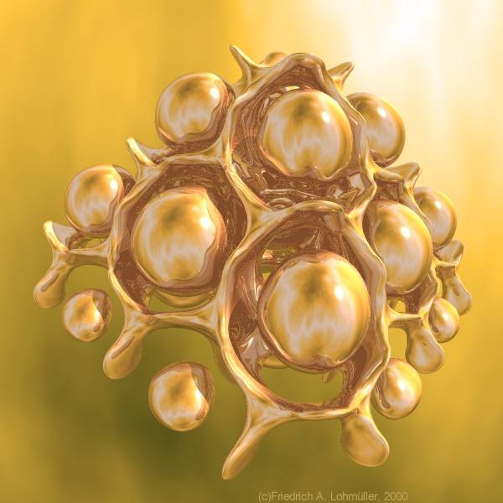
Ray Tracing
Friedrich A Lohmüller, POV-Ray Hall of Fame Gallery

Slide 3
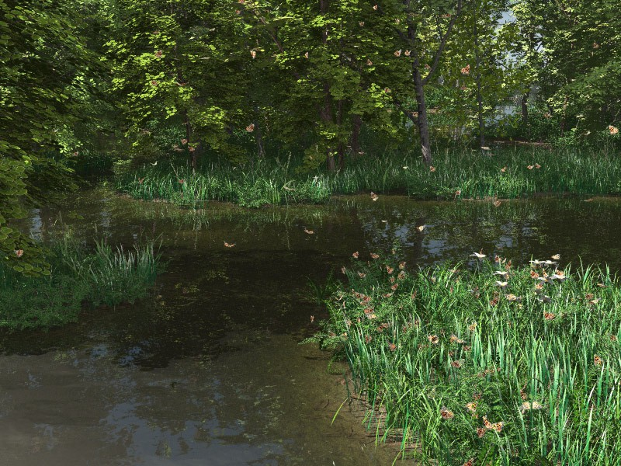
Ray Tracing
Norbert Kern, POV-Ray Hall of Fame Gallery

Slide 4
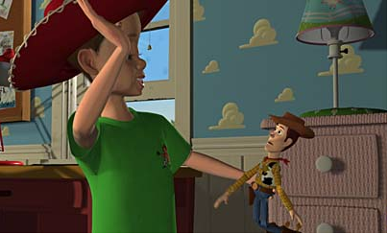
Procedural Shading
Pixar, Toy Story

Slide 5
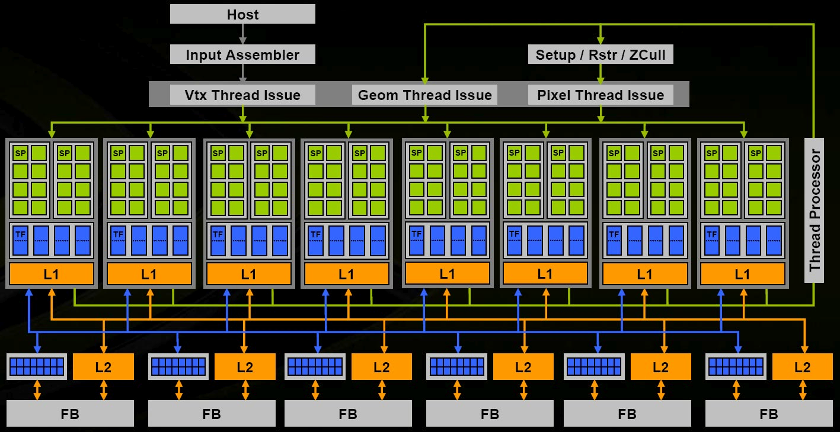
Graphics Hardware
NVIDIA 8800 Architectural Overview, NVIDIA TB-02787-001_v01, November 2006

Slide 6
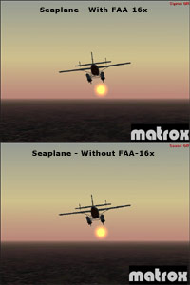
Antialiasing

Slide 7
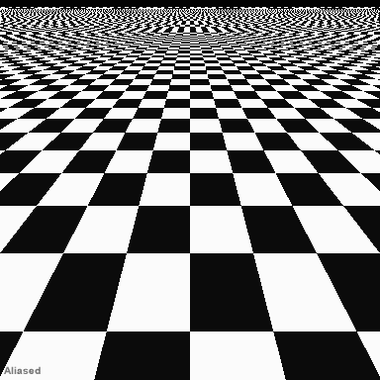
Antialiasing
HP Mobile & Media Systems Lab

Slide 8
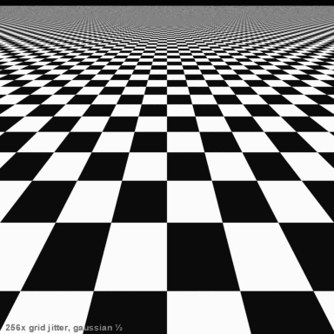
Antialiasing
HP Mobile & Media Systems Lab

Slide 9
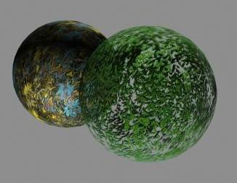
Texturing
SIGGRAPH HyperGraph

Slide 10
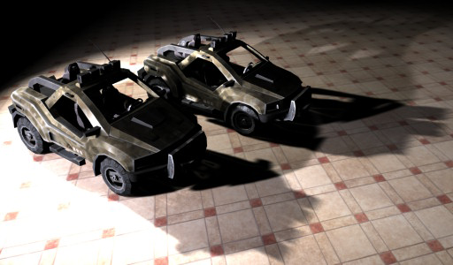
Shadows
Donnelly and Lauritzen, Variance Shadow Maps

Slide 11
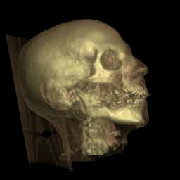
Volume Rendering
Stanford VolPack

Slide 12
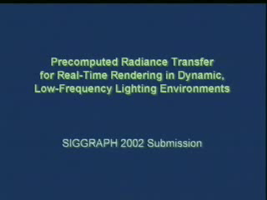
Illumination
Sloan, Kautz and Snyder, Precomputed Radiance Transfer for Real-time Rendering in Dynamic Low-frequency Lighting Environents

Slide 13
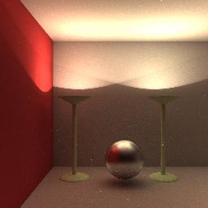
Global Illumination
Glenn Evans and Michael McCool

Slide 14
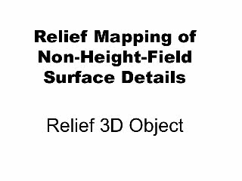
Surface Effects
Policarpo and Oliveira, Relief Mapping of Non-Height-Field Surfaces

Slide 15
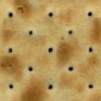
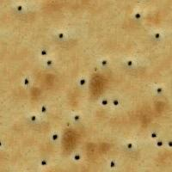
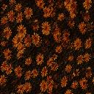
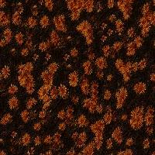
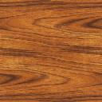
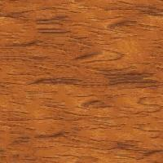


Texture Synthesis
Li-Yi Wei and Marc Levoy

