Slide 1
CMSC 491/635
Sampling and Antialiasing

Slide 2
Abstract Vector Spaces
Addition
C = A + B = B + A
(A + B) + C = A + (B + C)
given A, B, A + X = B for only one X
Scalar multiply
C = a A
a (A + B) = a A + a B
(a+b) A = a A + b A

Slide 3
Abstract Vector Spaces
Inner or Dot Product
b = a (A • B) = a A • B = A • a B
A • A ≥ 0; A • A = 0 iff A = 0
A • B = (B • A)*

Slide 4
Vectors and Discrete Functions
Vector | Discrete Function
V = (1, 2, 4) | V[I] = {1, 2, 4}
a V + b U | a V[I] + b U[I]
V • U | ∑ (V[I] U*[I])

Slide 5
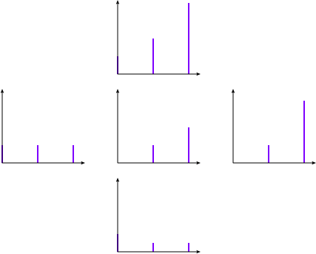
Vectors and Discrete Functions
2^{t} in terms of t⁰, t¹, t² = [1,.5,.5]
2^{t}
1
t
t²

Slide 6
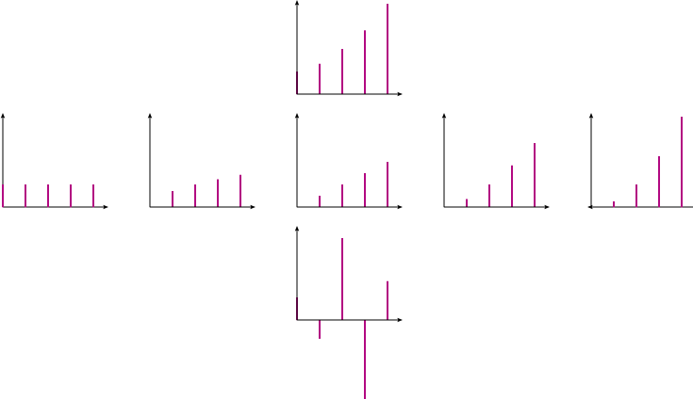
Vectors and Discrete Functions
2^{t} in terms of t⁰, t^{0.5}, t¹, t^{1.5}, t²
2^{t}
1
t^{0.5}
t
t^{1.5}
t²

Slide 7
Vectors and Functions
Vector | Discrete | Continuous
V | V[I] | V(x)
a V + b U | a V[I] + b U[I] | a V(x) + b U(x)
V • U | ∑ V[I] U*[I] | ∫ V(x) U*(x) dx

Slide 8
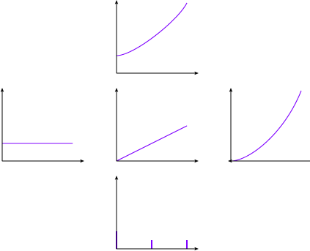
Vectors and Functions
2^{t} projected onto 1, t, t²
2^{t}
1
t
t²

Slide 9
Function Bases
Time: δ(t)
Polynomial / Power Series: t^{n}
Discrete Fourier: e^{i π t K/N} / √2N
K, N integers
t, K ∈ [-N, N]
(where e^{iθ} = cos θ + i sin θ)
Continuous Fourier: e^{i ω t} / √2π

Slide 10
Fourier Transforms
 | Discrete Time | Continuous Time
Discrete Frequency | Discrete Fourier Transform | Fourier Series
Continuous Frequency | Discrete-time Fourier Transform | Fourier Transform

Slide 11
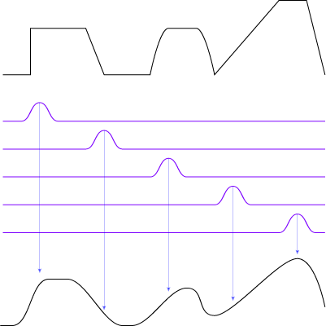
Convolution
f(t) g(t) ⇔ F(ω) * G(ω)
g(t) * f(t) ⇔ F(ω) G(ω)
Where f(t) * g(t) = ∫ f(s) g(t-s) ds
Dot product with shifted kernel

Slide 12
Filtering
Filter in frequency domain
FT signal to frequency domain
Multiply signal & filter
FT signal back to time domain
Filter in time domain
FT filter to time domain
Convolve signal & filter

Slide 13
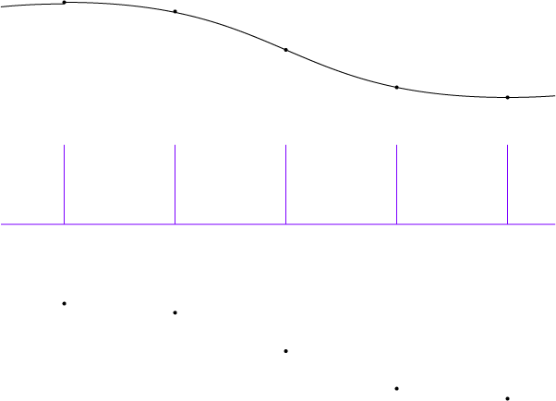
Sampling
Multiply signal by pulse train

Slide 14
Aliasing
High frequencies alias as low frequencies

Slide 15
Aliasing in images

Slide 16
Antialiasing
Blur away frequencies that would alias
Blur preferable to aliasing
Filter kernel size
IIR = infinite impulse response
FIR = finite impulse response
Windowed filters

Slide 17
“Ideal”
Low pass filter eliminates all high freq
box in frequency domain
sinc in spatial domain (sin x / x)
Possible negative results
Infinite kernel
Exact reconstruction to Nyquist limit
Sample frequency ≥ 2x highest frequency
Exact only if reconstructing with ideal low-pass filter (=sinc)

Slide 18
Reconstruction
Convolve samples & reconstruction filter
Sum weighted kernel functions

Slide 19
Filtering & Reconstruction
Ideal Continuous Image
Sample
Sampled Image Pixels
Reconstruction Filter
Continuous Display

Slide 20
Filtering, Sampling, Reconstruction
Ideal Continuous Image
Filter
Filtered Continuous Image
Sample
Sampled Image Pixels
Reconstruction Filter
Continuous Display

Slide 21
Combine Filter & Sample
Can combine filter and sample
Evaluate convolution at samples
Ideal Continuous Image
Sampling Filter
Sampled Image Pixels
Reconstruction Filter
Continuous Display

Slide 22
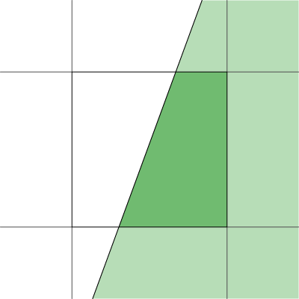
Analytic Area Sampling
Compute “area” of pixel covered
Box in spatial domain
Nice finite kernel
easy to compute
sinc in freq domain
Plenty of high freq
still aliases

Slide 23
Analytic higher order filtering
Fold better filter into rasterization
Can make rasterization much harder
Usually just done for lines
Draw with filter kernel “paintbrush”
Only practical for finite filters

Slide 24
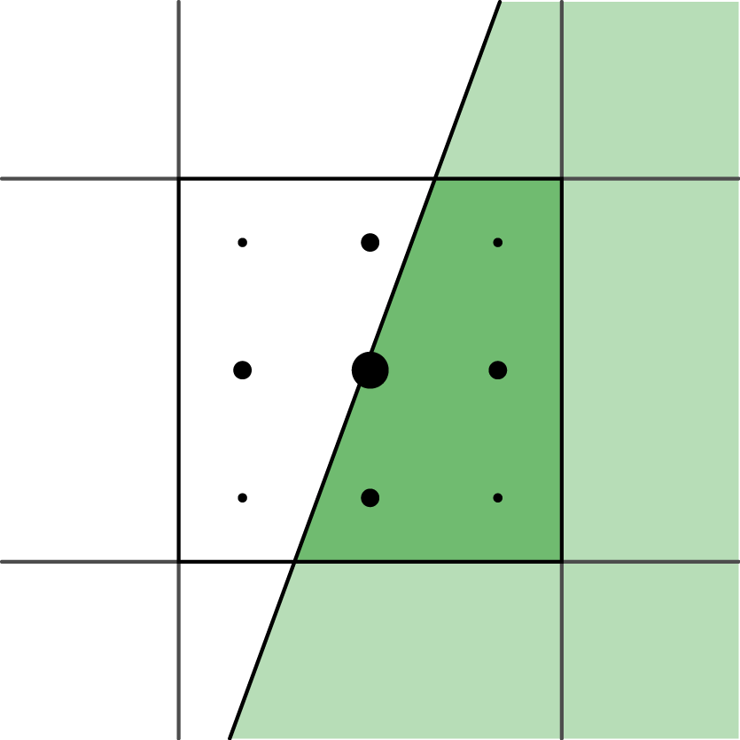
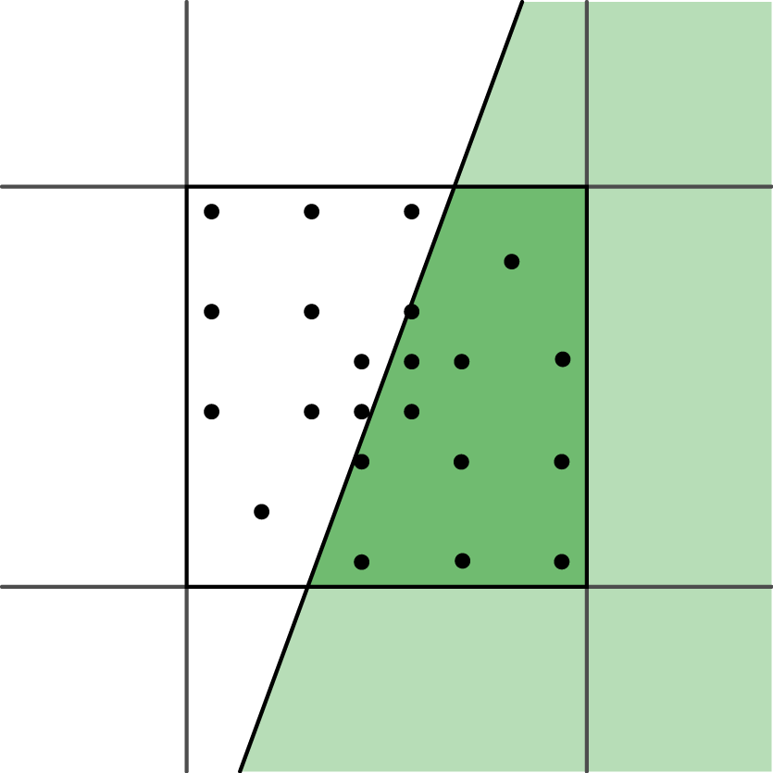
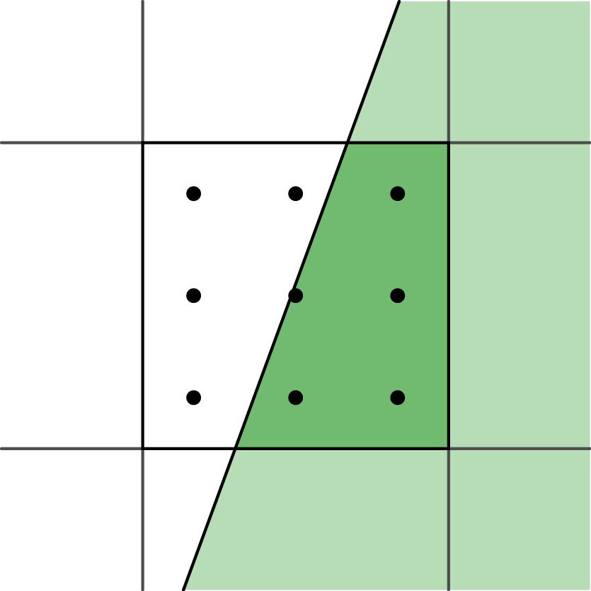
Supersampling
Numeric integration of filter
Grid with equal weight = box filter
Push up Nyquist frequency
Edges: ∞ frequency, still alias
Other filters:
Grid with unequal weights
Priority sampling

Slide 25
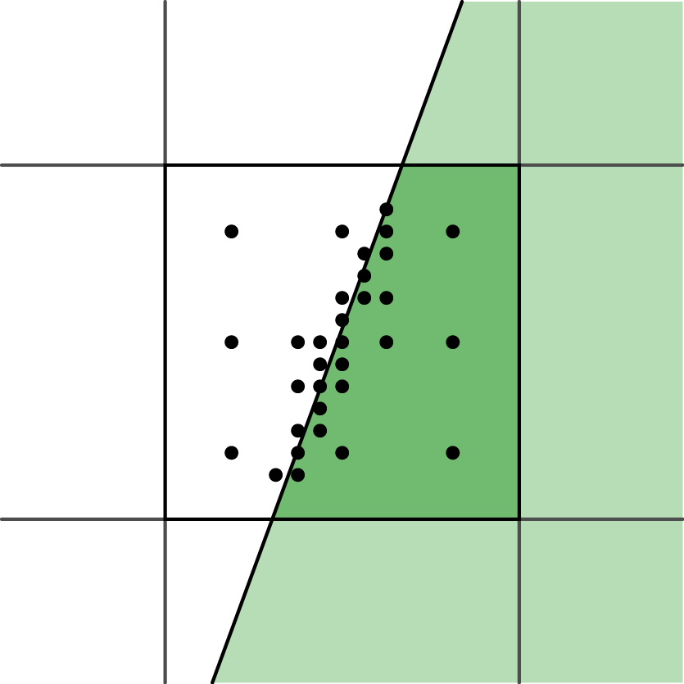
Adaptive sampling
Vary numerical integration step
More samples in high contrast areas
Easy with ray tracing, harder for others
Possible bias

Slide 26
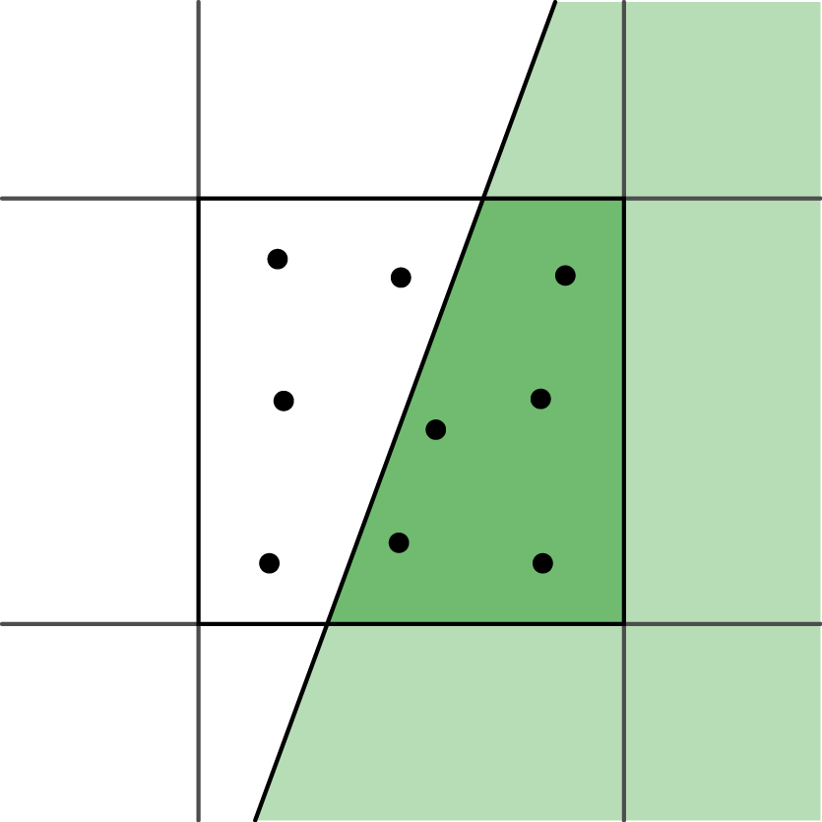
Stochastic sampling
Monte-Carlo integration of filter
Sample distribution
Poisson disk
Jittered grid
Aliasing ⇔ Noise

Slide 27
Resampling
Image Pixels
Reconstruction Filter
Continuous Image
Sampling Filter
Resampled Image Pixels

Slide 28
Resampling
Image Pixels
Resampling Filter
Resampled Image Pixels

