Slide 1
Shading
CMSC 435/634

Slide 2
RenderMan
Displacement
Surface
Light
Volume
Imager

Slide 3
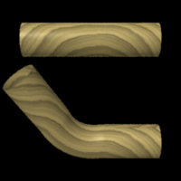
Displacement
Given
  Position
  Normal
Compute
  Position
  Normal
Displacement
Surface
Light
Volume
Imager

Slide 4
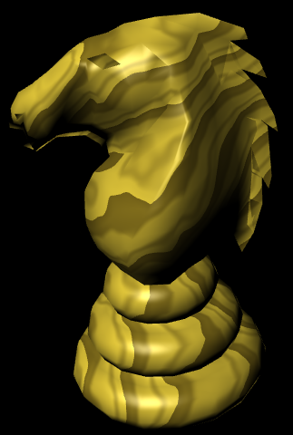
Surface color
Given
  Position
Compute
  Color
  Opacity
Displacement
Surface
Light
Volume
Imager

Slide 5
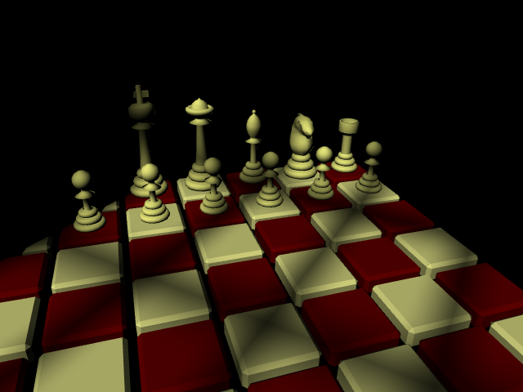
Lighting
Given
  Surface Position
Compute
  Light Direction
  Light Color
Displacement
Surface
Light
Volume
Imager

Slide 6
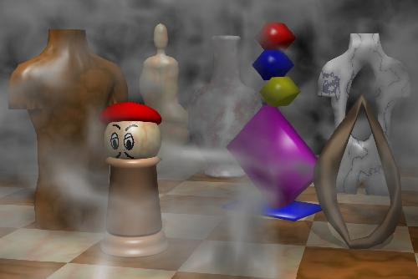
Volume Effects
Given
  Position
  Color
Compute
  New Color
Displacement
Surface
Light
Volume
Imager

Slide 7
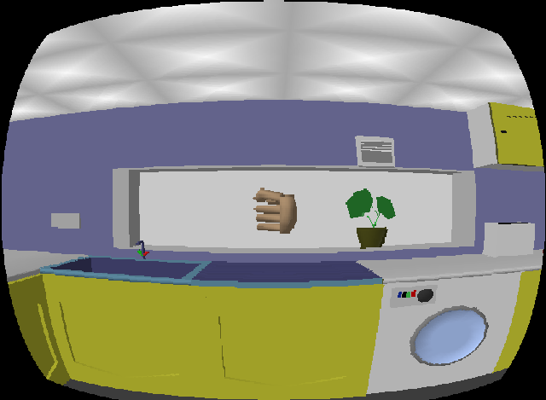
Image Effects
Given
  Pixel Color
Compute
  Pixel Color
Displacement
Surface
Light
Volume
Imager

Slide 8
Non-real time vs. Real-time
RenderMan
GPU
Application
Application
Displacement
Texture/
Buffer
Vertex
Light
Surface
Volume
Fragment
Imager
Displayed
Pixels
Displayed
Pixels

Slide 9
RenderMan vs. GPU
RenderMan
  Developed from General CPU code
  Seconds to hours per frame
  “Unlimited” computation, texture, memory, …
GPU
  Developed from fixed-function hardware
  Tens of frames per second
  Limited computation, texture, memory, …

Slide 10
History (not real-time)
Testbed [Whitted and Weimer 1981]
Shade Trees [Cook 1984]
Image Synthesizer [Perlin 1985]
RenderMan [Hanrahan and Lawson 1990]

Slide 11
History (real-time)
Custom HW [Olano and Lastra 1998]
Multi-pass standard HW [Peercy, Olano, Airey and Ungar 2000]
Register combiners [NVIDIA 2000]
Vertex programs [Lindholm et al. 2001]
Compiling to mixed HW [Proudfoot et al. 2001]
Fragment programs
Standardized languages
Compute

Slide 12
GLSL / HLSL
Vertex, Geometry & Fragment/Pixel
C-like, if/while/for
Structs & arrays
Float + small vector and matrix
  vec2, vec3, vec4, mat2, mat3, mat4
  Swizzle & mask (a.xyz = b.xxw)

Slide 13
GLSL / HLSL
Common math & shading functions
  Trigonometric, exponential, min, max, abs, …
  length, distance, normalize, dot, cross
  mix(a, b, t)
  clamp(t, a, b)
  step(a, t), smoothstep(a, b, t)
  reflect, refract

Slide 14
Shader Debugging
Render as color
  Map intermediate values to 0-1
  Interpret results
Hot reloading
  Make changes without changing viewpoint
Remap debug values
  vec4(-sign(x), sign(x), abs(x), 1)
  x / (1 + abs(x))
External debugging tools

Slide 15
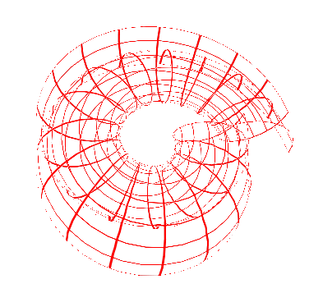
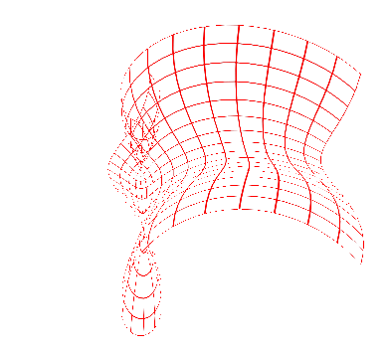
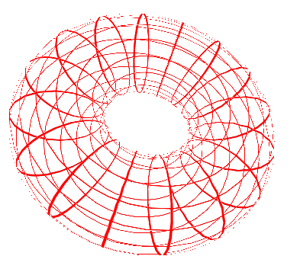
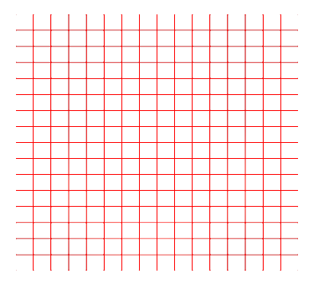
Vertex Demo:
Blend Positions

Slide 16
Shading Methods
Repeating Patterns
  mod, sin
  Divide and floor
Shapes
  Implicit form: is this pixel inside
Color maps
Bombing
Blend layers
Noise or computed patterns

Slide 17
Brick Demo
mortar
brick
gap
height
width
gap

Slide 18
Bombing
Divide space into cells
Compute random position in each cell
Check if pixel is inside shape (incl. adjacent cells)

Slide 19
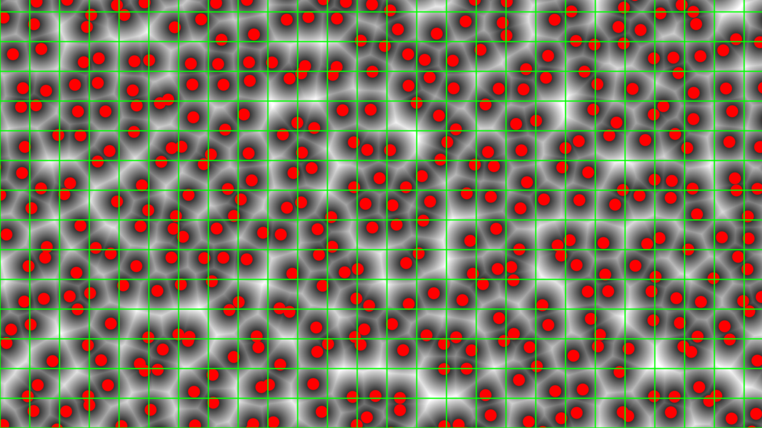
Layers
Blending
  Fade effects in and out with mix and smoothstep
  Pixel-width elements using fwidth or dFdx and dFdy

Slide 20
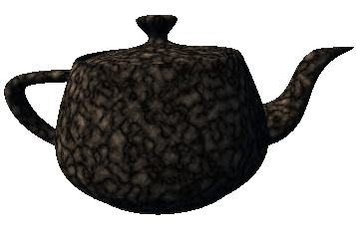
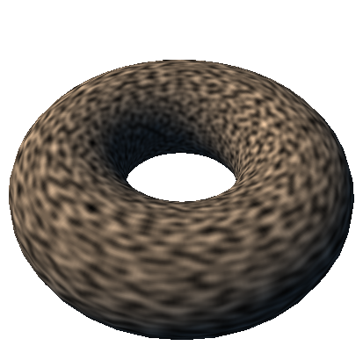
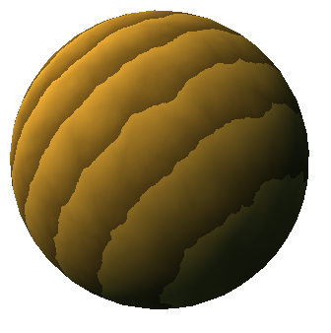
Noise
Controlled, repeatable randomness
  Still spotty GPU implementation (19 years later!)
  Can use texture or compute

Slide 21
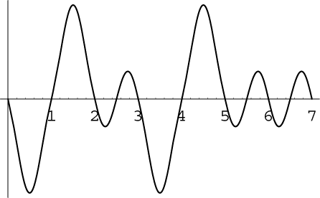
Noise Characteristics
Repeatable
Locally continuous but distant points uncorrelated
Values
  RenderMan [0,1], average 0.5
  Perlin’s [-1,1], average 0
1/2 – 1 cycle per unit
Versions for 1D-4D input/output

Slide 22
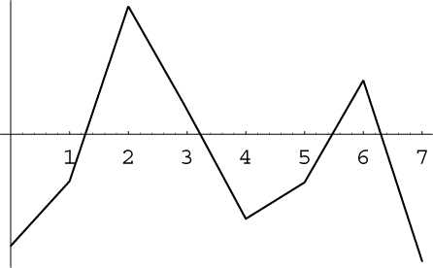
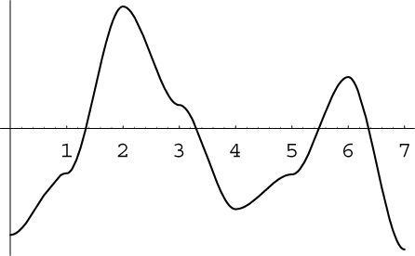
Noise Subtleties
Many noise functions based on a lattice
  Piecewise function between integer coordinates
  Hash of integer coordinates → control points
Interpolating values easy but poor
  Even with higher-order interpolation
Perlin’s noise
  Passes through 0 at each integer
  Hash gives gradient
1D
2D Square Grid
2D Simplex Grid

Slide 23
Perlin’s Noise
For point p near lattice point P
Gradient = hash(P)
Function with that gradient: hash(P)*(p – P)
Smooth blend between closest lattice points
  Blend should have 0 gradient at lattice points
  Smoothstep function: 3 x² – 2 x³
1D:
  mix(hash(floor(x)+0)*(fract(x)-0),
  hash(floor(x)+1)*(fract(x)-1),
  smoothstep(0, 1, fract(x)))

Slide 24



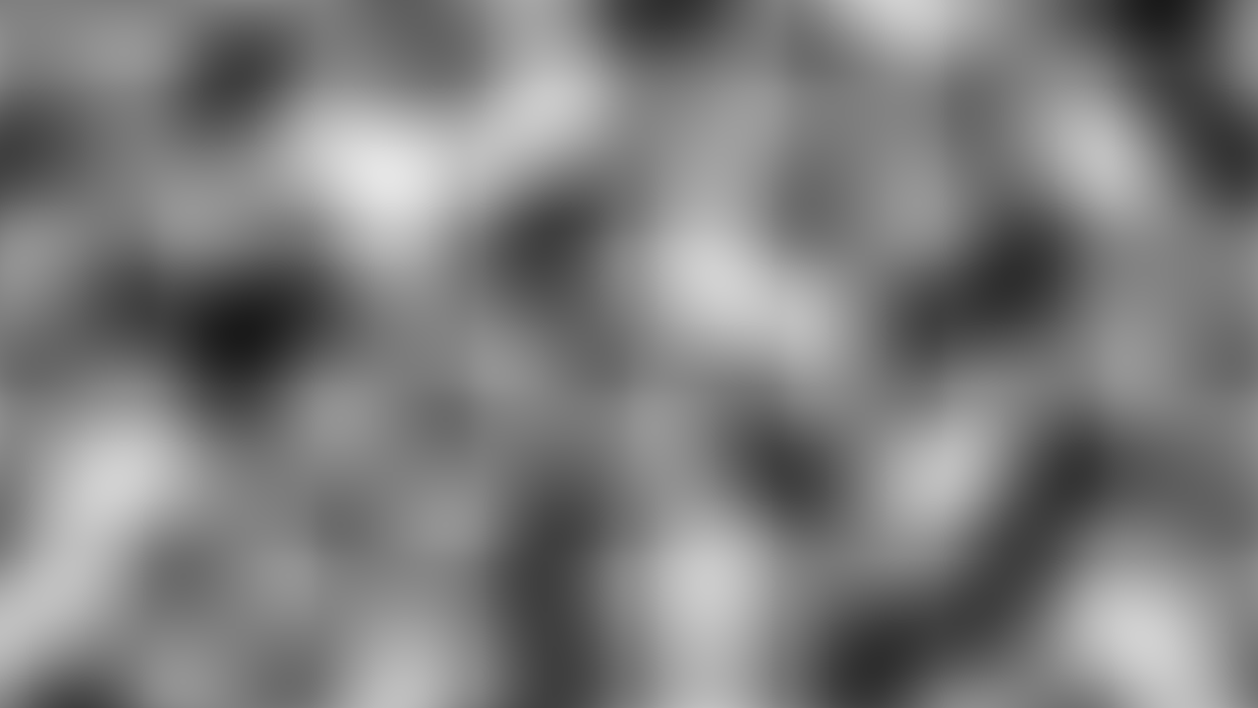
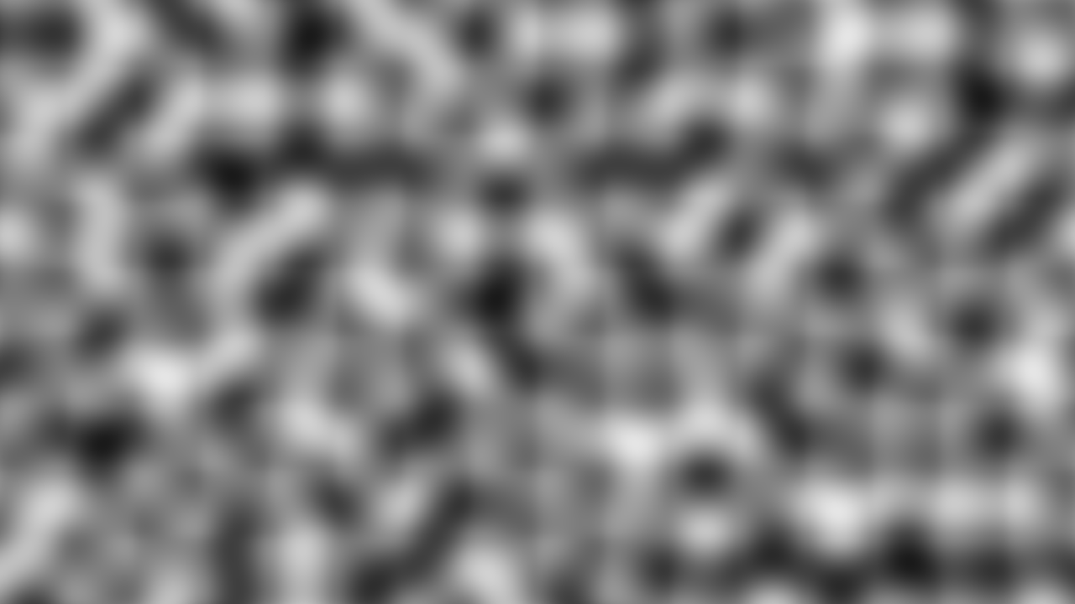
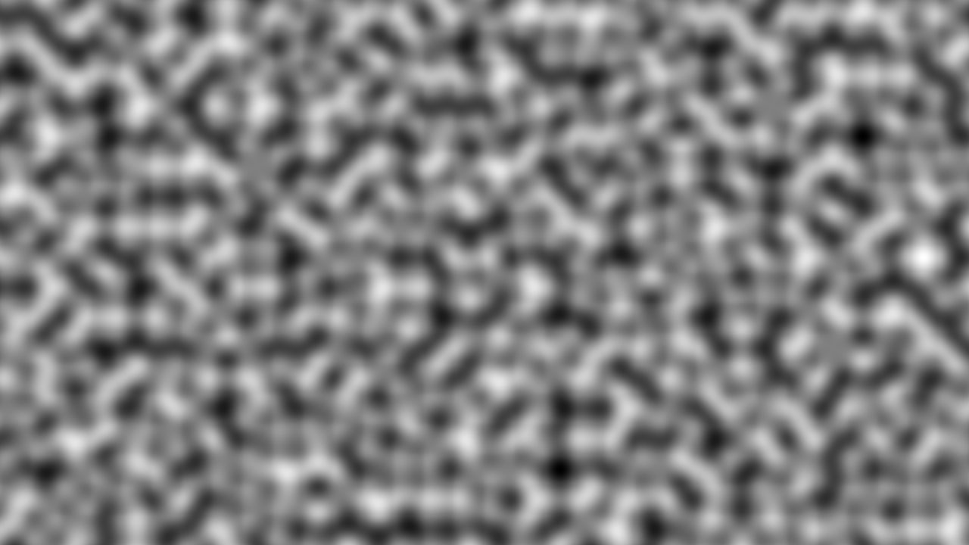
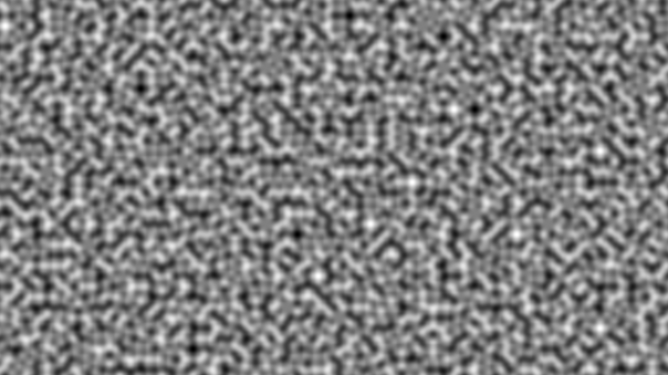
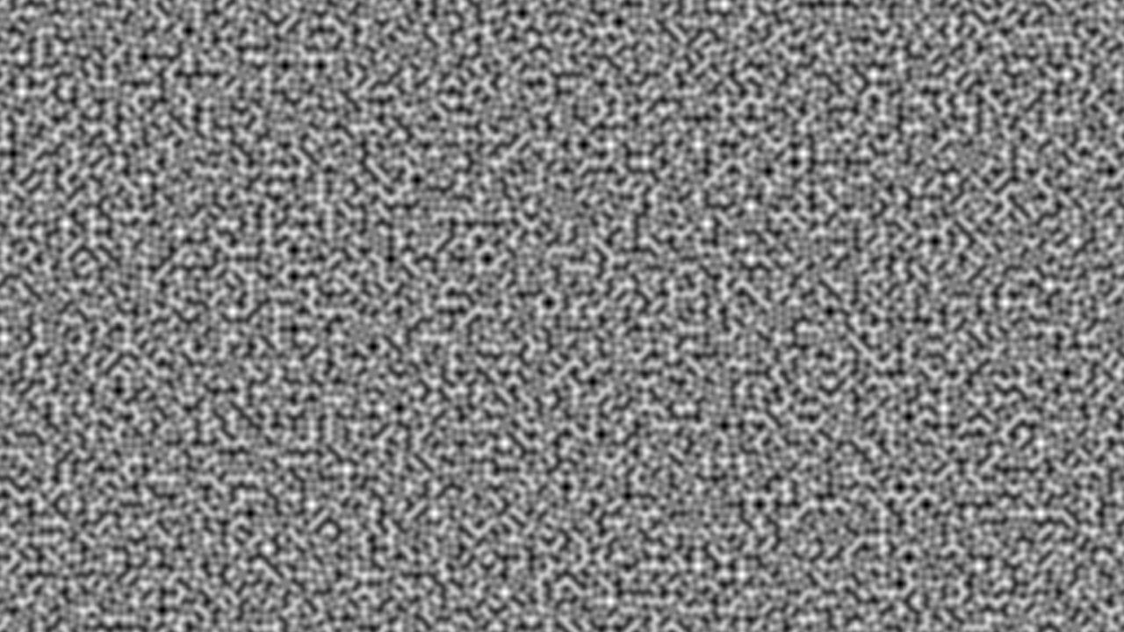
Noise Scale
float n = noise(scale * p) * 0.5 + 0.5;
scale = 1
scale = 2
scale = 4
scale = 8
scale = 16
scale = 32
scale = 64
scale = 128

Slide 25
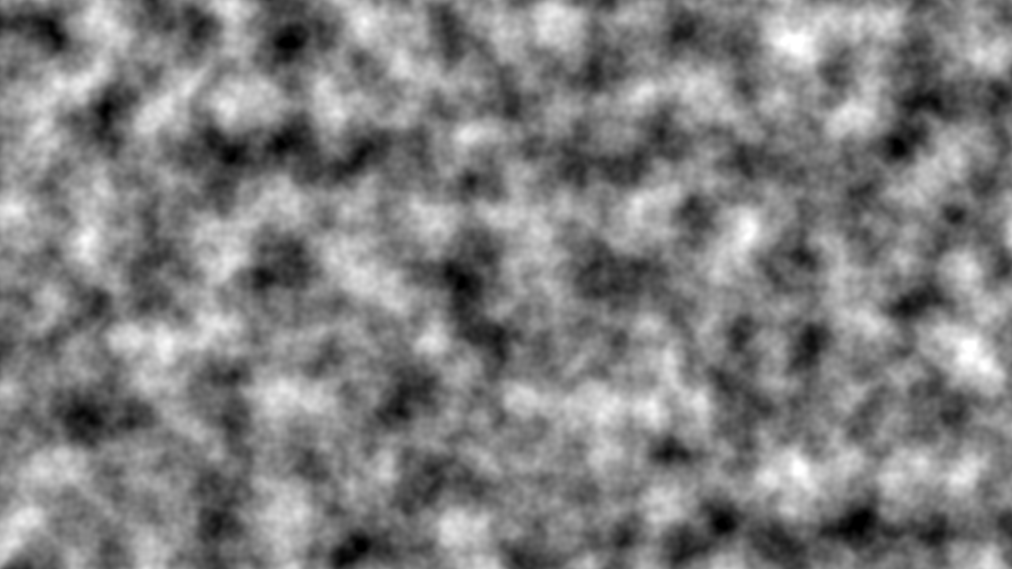
Fractional Brownian Motion (fBm)
float n = 0
for(f=1; f <= M; f*=2)
n += noise(f*P) / f;
n = n * 0.5 + 0.5;

Slide 26
Turbulence
Absolute value introduces creases
float n = 0;
for(f=0; f <= M; f *= 2)
n += abs(noise(f*P)) / f;

Slide 27
Perturbed patterns
Adjust position, radius, etc. with noise

