Slide 1
Advanced Ray Tracing
CMSC 435/634

Slide 2
Photon Paths

Slide 3
Ray Casting vs Ray Tracing
Ray Casting asks the question: “Where did the photons that hit this pixel come from?” and finds the first object along that ray.
Ray Tracing and Path Tracing extend the question to additional bounces: “But where did they come before that?” continuing until you find a photon path back to a light source or “emitter” (i.e. glowing object).
Many photons follow the same (or similar) paths. Track the percentages of photons following each path and combine with a weighted sum.

Slide 4
Taking Multiple Photons per Pixel
Quite a few effects can be achieved by averaging the contribution of multiple photon rays per pixel
  Antialiasing
  Depth of field
  Motion blur
  Glossy reflection
  Secondary bounces (path tracing)

Slide 5
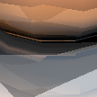



Ray Traced Antialiasing
Only sampling center of each pixel leads to jagged aliasing
Jitter position within pixel on image plane
Average over several random rays per pixel

Slide 6
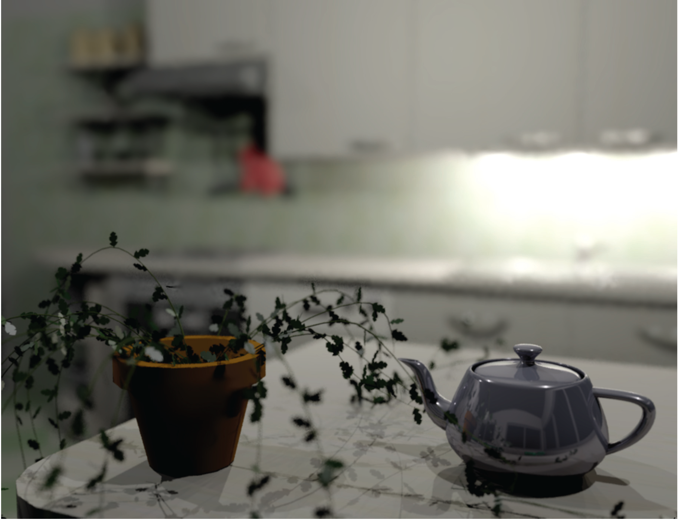
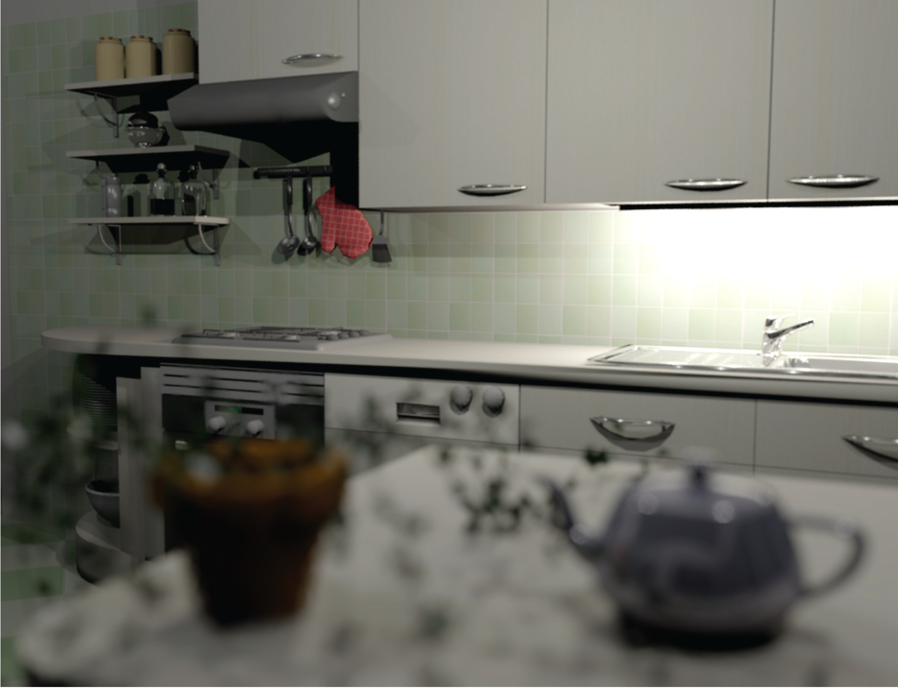
Depth of Field
Soler et al., Fourier Depth of Field, ACM TOG v28n2, April 2009

Slide 7
Pinhole Lens

Slide 8
Lens with Depth of Field
Focal Plane

Slide 9
Pinhole Lens Model
Image Plane

Slide 10
Lens Model with Depth of Field
Image & Focal Plane

Slide 11
Ray Traced DOF
Make sure image plane is at focal plane
Jitter ray start position within lens aperture
  Disk in plane centered on eye
    Given random
  Smaller aperture = closer to pinhole
  Larger aperture = more DOF blur
Average over several random rays per pixel

Slide 12
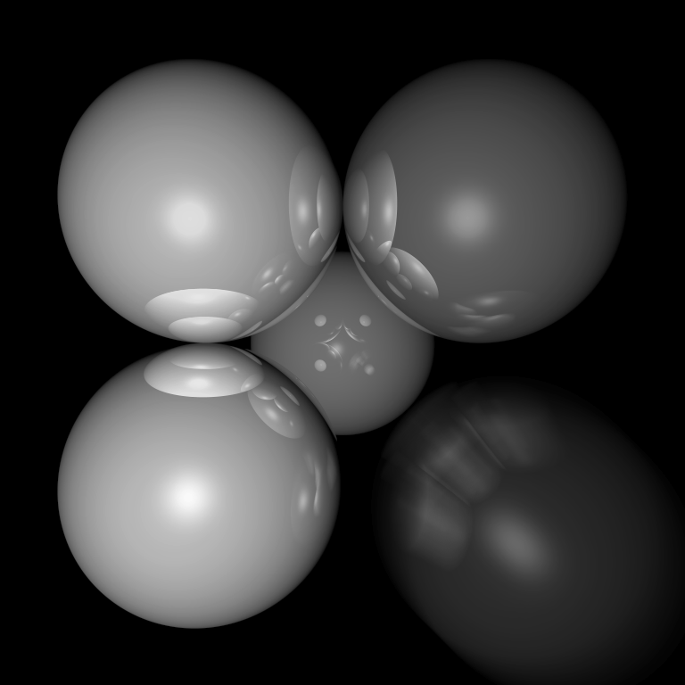
Motion Blur
Things move while the shutter is open
Track object motion
Jitter ray start time within frame

Slide 13
Combining Effects
For each ray, choose a random (point in time, start point, screen location, etc.)
Lots of extra details on reducing the resulting noise
  Non-uniform choice of rays (importance sampling)
  Smart sample selection (quasi-random, blue noise, adaptive)
  Combination and reuse of samples (denoising)
For more, look up Monte-Carlo rendering

Slide 14
Light Sources

Slide 15
Lambert’s Law
Intensity of reflected light is related to surface orientation
I
I
0.7*I
I

Slide 16
Lambert’s Law (AKA Diffuse Reflectance)
Specifically: the radiant energy from any small surface area dA is proportional to cos θ
= normalized surface normal
= normalized vector toward light
= surface color
= light intensity

Slide 17
Color
Surface diffuse color aka albedo
Light intensity
Lambertian reflectance
Intensity
Adding color:
For any wavelength λ (or use random λ for each ray):

Slide 18
Light Directions
Technically could trace all possible photon directions
  If you hit something emitting light, add it in
  If you hit a regular object, continue tracing photon bounces
  Need a ton of photon paths per pixel
Simplify to sum over fixed light sources
  Rather than sample photon directions randomly, always trace at least one photon path back toward each light.
  Makes sure not to miss the important (light ⇢ surface ⇢ eye) paths.

Slide 19
Shadows
What if there is an object between the surface and light?

Slide 20
Ray Traced Shadows
Trace a ray
  Start = point on surface
  End = light source
  t=0 at Surface, t=1 at Light
  “Bias” (𝜖 < t < 1) to avoid surface acne
Test
  𝜖 < t < 1 = shadow
  No intersection or t ≥ 1 = use this light

Slide 21
Ambient Light
Additional light bounces we’re not counting
Approximate them as a constant
  = Amount of extra light coming into this surface
  = Amount that bounces off of this surface
  Total extra light bouncing off this surface

Slide 22
Reflections

Slide 23
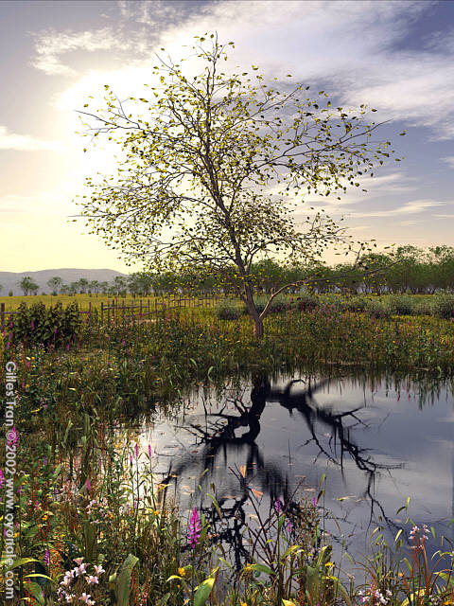
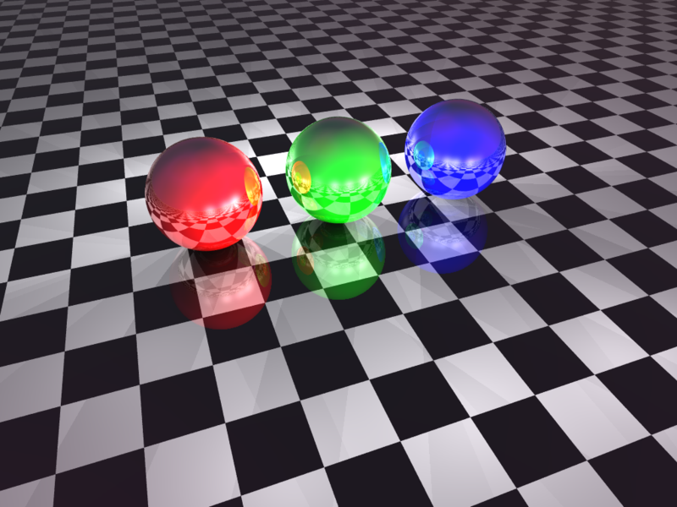
Mirror Reflection

Slide 24
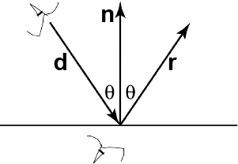
Ray Tracing Reflection
Viewer looking in direction d sees whatever the viewer “below” the surface sees looking in direction r
In the real world
  Energy loss on the bounce
  Loss different for different colors
New ray
  Start on surface, in reflection direction

Slide 25
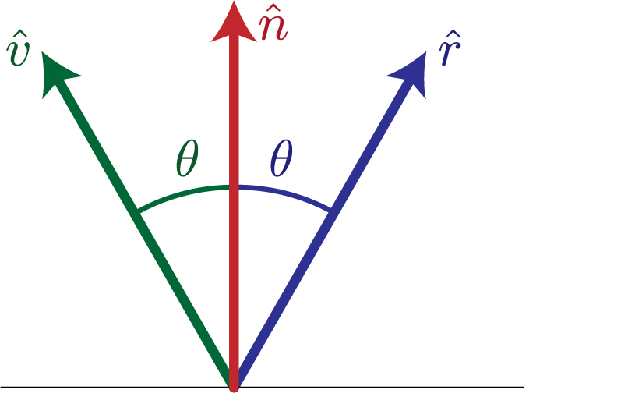
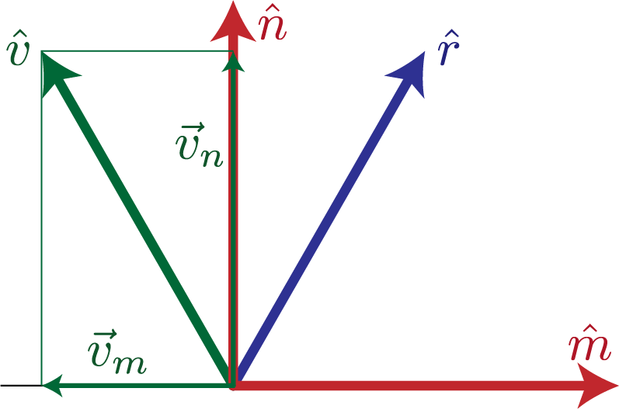
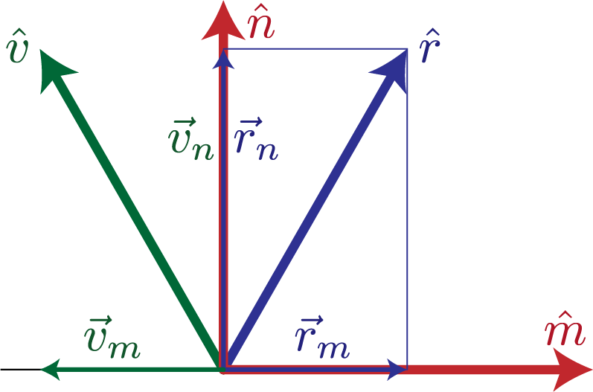
Calculating Reflection Vector
Angle of of incidence
= angle of reflection
Decompose
Recompose

Slide 26
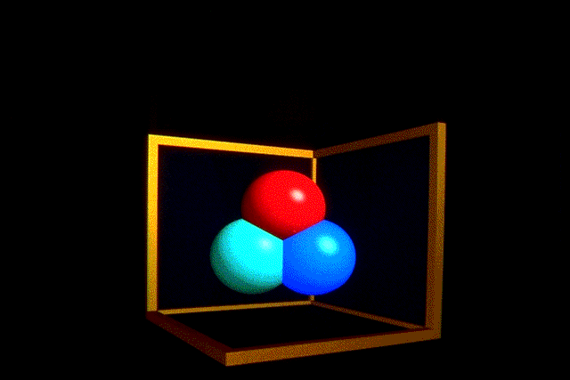
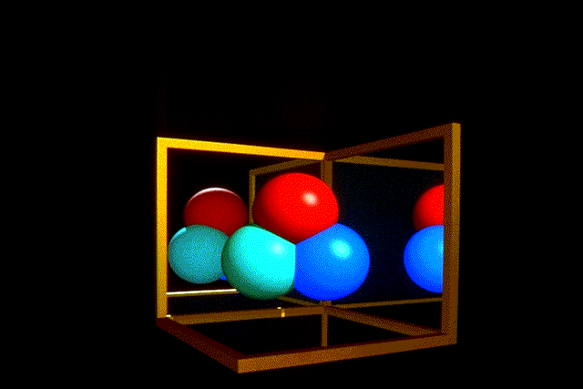
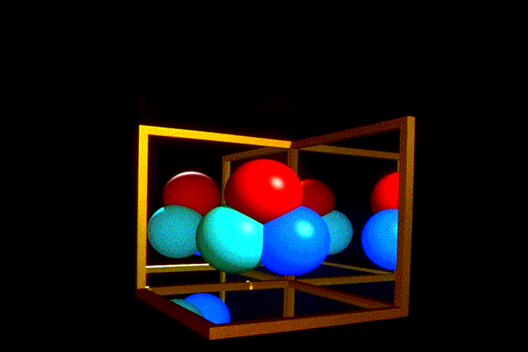
Ray Traced Reflection
Avoid looping forever
  Stop after n bounces
  Stop when contribution to pixel gets too small
  Random probability to kill photon path

Slide 27
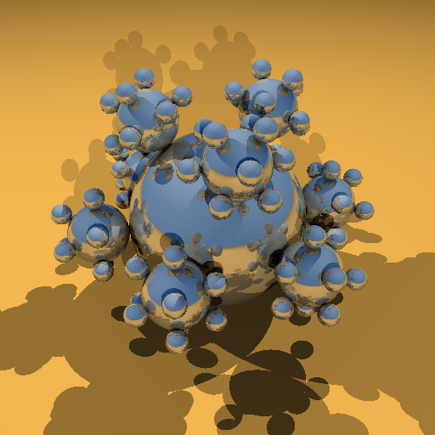
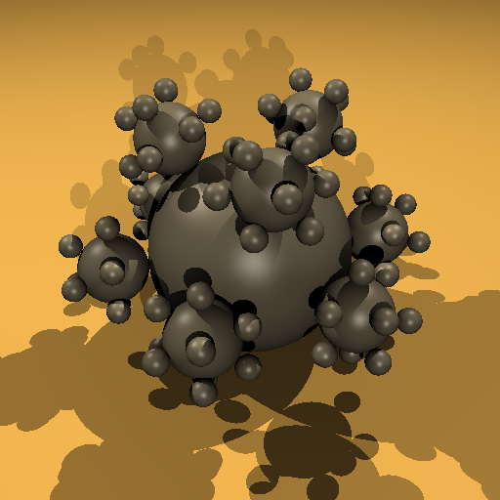
Specular Reflection
Mirror
Glossy reflection from rough surface
  Lots of mirror reflections from microfacets.
Centered around mirror reflection direction
  But more spread more, depending on roughness
Easiest for individual light sources
  Add to diffuse after shadow check
  Should still scale by for angle between light and surface
Specular

Slide 28
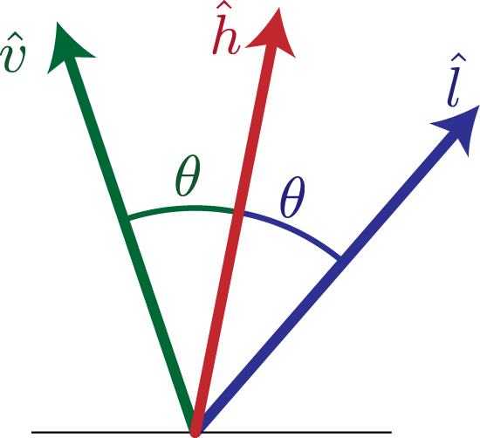
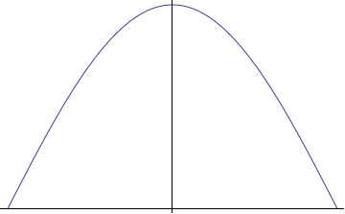
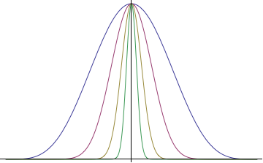
H vector
Strongest for normal that reflects to
  1.0 at center of highlight
  0.0 at 90°
Control highlight width
Combine with diffuse

Slide 29
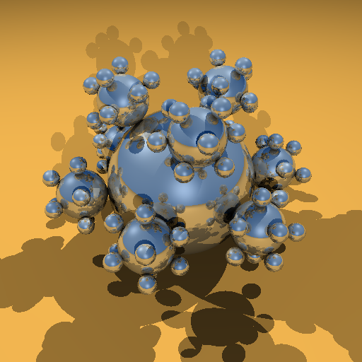

Combined Specular & Mirror
Many surfaces have both

Slide 30
Refraction

Slide 31
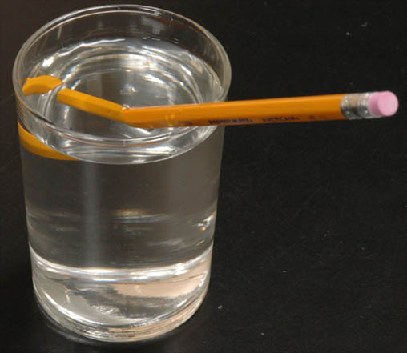
Refraction

Slide 32
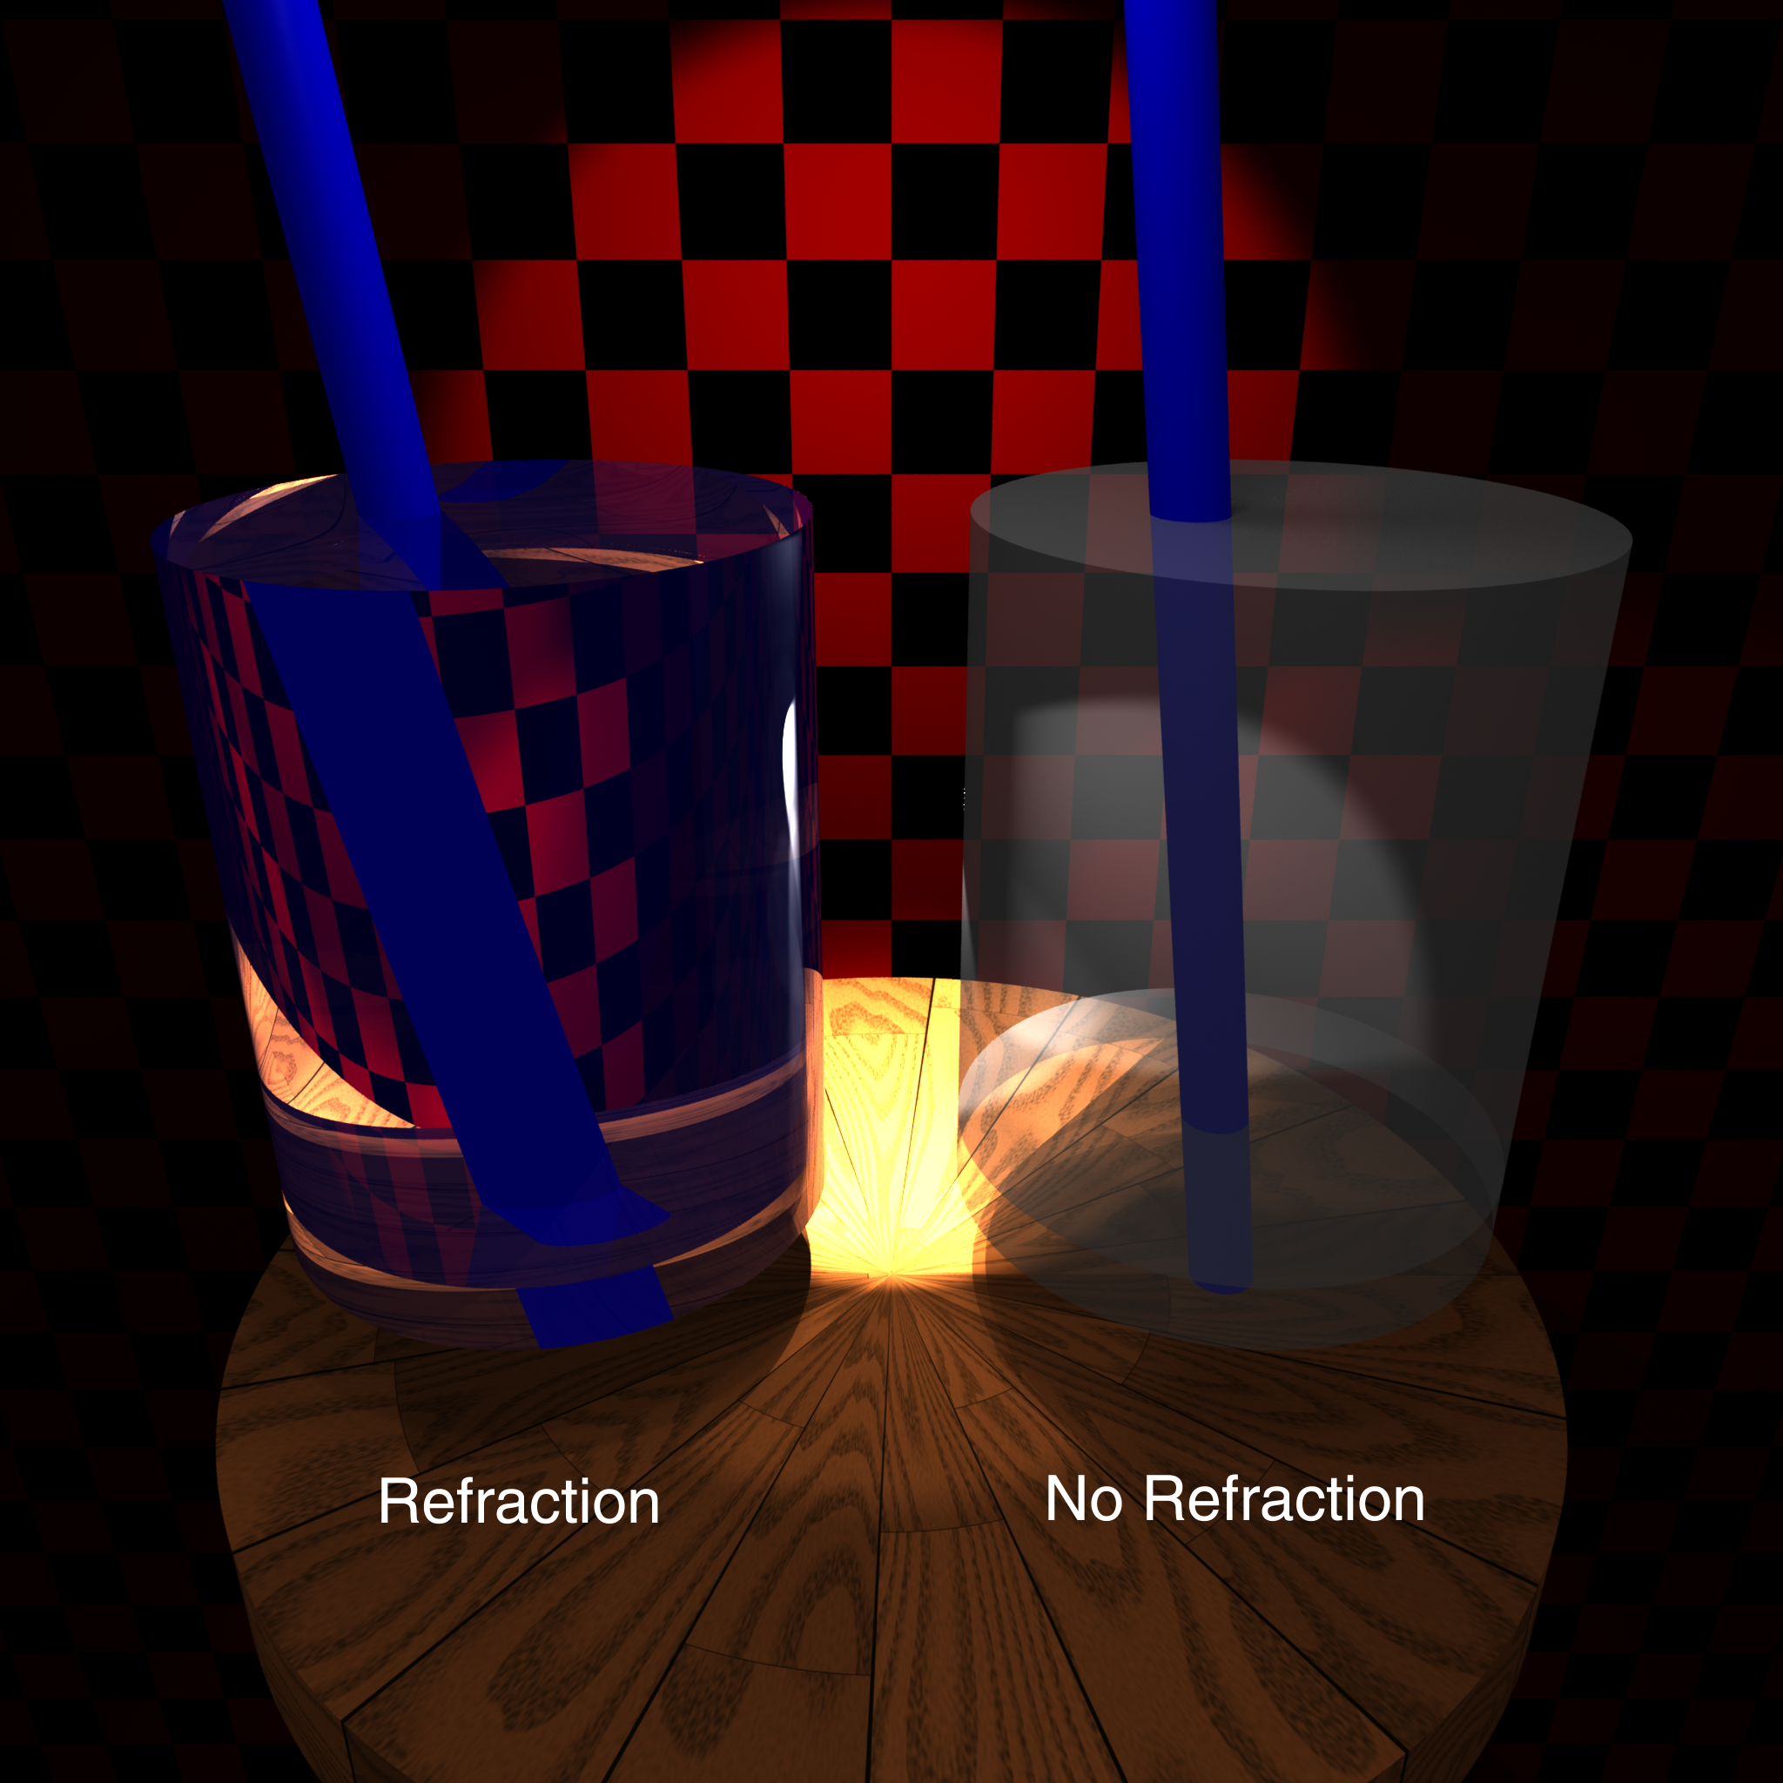

Slide 33
Calculating Refraction Vector
Index of refraction & Snell’s Law
In terms of normal & tangent
in terms of and

Slide 34
Calculating Refraction Vector
Index of refraction & Snell’s Law
In terms of
term

Slide 35
Calculating Refraction Vector
Snell’s Law
In terms of
term

Slide 36
Calculating Refraction Vector
Snell’s Law
In terms of
in terms of and

Slide 37
Alpha Blending
How much makes it through
α = opacity
  How much of foreground color 0-1
1 – α = transparency
  How much of background color
Foreground * α + Background * (1 – α)

Slide 38
Refraction and Alpha
Refraction = what direction, α = how much
Often approximate as a α constant
Better: Use Fresnel
  = index of refraction of material above interface
  = index of refraction of material below interface
  Schlick approximation

Slide 39
Summary

Slide 40
Full Ray Tracing (single sample)
e = eye position
foreach pixel
s = pixel screen position
pixel color = trace(e, s-e)

Slide 41
Full Ray Tracing (multiple samples)
e = eye position
foreach pixel
pixel color = (0,0,0)
s = pixel screen position
foreach sample
s’ = jittered screen position
e’ = jittered eye position
pixel color += trace(e’, s’-e’)
pixel color /= number of samples

Slide 42
Full Ray Tracing (trace)
Recursion depth, contribution, or probability
trace(e, d)
if (ray termination) return;
find first object
P,N,S = position, normal, surface parameters
color = (0,0,0)
foreach light
color += S.ambient * light.intensity
L = normalize(light.position – P)
if N•L > 0 and probe(P, L, length(light.position – P))
I = light.intensity * N•L
color += S.diffuse * I
if N•H > 0
color += S.specular * I * N•H^{S.specpow}
color += S.reflect * trace(P, reflection direction)
color += S.refract * trace(P, refraction direction)
Direct illumination
Reflection & refraction rays

Slide 43
Full Ray Tracing (shadow probe)
probe(e, d, distance)
foreach object
if 𝜖 < object.intersection(e,d) < distance
return false; // early exit from object loop
return true;
False if shadow
True if not shadowed

