Slide 1
Ray Casting
CMSC 435/634

Slide 2
Images
Grid of pixels
  Resolution says how fine,
  not how big
Each has a color
  How much Red, Green, Blue
  Absolute physical intensity
  Scale from darkest to lightest
    Float 0 to 1
    Integer 0 to max (e.g. byte 0-255)
1 x 1
2 x 2
3 x 3
4 x 4

Slide 3
Visibility Problem
Rendering: converting a model to an image
Visibility: deciding which objects (or parts) will appear in the image
  Object-order
    One object at a time for all pixels it covers
    Rasterization (later)
  Image-order
    One pixel at a time, for all of the objects
    Ray Tracing (now)

Slide 4
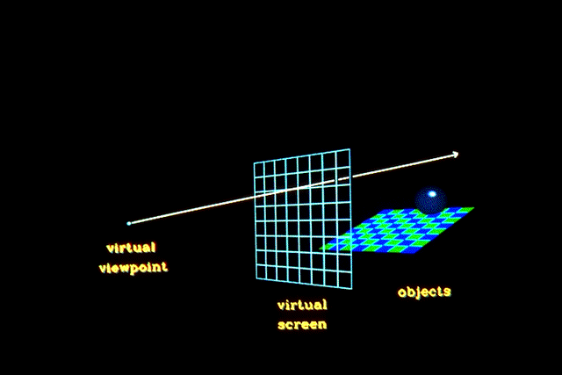
Ray Casting
Given
  Scene
  Viewpoint
  Image Plane
Cast ray from viewpoint through pixels into scene
  If a photon made it to the viewer through this pixel, where did it come from?

Slide 5
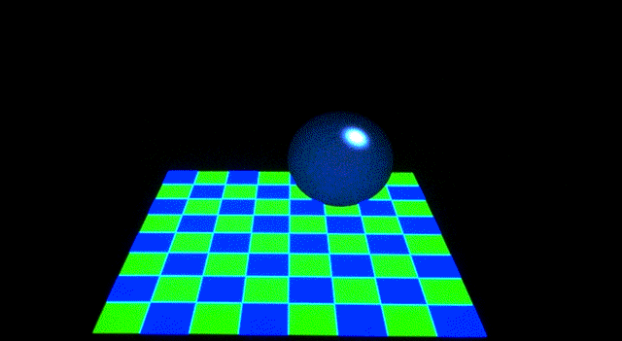
View

Slide 6
Ray Tracing
Ray cast = first hit
Ray trace = additional primary bounces
Path trace = additional less-common bounces

Slide 7
Parametric and Implicit Forms
Want to describe an object
  plane / sphere / triangle / ray / …
Parametric: equation(s) with parameters
  Varying parameters sweeps out object
Implicit: equation(s) true on the object

Slide 8



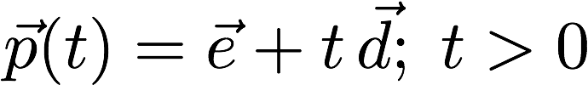
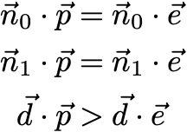
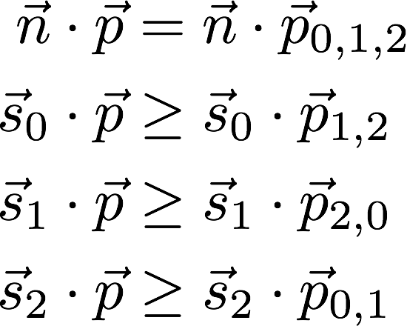
Parametric vs Implicit
Object
Given
Parametric
Implicit
Plane
Sphere
Ray
Triangle

Slide 9
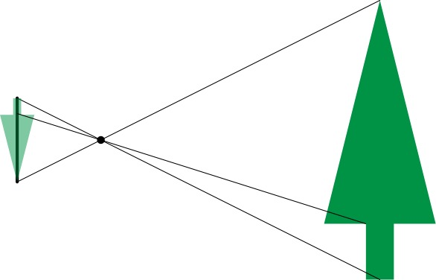
Pinhole Lens

Slide 10
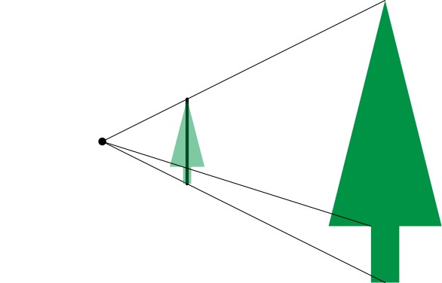
Lens Model

Slide 11
Lens Model

Slide 12
Field of View

Slide 13
Field of View

Slide 14
Field of View

Slide 15
Symmetric Window

Slide 16
Rectangular Windows
Width
Compute Height using Vertical
Field of View
Height

Slide 17
Off-center Projection
Used for display walls, image tiling, and VR
d is perpendicular distance to screen
Still need right triangles for trig

Slide 18
Linear Interpolation (aka lerp or mix)
lerp(a, b, t)
  Linear in t
  a @ t=0
  b @ t=1
lerp(a, b, t) = a + (b – a) * t
lerp(a, b, t) = a * (1 – t) + b * t

Slide 19
Pixel Centers
Fractional pixel corners in (0,0) to (1,1)
Fractional pixel centers
Position on screen between to

Slide 20
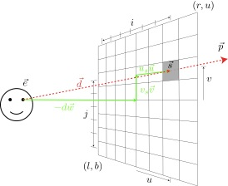
Computing Viewing Rays
Parametric ray
Camera frame
  : eye point
  : basis vectors
  right, up, backward
    Right hand rule!
Screen position

Slide 21
Computing Camera Frame
points from lookp toward eyep
  Normalize
is perpendicular to and up
  Normalize
is perpendicular to and
  , guaranteed to be unit-length

Slide 22
Calculating Intersections
Define ray parametrically:
If is center of projection and
is center of one of the screen pixels
  : points between those locations
  : points behind viewer
  : points beyond view window

Slide 23
Ray-Sphere Intersection
Sphere in vector form
Ray
Intersection when

Slide 24

Ray-Sphere Problems
When can go bad?
Division by 0?
  Only if , aka ray direction = 0
  No real intersections
  Happens when ray misses the sphere

Slide 25
Ray-Triangle Intersection
Intersection of ray with barycentric triangle
  4 linear equations (x,y,z and barycentric sum) in 4 unknowns
  In triangle if α ≥ 0, β ≥ 0, γ ≥ 0
  To avoid computing all three, can replace α ≥ 0 with β+ γ ≤ 1
boolean raytri (ray r, vector p0, p1, p2, interval [t₀,t₁] )
{
  compute t
  if (( t < t₀ ) or (t > t₁))
return ( false )
  compute γ
  if ((γ < 0 ) or (γ > 1))
return ( false )
  compute β
  if ((β < 0 ) or (β+γ > 1))
return ( false )
return true
}

Slide 26
Ray-Polygon Intersection (General Case)
Given ray and plane containing polygon
What is ray/plane intersection?
Is intersection point inside polygon?

Slide 27
Point in Polygon?
Is P in polygon?
Cast ray from P to infinity
  1 crossing = inside
  0, 2 crossings = outside

Slide 28
Point in Polygon?
Is P in concave polygon?
Cast ray from P to infinity
  Odd crossings = inside
  Even crossings = outside

Slide 29
What Happens?
Option 1: Odd # of crossings
  Center of star is not in polygon
Option 2: Winding rule
  Vertices given counter-clockwise
  Track “entering” and “exiting” crossings
  Inside for non-zero winding number
  Center of star is in polygon

Slide 30
Ray Tracing Algorithm Summary
For y in 0..height
For x in 0..width
t* = ∞; c* = background
d = ray_direction(x,y)
For obj in objects
t = obj.intersection(e, d)
if (t < t*) t* = t; c* = obj.color
image[y][x] = c*

Slide 31
Raytracing Characteristics
Good
  Simple to implement
  Minimal memory required
  Easy to extend
Bad
  Aliasing
  Computationally intensive
    Intersections expensive (75-90% of rendering time)
    Lots of rays

