Slide 1
Graphics Pipeline
Rasterization
CMSC 435/634

Slide 2
Graphics Pipeline
Object-order approach to rendering
Vertex Processing
Transformations
Vertex components of shading
Clipping
Find the visible parts of primitives
Rasterization
Break primitives into fragments/pixels
Fragment Processing
Fragment components of shading
Visibility & Blending
Which do we see, how do they combine?

Slide 3
Drawing Terms
Primitive
  Basic shape, drawn directly
  Compare to building from simpler shapes
Rasterization or Scan Conversion
  Find pixels for a primitive
  Usually for algorithms that generate all pixels for one primitive at a time
  Compare to ray tracing: all primitives for one pixel

Slide 4
Line Drawing
Given endpoints of line, which pixels to draw?

Slide 5
Line Drawing
Given endpoints of line, which pixels to draw?

Slide 6
Line Drawing
Given endpoints of line, which pixels to draw?
Assume one pixel per x. Which y?
Look at midpoint between candidate pixels
?
?
?
?
?
?
?
?

Slide 7
Line Drawing
Plug midpoint into implicit line equation
Sign decides: called a decision variable
Incremental update

Slide 8
Line Drawing
Implicit line equation
Midpoint algorithm
  y = y₀
  d = f(x₀+1, y₀+0.5)
  for x = x₀ to x₁
    draw(x,y)
    if (d < 0) then
      y = y+1
      d += (x₁ - x₀) + (y₀ - y₁)
    else
      d += (y₀ - y₁)

Slide 9
Polygon Rasterization
Problem
  How to generate filled polygons (by determining which pixel positions are inside the polygon)
  Conversion from continuous to discrete domain
Concepts
  Spatial coherence
  Span coherence
  Edge coherence

Slide 10
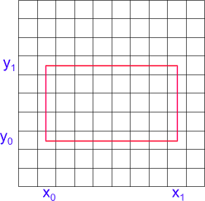
Scanning Rectangles
for ( y from y₀ to y₁ )
for ( x from x₀ to x₁ )
Write Pixel (x, y)

Slide 11
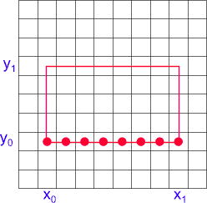
Scanning Rectangles (2)
for ( y from y₀ to y₁ )
for ( x from x₀ to x₁ )
Write Pixel (x, y)

Slide 12
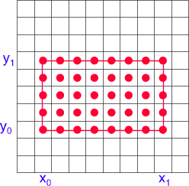
Scanning Rectangles (3)
for ( y from y₀ to y₁ )
for ( x from x₀ to x₁ )
Write Pixel (x, y)

Slide 13
Triangle Rasterization
Barycentric coordinates are decision variables

Slide 14
Interpolation
Use same barycentrics for any other per-vertex parameter
  Color:
  Normals:
  Texture coordinates:
  …

Slide 15
Barycentric Triangle Rasterization
For all y in y_{min} to y_{max} do
  For all x in x_{min} to x_{max} do
    Compute (α, β, γ) for (x,y)
    If (α ≥ 0 and β ≥ 0 and γ ≥ 0) then
      c = αc₀ + βc₁ + γc₂
      Draw pixel(x,y) with color c

Slide 16
Incremental Computation
α, β, and γ are linear in X and Y
What about pixel-to-pixel updates?

Slide 17
Incremental Rasterization
(α_{row}, β_{row}, γ_{row}) = Compute (α, β, γ) for (x_{min},y_{min})
For all y in y_{min} to y_{max} do
  (α, β, γ) = (α_{row}, β_{row}, γ_{row})
  (α_{row}, β_{row}, γ_{row}) += (b_{α}, b_{β}, b_{γ})
  For all x in x_{min} to x_{max} do
    If (α ≥ 0 and β ≥ 0 and γ ≥ 0) then
      c = α c₀ + β c₁ + γ c₂
      Draw pixel(x,y) with color c
    (α, β, γ) += (a_{α}, a_{β}, a_{γ})

Slide 18
Homogeneous Barycentrics
Each barycentric is
  Equal to 1 at one vertex
  Equal to 0 at the other two

Slide 19
Homogeneous Barycentrics
Write formula for barycentric coordinate in homogeneous form

Slide 20
Homogeneous Barycentrics
This defines a system of three equations
or

Slide 21
Homogeneous Barycentrics
Equation (again)
Which we can solve:

Slide 22
Homogeneous Barycentrics
Coefficients for all three:

Slide 23
Homogeneous Barycentrics
Rows of inverse matrix

Slide 24
Changes to Rasterization
NONE!
  Coefficients computed with homogeneous coords
  But they’re the same coefficients!

