Slide 1
Light & Displays
CMSC 435/634

Slide 2
Light & Color

Slide 3
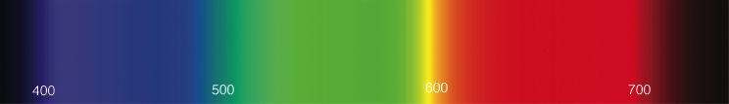
Light
Electromagnetic wave
  E & M ⟂ to each other & direction of travel
Photon wavelength λ, frequency f = c/λ
Photon energy q = h f = h c/λ (in J)
  Visibile λ ≈ 380 nm (blue) to 720 nm (red)
  c = speed of light, h = Planck’s constant
Spectral energy Q = J/nm

Slide 4
Light
Infinite-dimensional function vector space
  spectrum(λ)
  Dimensions = wavelength
Shine two lights on something adds energies
  Vector/Vector addition
Scale light energy, scales the intensity
  Scalar/Vector multiplication

Slide 5
Radiometric Units
Term | Symbol | Units
Spectral Energy | Q | J
Spectral Power | Φ = dQ/dt | W = J/s
Irradiance | E = dΦ/dA | W/m²
Radiant Intensity | I = dΦ/dω | W/sr
Radiance | L = d²Φ/(dω dA) | W/(sr m²)
/nm dropped by graphics convention

Slide 6
Radiant Energy (Q)
Total energy (Joules)
Over all time, directions, area, …

Slide 7
Radiant Flux (Φ)
Φ = dQ/dt in Watts = J/s
Radiant energy per unit time
This is the one you probably want
  Unless you are measuring total energy absorbed
  E.g. by a plant over hours of daylight
Not the same as light bulb Watts
  Power in vs. power out

Slide 8
Radiant Intensity (I)
I = dΦ/dω in W/sr
Radiant Flux emitted/received per unit solid angle
  Light from a point in a small cone of directions
Same units for incoming and outgoing light

Slide 9
Radiosity (B)
B = dΦ/dA in W/m²
All light leaving a patch of surface
  Emitted or reflected
  All directions at each point
  Measured per unit area

Slide 10
Irradiance (E)
E = dΦ/dA in W/m²
All light entering a patch of surface
  All directions at each point
  Measured per unit area

Slide 11
Radiance (L)
L = d²Φ/(dω dA) in W/(sr m²)
Light entering patch of surface from a small range of directions
  Per unit area
  Per unit solid angle
Compare to Irradiance
(over all directions)

Slide 12
Spectral Graphs
A = Incandescent light
D = Daylight
(50=horizon,
65=noon)
F = Fluorescent
light

Slide 13
Physiology
Rods
  active at low light levels (scotopic vision)
  only one wavelength sensitivity function
Cones
  active at normal light levels
  three types: sensitivity functions with different peaks

Slide 14
Color Perception

Slide 15
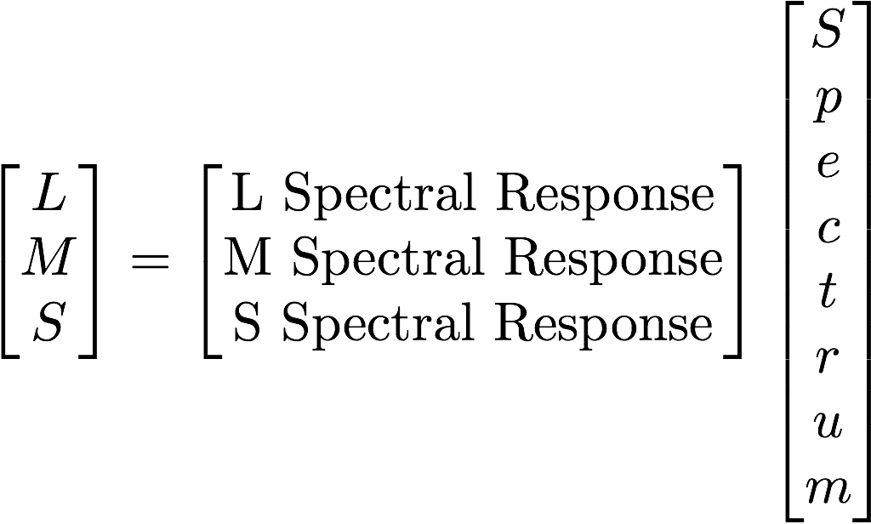
Color Perception
Cones = function dot product
For quantized spectra:
Projects to a 3D subspace

Slide 16
Metamers
Different spectrum, looks the same
Same 3D projection

Slide 17
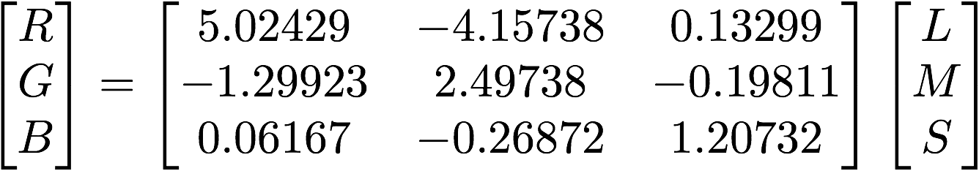
Color Basis
Can transform to any 3D linear basis
  As long as it spans the same subspace
Transform between bases with a 3x3 matrix

Slide 18
Linear Bases
Additive (light)
  Tristimulus (LMS cone response)
  CIE XYZ (from color matching experiments)
  RGB (red/green/blue; different for each device)
  Yuv, YC_{r}C_{b}, … (intensity/2 chroma)
Subtractive (pigment)
  CMY = 1 - RGB (cyan/magenta/yellow)
    grade school Blue, Red, Yellow
  CMYK (cyan/magenta/yellow/black)
    Hard to reliably get pure black in ink by mixing CMY

Slide 19
Chromaticity
Normalize x = X / (X+Y+Z); y = Y / (X+Y+Z)

Slide 20
RGB Gamut
Gamut = representable colors

Slide 21
Subtractive
Start at white, remove R, G, or B

Slide 22

White Points & Color Temperature
Color of radiating black body at given temperature (°K)
Color of a black body that temperature, not necessarily the temperature of the light

Slide 23
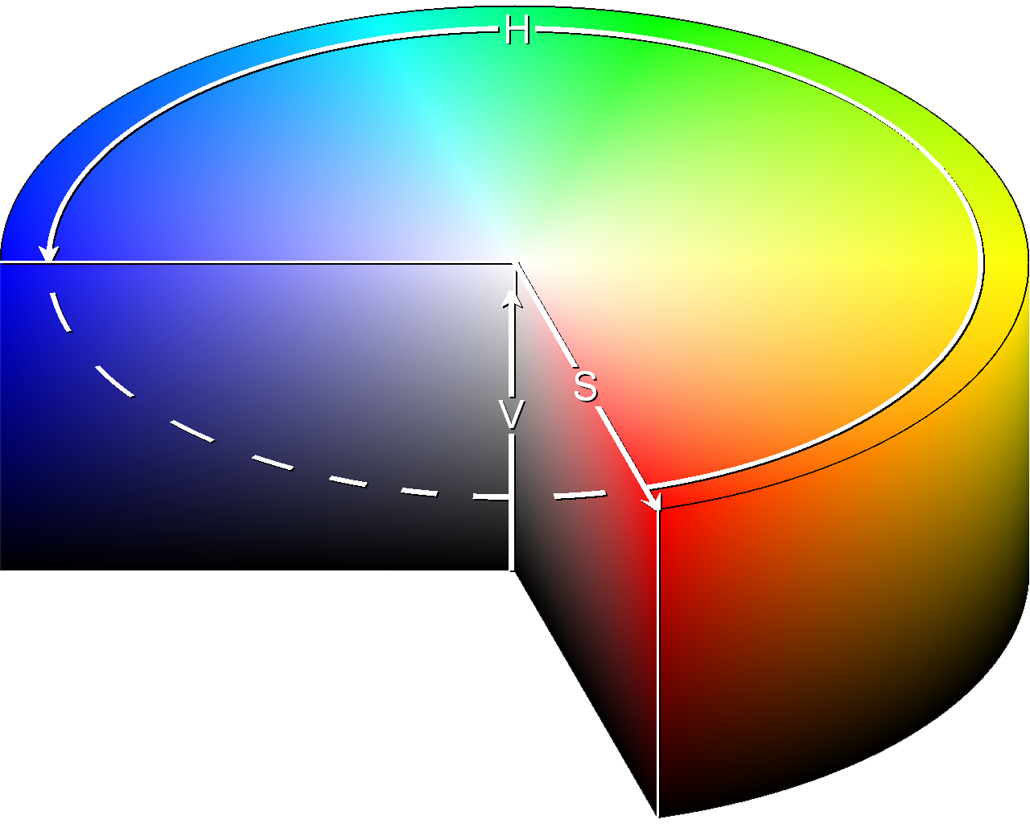
Nonlinear Color Spaces
HSV: Cylindrical Coordinates
  Hue = angle
  Saturation = distance from central axis
  Value = distance along axis
Related HLS
  Hue/Lightness/Saturation

Slide 24
Perception

Slide 25
Nonlinear Perception
Linear colors don’t look uniformly different
Nonlinear Luminance
  Gamma (sRGB), L*uv
Nonlinear Luminance & Color
  L*u*v*, L*a*b*
  Can measure color distances

Slide 26
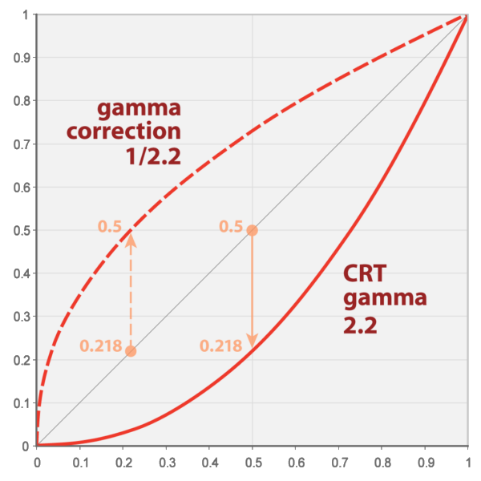
Gamma
Gamma transform
  sRGB is approximately
  with linear bit near 0
Images
  Often stored with sRGB or gamma
  Nonlinear colors do not add
    Undo gamma, operate in
    linear space, redo gamma
Some games use

Slide 27
Photometric Units
Visual intensity
Term | Symbol | Units
Luminous Energy | Q | talbot
Lumens | Φ = dQ/dt | lm = talbot/s
Illuminance (lux) | E = dΦ/dA | lx = lm/m²
Candelas | I = dΦ/dω | cd = lm/sr
Luminance (nit) | L = d²Φ/(dω dA) | nt = cd/m²

Slide 28
Dynamic Range
Real world: High Dynamic range (HDR)
  Outside, moonlight 0.0014 nt
  Outside, sunrise 25 nt
  Outside, overcast 700 nt
  Outside, sunlight 5,000 nt
  Sky 7,000 nt
  Light blub 130,000 nt
  Sun 1,600,000,000 nt
Displays: Low Dynamic Range (LDR)
  Typically about 1 nt to 250 nt

Slide 29
Tone Mapping
HDR ∈ [0,∞); LDR ∈ [0,1] or [0,255]
Convert HDR to LDR
  Nonlinear tone
  mapping curve
  Adapt to overall
  intensity
  Time-dependent
  adaptation

Slide 30
Displays

Slide 31
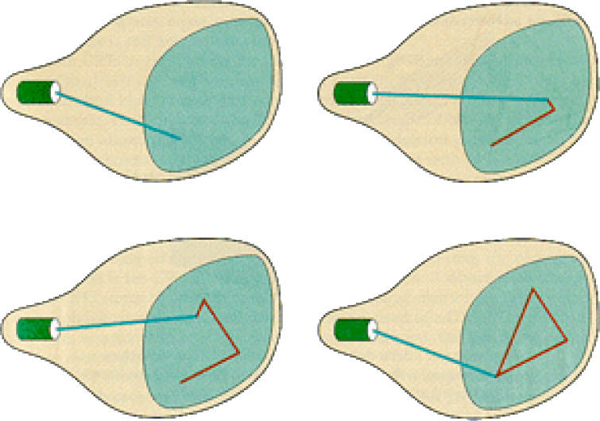
Random/Vector Display

Slide 32
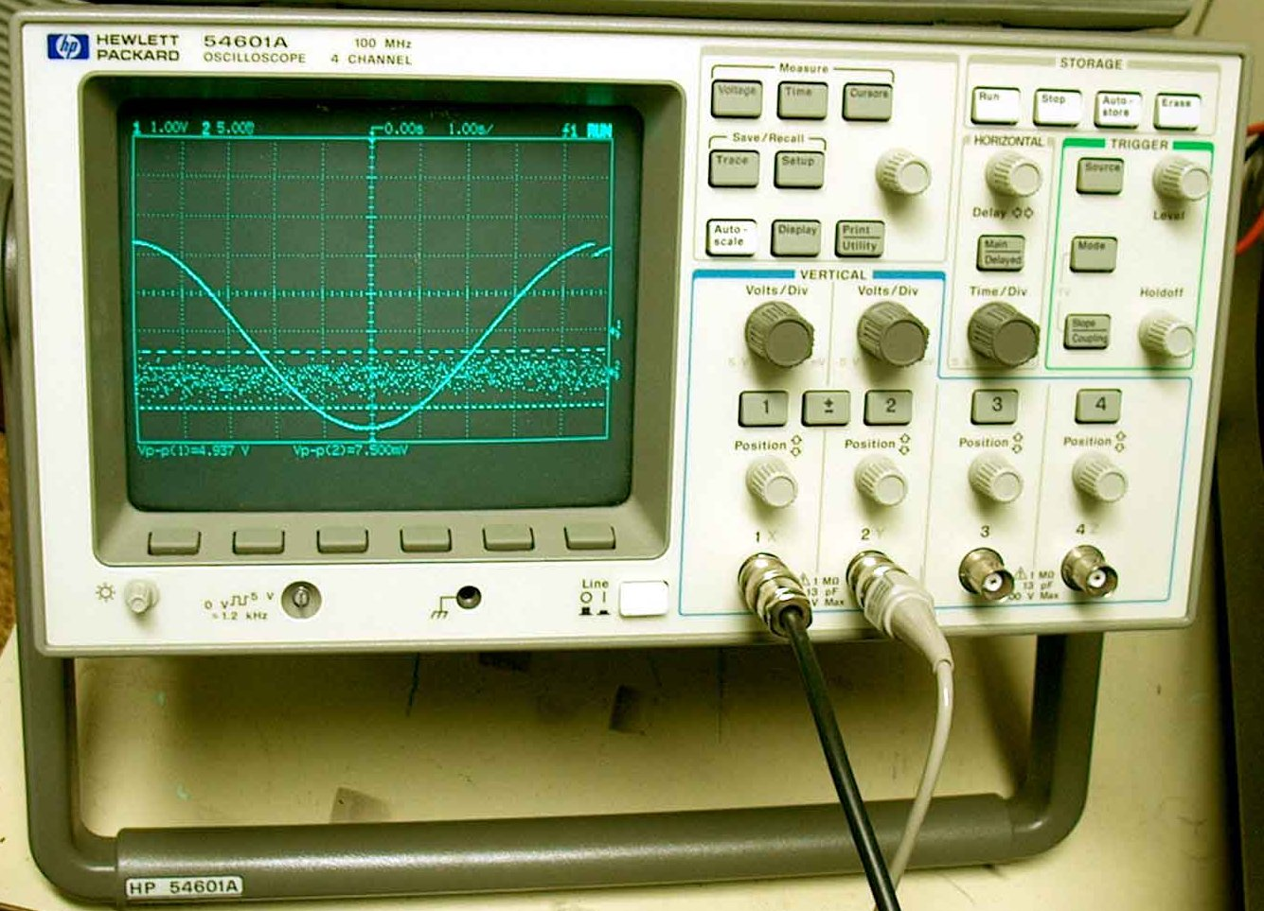
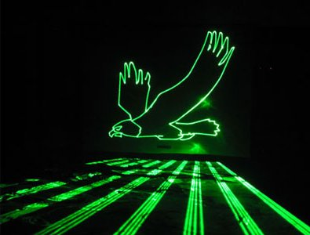
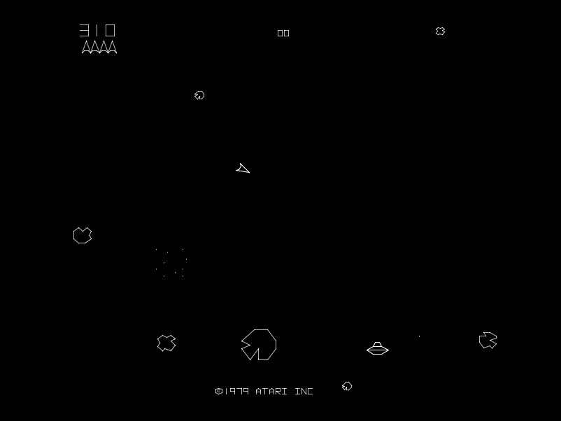
Examples of Random Scan

Slide 33
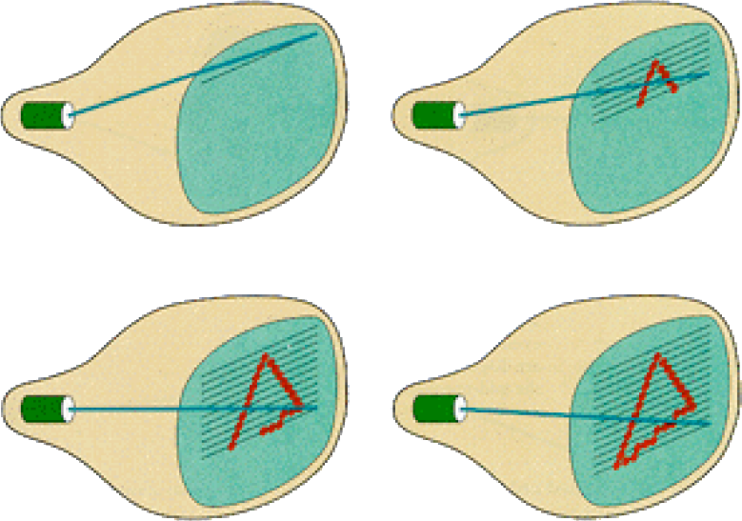
Raster Display

Slide 34
Raster Display
Each left-to-right trace is called a scan line
Each spot on the screen is called a pixel
CRT displays: Beam turned off to swipe back to the top
  Called a vertical retrace or blanking interval

Slide 35
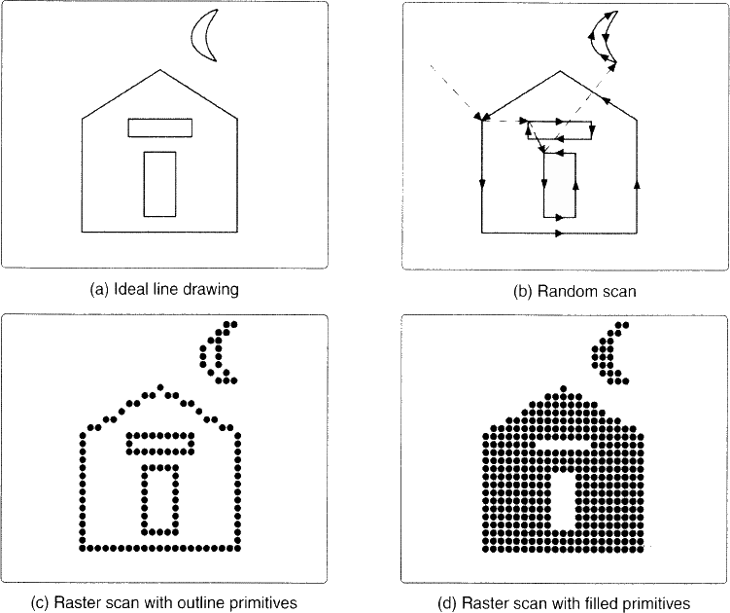
Vector vs. Raster

Slide 36
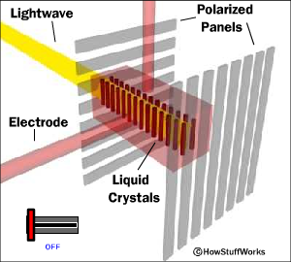
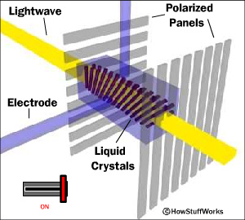
Liquid Crystal Display (LCD)‏
Light enters polarizer
Nematic crystals twist based on voltage
Allowing light
to pass through
to other
polarizer

Slide 37
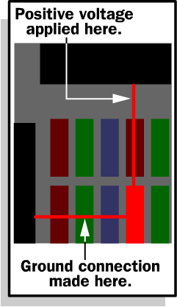
Passive Matrix
Two glass layers
One layer is given vertical transparent conductive material, the other is given horizontal
Integrated circuit sends charge/ground activation to complete circuit at given row/column
Simple, but slow response time

Slide 38

Active Matrix
Thin Film Transistor (TFT) at each cell
  Stays on until changed
More light transmission
  Less powerful back light
Much faster crystal switching

Slide 39
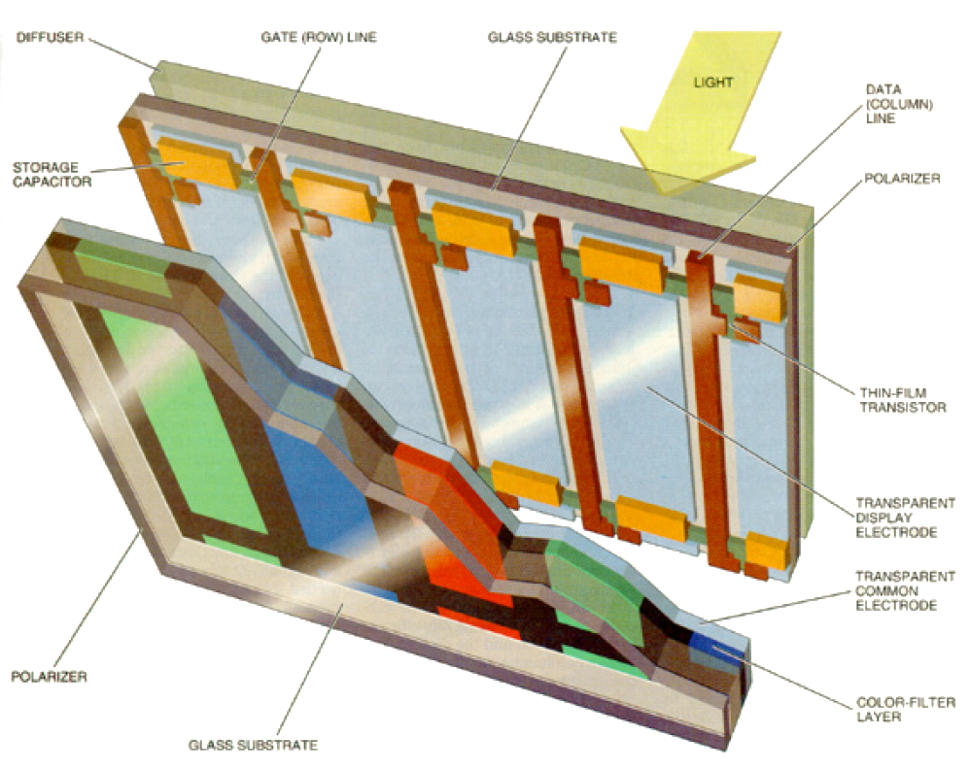
Color LCD

Slide 40
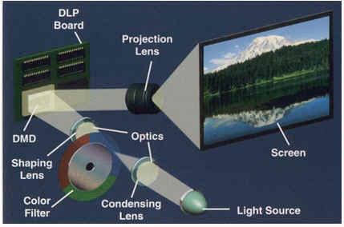
DLP Projector

Slide 41

DLP Projector

Slide 42
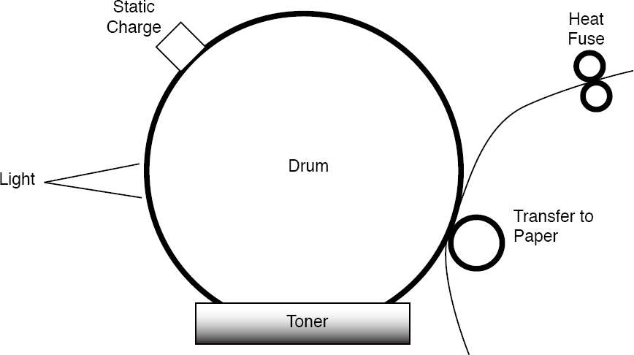
Laser Printer

Slide 43
Generalize to Images
2D array of pixels
  Sometimes y=0 at top (from scanned displays)
  Sometimes y=0 at bottom (graph convention)
RGB color per pixel (usually sRGB)

