Slide 1
Graphics Pipeline
Clipping
CMSC 435/634

Slide 2
Graphics Pipeline
Object-order approach to rendering
Vertex Processing
Transformations
Vertex components of shading
Clipping
Find the visible parts of primitives
Rasterization
Break primitives into fragments/pixels
Fragment Processing
Fragment components of shading
Visibility & Blending
Which do we see, how do they combine?

Slide 3
Why Clip?
Window sides
  Draw less
  Some rasterization algorithms need everything on screen
Near
  Draw less
  Don’t divide by 0
  Don’t divide by negative z
Far
  Draw less
  Constrain Z range (avoid overflow)

Slide 4
Clipping & Culling
Cull: decide not to draw an object at all
Clip: slice to keep just the visible parts
Trivial Reject: Easy to decide entirely off screen
Trivial Accept: Easy to decide entirely on screen

Slide 5
Clipping Lines
Lines intersecting a rectangular clip region are always clipped into a single line segment
Clip against one window edge at a time
F
D
D’
D’
B
H
B
C
H’
C
H’
E
A
J
A
G’
J’
G’
G
I’
Clip Rectangle
I

Slide 6
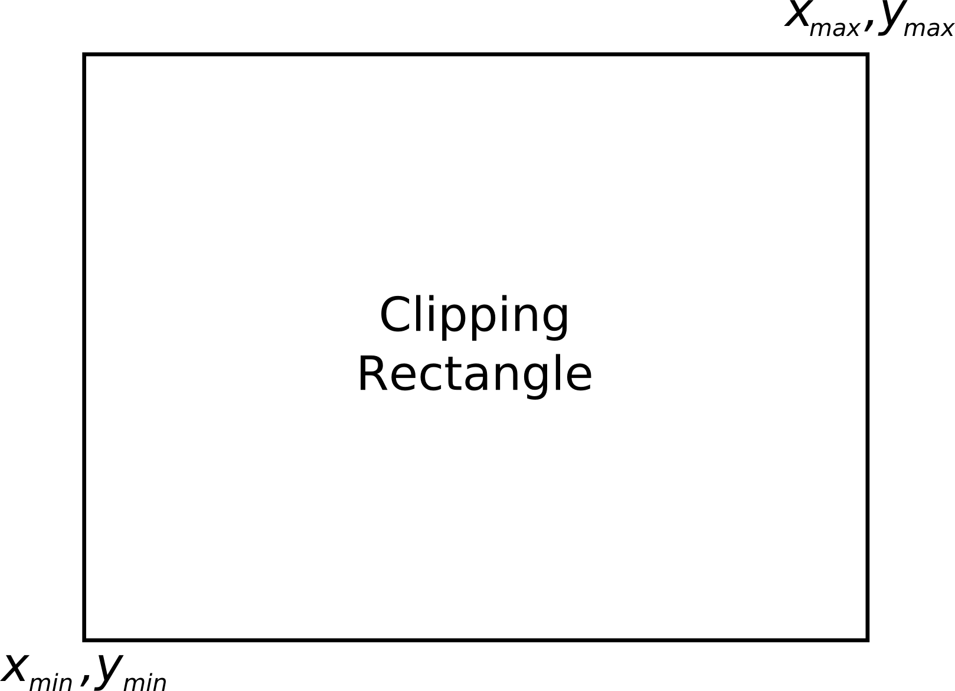
Clipping Endpoints
For a point at (x,y) to be inside the clipping rectangle
x_{min} ≤ x ≤ x_{max}, y_{min} ≤ y ≤ y_{max}

Slide 7
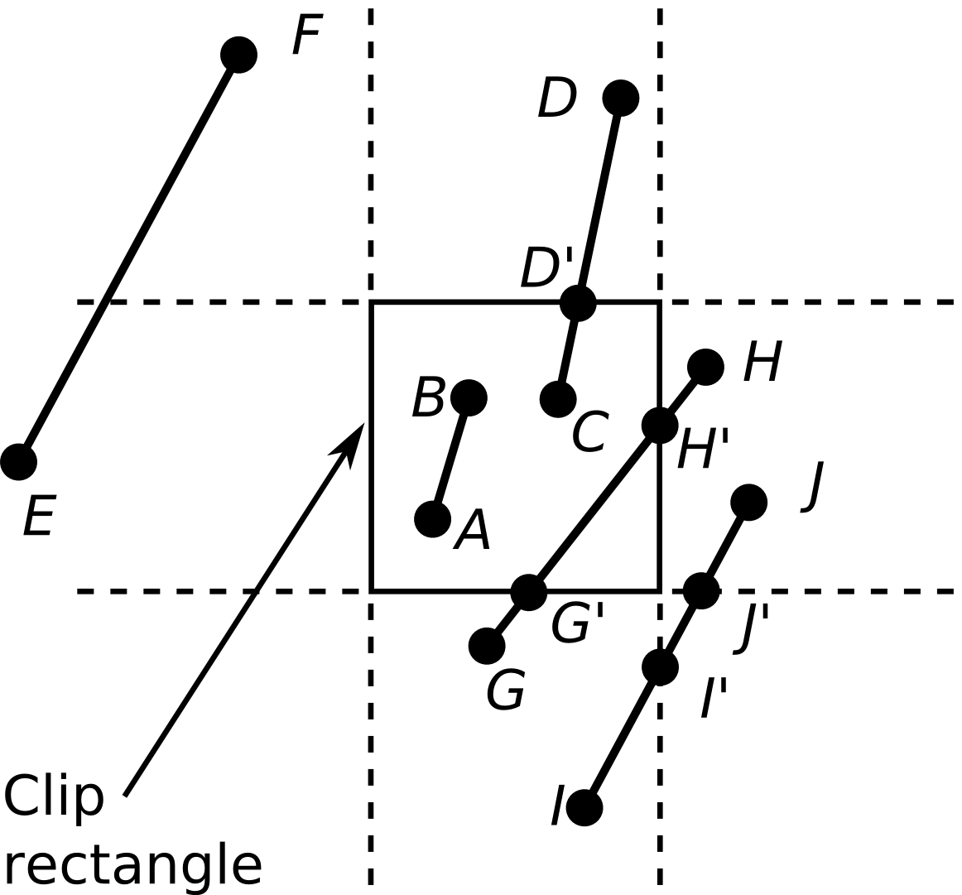
Clipping Conditions
Both endpoints are inside (AB)
One endpoint in, another end outside (CD)
Both outside (EF, GH, IJ)
  May or may not be in, further calculations needed

Slide 8
Cohen-Sutherland Line Clipping
First, endpoint pairs are checked for trivial acceptance
If not, region checks are performed in order to trivially reject certain lines
  If both x’s or both y’s are < –1 or both are > 1, then it lies outside (EF)

Slide 9
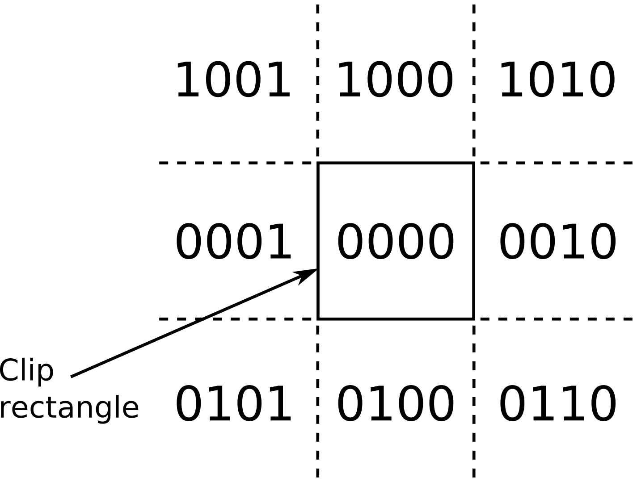
Cohen-Sutherland Line Clipping
Create bit code for each endopint
Each region is assigned a 4-bit code (outcode)
  1st bit – above top edge
    y > ymax
  2nd bit – below bottom edge
    y < ymin
  3rd bit – right of right edge
    x > xmax
  4th bit – left of left edge
    x < xmin

Slide 10
Efficient Computation of Bit-Code
Compute each bit
  First bit is the sign bit of ymax – y
  Second bit is the sign bit of y – ymin
  Third bit is the sign bit of xmax – x
  Forth bit is the sign bit of x – xmin

Slide 11
Bit-Code Trivial Rejects and Accepts
If both bit codes are zero – trivial accept
If endpoints are both outside of same edge, they will share that bit
  This can easily be computed as
  a bitwise and (&) operation –
  trivial reject if non-zero result
If not, then need to split line at
clip edge, discard portion
outside, continue testing

Slide 12
Cohen-Sutherland
Line Clipping Algorithm
code1 = outcode from endpoint1
code2 = outcode from endpoint2
if (code1 | code2 == 0) then
trivial_accept
else if (code1 & code2 != 0) then
trivial_reject
else
clip against left
clip against right
clip against bottom
clip against top
if (anything is left) then
accept clipped segment

Slide 13
Homogeneous Clipping
Works for 3D planes
If point is inside clipping plane:
Point on line:
Intersection:

Slide 14
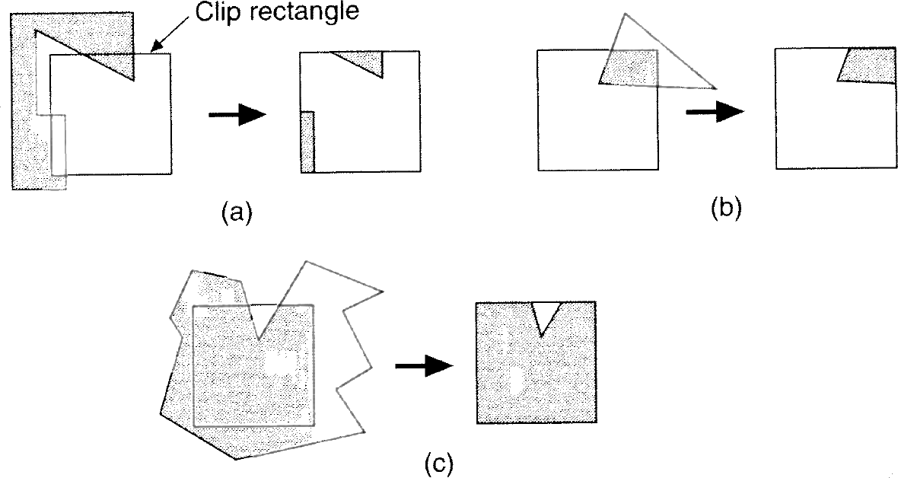
Polygon Clipping
Many cases (new edges, discarded edges)
  Multiple polygons may result from a single (concave) polygon

Slide 15
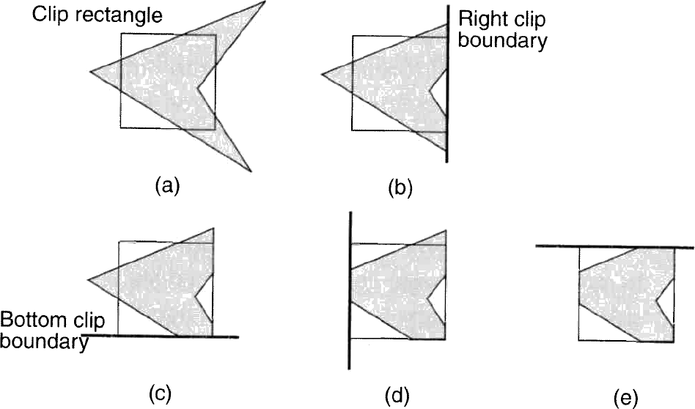
Sutherland-Hodgman Polygon Clipping
Divide and conquer
Simpler problem is to clip polygon against a single infinite edge
  Sequence of 4 clips against clipping rectangle

Slide 16
Sutherland-Hodgman Polygon Clipping
Algorithm moves around the polygon from v_{n} to v₁ and then on back to v_{n}
At each step
  Check (v_{i} to v_{i+1}) line against the clip edge
  Add zero, one, or two vertices to the output

Slide 17
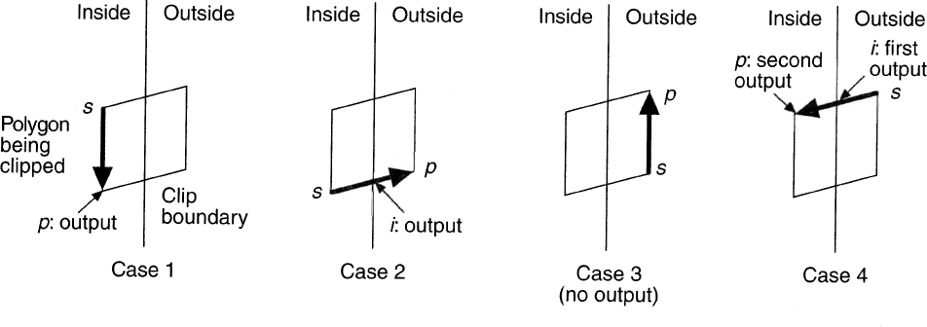
Sutherland-Hodgman Polygon Clipping
At each step, 1 of 4 possible cases arises
  1) Edge is completely inside clip boundary, so add vertex p to the output
  2) Intersection i is output as vertex because it intersects with boundary
  3) Both vertices are outside boundary, so neither is output
  4) Intersection i and vertex p both added to output list

Slide 18
Sutherland-Hodgman Algorithm
Sutherland-Hodgman(array)‏
vertex S = array[ length(array) - 1 ]
for ( j = 0 ; j < length(array) ; j++ ) do
vertex P = array[ j ]
if ( P is inside clip plane ) then
if ( S is inside clip plane ) then /* case 1 */
Output( P )
else /* case 4 */
Output( ComputeIntersection( S, P, clip plane ) )‏
Output( P )‏
else if ( S is inside clip plane ) then /* case 2 */
Output( ComputeIntersection( P, S, clip plane ) )‏
else /* case 3 */
do nothing
S = P

Slide 19
“Clipless” Homogeneous Rasterization
Compute barycentrics using homogeneous coordinates
  Don’t need to clip to compute valid barycentrics
Extra edge equation / decision variable for each clip edge
  Compute t for clip plane at each vertex
  Only visible (w>near) pixels will be drawn
Adds computation
  Divide by w per pixel instead of per vertex
    No clipped pixels drawn, so no division by 0
  But avoids branching and extra triangles
    Good for hardware

Slide 20
Homogeneous Barycentrics

Slide 21
Homogenous Clip Plane
Clip parameter at each vertex
Clipping decision variable coefficients

