Slide 1
Cloud Shader Walkthrough

Slide 2
Setting up the Project

Slide 3
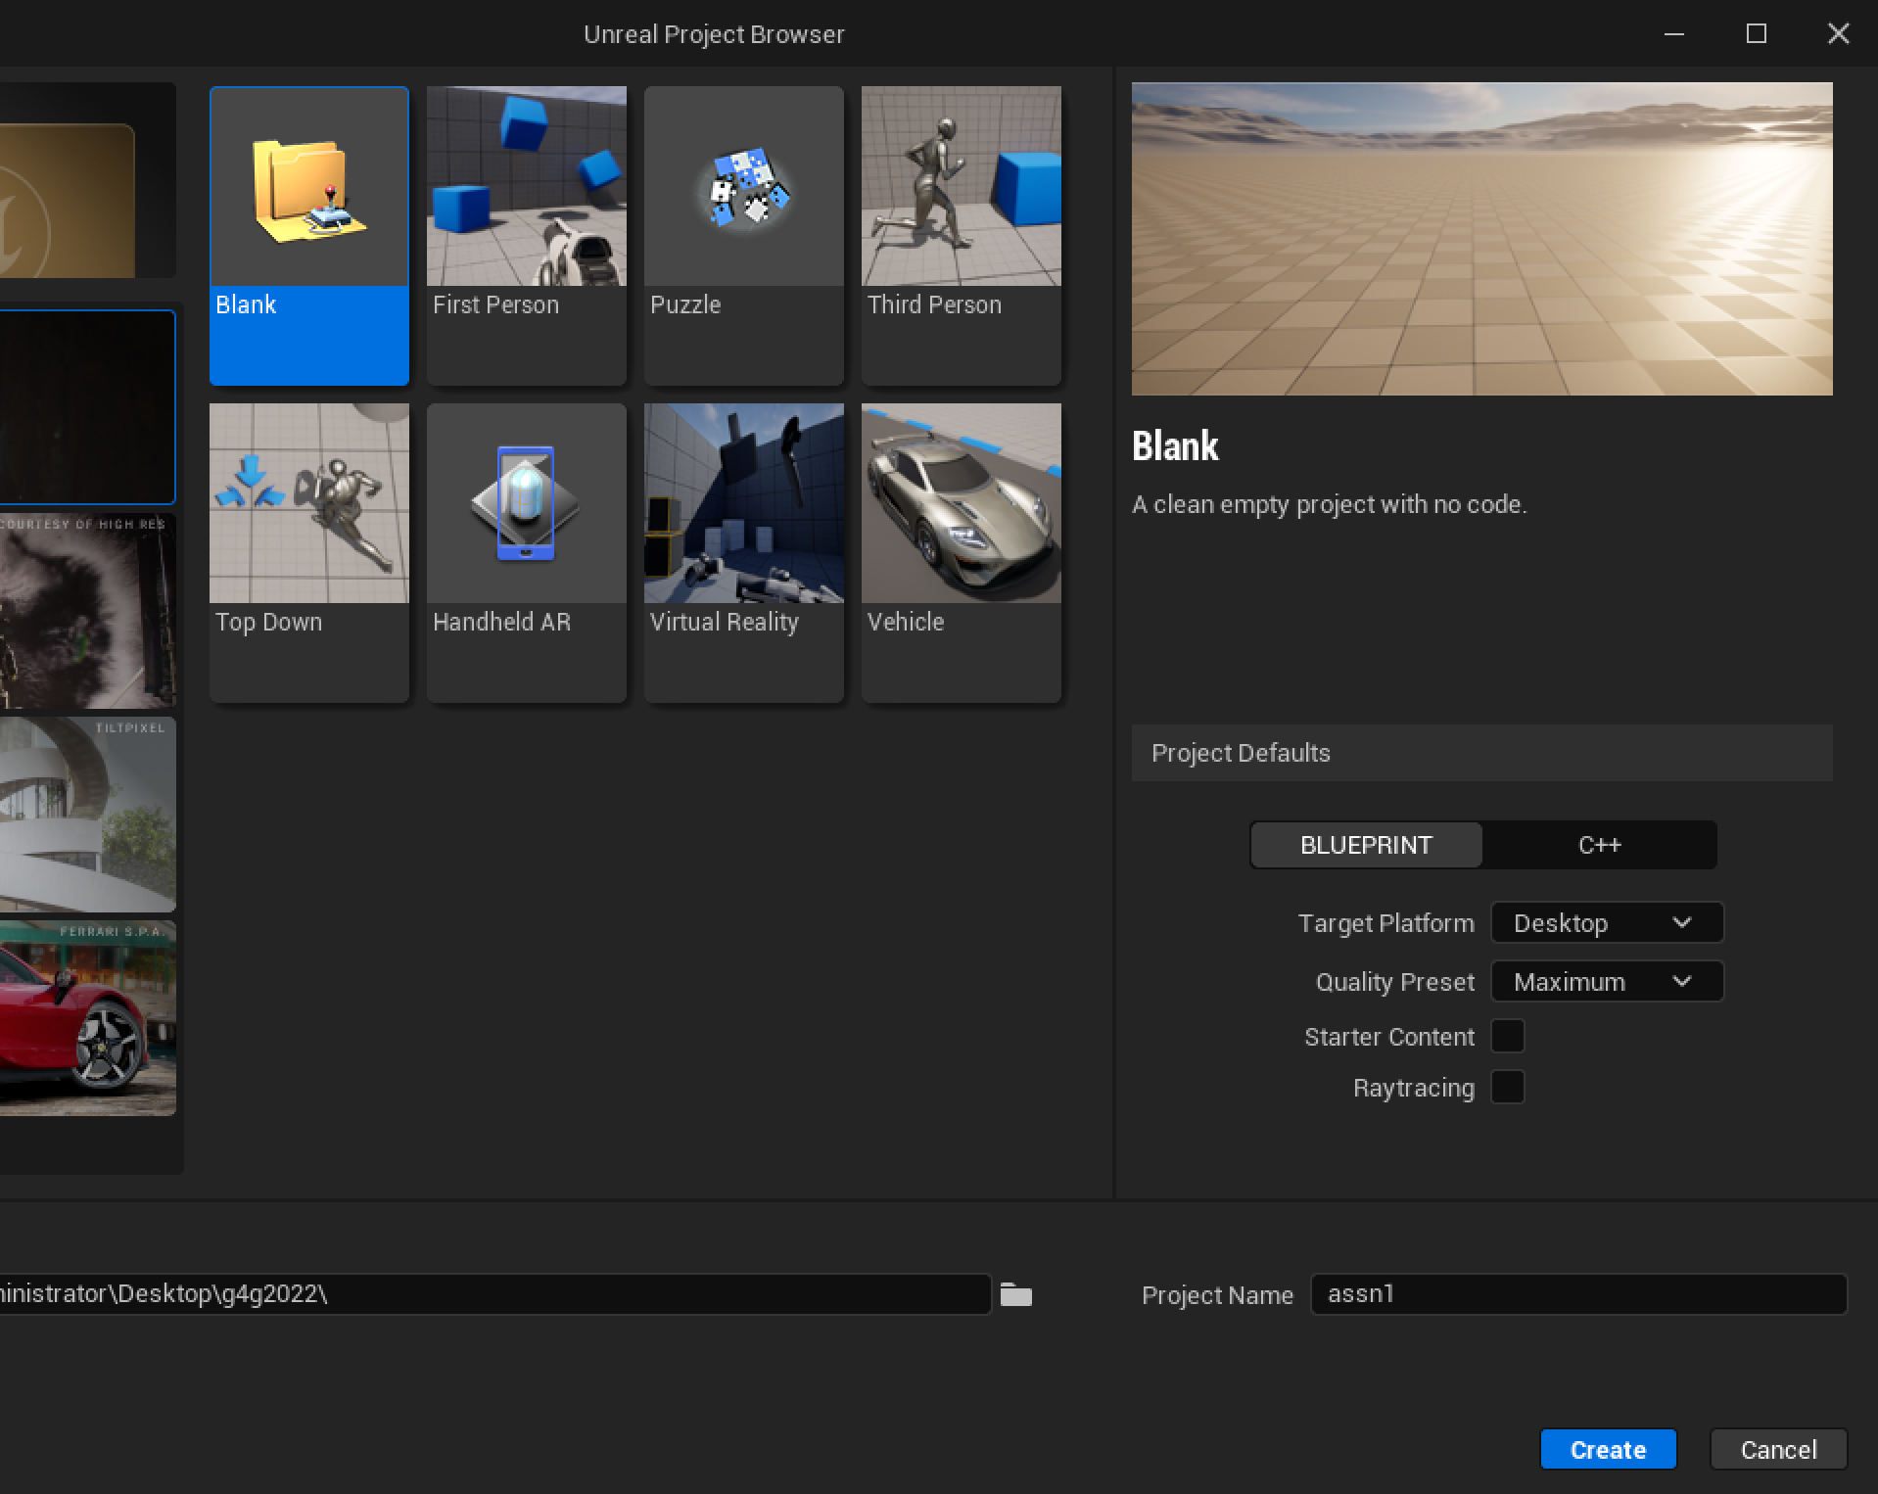
Create a Project
Launch your home-built UE5, choose the “Games” project category.
Use the Blank template, to create a C++ project with No Starter Content.
Set the folder where your project will be created to the base folder for your engine source (the directory containing the Setup and GenerateProjectFiles scripts).

Slide 4
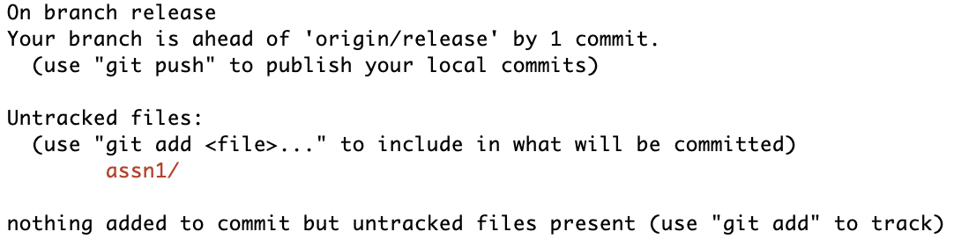
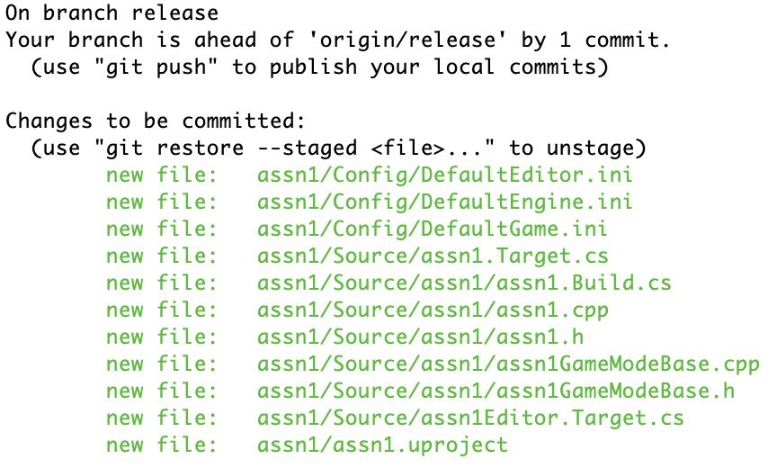
First Commit
git status
Once the project is created and launched, quit it and commit it to your local Git repository.
git add assn1
git status
git commit –m "created cloud project"

Slide 5
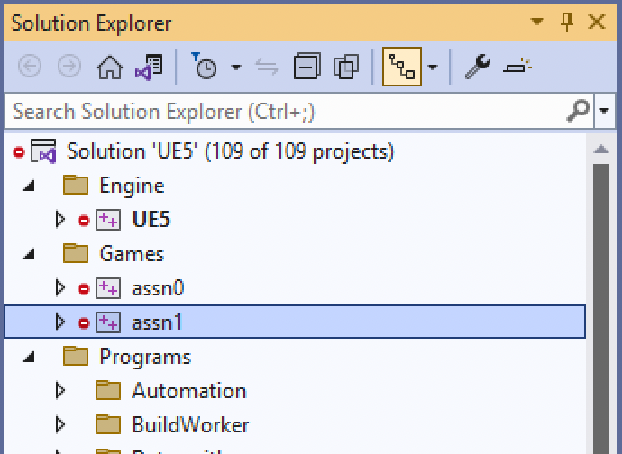
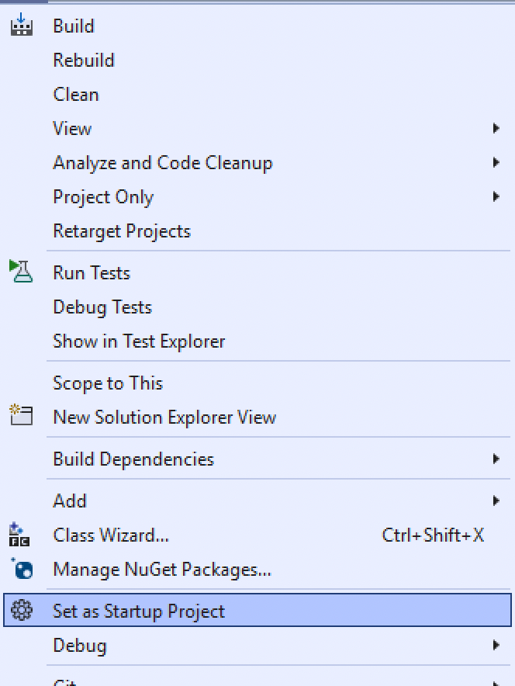
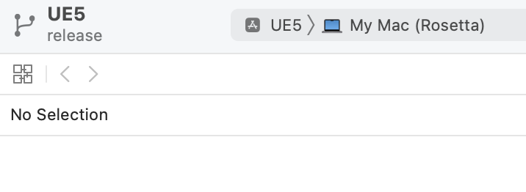
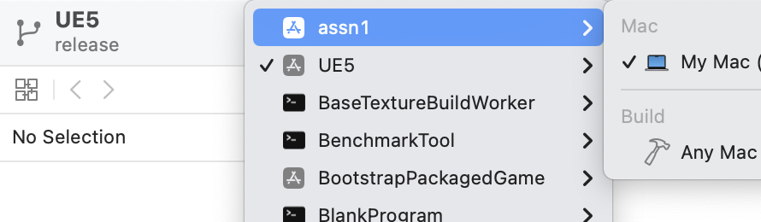
Run from your IDE
Creating the project runs GenerateProjectFiles for you.
  If you do not see the project listed, you may need to quit and re-open Visual Studio or Xcode.
In Visual Studio, right click on the project to Select as Startup Project.
  In Xcode, choose the project from the drop-down list.
Run (using the Play button). It’ll launch directly into the project.

Slide 6
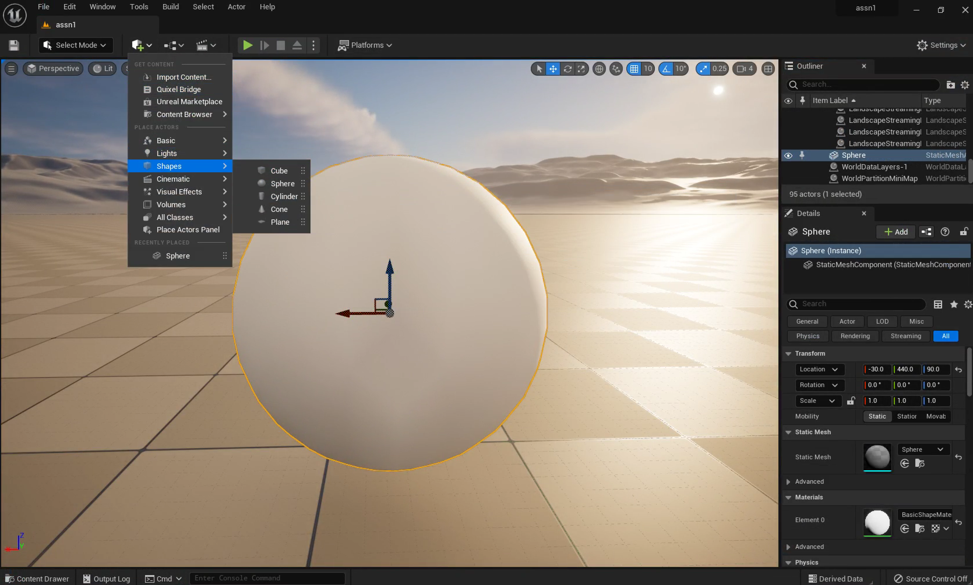
Set up a Scene
Add a new sphere shape into the scene and position it above the ground plane.
Save the current Level (you’ll have to name it), then set it as the Editor Startup Map in Settings > Project Settings ...
Add and commit the project Content directory and DefaultEngine.ini files to Git. This will add the .umap and .uasset files for the new Level.
It is reasonable to commit at each major step along the way. You don’t need to quit the Editor, but be sure to “Save All” before each commit to make sure you are not missing unsaved work.
UE5 has Git support for asset changes like this, but the support doesn’t apply to the source changes we’ll make later, so better to get used to using Git directly.

Slide 7
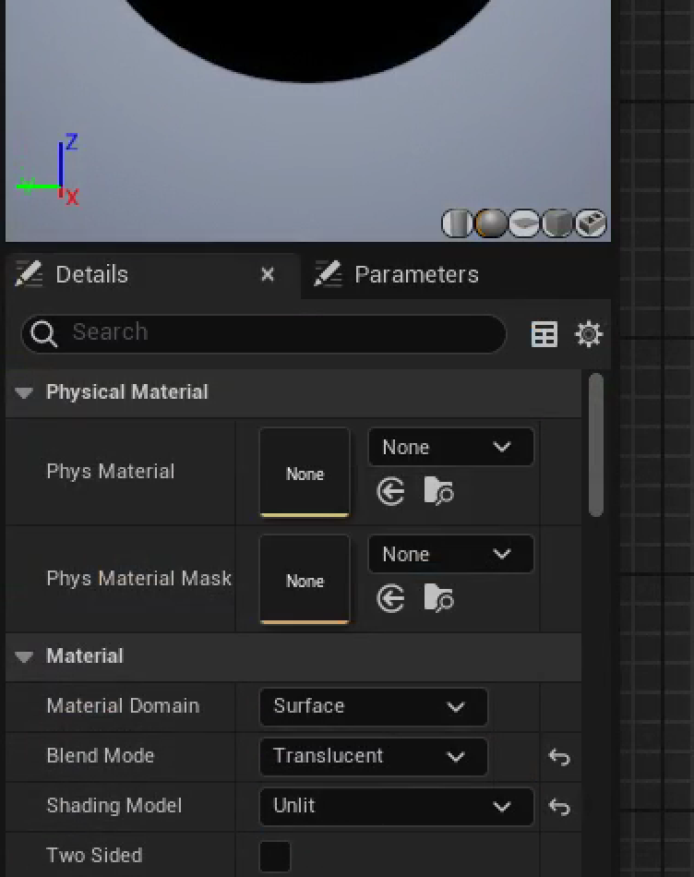
New Material
Create a new Material on the sphere, open it in the Material Editor, and change it to “Translucent” and “Unlit”.
We will ultimately include some lighting calculation, but the shader will do it, so we don’t want UE5 to add its own surface lighting on top of that.
The Emissive Color input is not affected by scene lighting, and we can use the Opacity input to make the cloud transparent.

Slide 8
Materials & HLSL

Slide 9
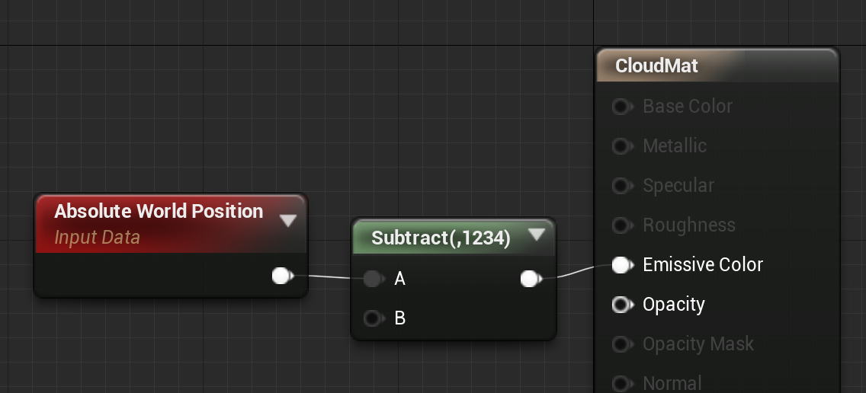
Accessing Data
We’ll need to access several pieces of data in shader code. The first of those is the 3D world position for each point on the surface of the sphere.
How do you figure out the shader code to get that position? Look at the source.
  Window > Shader Code > HLSL Code, or r.DumpShaderDebugInfo.
Add a searchable constant (like 1234) to make it easier to find

Slide 10
What is that LWC?
Floating point precision is not enough for large worlds
Float precision of x is [next lower power of 2] * 2⁻²³ ≈ x ∗ 10⁻⁷
  Earth radius 6.378 ∗ 10⁶ m; UMBC at 39.2498º N, 76.7115º W
  ∴ X=1.135∗10⁶ m; Y=4.807∗10⁶ m; Z=4.035∗10⁶ m
  Position resolution: X ± 0.125m; Y ± 0.5m; Z ± 0.25m
Use doubles … or recenter for better precision away from the origin
  UE uses Translated World or Large World Coordinates (LWC)
  Translated World is centered at camera (errors too far away to see)
  LWC uses a struct with tile location & offset within tile
    Tile locations exactly representable as float (0’s in least significant bits)
    Offsets are small numbers with higher precision
Only really matters for huge worlds

Slide 11
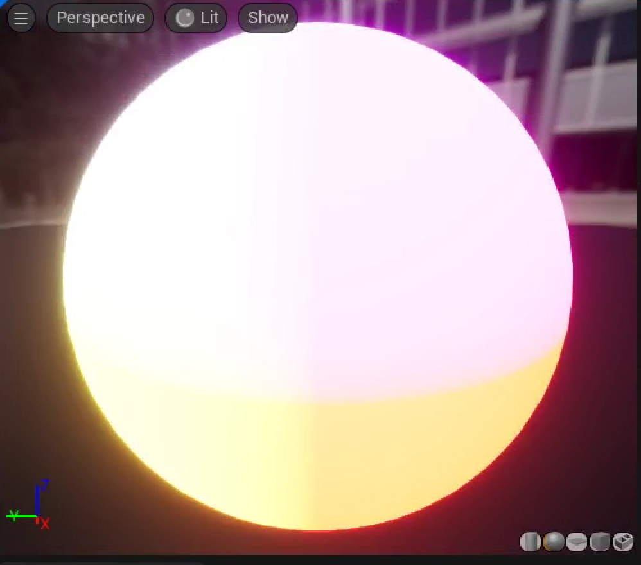
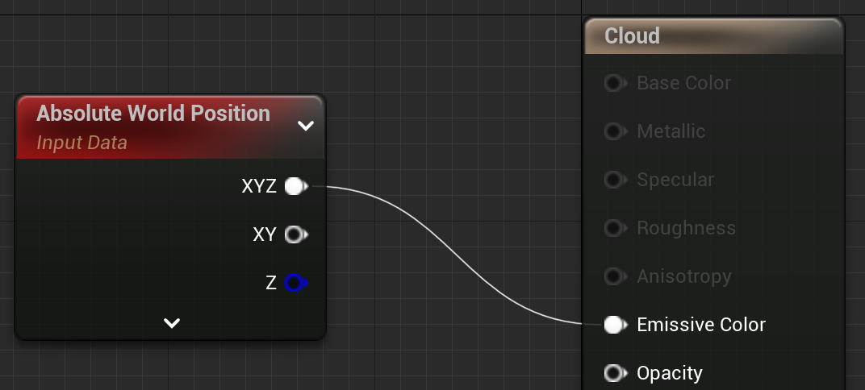
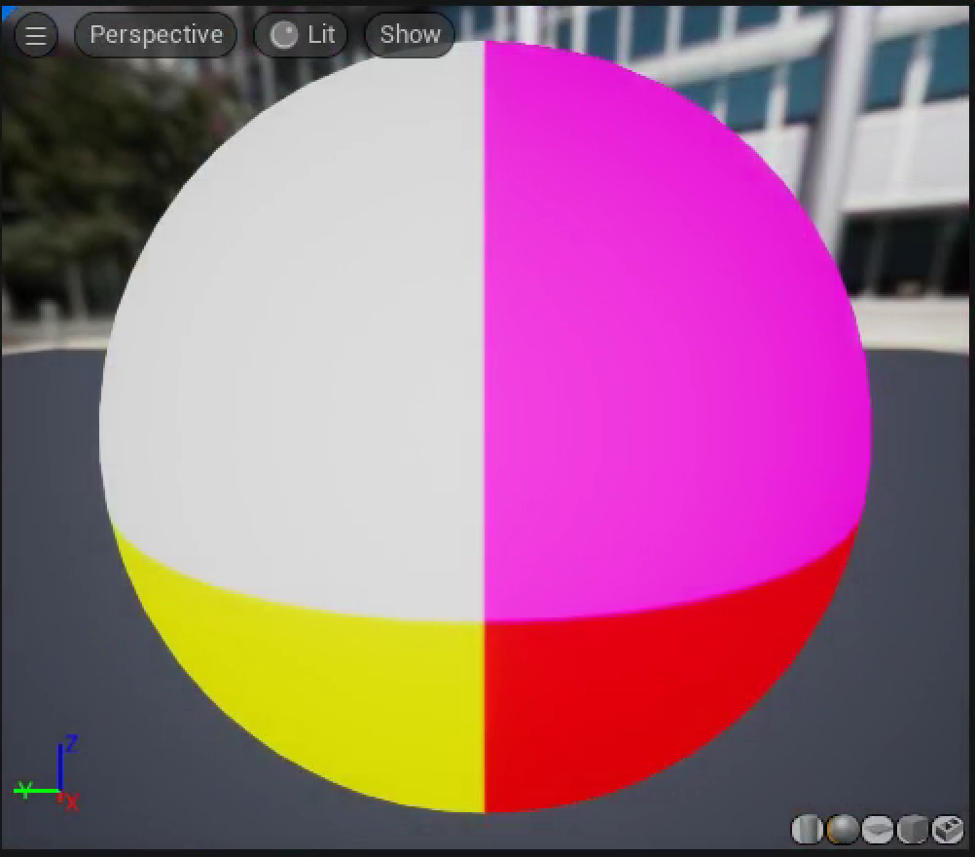
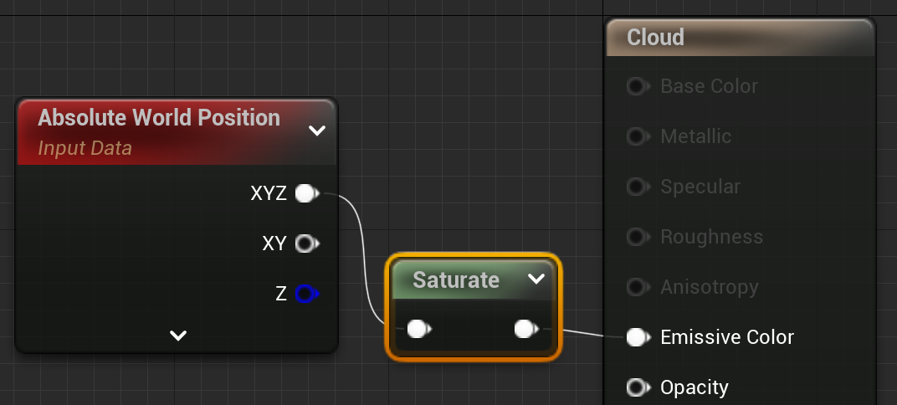
Visualize with saturate
Positions values are huge
Displayed as color is really bright
Clamp to 0 – 1 with saturate

Slide 12
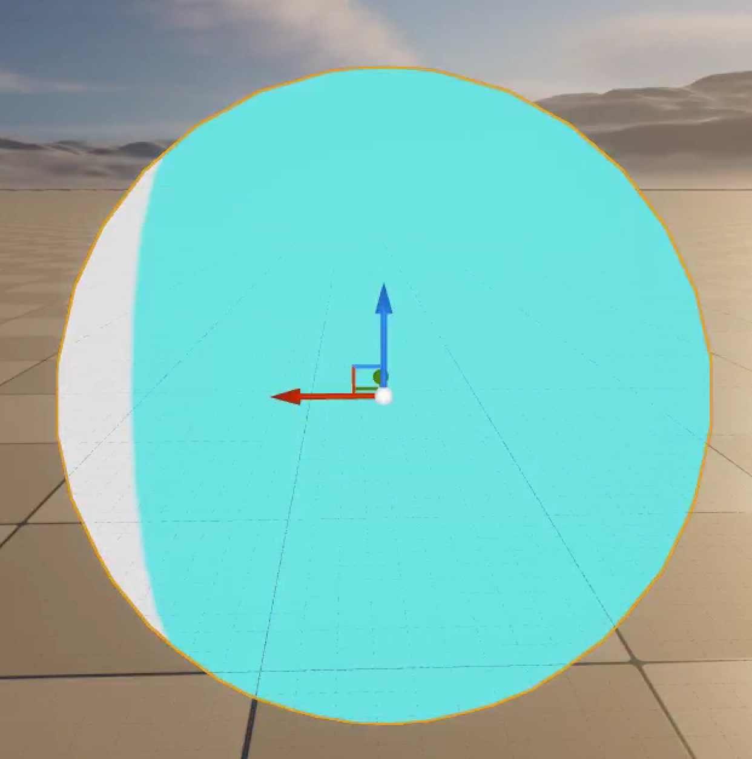
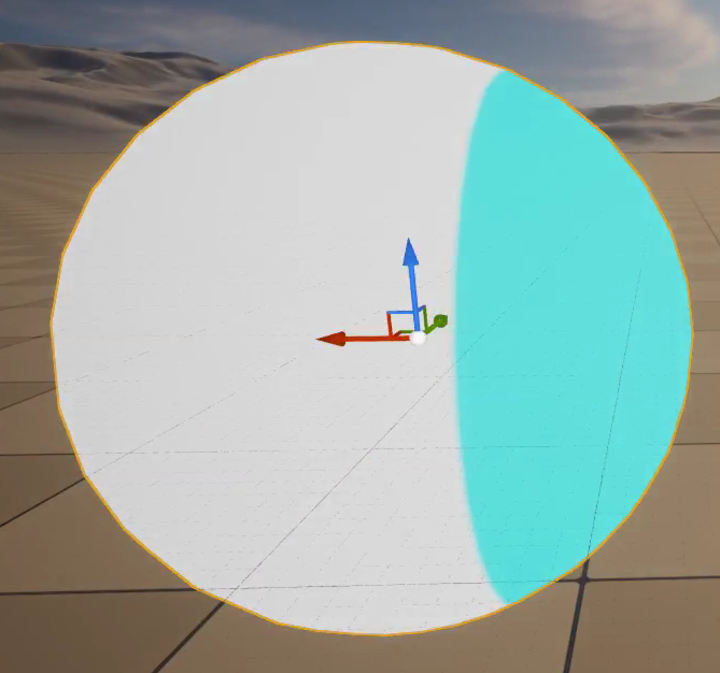
Where to View
Usually, updating and viewing a shader in the Material Editor gives the fastest iteration time to see shader changes, but you should still periodically check how the shader behaves in the scene.
If you apply this shader and switch back to the main view, you’ll see that when you move the sphere around the scene, the Material slides through it. That’s not what we want.
You’d miss this in the Material Editor because the preview object is always centered at the preview scene origin.

Slide 13
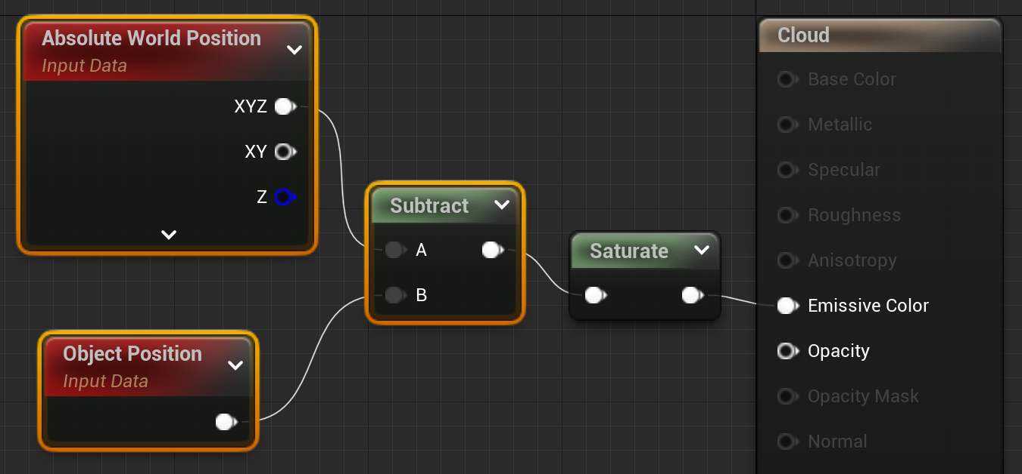
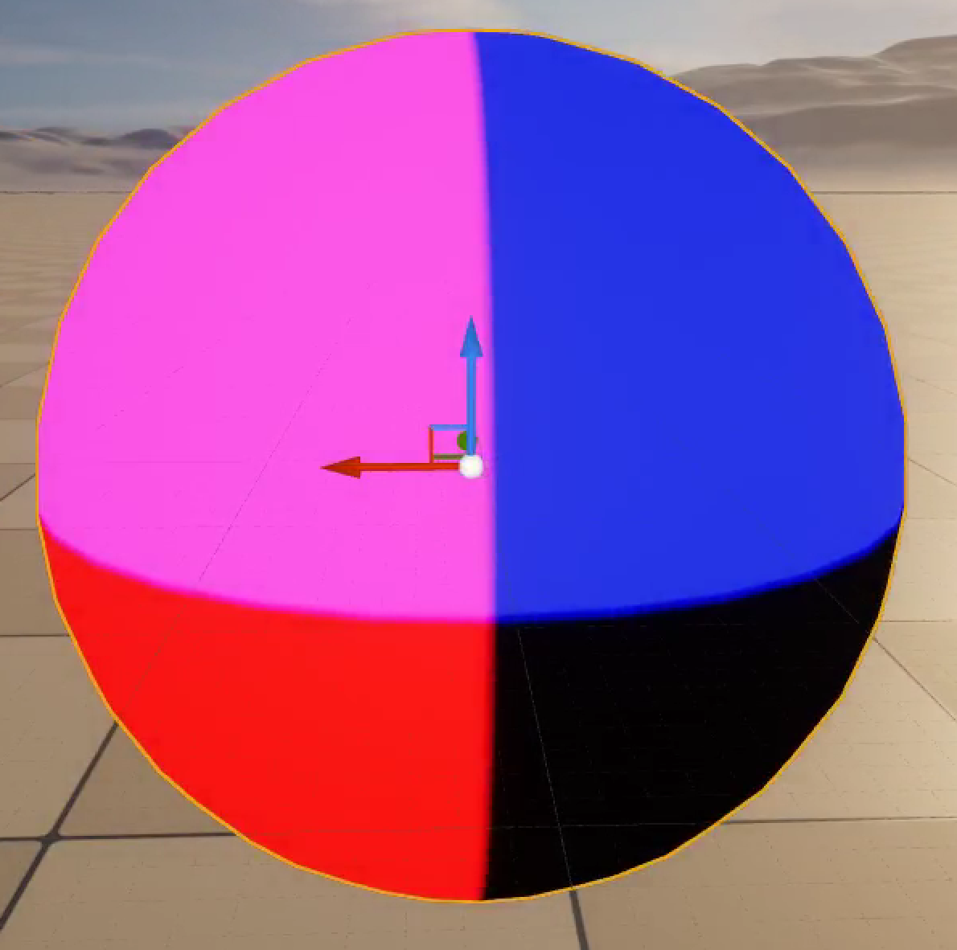
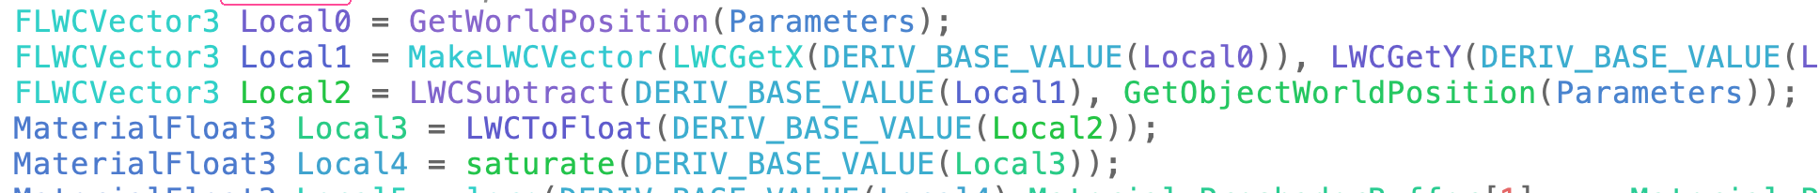
Locking to the Object
We can fix this by finding the position relative to the object position
Subtracting the AbsoluteWorldPosition from the Object Position gives position relative to the center of the sphere, which locks the shader to the object no matter how you move it.

Slide 14
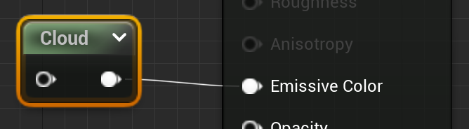
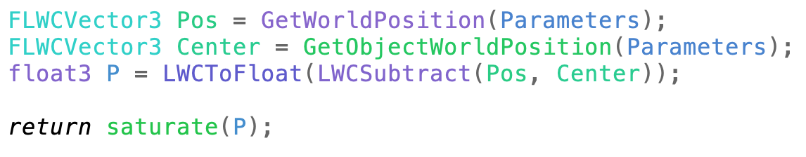
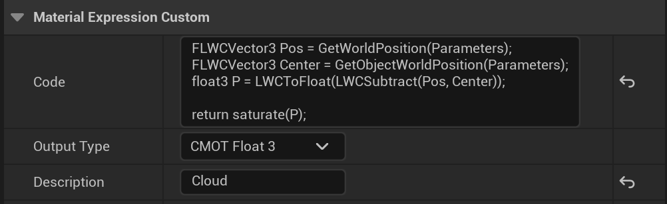
Custom Node
The Custom node lets you add short sections of HLSL code to a material
You can give it a name by changing the Description field
It is easiest to edit in an external editor then paste into the Code block.

Slide 15
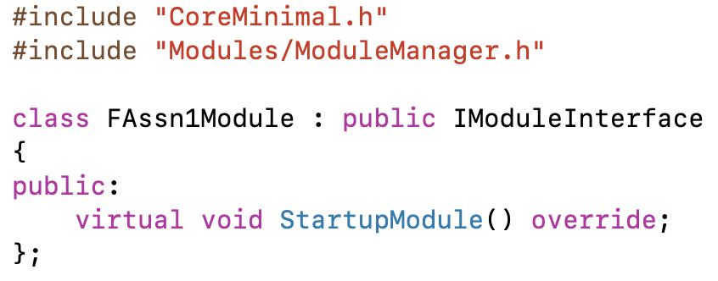
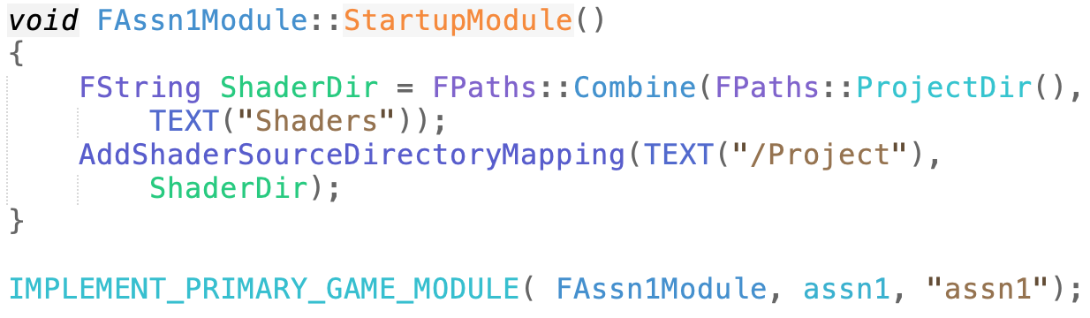
Getting Shader Code from a File
Add RenderCore to dependencies in assn1.Build.cs
  Then GenerateProjectFiles
Add custom module for this assignment to assn1.h
Replace default game module macro in assn1.cpp with new custom one adding a project
shader directory to the search
path.

Slide 16

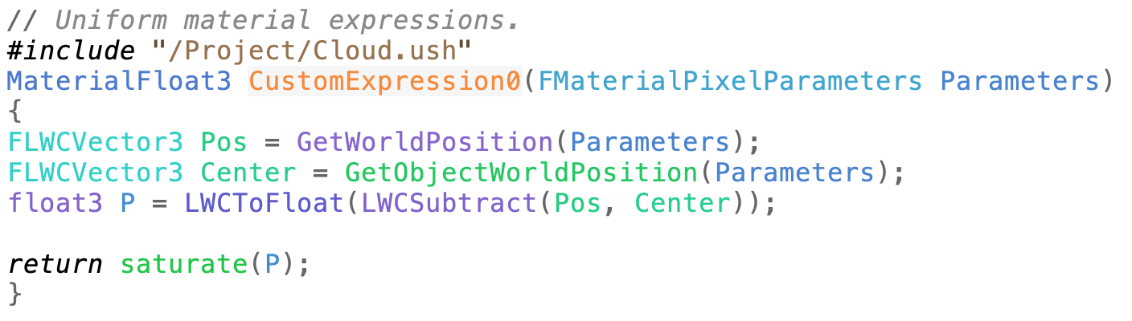
Getting Shader Code from a File (2)
Create a new shader file:
  assn1/Shaders/Cloud.ush
  Put at least a space or comment in it (UE5 doesn’t like empty files)
Add in the “Include File Paths” for the Custom Node
  The code on the last slide converts /Project to the project Shaders directory

Slide 17
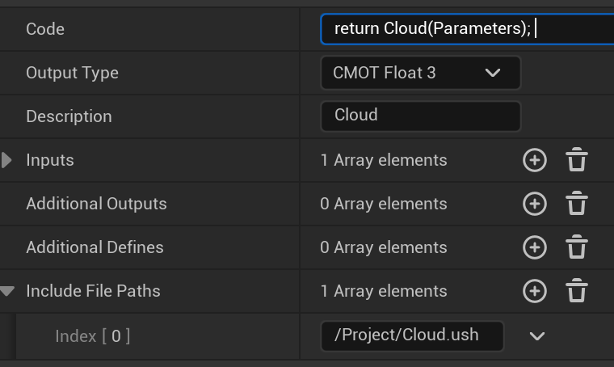
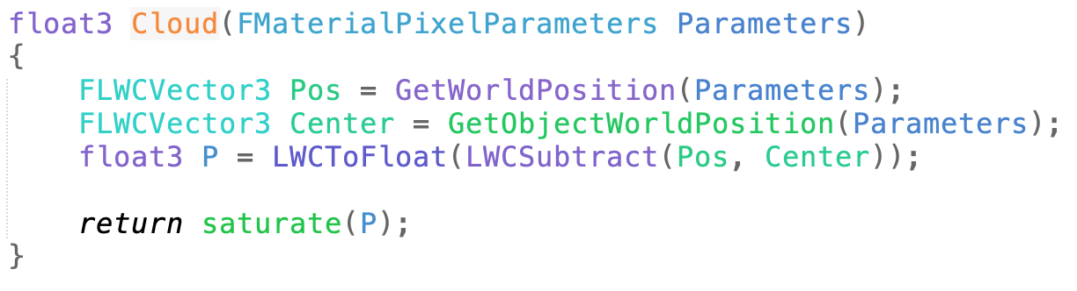
Move custom code to Cloud.ush
Custom node
Cloud.ush

Slide 18
Forcing a Shader Compile
UE5 caches the compiled shader results
It won’t notice if the shader file changes if the custom node code is the same
Add a comment with a number to force a compile each time you edit the ush.

Slide 19
Computing Cloud Density

Slide 20
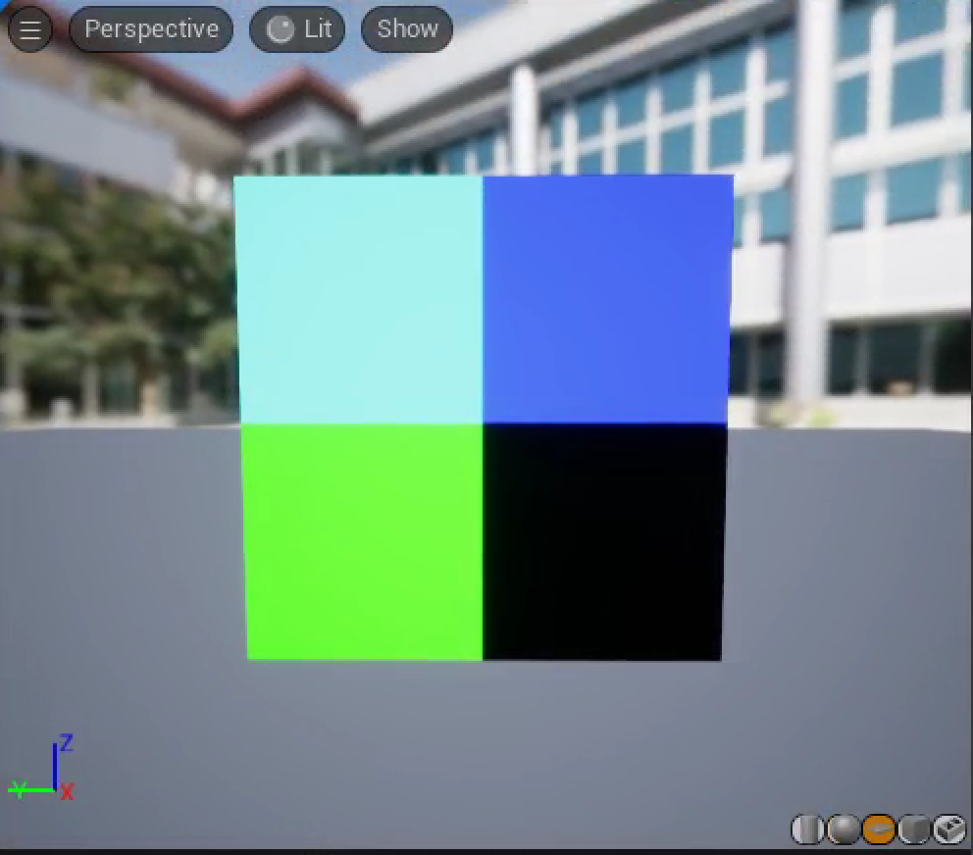
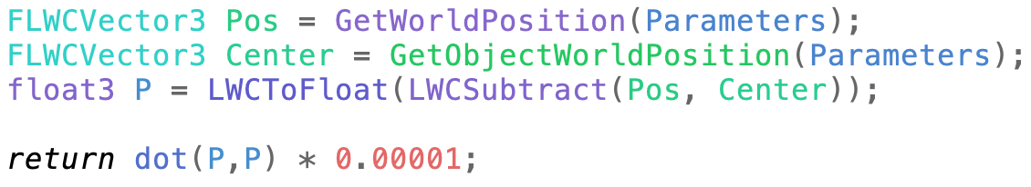
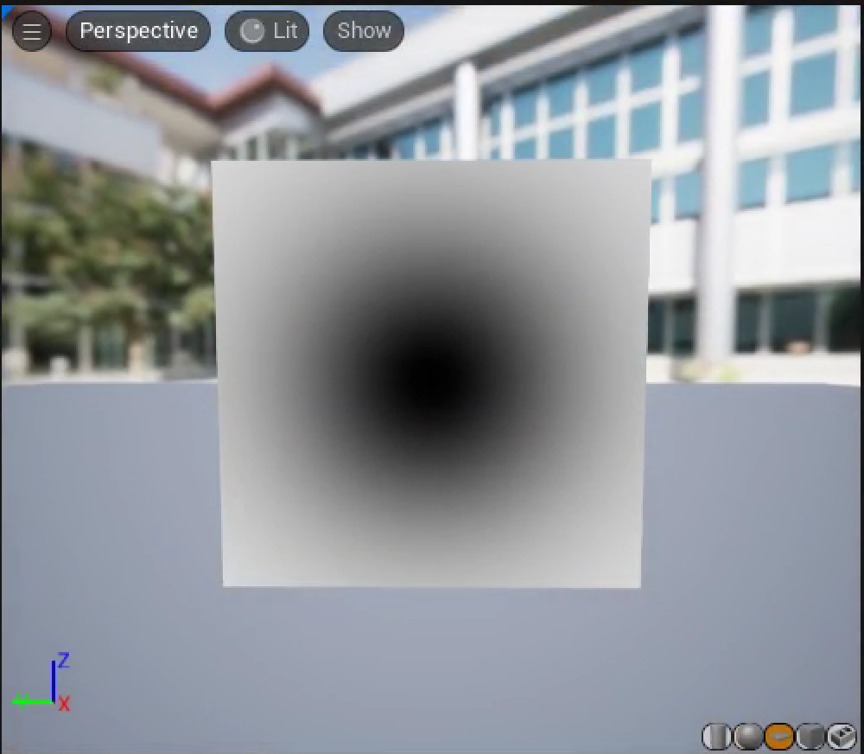
Radial Mask
Switch to a square as the preview object to see what’s happening inside the sphere
It’s invisible from the back, so you might need to spin the view around.
The dot product, P•P, gives the squared distance of each pixel from the object center.
Since the size of P is large, we can try a few scale factors until we find one that’ll show how the dot product changes over the surface.

Slide 21
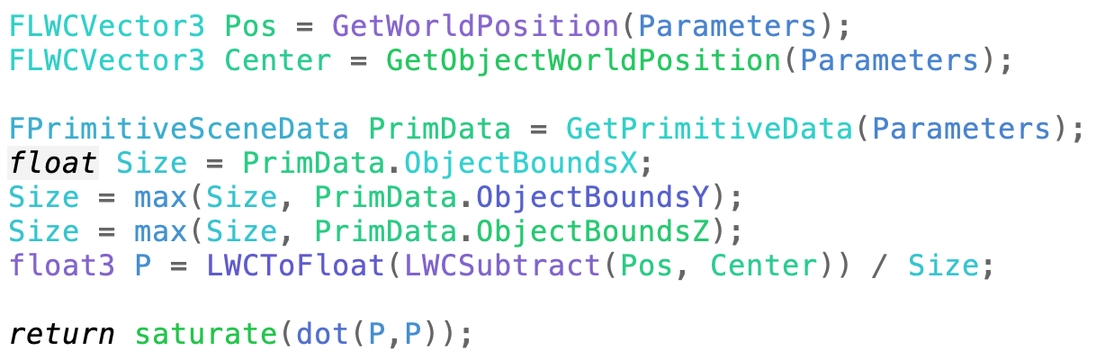
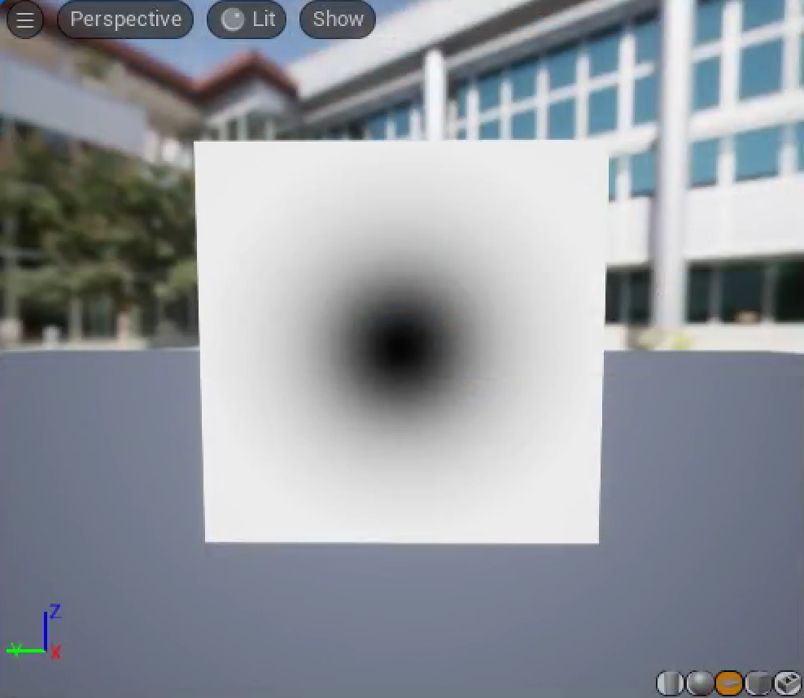

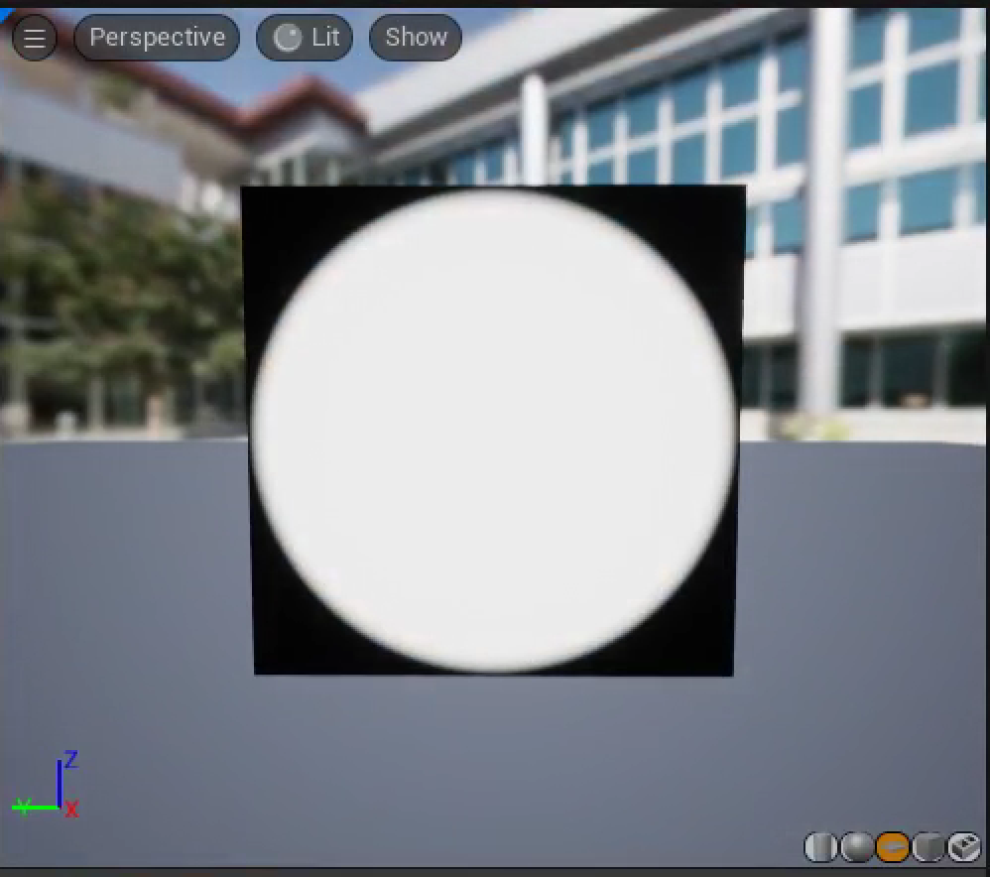
Scale by Object Radius
Instead of choosing an ad hoc scale, we can check how ObjectBounds gets its result.
We can then turn that into a smooth-edged mask with the smoothstep shader function

Slide 22
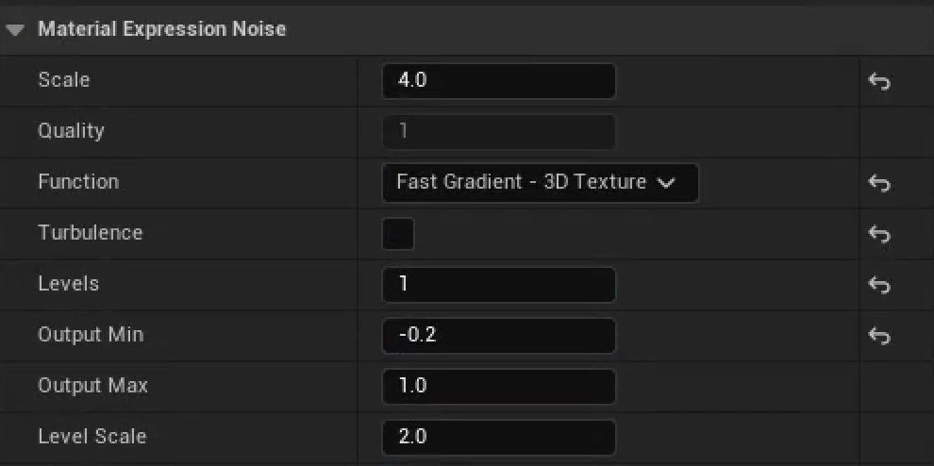
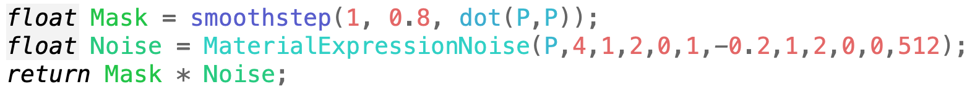
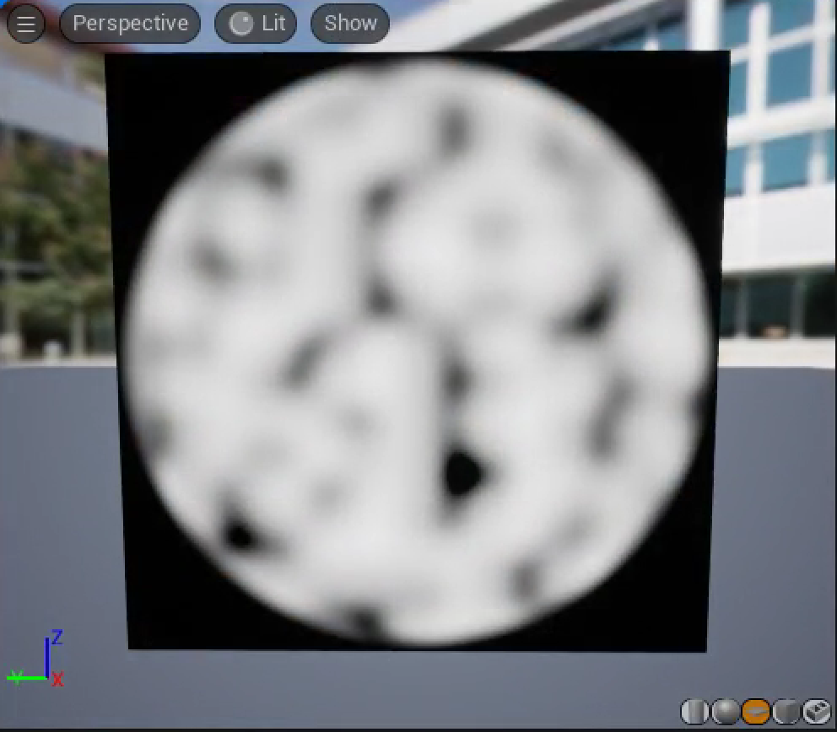
Cloud Base
The basic structure of our clouds will be built using a Noise function.
Noise has a bunch of obscure parameters, so it’s reasonable to start by tweaking some of them in the Material node, then looking at the corresponding code to include in the shader.

Slide 23

Simplifying this Code
MaterialExpressionNoise has a bunch of obscure parameters that map directly to the Material node user interface.
If we dig just a little into the shader code for that function, we can convert to a much simpler equivalent directly using the internal function.
  There are options for Turbulence that we’re not using.
  There’s a loop, but we only do it once.
  Inside that loop is a call to the Noise3D_Multiplexer function, which just picks between noise choices, and we’re only using one.
  There are two different a*noise+b adjustments made to the output that can be folded together.

Slide 24
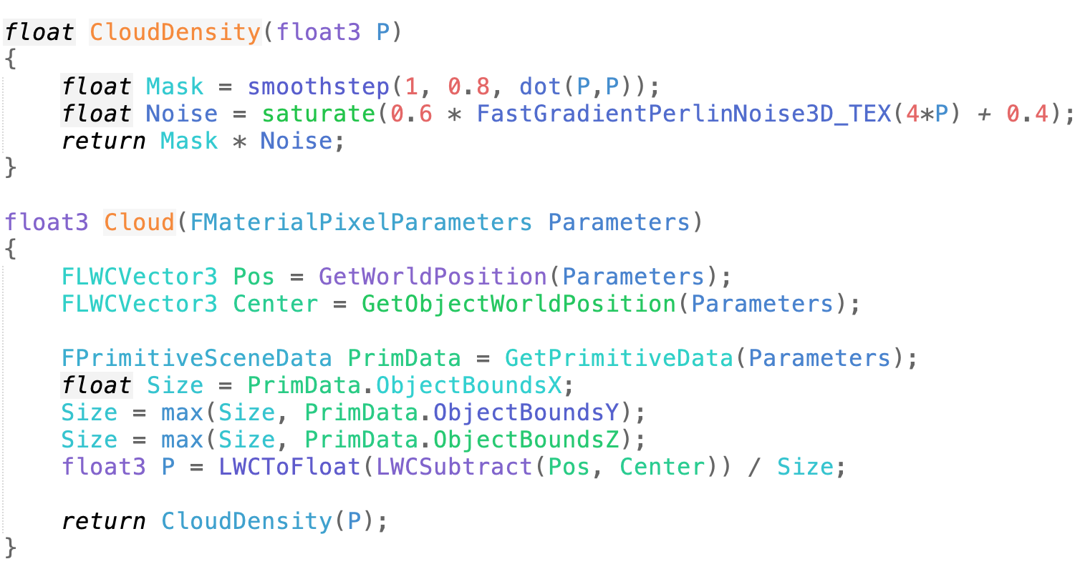
Moving to a Function
We’ll want to compute this cloud density many times in the shader, so it’d be convenient to have it in its own function.

Slide 25
Ray Marching

Slide 26
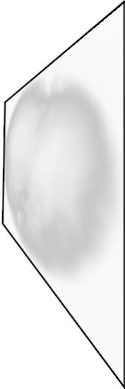
Ray Marching
To create a volumetric shader, we will use a technique called ray marching.
The shader runs on a surface. Ray marching takes steps through a volume imagined to be behind that surface.

Slide 27
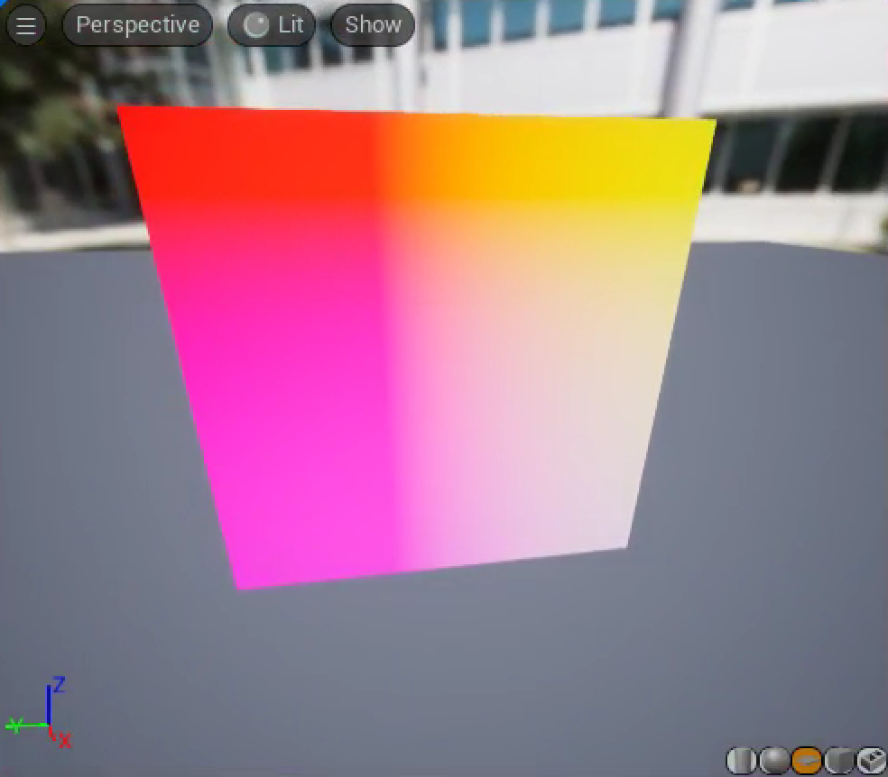
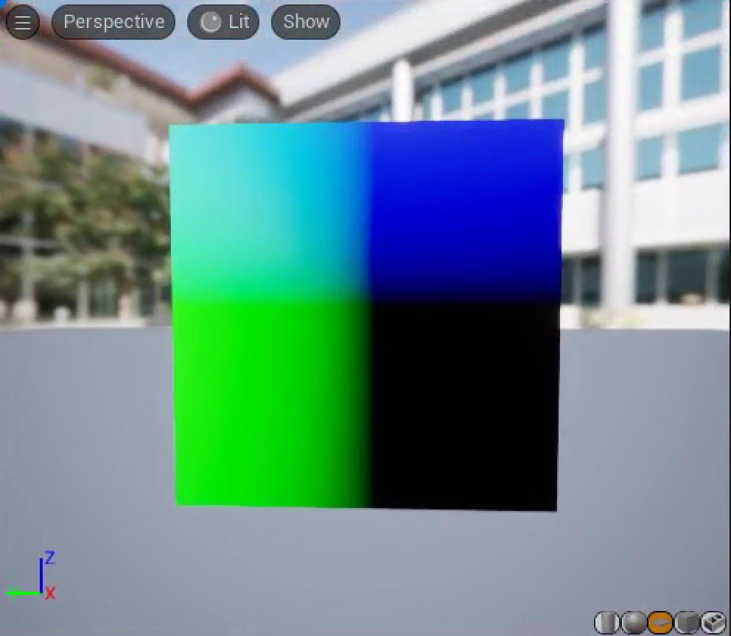
Direction to March
The first thing we need is the direction from the camera to the pixel. This is the direction to march.
Place a Custom node into your Material Editor graph and switch the preview object back to a sphere.
From looking at the code generated by the CameraVector node, we know there’s a Parameters.CameraVector.
Comparing the color to the axes, it is mostly red, implying that the CameraVector appears to be pointing toward the camera.
–Parameters.CameraVector looks like what we need.

Slide 28
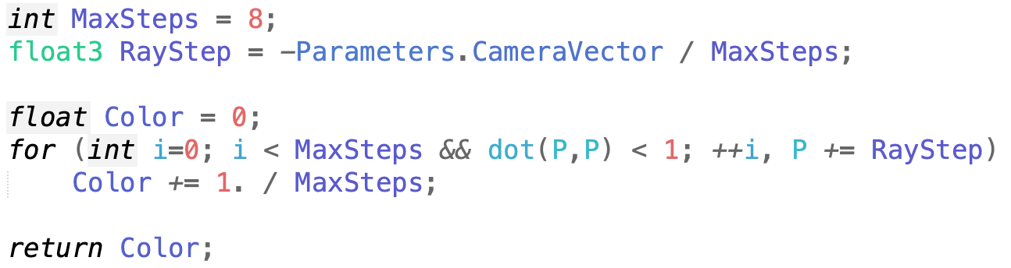
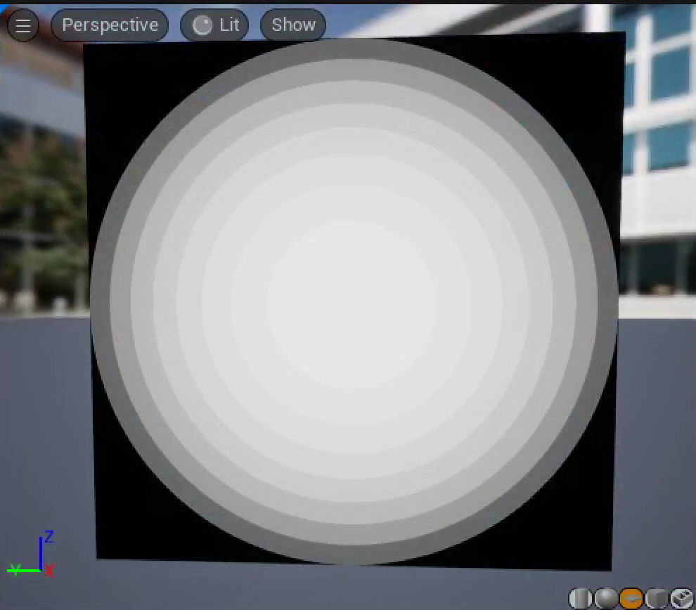
Basic March
Starting on the surface of the square, we’ll march into the hemisphere behind it until the marching point is outside the sphere’s radius.
The color just shows how many steps it took before the marching point was outside the sphere.

Slide 29
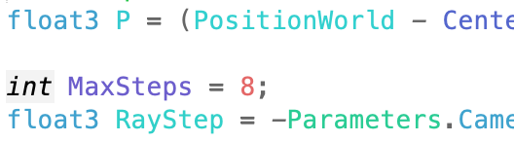
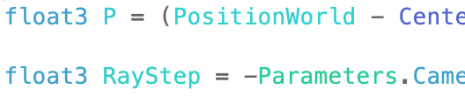
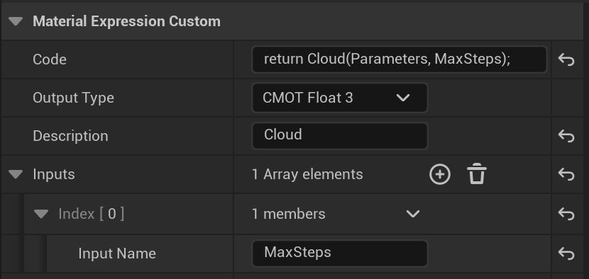
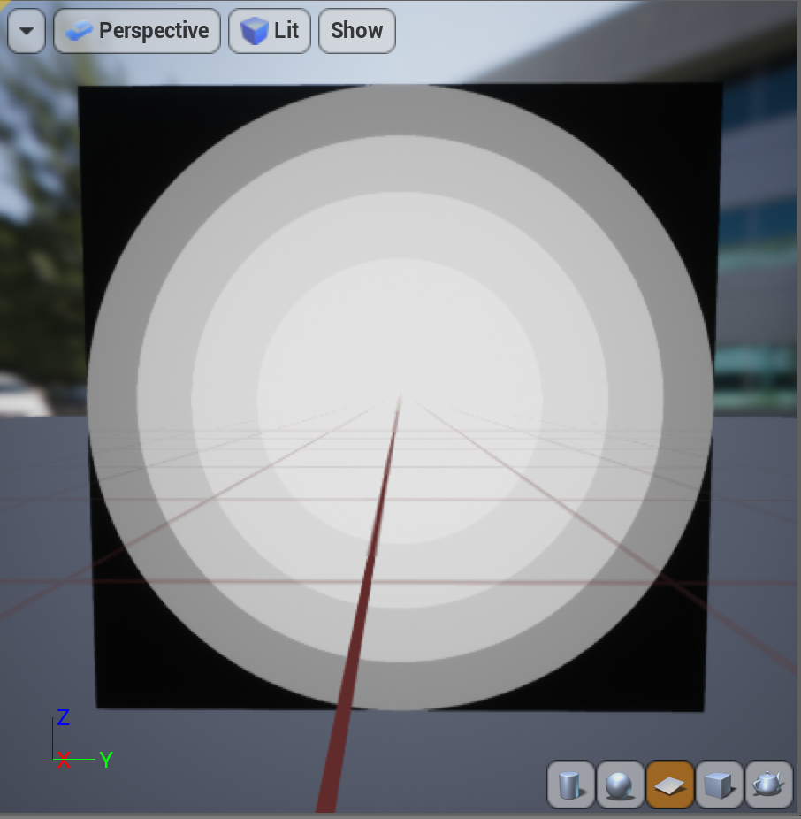
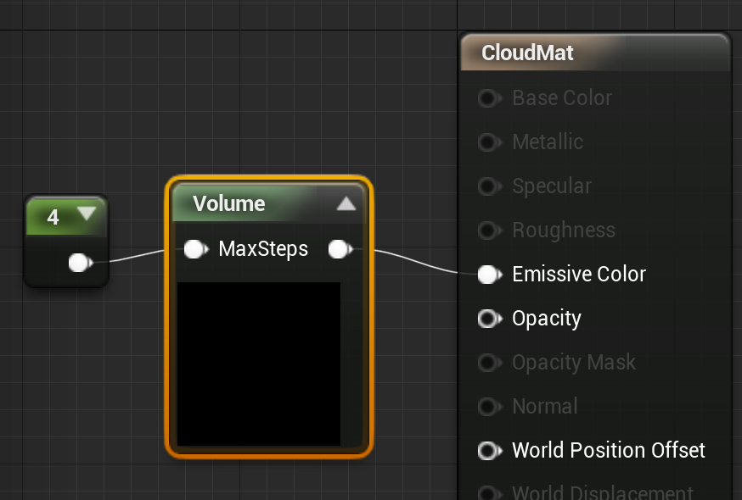
Shader Parameter
The value defining how many steps to take appears several places in the shader and may need to be adjusted for performance
Remove it from the shader and add it as a parameter to the Custom node to make it easier to change.

Slide 30
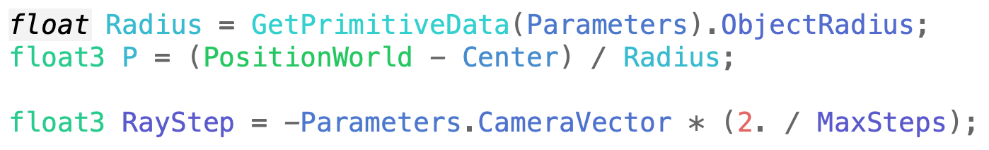
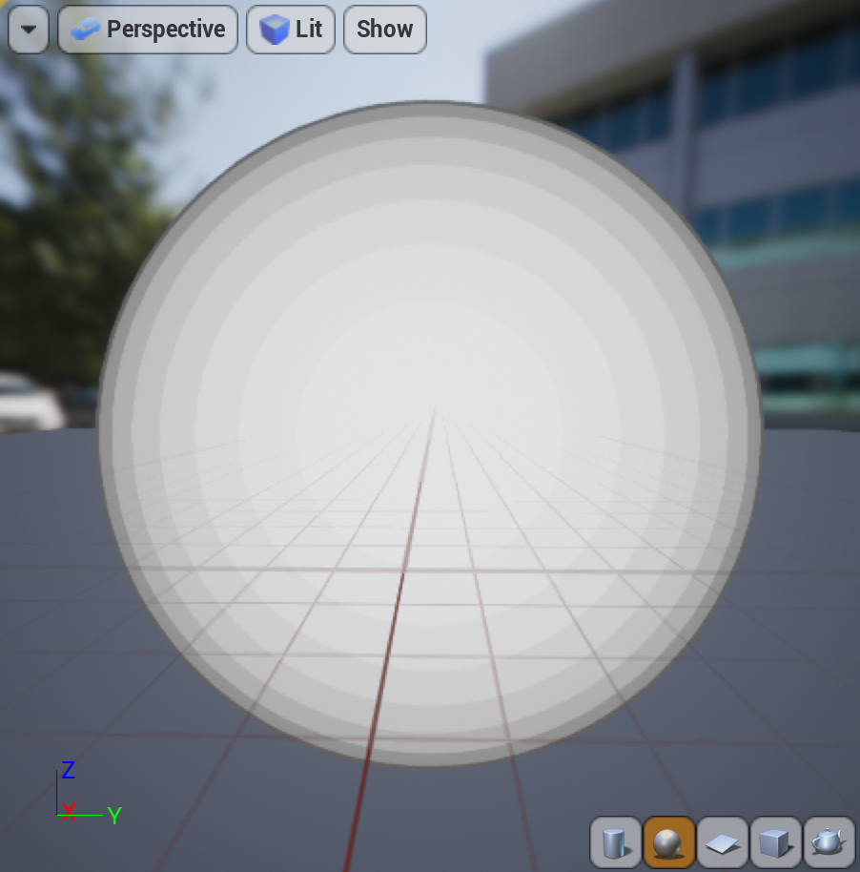
Back to a Sphere
The step size is scaled to go up to one unit distance in the maximum number of steps allowed.
That’s enough to get from the middle of the sphere to the back, but not to get from the front to the back.
A unit sphere has a diameter of 2, so the step sizes need to be twice as big to make sure we can make it all the way through.

Slide 31
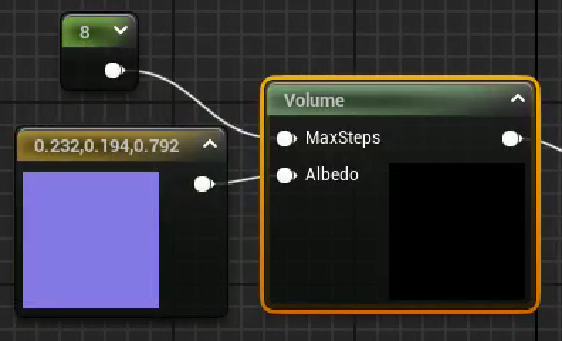



Marching Cloud Density
To account for the cloud density, we need to accumulate the color and opacity with each step. We’ll augment the Color variable with a fourth alpha component to track that opacity, and use that to tell how much of the local color we can see at each step through all of the cloud we’ve marched so far.
We also may want to define a color for our cloud, as an additional parameter.
We can use the CloudDensity function added to Cloud.ush to compute the actual density.

Slide 32


Cloud Opacity
Of course, the cloud doesn’t look very cloudlike with the dark border. We’re computing the opacity as we go, so it’s in Color.a at the end of the march, but we’re not using it.
We’ll need to change the Custom node to return all four components of the final color.
Then we’ll need to extract the alpha component using a Component Mask node.

Slide 33
Volumetric Lighting

Slide 34

Light Direction
We won’t add lighting from all directions, just from the direction of the sun.
The AtmosphereSunLightVector node generates MaterialExpressionAtmosphericLightVector(Parameters).

Slide 35


Shadow March
We won’t add lighting from all directions, just from the primary atmospheric light direction.
Now, at each point along the ray march, we have to march toward the light, accumulating opacity to see how much makes it through.

Slide 36


Removing Step Artifacts
There are bad stepping artifacts visible, especially in the shadow. One way to avoid these is to randomize the starting point for each march.
Temporal anti-aliasing blends across frames and can smooth the randomness out, but needs a different offset at every pixel, changing every frame.
Look at VectorNoise / CellNoise for hints on how to generate three random numbers from a three-element vector (it calls MaterialExpressionVectorNoise, but that just calls Rand3DPCG16).
Look at ScreenPosition / PixelPosition for how to get the x/y pixel position (use GetPixelPosition).
There’s no Material node for the frame number, but looking at r.DumpShaderDebugInfo results, we see that there is a View.FrameNumber.

Slide 37
Extensions

Slide 38
Step-Independent Extinction
We’ve been using Opacity,
Can also represent this with Extinction,
These are related by , for distance .
  For one unit of volume, , or
  doesn’t scale linearly with step size, but does.
  Scaling by a step size of .
  Often approximate as
If you change MaxSteps, the overall volume opacity will change as well.
That’s because we assume the same amount of light attenuation no matter how big the step is, but a thicker slab of translucent Material should block more light.
The UE5 built-in Volumetric Fog reformulates the ray march in terms of extinction instead of opacity in part to make the run-time step size adjustment cheaper.

Slide 39

Baked Densities
Densities are expensive to compute every step O(MaxSteps²), including the shadow steps. If you precompute them into a Texture, it’s just a lookup or two per step.
The engine supports 3D Textures, but you’d need C++ code to generate them.
You can also decompose a 3D Texture into a grid of 2D slices packed into a 2D Texture. There’s a function, PseudoVolumeTexture in Common.ush, designed to access a Texture built this way.

Slide 40

Embedded Objects
Opaque objects are drawn before any transparent objects. You can look in the depth buffer to tell when the marched ray would hit an embedded object and stop the march early.

Slide 41

Deep Shadow Map
A separate pass before the cloud render can start at the light to march through the volume. There are various deep shadow algorithms that use the four color channels of a Texture to store data that you can use to approximate the shadow opacity. It’s not exact, but it’s way faster.
An even faster approach just assumes the fine whorls of the volume don’t matter that much and uses the distance until the shadow ray exits the sphere as an estimate of how much shadow to use.

