Slide 1
Physically-Based Rendering
UMBC Graphics for Games

Slide 2
A Little Multivariable Calculus
Because I didn’t make it a prereq

Slide 3
Partial Derivatives
Derivatives with respect to one variable, treat the rest as constant

Slide 4
Surface Integrals
Integrate one variable at a time
Concrete example

Slide 5
Change of Variables
Disk in polar coordinates:
Area scales with radius:
Integral with area scaling:

Slide 6
Illumination

Slide 7
Illumination
Effect of light on objects
Mostly just look at intensity
  Apply to each color channel independently
Good for most objects
  Not fluorescent
    Light enters at one wavelength, leaves as another
    Brighter green, yellow than we expect
  Not phosphorescent
    Light enters at one point in time, leaves later

Slide 8
Local vs. Global
Local
  Photons leave light, bounce off of one surface, make it to eye
Global
  Photons bouncing multiple times
  Ambient Illumination
    Approximate global illumination as a constant
    Typically ~1% of direct illumination
  Ambient Occlusion
    Approximate as a constant scaled by local visibility
    Harder for light to bounce into corners

Slide 9
BRDF
Bidirectional Reflectance Distribution Function
How much of L_{i} makes it to L_{o}?

Slide 10
Physically Plausible BRDF
Positive
Reciprocity
  Same light from L_{i} to L_{o} as from L_{o} to L_{i}
  Can trace view to light or light to view
Conservation of Energy
  Don’t put out more than
  comes in

Slide 11
Important directions
L = position of light
V = position of viewer
P = position on surface
= unit-length surface normal
= unit vector toward light
= unit vector toward view
= half-way between and

Slide 12
Rendering Equation
Integral of all incoming light
Playing a little loose with the notation
  Really differential solid angles, not unit vectors: not

Slide 13
Rendering Equation
outgoing light in direction
hemisphere above P
incoming light from direction
BRDF from to
projection of differential solid angle onto surface
  Like the for integrating in polar coordinates

Slide 14
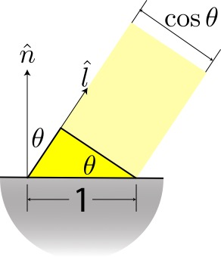
Dot product part
Less light per unit area of surface at steeper angles
Comes from change of variables from integration over a surface patch to integration over the hemisphere (like dx dy ➝ r dr d𝜃)

Slide 15
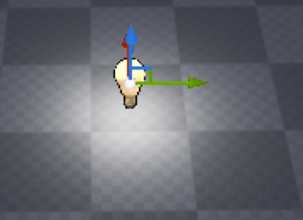
Point Lights
Light emitted an infinitesimally small point
Intensity falls off with square of distance to the source
For light at position , shining on a surface at point
  Light intensity

Slide 16
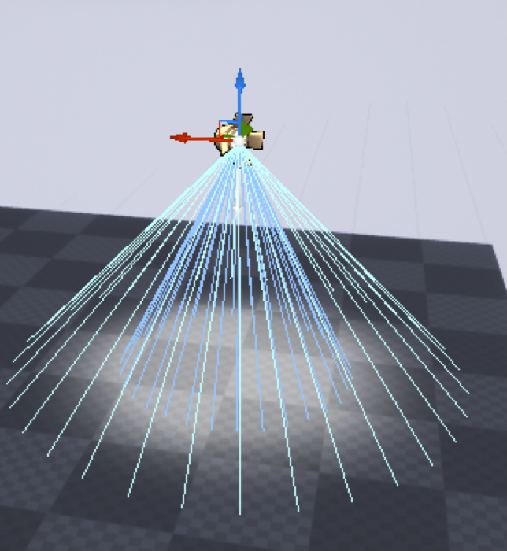
Spot Lights
Lights with a direction and cone
  Just point lights with extra code to mask intensity
  For direction , mask based on
    AKA the cosine of the angle to the light axis

Slide 17
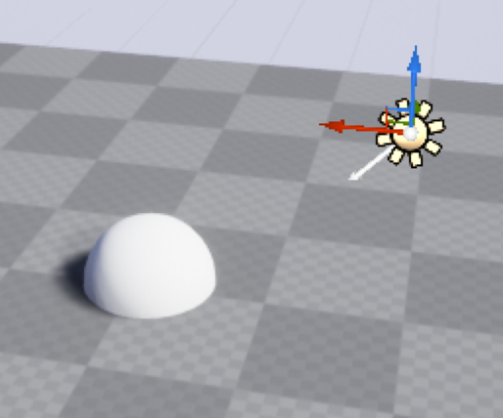
Directional Lights
Really bright point light, really far away
  Basically, an optimization for the sun
Far enough away is basically constant
Far enough away that the squared distance is basically constant
  No falloff with distance

Slide 18
Punctual lights
Point, Spot, and Directional
From the point of view of any single point on the surface, these all come from a single direction.
Integral turns into a sum

Slide 19
More on BRDFs

Slide 20
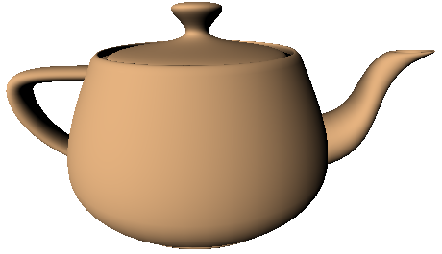

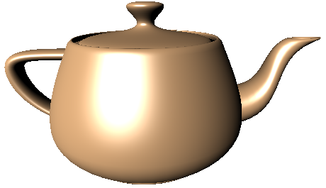
Decompose BRDF
BRDF = sum of convenient parts
Typical breakdown
  Diffuse (view independent)
  Specular (view dependent glossy reflection)
  Others less common, often ignored (e.g. retro reflection)
+
=

Slide 21
Decompose BRDF
BRDF = sum of convenient parts

Slide 22
Diffuse
Also called Lambertian or Matte

Slide 23
About Pi [Legarde 2012]
Common to have a ~3x too bright or ~3x too dark bug
Often easier specify point lights with a scaled intensity
  Specify intensity I at one unit distance with normal incidence and unit albedo
  So
Simplifies lighting equation:
If you use k_{d} with a light that doesn’t have the , it’s 3.14x too bright
If you use I as the intensity where you need L_{i}, it’s 3.14x too dark

Slide 24
Microfacet Specular
Model to construct physically plausible BRDFs
Imagine random mirrored microfacets, too small to see
Perfect reflectors, so only facets aligned with contribute
Normal Distribution Function (D)
  Probability density (on hemisphere of directions) that aligns with
Geometry Term (G)
  Proportion of facets blocked from the light (shadowing) or view (masking)
Fresnel Term (F)
  Reflection is stronger at glancing angles

Slide 25
Microfacet BRDF
Original form by Cook & Torrance [1981]
Often swap out D & G
GGX (aka Trowbridge-Reitz) NDF [Walter et al. 2007]
Smith geometry term for GGX [Walter et al. 2007, Karis 2013]

Slide 26
Fresnel
n = index of refraction
  Air: 1; Water: 1.33; Ice; 1.31; Glass: 1.5; Diamond: 2.4
  What matters is ratio between materials
F₀ = reflectance at normal incidence
  Air to Water: 0.02; Ice: 0.018; Glass: 0.04; Diamond: 0.17
  Some games just use one value (0.02-0.04) for everything
Schlick approximation [Schlick 1994]
  Wrong for metals (misses some color change), but not too bad [Hoffman 2020]

Slide 27
Advanced Microfacets
Distribution of visible facets [Heitz & D’Eon 2014]
  Combine D and G terms into a single joint probability density
Multi-bounce [Heitz et al. 2016, Kulla & Conty 2017]
  Especially for rough surfaces, lose a ton of energy due to single bounce
  Model multiple bounces between microfacets (still part of BRDF)
  Ground truth: simulate multiple bounces
  Approximation: add a term to compensate for missing energy

Slide 28
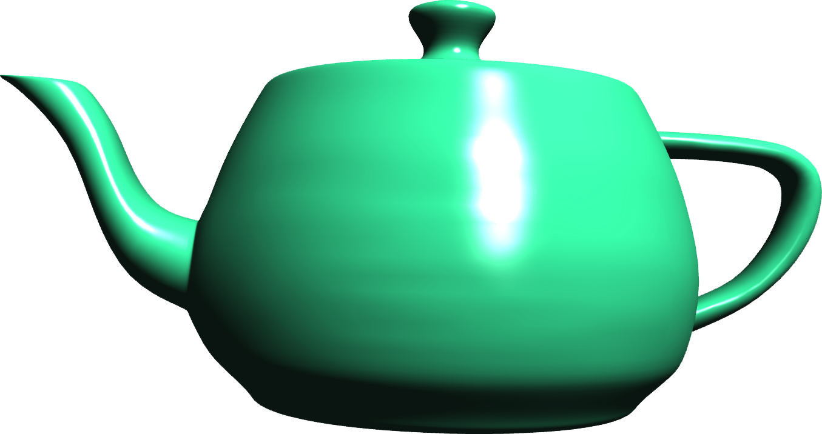
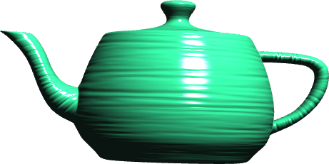


Normal Map to BRDF
When far away, variation in normal map blends to average normal
  Should push that variation into NDF
  Otherwise, muddy road (shiny with bumps) turns to mirror in the distance
  Plus, shiny normal maps alias like crazy
LEAN mapping
  Model NDF as Gaussian, bumps as off-center Gaussians
  Best fit Gaussian to a mixture of Gaussians = blend moments
  Ignores shadowing, masking, Fresnel
LEADR mapping (more accurate, more
expensive)
  Model PDF of visible normals as off-center
  Gaussians (ignores Fresnel)
Toksvig (less accurate, less expensive)
  Weighted average of unit-length normals will be
  less than unit length
  How much less depends on spread, can use to
  estimate NDF variance

Slide 29
Diffuse as Subsurface
Fresnel F = proportion that reflects
  1 – F is proportion that enters surface
Diffuse is just subsurface scattered < 1 pixel [Jensen et al. 2001]
  Instead of BRDF = diffuse + specular
  Have

Slide 30
Environment Light

Slide 31
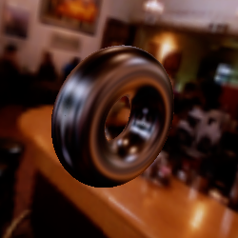
Beyond Points
Especially reflection is affected by full environment
Pre-convolved Reflection (aka Environment) map [Greene 1986]
  Approximate as
  Blur to approximate integral
Precomputed Radiance Transfer (PRT)
[Sloan et al. 2005]
  Glossy reflection as sum of Spherical Harmonics
  9-17 coefficients for fixed basis functions

Slide 32
Area Lights

Slide 33
Beyond Points
All real light comes from an area
  Even the sun is about ½º
Affects shadows
Softens diffuse
Spreads specular

Slide 34
Area diffuse
Multiple samples
  Approximate area light as multiple point lights
Overall approximation
  Above horizon, use center of light
  Below horizon, shift light direction & scale intensity
Exact
  Polygonal shapes
  Closed form for integral of cosine (& powers of cosine) [Arvo 1995]

Slide 35
Area Specular
Multiple samples
  Approximate area light as multiple point lights
Representative Point [Karis 2013]
  If mirror reflection direction lands in light source, use that point
  If it lands outside the light source, use the closest point in the light
Arvo integral approximations
  Zonal Harmonics [Belcour et al. 2018]
    Single-axis subset of Spherical Harmonics
  Linearly Transformed Cosines [Heitz et al. 2016]
    Squish and stretch cosine (and projection of light shape) to match roughness

