Slide 1
Hardware
UMBC Graphics for Games

Slide 2
CPU Performance

Slide 3
CPU Architecture
Start 1-4 instructions per cycle
Pipelined, takes 8-16 cycles to complete
Memory is slow
  1 cycle for registers ≈ 2⁰ = 1
  2-4 cycles for L1 cache ≈ 2² = 4
  10-20 cycles for L2 cache ≈ 2⁴ = 16
  50-70 cycles for L3 cache ≈ 2⁶ = 64
  200-300 cycles for memory ≈ 2⁸ = 256

Slide 4
CPU Goals
Make one thread go very fast
  Avoid pipeline stalls
Branch prediction
  Don’t wait to know branch target (misprediction ~64 instructions)
Out-of-order execution
  Don’t wait for one instruction to finish before starting others
Memory prefetch
  Recognize common access patterns, get data to fast levels of cache early
Big caches
  Though bigger caches add latency

Slide 5
CPU Performance Tips
Avoid unpredictable branches
  Specialize code
  Avoid virtual functions when possible
  Sort similar cases together
Avoid caching data you don’t use
  Takes time to fetch, takes cache space that could be used for useful data
  Structure of Arrays organization
    struct{P, V}[N] vs. struct{P[N], V[N]}
Avoid unpredictable access
  O(N) linear search faster than O(log N) binary up to 50-100 elements
    Linear access = can prefetch; branch predictable (keep looping) until final iteration
  Asymptotically worse, but for small N, constants matter
  Don’t underestimate how big small N can be

Slide 6
Models of Behavior
All of CS is built on simplified models of how things work
  Don’t need to know differential equations for transistors to program
  Models allow you to reason about performance
Compare to Physics
  An atom is … The smallest unit of matter? A nucleus with electrons orbiting around it? A nucleus with electron probability clouds? A complex collection of quarks?
Model misses something important?
  Code is not as fast as it could be
  Trying to make it faster might actually make it slower

Slide 7
Revised CPU Model
CPUs execute instructions sequentially
Arithmetic operations are a small fixed cost
Random memory accesses are expensive
Unpredictable branches are expensive

Slide 8
Entity Component Systems
Compact lists of each type of component
  Physics component, collision component, rendering component
  Fast cache- and branch-friendly iteration over components
Mapping from each entity to its components (& back)
  Reference / pointer in entity?
  Entity ID with hash map?

Slide 9
Data Oriented Design
General term for optimizing for cache and branch performance
Organize data into compact tables
  E.g. components, though often finer grained
  Functions process or transform tables
  Tables of active elements avoid branching
Data organization ends up looking very similar to database tables

Slide 10
Data Oriented Design Choices
Prefer arrays over linked lists
  Linked list traversal = likely cache miss at each link
Cross linked hash(key) ➞ index / dense array(index) ➞ (key,data)
  Allow fast processing of elements
  Also SOA form: KeyArray(index) ➞ key; DataArray(index) ➞ data
  If hash uses open addressing, may use index in hash table instead of key
Prefer functions operating on arrays to member functions
  Avoid branching in processing loop
  Avoid virtual functions

Slide 11
Packed-table Transforms
Generate
  Create list from external source; procedural generation
In-place
  Operate on elements; transform elements
A to B transform
  Generate one list from another; Filter list to active elements
Dispatch
  Generate sub-lists; Split for parallelization
Gather
  Combine multiple lists into one

Slide 12
GPU Performance

Slide 13
CPU vs GPU Goals
CPU
Make one thread go very fast
  Avoid pipeline stalls
Complex control
  Continue work past stalls
  Predict work before the stall
GPU
Make 1000’s of threads running the same program go very fast
  Hide stalls
Share hardware
  All running the same program
Swap threads to hide stalls
  Large, flexible register set
  Enough for active and stalled threads

Slide 14
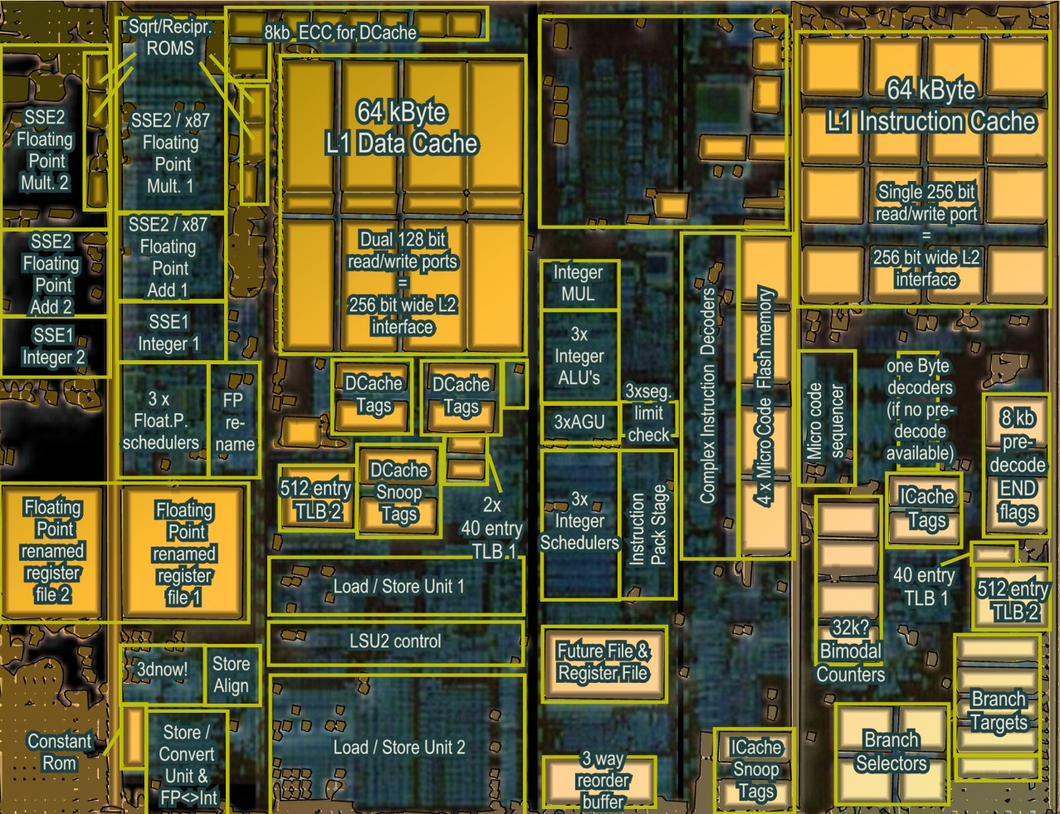
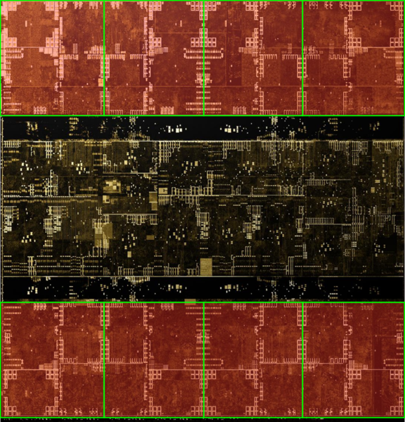
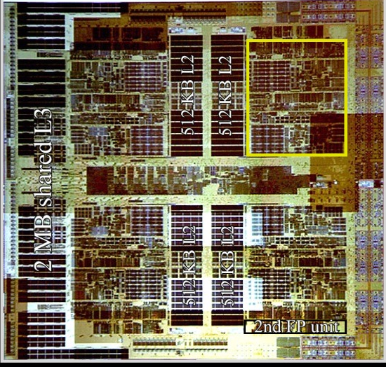
Architecture (MIMD vs SIMD)
Actual computational
Units
SIMD (GPU-Like)
MIMD (CPU-Like)
(AMD K10 chip-architect.org)
(NVIDIA Volta / wikichip.org)
Flexibility
Horsepower
Ease of Use

Slide 15
SIMD Branching
if( x ) // mask threads
{
// issue instructions
}
else // invert mask
{
// issue instructions
} // unmask
Threads agree
Threads disagree
or
THEN

Slide 16
SIMD Looping
Active
% Active = Utilization
Inactive
while(x) // update mask
{
// do stuff
}
Everyone runs as long as slowest
This example: 36% utilization
(64 blocks useful work / 176 blocks potential work)

Slide 17
GPU Programming Model
Vertex
Vertex Shader
  Runs on one
  vertex at a time
Rasterizer
  Collects sets of
  three vertices
Pixel
  Runs on one pixel
  at a time
Texture/
Buffer/
Cache
Rasterize
Displayed
Pixels
Pixel
Z-buffer/
Blend

Slide 18
GPU Processing Model
SIMD for efficiency
  Same processors
  for vertex & pixel
SIMD Batches
  Limits on # of vertices &
  pixels that can run together
  Improve Utilization
  Limit divergence
Basic scheduling
  If batch of pixels, run it
  Otherwise run some
  vertices to make more pixels
Texture/
Buffer/
Cache
Vertex
Displayed
Pixels
Pixel
Z-buffer/
Blend
Rasterize

Slide 19
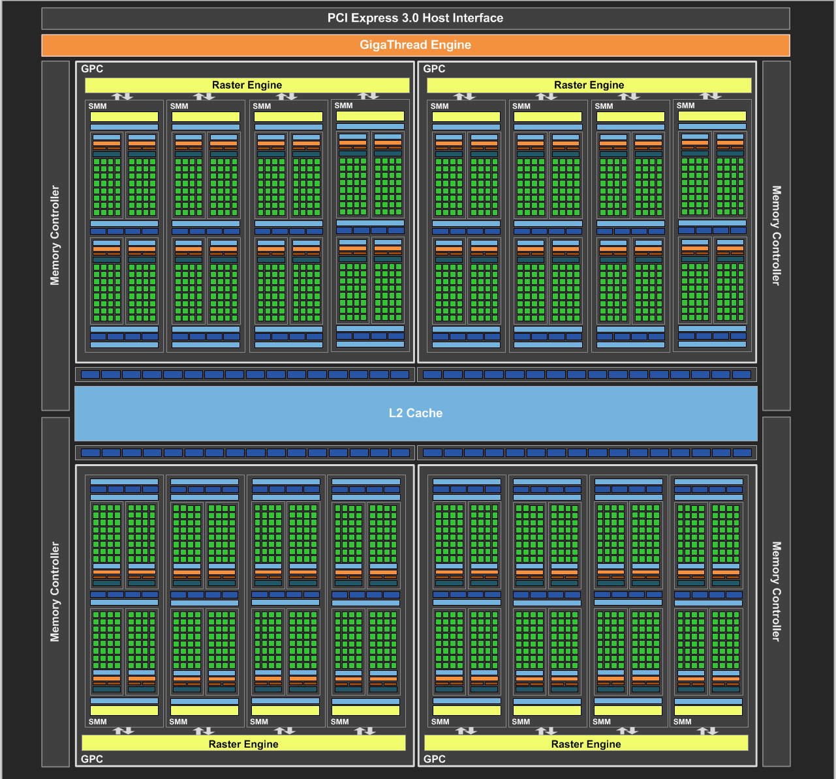
NVIDIA Maxwell
[NVIDIA GeForce GTX 980 Whitepaper, 2014]

Slide 20
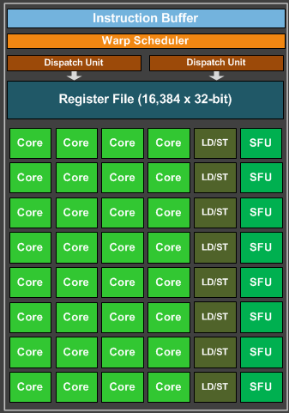
Maxwell SIMD Processing Block
32 Cores
8 Special Function Units (SFU)
  Double precision, trig, …
  Still issue 1/thread, but run ¼ rate
8 Load/Store
  Hide latency by interleaving threads
Wave (AMD) / Warp (NVIDIA)
  One set of lanes (AMD) / threads (NVIDIA)
  Want at least 4-8 interleaved
  % of max = Occupancy

Slide 21
GPU Registers
Scalar General Purpose Register (SGPR)
  Same value for all threads
  AMD term — Pixar’s RenderMan (& GLSL)
  called these uniform
Vector General Purpose Registers (VGPR)
  Different value in every thread
  AMD term — Pixar & GLSL called these varying
  # wavefronts usually limited by VGPR

Slide 22
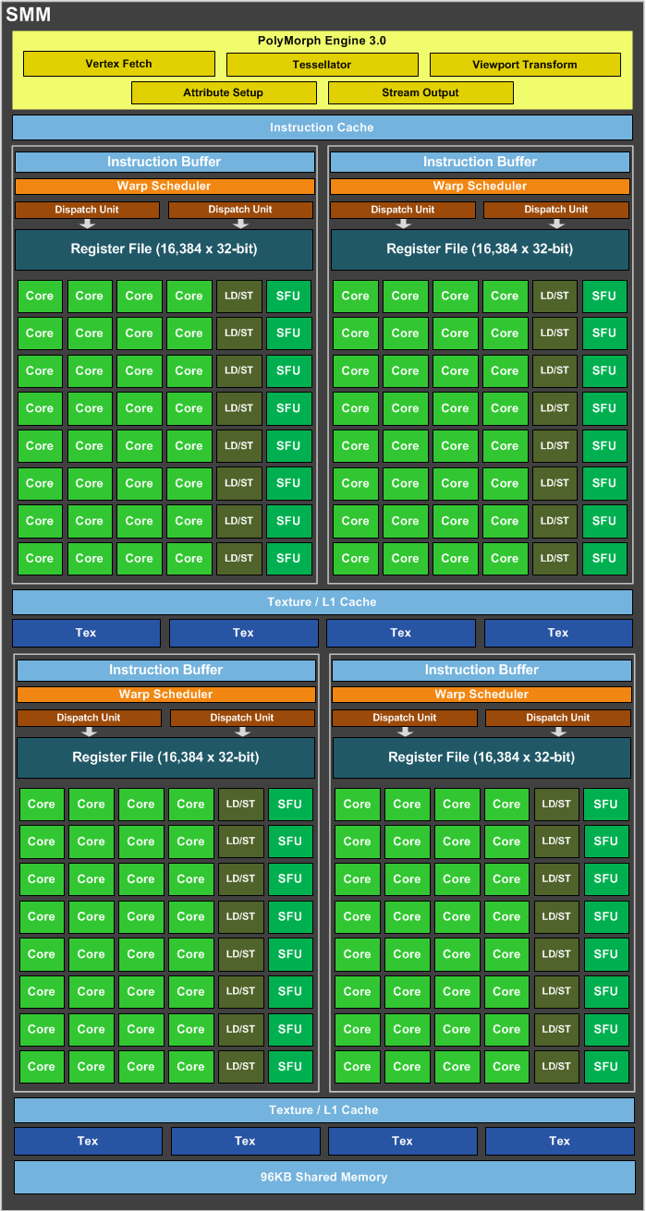
Maxwell Streaming
Multiprocessor (SMM)
4 SIMD blocks (128 total cores)
Share L1 Caches
Between-core shared memory
  Communication through this memory is fast
Share tessellation HW
  Hardware support for tessellation shaders

Slide 23
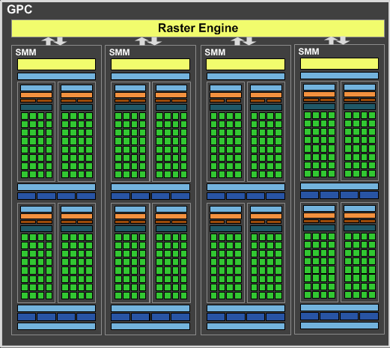
Maxwell Graphics Processing Cluster (GPC)
4 SMM (512 total cores)
Share rasterizer

Slide 24
Full NVIDIA Maxwell
4 GPC (2048 total cores)
Share L2
Share dispatch
  Decides which threads
  to launch and when

Slide 25
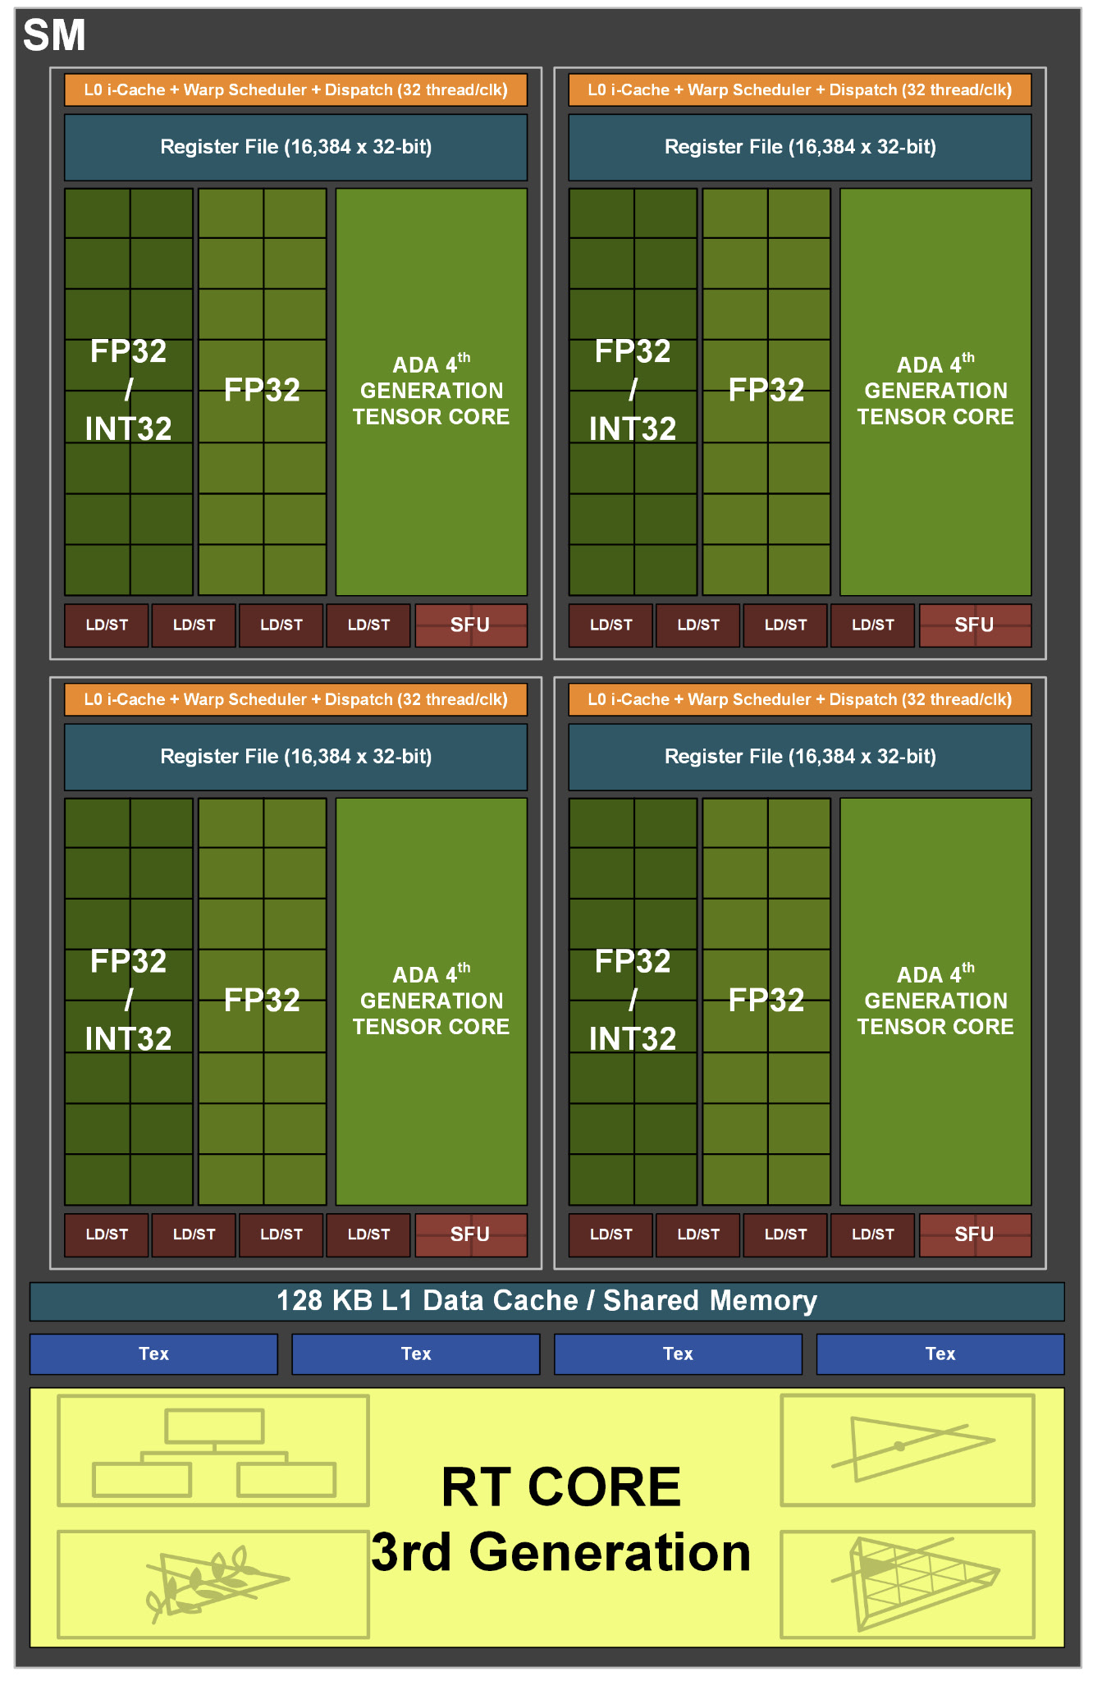
Things in newer GPUs
MMMMMOOOORRRRREEEE CORES
  NVIDIA Ada: up to 18,432 cores
“Tensor cores” = bunch of 4/8/16-bit
multiply-add/matrix multiply cores
  Targeting AI applications, but general purpose
Hardware support for new shader types
  Mesh shaders
  Ray tracing hardware at SM level
Adjust balance of float, int,
and memory units
[NVIDIA Ada GPU Architecture, 2022]

Slide 26
Graphics System Architecture
Your Code
Engine
Display
GPU
GPU
GPU(s)
API / Driver
Produce
Consume
Current Frame
(Buffering Commands)
Previous Frame(s)
(Submitted, Pending Execution)

Slide 27
Care and Feeding of a GPU

Slide 28
Parallel Submission
Any thread can build Command Lists & submit to GPU when ready
A Command List includes all necessary state, can execute in any order
  Command list execution will overlap on GPU
Tell GPU about resource dependencies (Barriers / Transitions)
  Enforces partial ordering of command list execution

Slide 29
Resource Transitions
What kind of memory operations does this buffer need to support?
  (CPU/GPU) (read/write) (once/many times)
  CPU write once, GPU read once; GPU write once, GPU read many times; …
Source/Target stage for the transition
  When is it ready? When will it be used?
What use should it be optimized for?
  CPU staging, Texture, Render Target, Depth Buffer, Vertex Buffer, Index Buffer,
  Graphics read/write unordered access view (UAV), Compute buffer, …
Explicitly transition between these
  E.g. between render target write in command list A and texture read in command list B

Slide 30
Setting up a Command List
What do I write?
  Render Targets, UAVs
  Transition/barrier to make sure anyone else reading or writing them is done
What do I read?
  Transition if just written or in a different format
What shader(s) am I using?
What shader parameter blocks?
  Given by Descriptors & Root Signature

Slide 31
Setting up a Graphics Command List
Begin Pass / End Pass
  Primarily necessary for batching on mobile
Rendering Graphics Pipeline State Object (PSO)
  Primitive Type: triangle list, fan, strip, quad, points, …
  Rasterizer State: Solid/wire frame, two sided / CW side / CCW side, MSAA
  Depth/Stencil State: Comparison (<, ≤,=,≠, ≥, >), update?
  Blend State:
    Transparent layer with opacity 𝛼: 𝛼 * new + (1 - 𝛼) * old
    Generalize to (a * new ^{<op>} b * old) for limited selection of a, b, and ^{<op>}

Slide 32
GPU Performance Tips

Slide 33
GPU Performance Tips: Communication
Reading results derails the CPU → GPU train…..
  Buffer to read answer 2-3 frames later
  Significant data will still be slow (e.g. read entire frame buffer)
CPU-GPU communication should be one way
  If you must read, do it a few frames later…
  Timing, occlusion queries

Slide 34
GPU Performance Tips: API & Driver
Merge shader/texture/constant sets
  Traverse engine data structures to generate render list; sort render list; traverse list to issue draw command lists
Minimize Draw calls
  One instanced draw is much more efficient than many static draws
Minimize CPU → GPU traffic
  Use static vertex / index buffers if you can
    Copy from CPU to GPU once, then leave there
  Use dynamic buffers if you must
    With discarding locks: region being updated / region in queue / region being rendered

Slide 35
GPU Performance Tips: Dependencies
Be aware of dependencies between command lists
  Can cause poor utilization
Use a tool like PIX to identify
Example: transparent objects
  Render & blend directly into deferred shading result buffer?
    Can’t start until prior pass is done
  Render into separate transparent buffer, then composite?
    Extra mem, but overlap drawing
Opportunities to overlap & improve utilization can allow “free” work.

Slide 36
GPU Performance Tips: Shaders
No unnecessary work!
  Precompute constant expressions
  Divide by constant → Multiply by reciprocal
    x*(1./3.) vs. x/3.
    Not always the same in float math, compiler is not allowed to make that optimization
Minimize fetches
  Prefer compute (generally)
  If ALU/TEX < 4+, ALU is under-utilized
    4 = LD/ST to core ratio on Maxwell, worse on newer GPUs
    Worse if incoherent accesses, not in cache
  If combining static textures, bake it all down…

Slide 37
GPU Performance Tips: Shader Occupancy
Know what’s limiting you
  Memory bandwidth limited, compute limited,
  local/shared memory capacity limited, VGPR limited, …
Limit VGPR usage by specializing shaders
  In UE, #ifdefs in shaders, compiles versions with different #define choices
  But… exponential growth in number of shader variants to compile
Limit VGPR usage with computation that’s constant across the warp
  Can re-merge with cross-wave primitives

Slide 38
GPU Performance Tips: Shaders
Careful with flow control
  Avoid divergence
  Flatten small branches (map to conditional move / predicated instructions)
  Prefer simple control structure
  Specialize shader (though can lead to 1000’s of shaders)
Double-check the compiler
  Shader compilers are getting better…
Look over artists’ shoulders
  Material editors give them lots of rope….

Slide 39
GPU Performance Tips: Vertices
Cull invisible geometry
  Coarse-grained (few thousand triangles) is enough
  “Heavy” Geometry load is ~20MTris and rising
    Epic released Paragon assets when game was cancelled: characters ~75k triangles
Minimize vertex data
  E.g. (position, normal, texture coordinate); (position, normal); (position); …
  Or index into separate UAV buffers for each vertex component used
Optimize index buffer
  Vertices executed in a full wave with duplicates removed & only run once.
    0,1,2, 1,2,3, 2,3,4 ➞ 0,1,2,3,4

Slide 40
GPU Performance Tips: Pixels
Small triangles hurt performance
  GPU always renders 2x2 pixel blocks (for texture filtering)
  Renders extra “fake” pixels to fill block → Waste at triangle edges
  UE5 Nanite does compute shader rendering of small primitives to avoid this
Do work per vertex
  There are usually less of those (see small triangles)

Slide 41
GPU Performance Tips: Pixels
HW is very good at Z culling
  Early Z, Hierarchical Z
If possible, submit geometry front to back
“Z Priming” is commonplace (UE5 does this)
  Render with simple shader to z-buffer
  Then render with real shader
  Helps a ton for complex forward shaders, but useful even for G-buffer

Slide 42
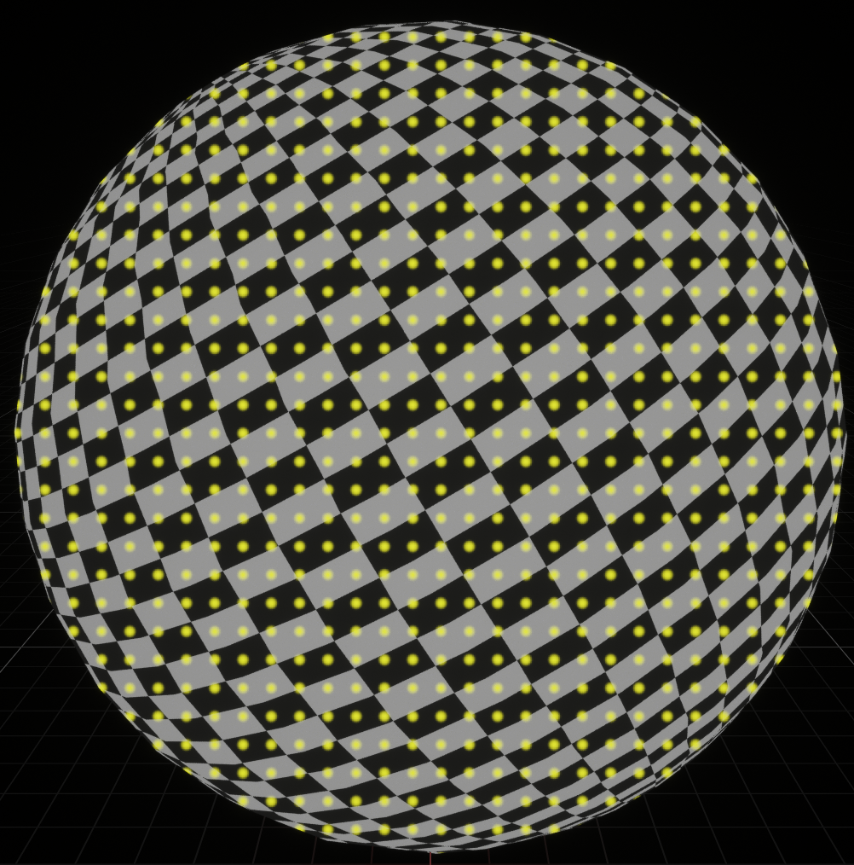
GPU Performance Tips: Textures
Respect the texture cache
  Adjacent pixels should touch same or adjacent texels
  Use mipmap if you can, adjacent in high mip
  level is cache miss in lowest level
  Use the smallest possible texture format
    Per texel sizes:
    DXT5 4b / RGBA8 4B / RGBA16F 8B / RGBA32F 16B
Avoid incoherent texture reads
  Commonly from texture used as data table

Slide 43
GPU Performance Tips: Frame Buffer
Turn off what you don’t need
  Alpha blending
  Color/Z writes
Minimize redundant passes
  Multiple lights/textures in one pass
  As long as it doesn’t kill your occupancy
Use the smallest possible pixel format
  8-bit components for 0-1, 1/255 ≈ 0.004 between values
  16-bit float when range (±65,504) & precision is good enough
Consider clip/discard in transparent regions
  Throws out pixels instead of blending them, does not require sorting

Slide 44
GPU Performance Tips: Overall
Learn as much as possible about GPU internals
  Use that to guide your optimization decisions
Benchmark, don’t assume
  Complex interrelationships can surprise you
  Build a good A/B test timing framework
    UE has abtest console command: do console command A, time a bit, do B, time a bit, …
Do at least big-picture optimizations early
  “Premature optimization is the root of all evil” — Knuth

