Slide 1
Ureal Engine Internals

Slide 2
Plugin vs. Engine Code

Slide 3
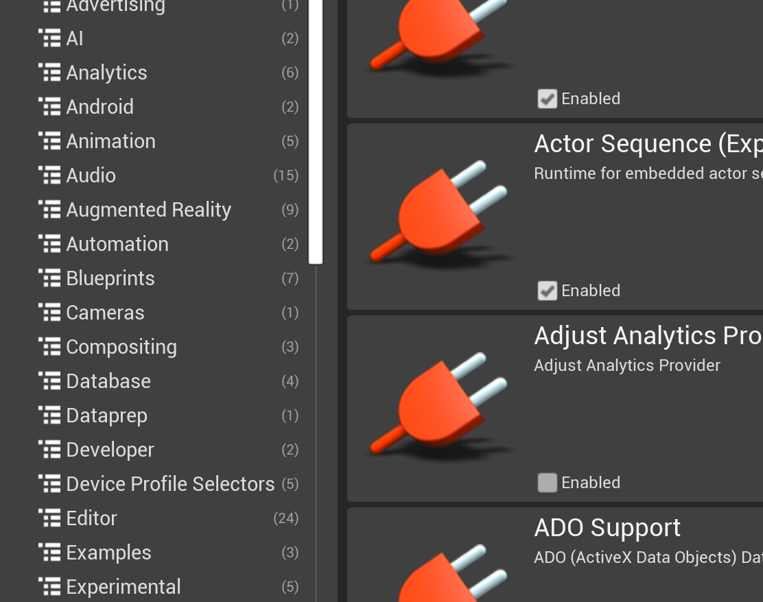
Why Not Plugin Code?
The Unreal Engine plugin system supports many kinds of extensions to core engine functionality. So why not just write game and plugin code?
There are two main reasons
Modifying Engine Modules
Low-level Code

Slide 4
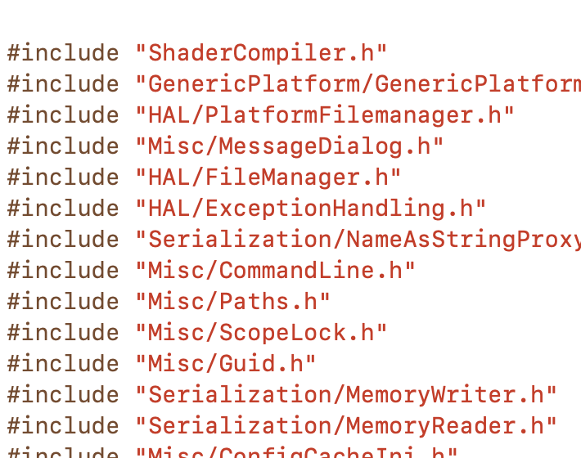
Modifying Engine Modules
This is the principal reason to modify the core engine code. Plugins allow you to extend engine behavior, but to change what is already implemented, you have to edit the code that’s already there.
Extending systems that are not designed for plugin function discovery.
Modifying the behavior or implementation of existing code.

Slide 5
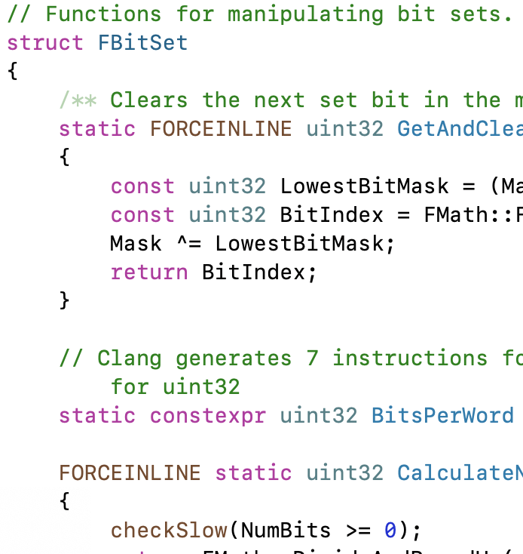
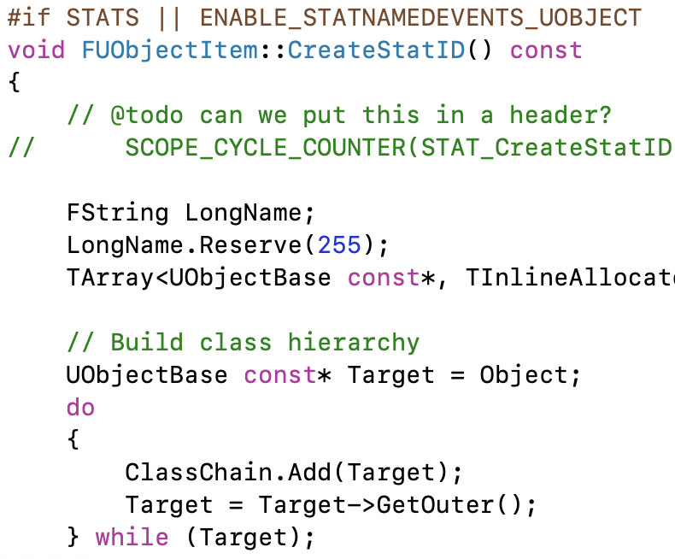
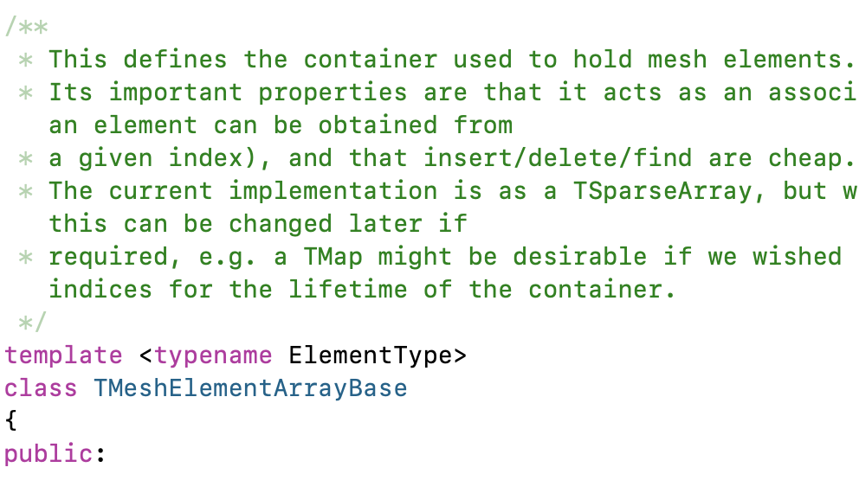
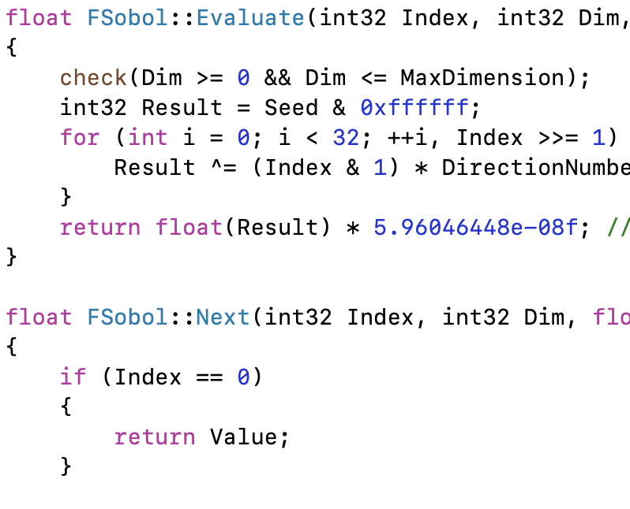
Low-Level Code
The other reason to change engine code is to add behavior to be used by other engine modules. Engine modules can only depend on other engine modules, not engine plugins, game plugins, or game code. If you want to add some core functionality for another engine class to use, it has to be in an engine module.

Slide 6
Engine Organization

Slide 7
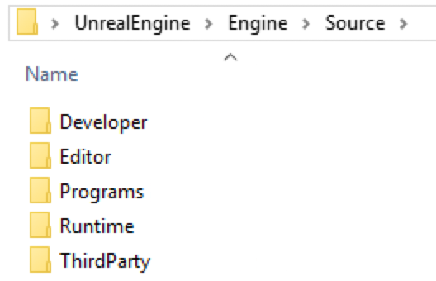
Engine Module Types
Look in the Engine/Source directory for all engine code. The major categories can be found in the directories there:
  Runtime – Code needed while a game is running.
  Editor – Code for implementing the Unreal Editor. Many systems have separate Runtime and Editor modules.
  Developer – Code for additional tools (output log, source control, profiling, cooking, derived data cache, …)
  ThirdParty – Integration for additional third-party libraries.
  Programs – Build and header tools, shader compiler, …

Slide 8
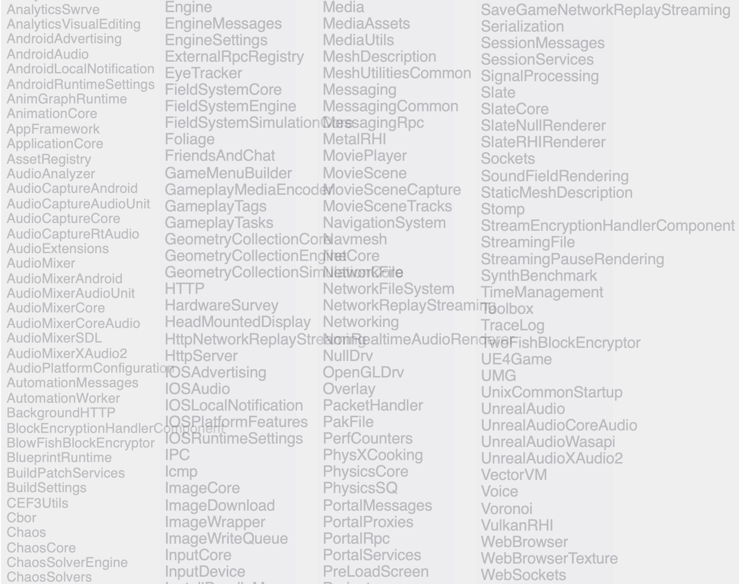
Runtime Modules
Every module has its own Build.cs file.
There are over two hundred runtime modules, but here are some of the major categories:
Basic functionality for the engine and major subsystems: *Core, Engine*
Rendering: *Render*, *RHI*
Slate UI: *Slate*
Audio, Video: *Audio*, *Media*
AI: AI*, Nav*

Slide 9
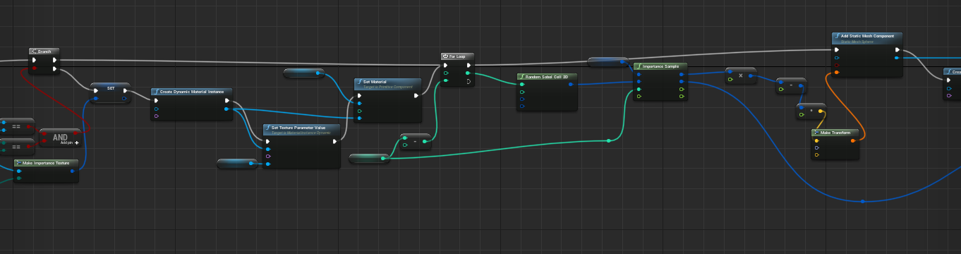
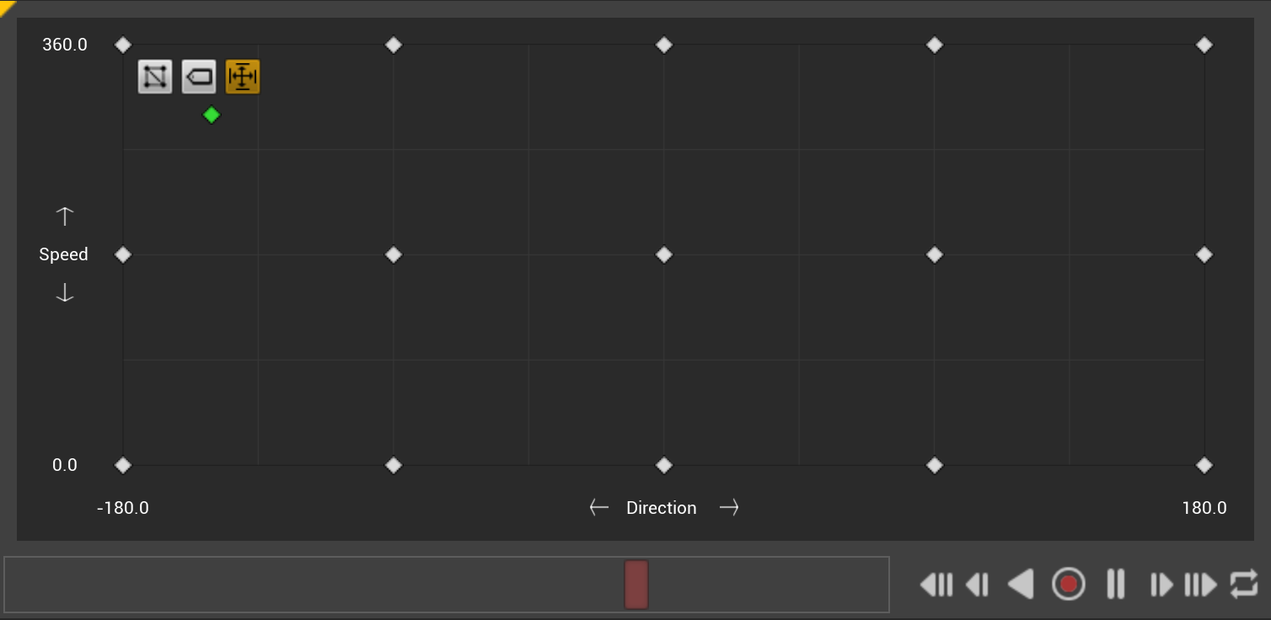
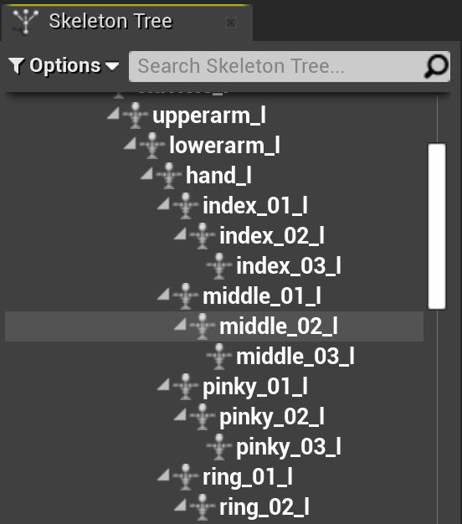
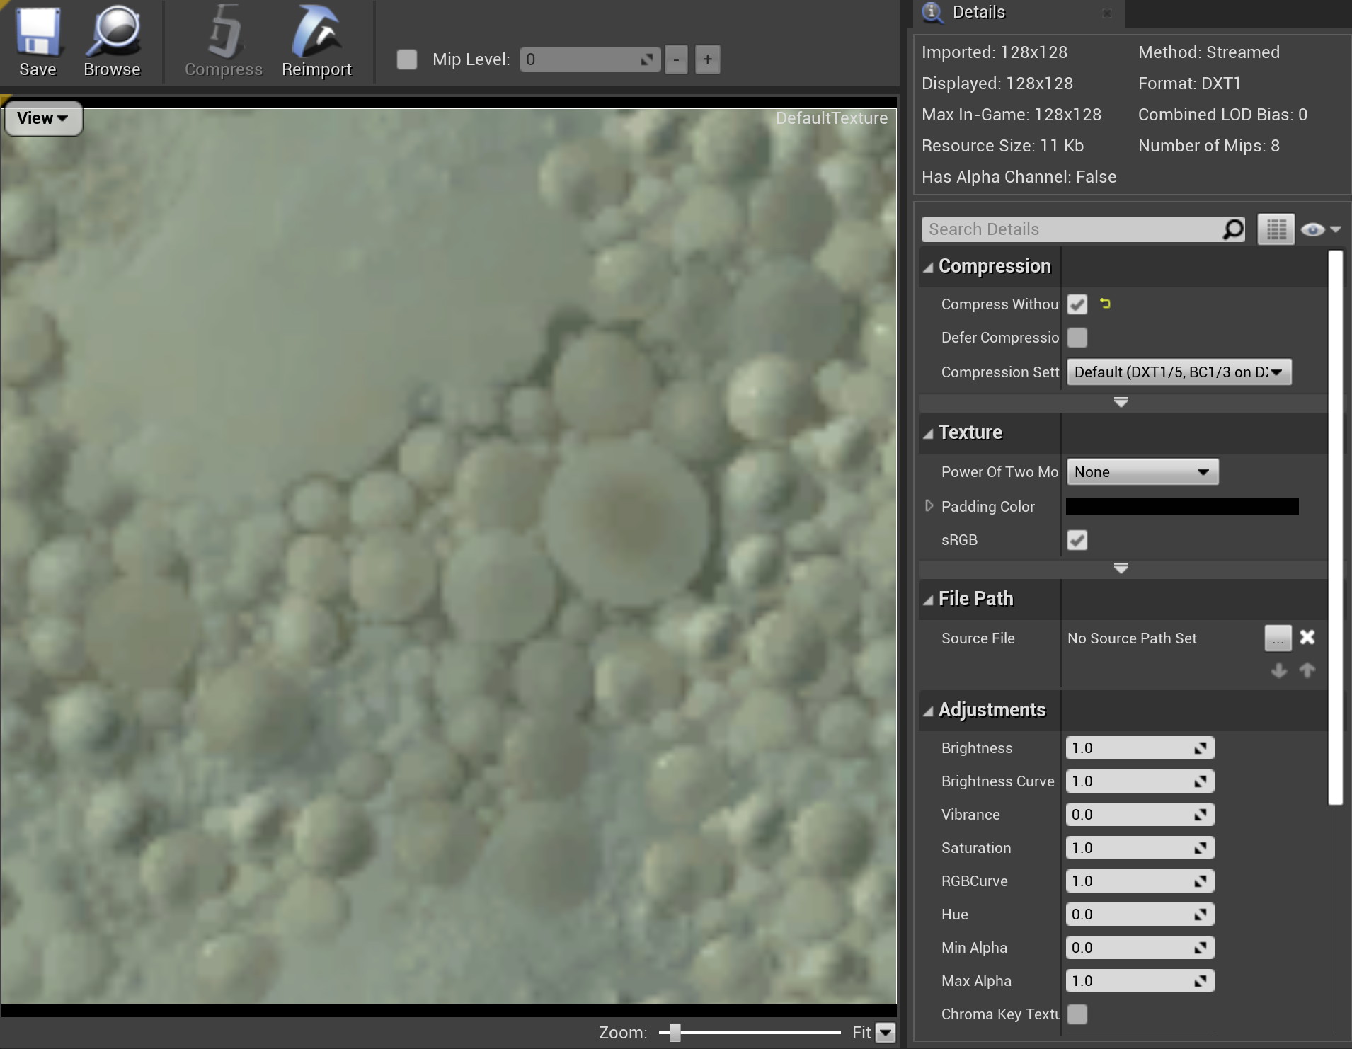
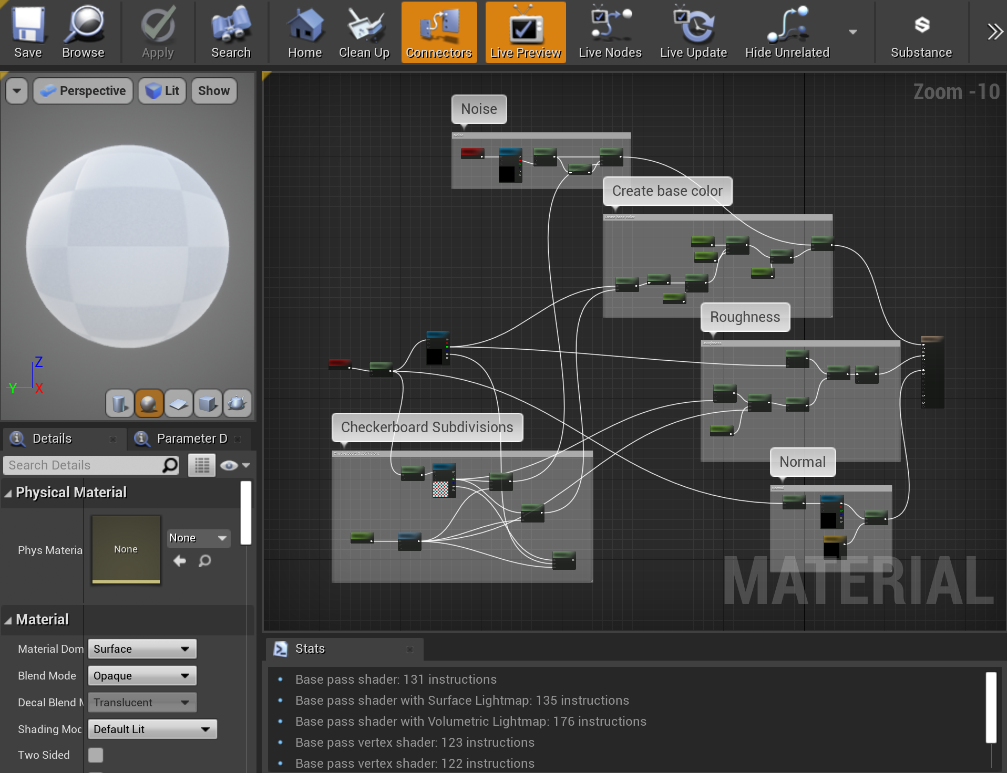
Editor Modules
There are over a hundred editor modules as well. Here are a few major categories:
Blueprint: Kismet*, *Blueprint*
Animation: Anim*
Various independent editor panels: *Editor

Slide 10
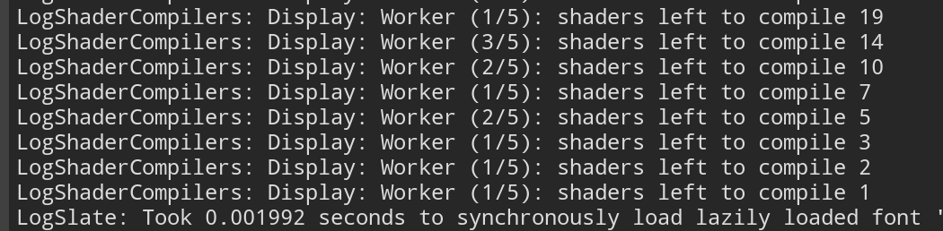

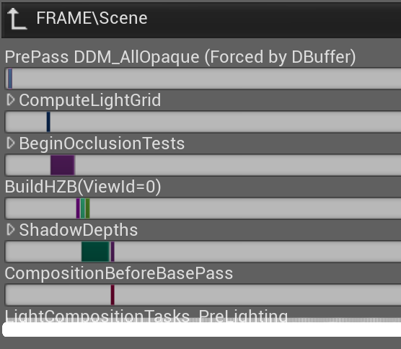
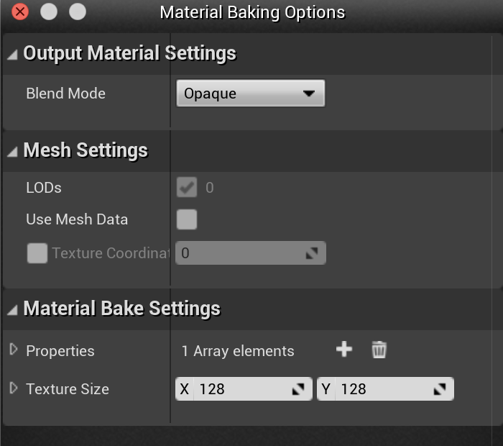
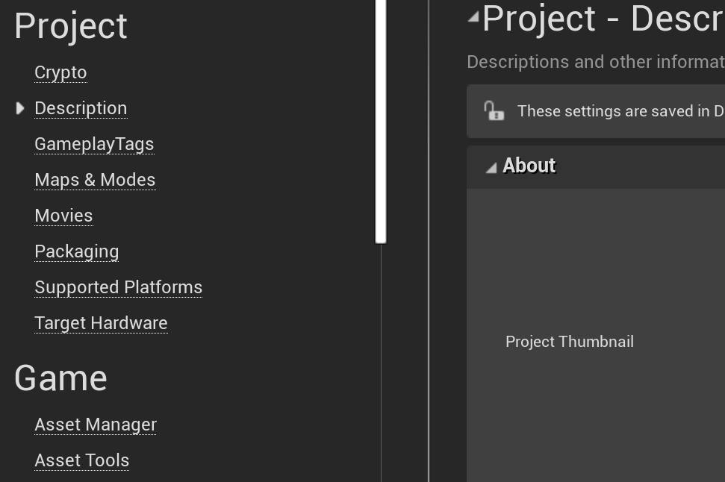
Developer Modules
Some key categories of Developer modules:
Asset cooking: *Target*, *Format*
Mesh tools: *Mesh*
Profiling: Profile*
Shader compiler support: *Shader*
Logging: *Log*

Slide 11
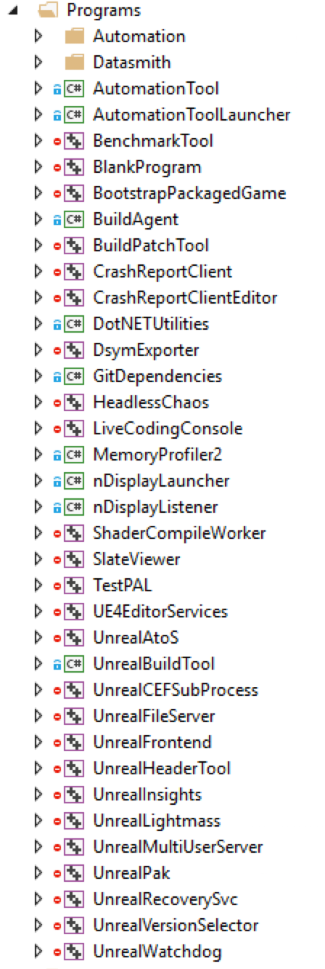
Programs
Among the separately compiled support programs, you will find
UnrealBuildTool: Build management, based on source and Build.cs files.
UnrealHeaderTool: UObject reflection code, auto-generated UI elements.
UnrealSwarm: Parallel task distribution.
ShaderCompilerWorker: Parallel shader compilation.

Slide 12
Engine Code Tips

Slide 13
Container Types
Rather than use C++ STL classes, use the Engine/Source/Runtime/Core/Public/Containers types.
These include
  Array (and Sparse Array, Bit Array, …)
  Binary Heap
  Circular Buffer
  Hash Table
  List (& lock-free version)
  Map

Slide 14
Why Don’t Game Developers Like STL?
STL relies heavily on C++ template metaprogramming, which promises zero (runtime) cost abstractions, but usually only on optimized builds.
Some implementations are unusably slow in Debug.
STL libraries add significantly to compile time.
In STL types, the memory allocator is a template parameter. It is part of the data type. That makes it difficult to mix objects using different allocators (though it can be done with a meta-allocator class that dispatches to different allocator types). Games commonly use several allocators:
A per-frame allocator that is reset without individual object deletions each frame
Pool allocators for commonly allocated and re-used types
An inline allocator, using fixed space inside the base type until it is full, then falling back to another allocator
A heap allocator used mostly for long-term persistent objects.
Any of these with more stringent alignment
constraints than the standard allocators.
The C++ standard template library (and boost project, which has created several things that ultimately became part of STL) have a lot of standard data structures and algorithms, but game developers almost universally create their own equivalents. Why?

Slide 15
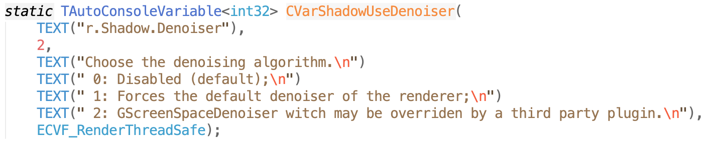
New Console Variables
New console variables (CVars) can easily be added to any engine file or plugin. They are an incredibly powerful means to change parameters or turn functionality on or off.
Change on the fly in the Output window or after hitting `
Flags
Description
CVar Name
Global Variable Holding Value
Default Value

Slide 16
CVar names
Game | g.
Timer | t.
Scalability Groups | sg.
Sound | s.
Network | net.
Physics | p.
Rendering | r.
Rendering Hardware Interface | rhi.
Slate (UI) | slate.
Debugging render modes | ShowFlags.
Particle effects | fx.
Variable names can be almost anything, but the convention is to start with a letter indicating the primary system, then a period, then the variable name (e.g. s.AsyncLoadingTimeLimit is a variable in the sound system).
Names may be nested with more “.” separated components for clarity.
The help console command will create an html page with all current console variables and commands.

Slide 17
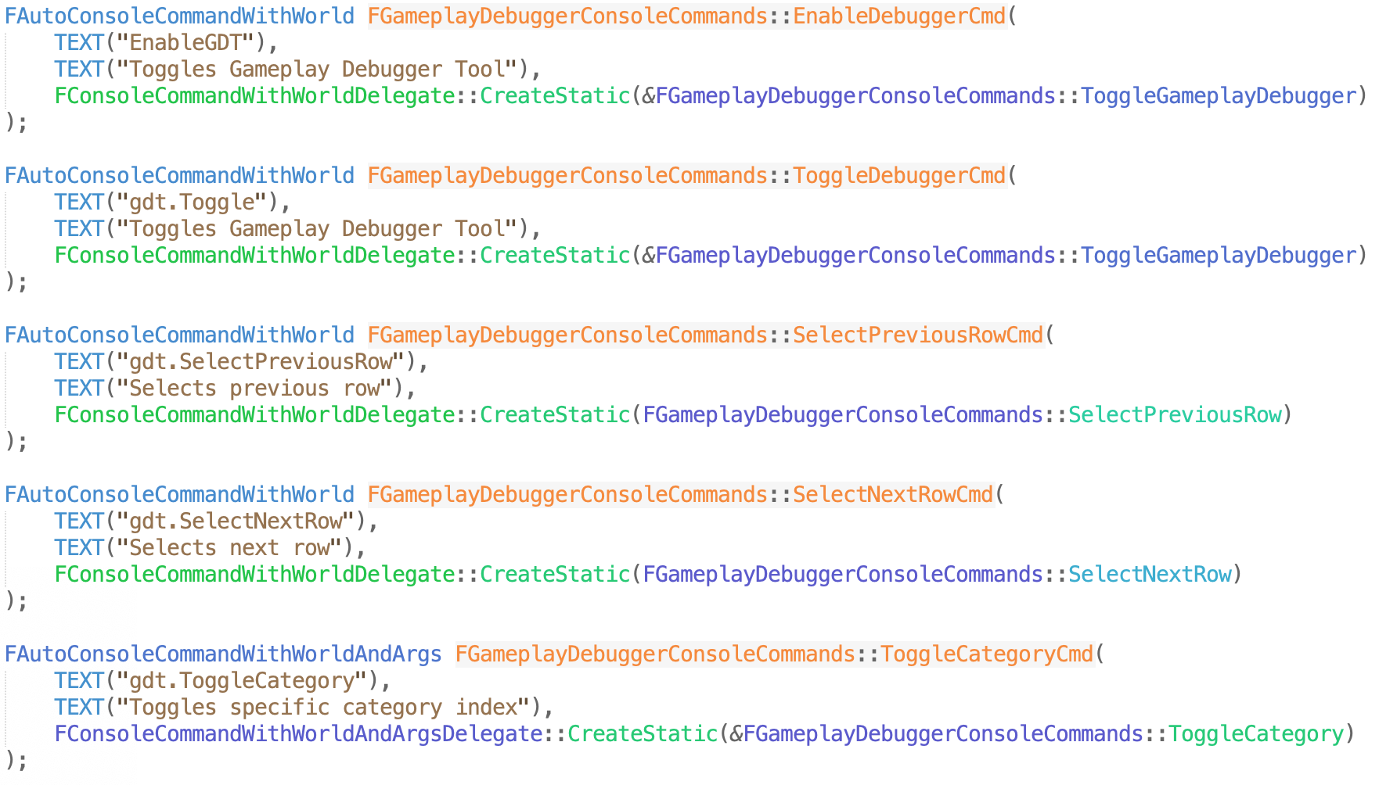
Console Commands
Console commands execute code when run, instead of just changing a value.
There are two ways to create new console commands:
  Derive a class from FSelfRegisteringExec, override the Exec function, and use FParse:Command to tell when your command was entered.
  Declare an FAutoConsoleCommand with a delegate to call when the command is entered.

Slide 18
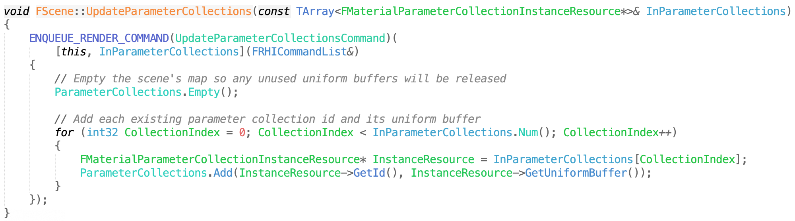
Game and Render Threads
The Unreal Engine farms work to many threads, but the primary persistent threads you may need to worry about are the game thread and the rendering thread (and possibly also the RHI thread for the rendering hardware interface)
CVars are set in the game thread. Render-thread accessible CVars are copied once per frame.
The game thread can schedule render thread work with ENQUEUE_RENDER_COMMAND. This takes a lambda function to execute on the render thread.

Slide 19
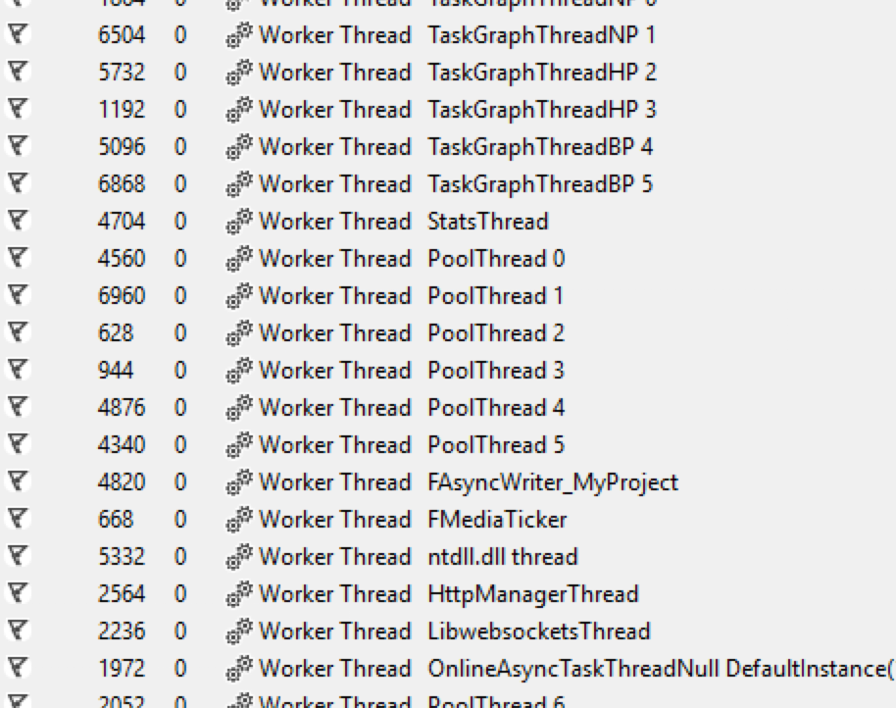
Other Threads
There is a system called the task graph to handle some parallelism and task scheduling. Schedule tasks to run in this system with TGraphTask
It can sometimes be helpful to turn off threading for debugging. Disable all threading, with the
–nothreading command-line parameter. Disable just the render thread with
–norenderthread, or the RHI thread with
–norhithread.

