Slide 1
Fitting and Approximation
UMBC Graphics for Games

Slide 2
Spherical Harmonics

Slide 3
Functions as Vectors
Express vectors in terms of coefficients for basis vectors
Functions form a vector space too
Value at every point on the real axis:
Power basis:
Fourier basis:

Slide 4
Function Dot Product
Regular real-valued dot product
  (e.g. )
Sum turns to integral for continuous real-valued functions
Orthonormal
  Orthogonal if
  Normal if
  When orthonormal,
  where

Slide 5
Light Probes
Grid of precomputed environment maps would be huge
Need a compact representation for a function of direction
  Directions = unit vectors
  = points on a sphere

Slide 6
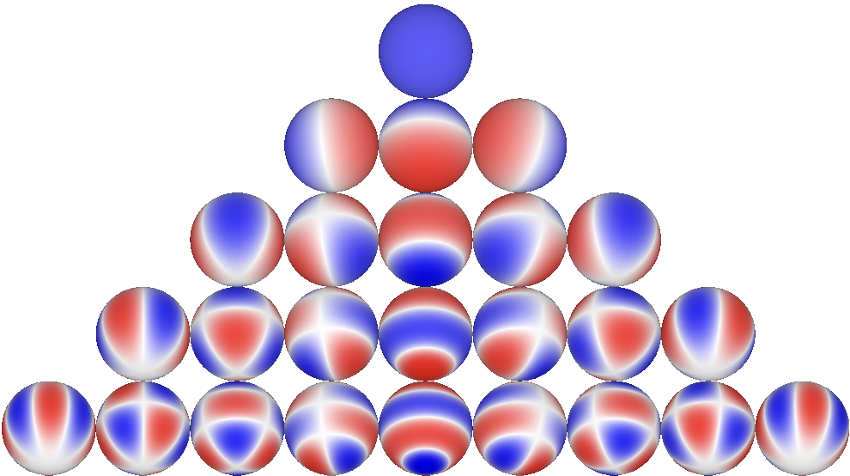
Spherical Harmonics
Orthonormal basis for functions on a sphere
  Indexed
–4
–3
–2
–1
0
1
2
3
4

Slide 7
Incoming Light as Spherical Harmonics
Integrals do not depend on the incoming light, can precompute
Double product: light & part of BRDF as SH
All: precompute integrals, just store coefficients

Slide 8
Light Probes (revisited)
Store as grid of SH coefficients (can store in a couple of textures)
  Few terms = blurry representation of incoming light
Run time: find closest, interpolate SH coefficients
  Be careful not to interpolate through walls!
Combine with other (higher frequency) lighting

Slide 9
Other Spherical Basis Functions
Zonal Harmonics (just the m = 0 ones + a rotation axis)
  , , , , …
Wavelets (multiresolution approximation & residuals)
Spherical Gaussians (+ an axis)
…

Slide 10
Function Approximation

Slide 11
Still Too Expensive???
Even without integrals, can have trig functions, or lots of computation
Find a function close in shape to the original, but easier to evaluate
  Can include 2D or 3D lookups, though lookups are expensive too
Finding the coefficients
  Taylor series: Polynomial – good near 0, can blow up far away
  Padé: Rational Polynomial – good near 0 and ∞
  Minimax: Polynomial – minimizes max error
  Nonlinear optimization

Slide 12
Examples: Hair [Karis 2016]
Marschner [2003]: sum of reflection (R) and Transmission (T) paths
Just do R, TT, TRT paths
Many terms, each with its own approximation (see Karis)
For example:
  Start with
  Change variables to to avoid acos(dot(…))
  Graph, looks similar to exp(–…)
  Fit :

Slide 13
Refinements for fitting
Range reduction
  Piecewise fit
  This is how most math library functions work
Constraints
  Constrain endpoints
  Constrain critical features (is the derivative at 0 important?)
  Lock those down before doing fit for the rest
  Reduces degrees of freedom in optimization

Slide 14
More from Iwanicki & Pesce [2015]
Reduce dimensionality (project, factor)
Toolkit: Global and local optimization algorithms
  When ground truth is Monte-Carlo, avoid ones that need derivatives
Steps
  Graph the function to fit
  Hypothesize a form for the fit
    Zero out small coefficients
    Parameters near limits = probably not the right function
  Graph & render with result
  Add refinement terms & constraints (or change fit function)

Slide 15
Examples: Schlick Fresnel
Original Fresnel (for unpolarized light)
Constrain
  Where
Polynomial fit [Schlick 1994]

Slide 16
Refining approximations [Jakob 2014]
For importance sampling, want this CDF
To generate samples, need inverse CDF, but no closed form
Compute approximate as a function of
Refine with several steps of Newton method to find where

Slide 17
Numerical Error
Or how good is good enough

Slide 18
Representation Error
Floating or fixed point (e.g. 8-bit color values) have limited precision
  True number can be ±0.5 * least significant bit
  8-bit color represents values in [0,1] with an 8-bit number
  LSB is 2⁻⁸, true value within ±2⁻⁹ of stored value
Floating point LSB scale depends on exponent
  For float x, LSB ≈ |x|*2⁻²³, error ≈ ±|x|*2⁻²⁴

Slide 19
Propagated Error
If input to a function has error, result has error scaled by derivative
  Exact:
  With small error in input:

Slide 20
Generated Error
Approximations generate their own error
Do not need approximation significantly better than propagated error.
How the error looks also matters
  Discontinuities in value or derivative may be worse than smooth consistent bias

