Slide 1
Animation
UMBC Graphics for Games

Slide 2
Skinning

Slide 3
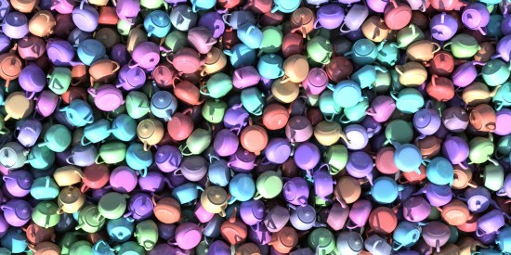
Rigid motion
Translation + Rotation
Representable as matrix or new origin & orientation
Apply to every vertex
pixelatedvertex.com/portfolio/teapot-scattering-tutorial

Slide 4
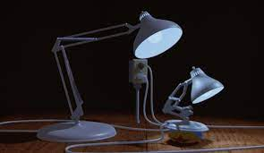
Jointed Bodies
Rigid parts, each with translation & rotation
  Robots or mechanical objects
Apply to every vertex of rigid part
Chains of local transforms
  Hand motion result of arm & wrist
  Matrix form = composition of matrices
Pixar, Luxo Jr., 1986

Slide 5
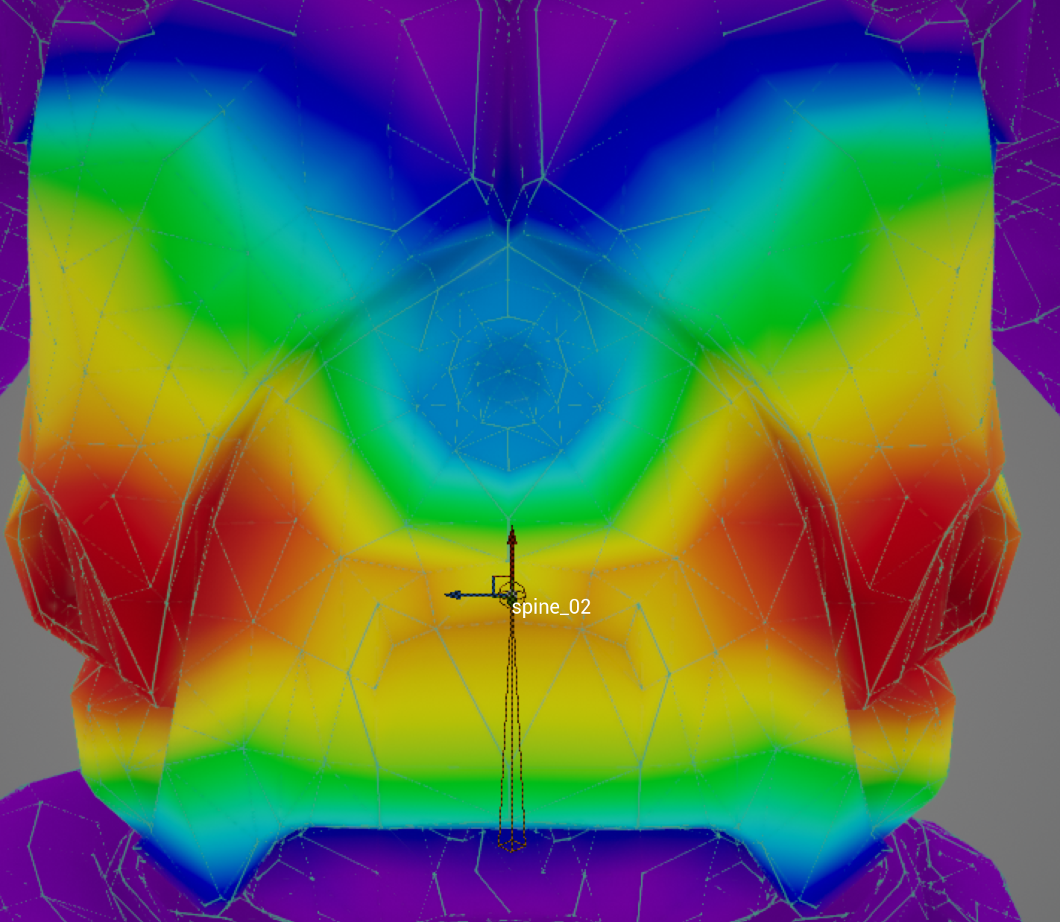
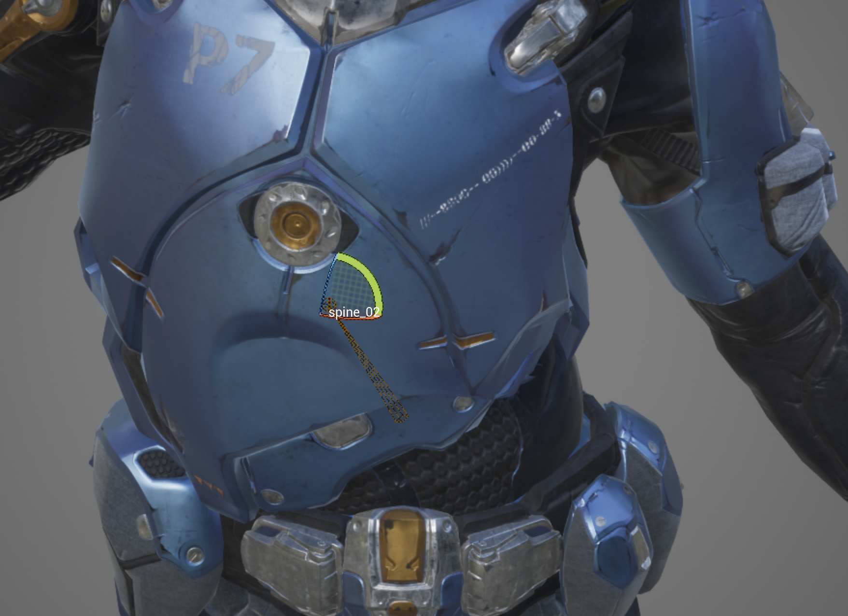
Linear Blend Skinning
Define jointed rigid skeleton
Vertex positions are weighted blend of closest bones
Bone = translation & rotation, not physical bone
Add extra spur bones
  Muscle bulge
  Preserve elbow shape
  (don’t round outside, don’t fold inside)
  Avoid candy-wrapper twist
Building bone rig + painting weights = rigging
  Artists do this in their modeling & animation tools
Epic Games, Paragon Murdoch
Notes:
Unreal: open skeletal mesh, select bone in tree, transform
Over-fold elbow, twist elbow to show candy wrapper
Select Character > Mesh > Mesh Overlay Drawing > Selected Bone Weight

Slide 6
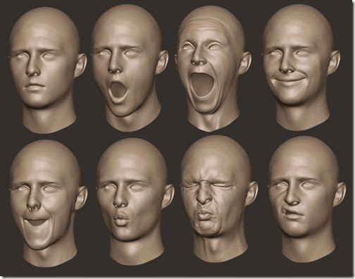
Blend Shapes (aka Morph Targets)
Multiple pose meshes: same vertices different positions
Linear blend between poses
More storage, but more flexible
  Most common for faces
3dstudents.com/2015/02/blend-shapes.html

Slide 7
Authoring Animation

Slide 8
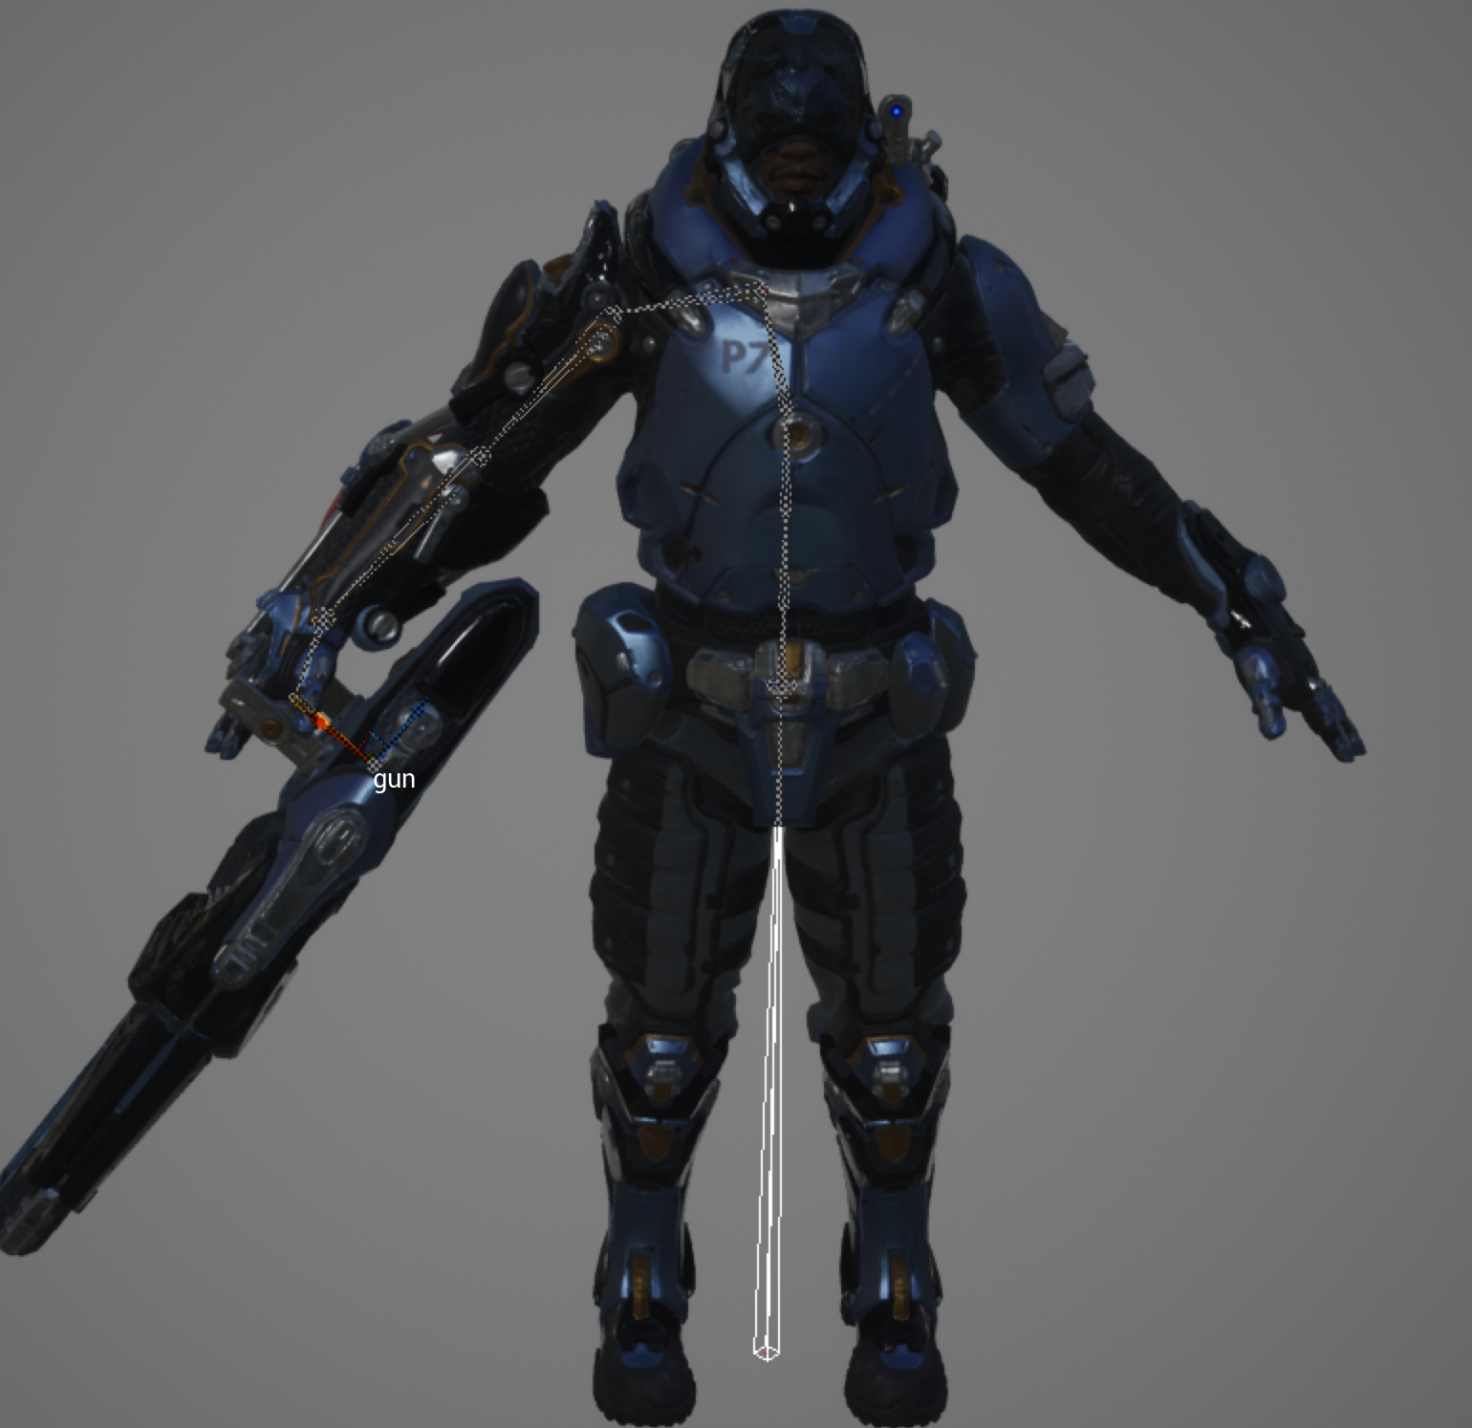
Forward Kinematics
Given a set of joint angles,
where’s the hand?
  (or foot or head or …)
  End effector
Just apply nested transforms
Epic Games, Paragon Murdoch
Notes:
Tweak several parent and child bones and note relative positions

Slide 9
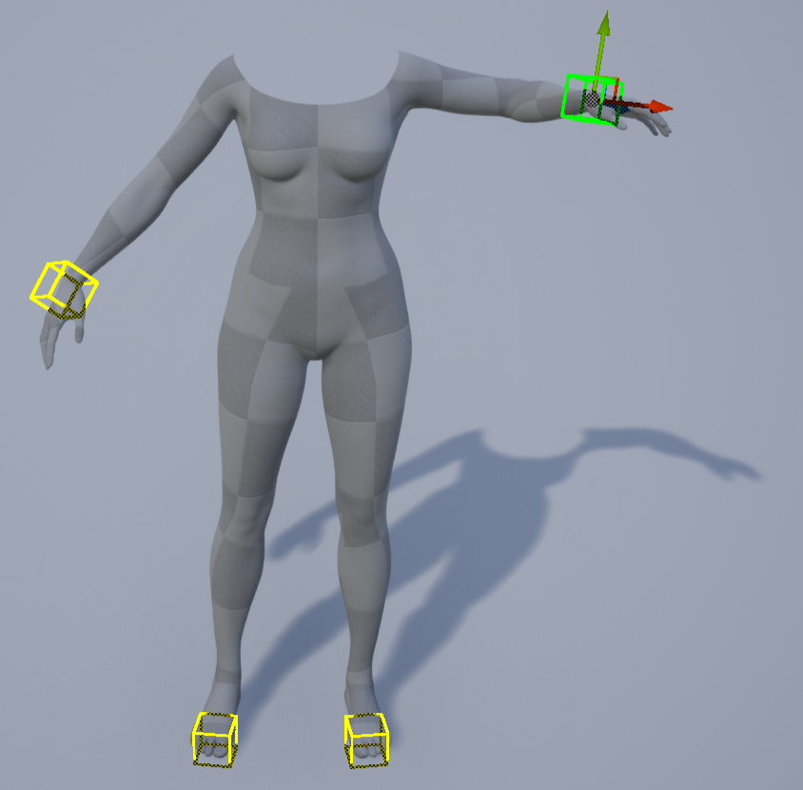
Inverse Kinematics
Find angles to match end effector
position
Few joints: system of equations
Many joints: optimization
  Often with constraints
    (wrist doesn't bend that way)
  And heuristics
    Minimal change
    Load support
    Physical data
Notes:
Download MetaHumans project from Epic, search for IK rig.

Slide 10
Keyframe Animation
From hand drawn animation
  Lead animator draws poses at key frames
  Inbetweener draws frames between keys
Computer animation
  Interpolate between values at key frames
  Can have separate keys for different attributes
Notes:
UE: from skeletal mesh window, choose animation mode (running character icon), then in the asset browser window, filter for Emote, play some of them

Slide 11
Blending animations
Animation overlays
  Just some joints, e.g. upper body for aiming
Common to create animation loops for specific behavior
  Idle, walk, run, turn left, turn right
Need to transition between these
  Speed up/slow down to match cadence, foot placements
  Linearly blend bone transforms
Some games will cheat
  e.g. pop or unsynced blend during critical action, good blend on playbeck
Notes:
UE animation pane, filter for Aim Offset

Slide 12
Blend Space
Weighted blend of poses
  Kind of like weighted blend for blend shapes
Allows run-time changing speed, direction, aim point, …
Notes:
Add paragon character model to a project, open the skeletal mesh asset. Find one of the AO (for “aim offset”) animation files.

Slide 13
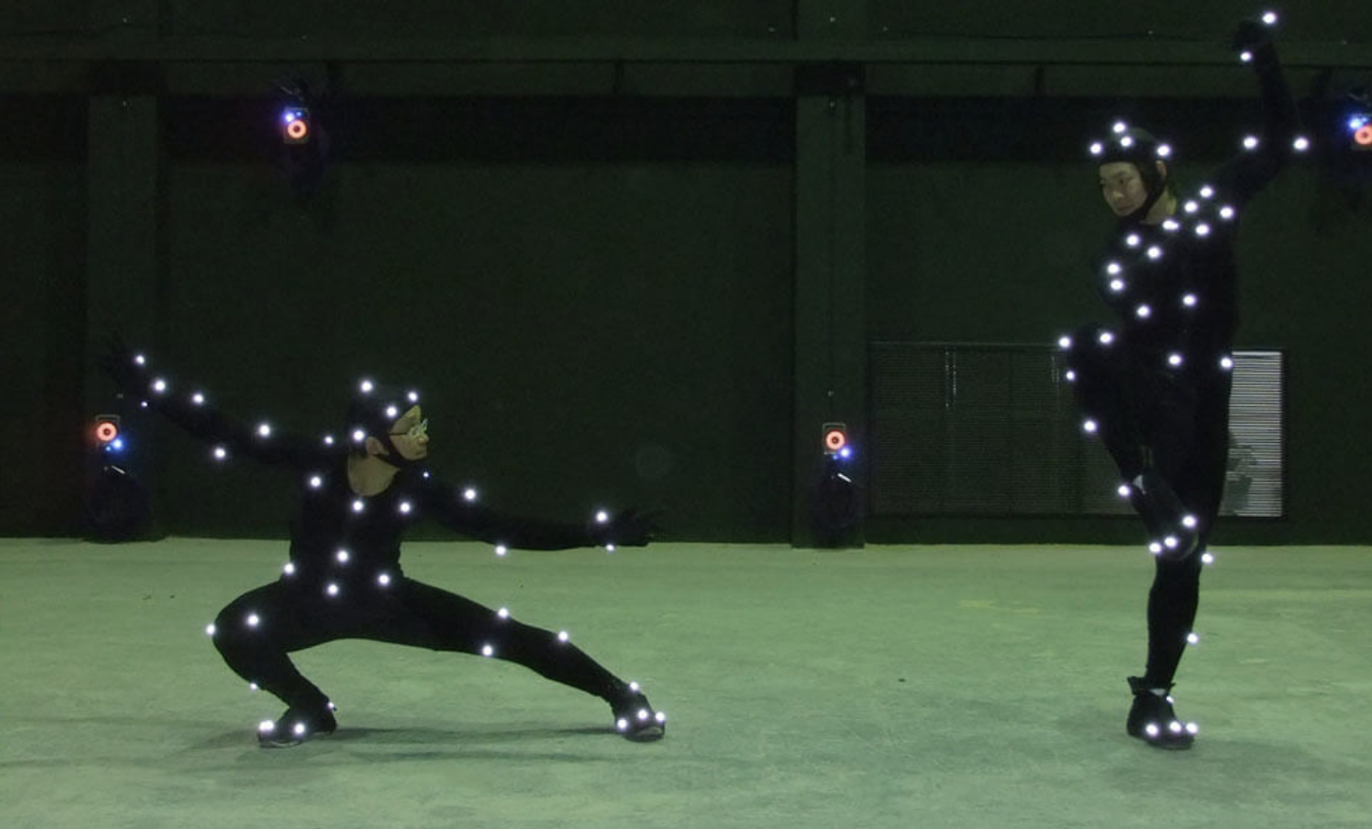
Motion Capture (mocap)
Track markers on actor
Infer transforms
  Markers are on surface, not on bones
  Not all markers visible every frame
Often significant artistic cleanup
www.creativementors.in/img/content/motion-capture.jpg

Slide 14
Retargeting
Apply animation from one character to another
Simple: match skeletons
More complex
  Consider changes in height, strength, weight
  Adjust speed and motion
Most often used for mocap
  Human actor ≠ giant ogre

Slide 15
Physics-based Animation
Generally: simulating the laws of physics to predict motion
Common applications:
  Rigid body motion (jointed bodies, rag doll physics)
  Cloth, hair (jointed mesh, may be coarse & interpolated)
  Fluids, gas (3D grids or particles)
Model change as differential equations
  Solve numerically in small time steps
  Games often don’t run to convergence

Slide 16
Autonomous Entities, Crowds, Groups
NPC, enemy characters
  Usually simple techniques over learning methods
  Want to tune difficulty, AI should be challenging, but don’t want it to beat you
Create complex group behavior from simple individual behavior
  Flocks, crowds
  Particle systems
Leverage techniques from AI & Robotics
  A* path finding over a navigation mesh (navmesh)
  State machines, decision trees

