Slide 1
Texture Compression
CMSC 435/634
UMBC
*With lots of borrowing from the usual victims…

Slide 2
Texture Performance
Mostly memory bandwidth limited
Use cache
  Best when access is coherent between pixels
  Cache in 4x4 blocks instead of 16x1 lines
  Use MIP maps (improves chance of cache hits)
Small data
  Don’t use RGBA when one or two channels will work
  Use 8-bit channels or 16-bit float instead of 32-bit
    32-bit float: sign, 8-bit exponent, 23-bit mantissa
    16-bit float: sign, 5-bit exponent, 10-bit mantissa
Compression
  Cheaper to fetch smaller data then decompress than to fetch full-sized

Slide 3
Texture Compression
Lossless vs Lossy
  Lossless: Get out exact bits you put in
  Lossy: Some error is OK if it is not perceptible
Variable vs Fixed/Constant Bit Rate
  VBR: Large single-color areas can compress more than complex changing areas
  FBR: Cannot easily randomly index into VBR, constant bit rate loses some compression to get random access

Slide 4
Lossless
Run Length Encoding (RLE)
  Pixel value & count
Dictionary (strings of bytes)
  Substring seen before: use dictionary index
  Update dictionary
Entropy coding (symbols with probability)
  Higher probability = fewer bits
  Lower probability = more bits
  Huffman, Arithmetic, Range, ANS

Slide 5
Arithmetic Coding
Bit stream interpreted as a fraction 0.xxxxxx

Slide 6
Arithmetic Coding
Read a 0 bit, know number is 0..½ (0.0xxx)

Slide 7
Arithmetic Coding
All possible #s below cutoff, next bit must be 0
  Rescale active range from 0..cutoff to 0..1

Slide 8
Arithmetic Coding
All possible #s still below cutoff
  Output another 0 bit & rescale to 0..1 again

Slide 9
Arithmetic Coding
All possible #s still below cutoff
  Output another 0 bit & rescale to 0..1 again

Slide 10
Arithmetic Coding
Active range spans cutoff, read another bit (1)
  Bottom of range moves up to 0.5 (0.1xxx)

Slide 11
Arithmetic Coding
Active range still spans cutoff, read another bit
  Bottom of range moves up to 0.75 (0.11xxx)

Slide 12
Arithmetic Coding
Active range still spans cutoff, read another bit
  Bottom of range moves up to 0.875 (0.111xxx)

Slide 13
Arithmetic Coding
Active range entirely above cutoff, output 1
  Rescale cutoff..1 to 0..1

Slide 14
Arithmetic Coding
Example output 3 likely bits from 1 bit read
Had to read 3 bits to output 1 unlikely bit
Can change
or adapt
probability

Slide 15
Entropy Coding IRL
Encoder can only use info decoder will know
Huffman
  Build binary tree (each branch=1 bit)
  Fast, but doesn’t share bits between symbols
Arithmetic/Range
  Can change or adapt probabilities as you go
  Algorithm uses machine-word sized window on input
ANS
  Fast (esp. table-based tANS)
  Encodes backwards, so adaptive probabilities harder

Slide 16
Transformation
Improve both entropy & lossy coding
Luminance / Chrominance
  Humans are more sensitive to luminance
Encode difference from a prediction
Fourier transform
  Energy varies by frequency (unless white noise)
…

Slide 17
JPEG Compression
Lossy VBR w/ 8x8 blocks
Convert to luminance/chrominance
  Full-res luminance, half-res chrominance
Quantize in frequency space (most loss here)
  Different # bits for low and high frequencies
  Too much leads to ringing at hard edges
Entropy encoding of result

Slide 18
JPEG 2000
Didn’t catch on, but some cool ideas
Color transform (YUV or YC_{r}C_{b})
Split image into tiles
Wavelet transform
  MIP-like pyramid of prediction & differences

Slide 19
JPEG 2000 (cont)
Encode blocks one bit-plane at a time
  MSB to LSB, same bit for all pixels in block together
  Rate-distortion ordering (next bit from any block: most important first)
  Stop at any time for lossy, all of them for lossless
Three probability models for entropy-coding next bit in a pixel
  Bits decoded so far for this pixel & its neighbors all still 0
    Next bit is more likely to still be 0
  Bits decoded so far for this pixel = 0, but at least one neighbor ≠ 0
    Next bit is more likely to be a 1
  Bits decoded for this pixel are already ≠ 0
    About equal probability for either a 0 or 1 bit

Slide 20
Block Compression (BC1/DXT1)
Lossy FBR w/ 64 bits per 4x4 block
Encode two representative colors (32 bits)
  16 bits each: 5 red, 6 green, 5 blue
Color of each pixel with 2 bits (32 bits)
  A>B: Color A; (⅔ A + ⅓ B); (⅓ A + ⅔ B); B
  A≤B: Black/Transparent; A; (½ A + ½ B); B

Slide 21

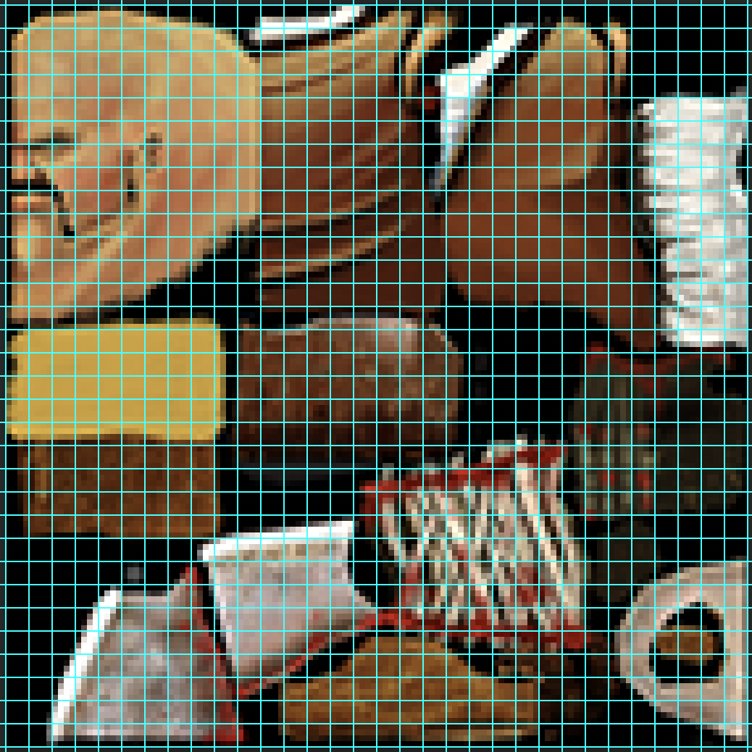


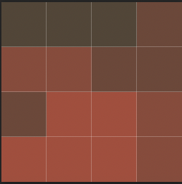
Block Compression
Source Image
Representative
Colors
Quantized
Single 4x4
Block
Palette
Compressed
Block
Result

Slide 22
Normals (BC5/RG)
Lossy FBR w/ 128 bits per 4x4 block
Two independent 64-bit channels.
For each
  Encode two representative values (16 bits)
  Value of each pixel with 3 bits (48 bits)
    A>B: Interpolate A to B in 8 steps
    A≤B: 0, 1; Interpolate A to B in 6 steps

