Slide 1
Computer Graphics
CMSC 435/634

Slide 2
Graphics Areas
“Core” graphics areas
  Modeling
  Rendering
  Animation
Other areas which draw on computer graphics
  Displays
  User Interaction
  Virtual Reality
  Visualization
  Image Processing
  3D Scanning

Slide 3
Graphics Areas – Modeling
Deals with the mathematical specification of shape and appearance
  Definition of surface
  Interpolation rules
  Reflection models

Slide 4
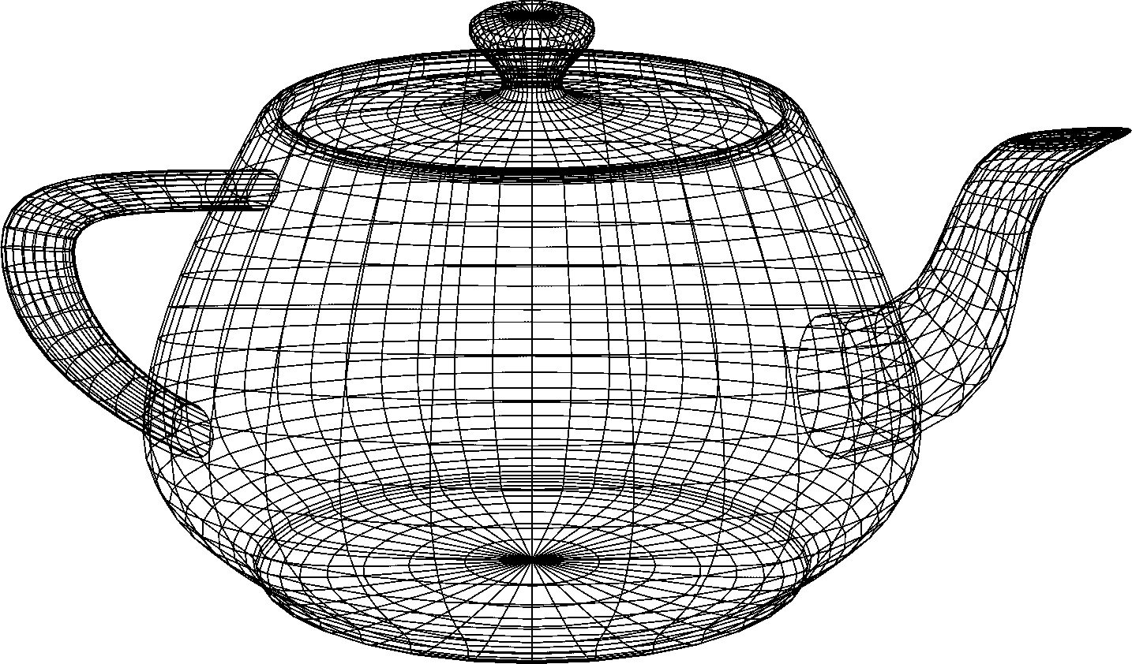
Graphics Areas – Modeling

Slide 5
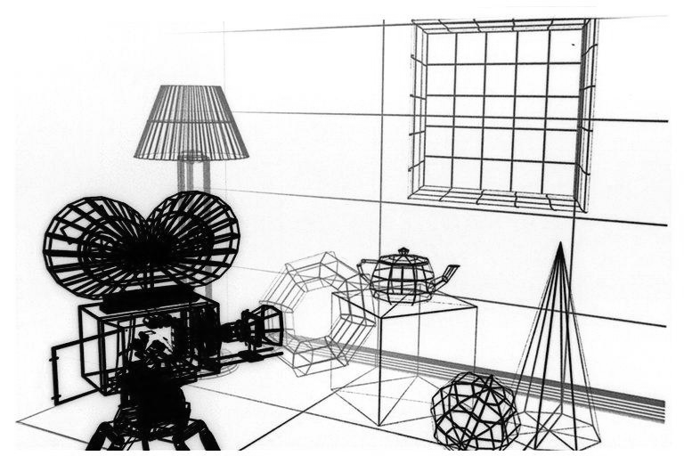
Graphics Area – Modeling

Slide 6
Graphics Areas – Rendering
Term inherited from art – create images from computer models
  Many techniques
  Many styles of rendering

Slide 7
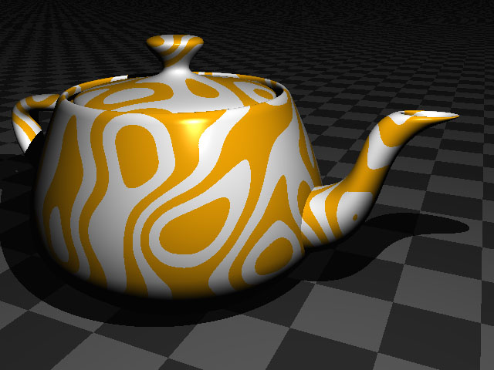
Graphics Areas – Rendering

Slide 8
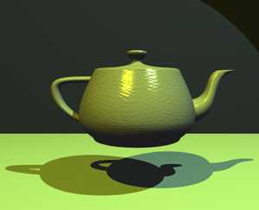
Graphics Areas – Rendering

Slide 9
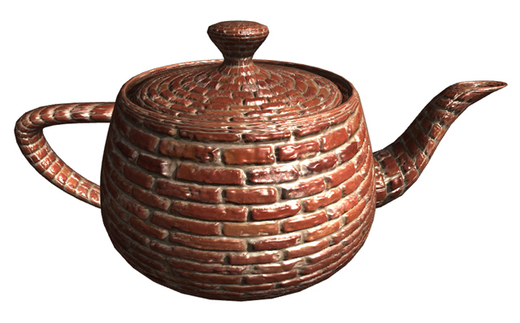
Graphics Areas – Rendering

Slide 10

Graphics Areas – Rendering

Slide 11
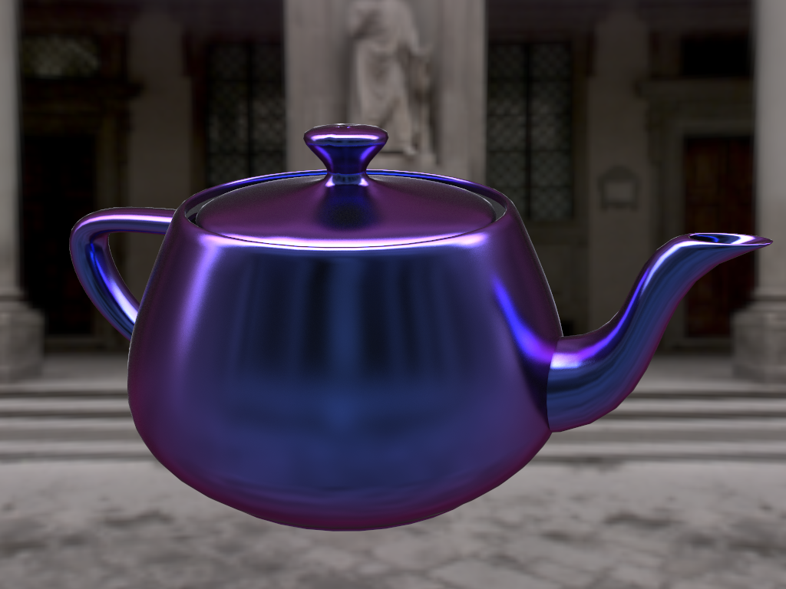
Graphics Areas – Rendering

Slide 12
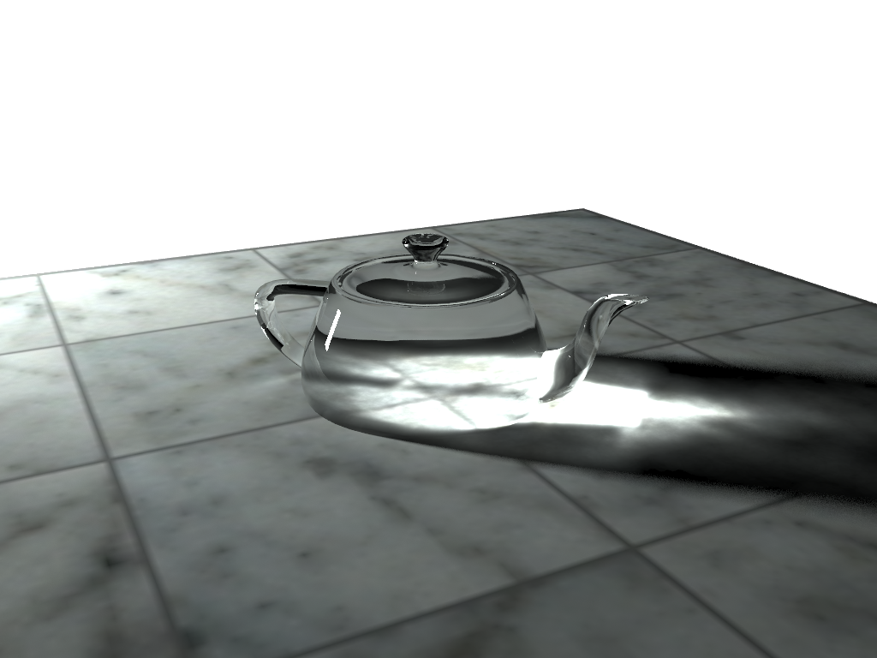
Graphics Areas – Rendering

Slide 13

Graphics Areas – Rendering

Slide 14
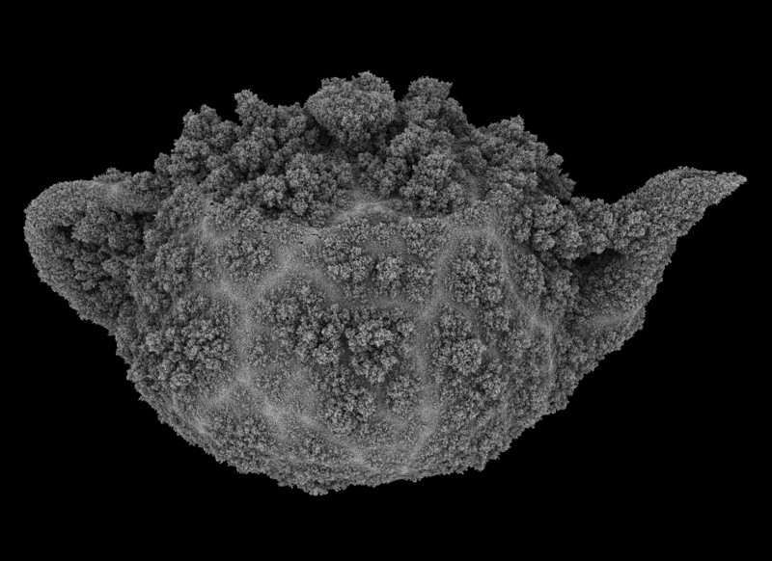
Graphics Areas – Rendering

Slide 15
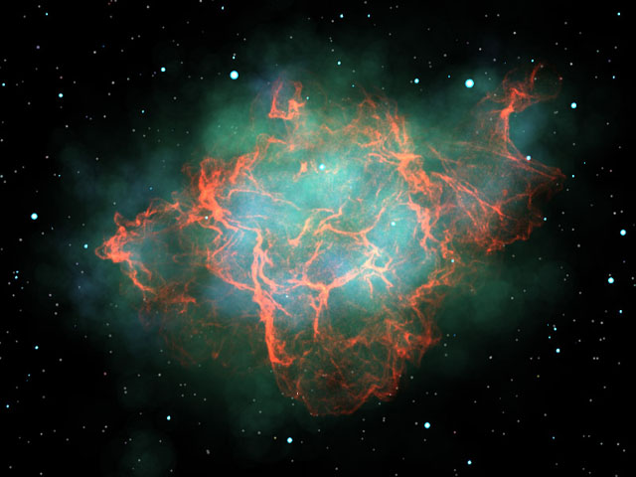
Graphics Areas – Rendering

Slide 16
Graphics Areas – Animation
Creating an illusion of motion through a sequence of images
  Time as a key issue, not normally dealt with in basic modeling and rendering
Key sub-areas
  Keyframe animation
  Motion capture
  Physics-based animation

Slide 17
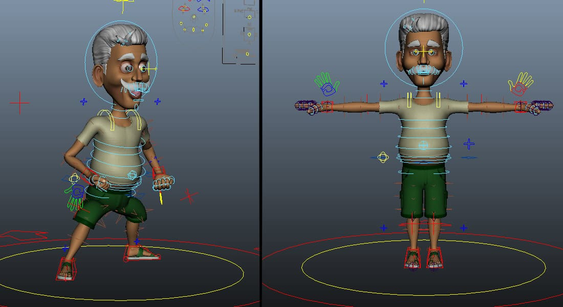
Keyframe Animation
Skeleton: Model / Rig / Animate

Slide 18
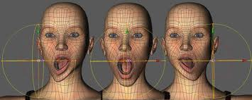
Keyframe Animation
Blend Shapes / Morph Targets

Slide 19
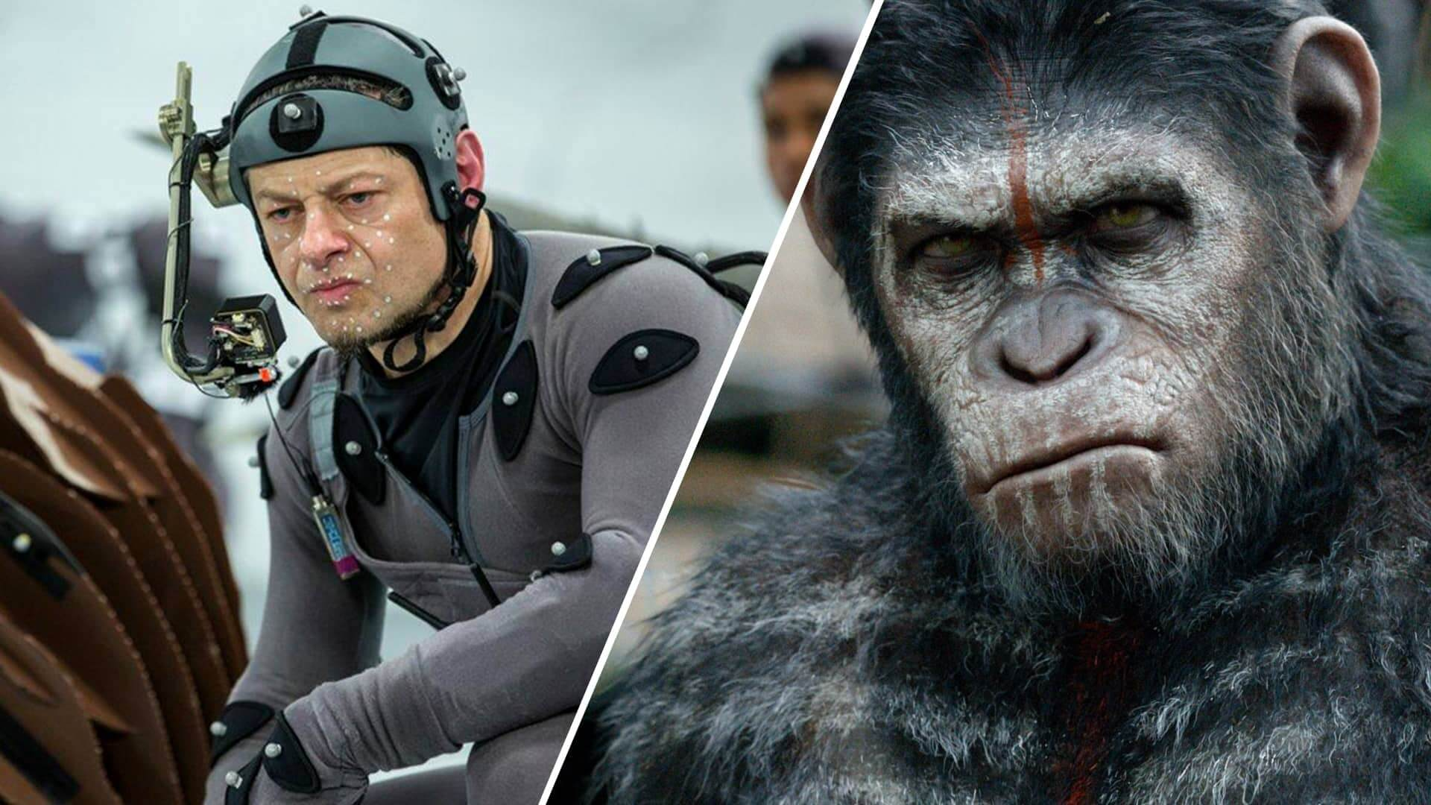
Motion Capture

Slide 20
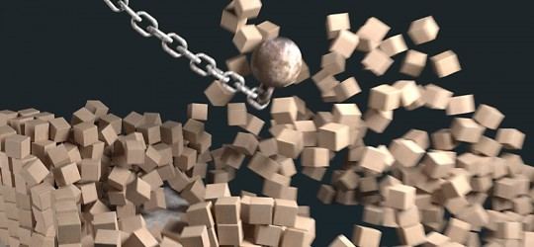
Physics-Based Animation / Rigid Bodies

Slide 21
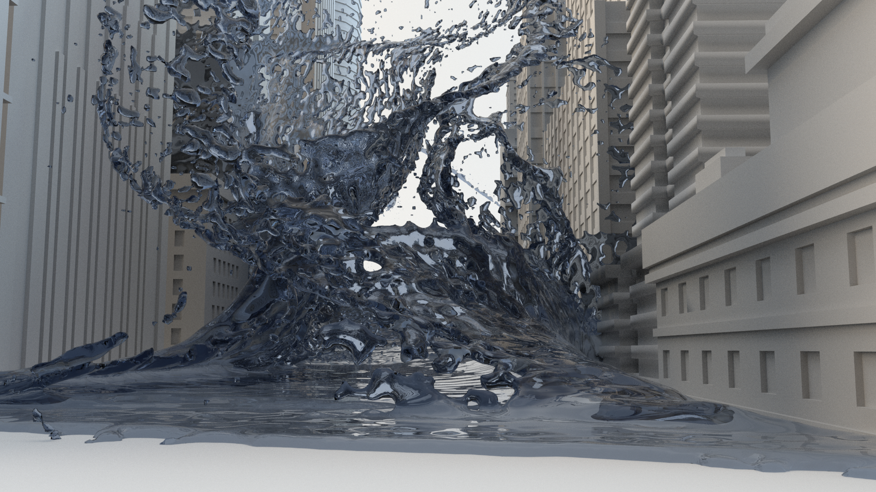
Physics-Based Animation / Fluids
Simulate physics Navier-Stokes equations
  Eulerian: discretize
  space, model motion of
  fluid from cell to cell
  Lagrangian: discretize
  fluid, model interaction
  between particles
Same math for fluids,
smoke, fire, …

Slide 22
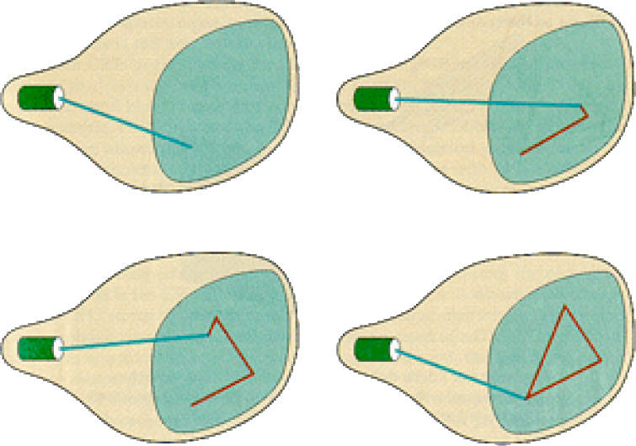
Displays — Random/Vector Display

Slide 23
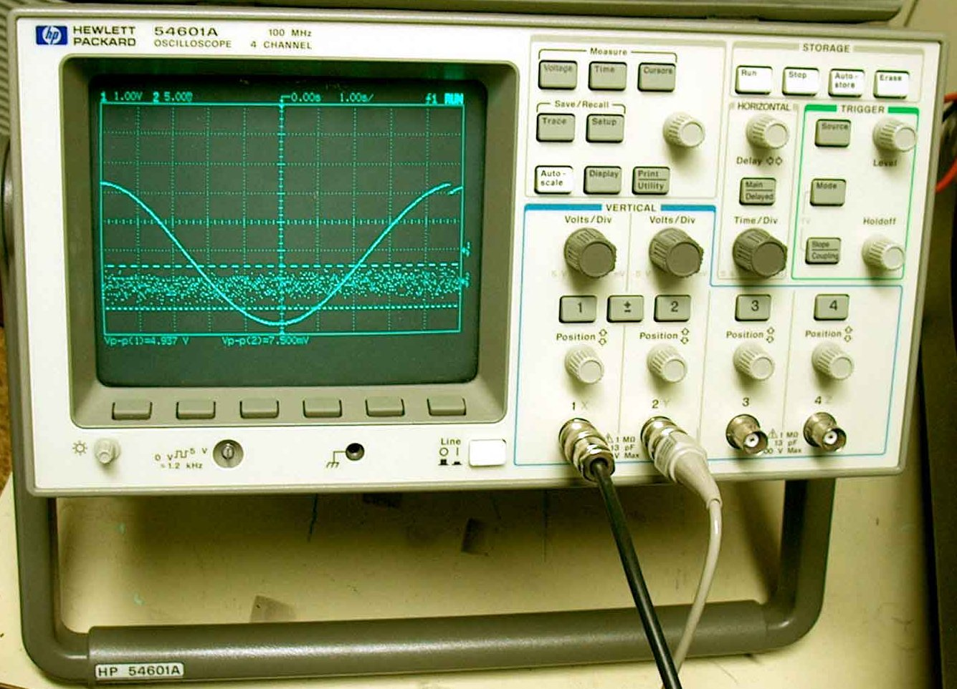
Examples of Random Scan

Slide 24
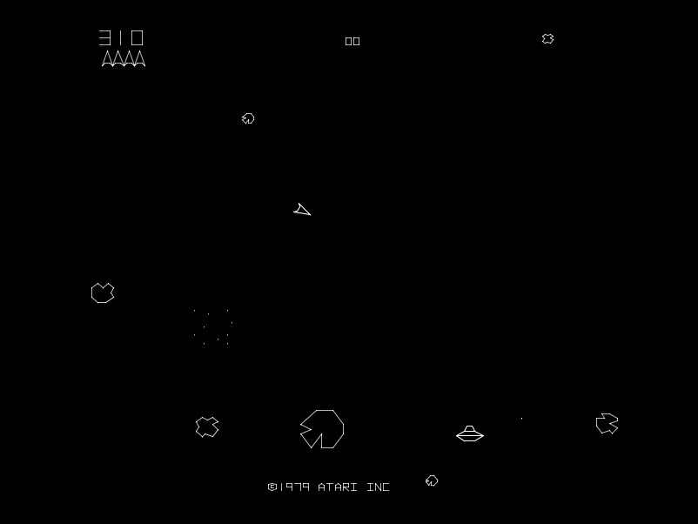
Examples of Random Scan

Slide 25
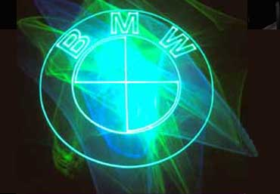
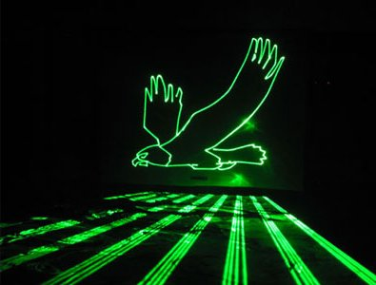
Examples of Random Scan

Slide 26
Raster Display
Terms defined from CRT displays
  Traced an electron beam across a phosphorescent screen
  When electron beam hit screen, phosphor would glow
  Have to repeatedly draw, or image will fade
Each left-to-right trace is called a scan line
Each spot on the screen is called a pixel
Beam turned off to swipe back and up screen
  Called a retrace or blanking interval

Slide 27
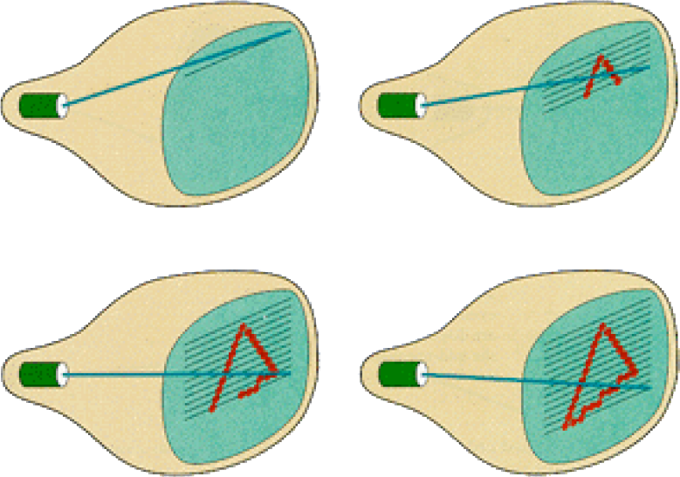
Raster Display

Slide 28
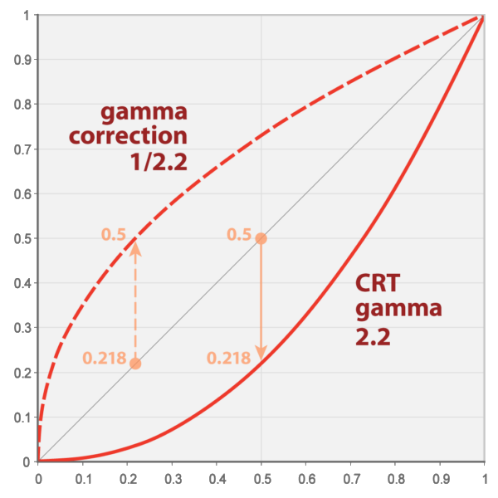
Gamma

Slide 29

Gamma Correction
Gamma originally based on CRT phosphor response to linear change in input voltage
…but good fit to human visual system too
  Especially for 8-bit images, better to store in gamma space and restore to linear intensities when you use it
Modern: sRGB color built into GPU texture units

Slide 30
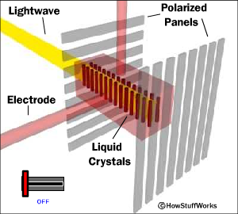
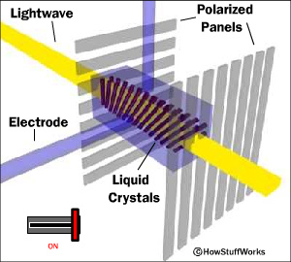
Liquid Crystal Display (LCD)‏
Light enters polarizer
Nematic crystals twist based on voltage
Allowing light to pass through to other polarizer

Slide 31
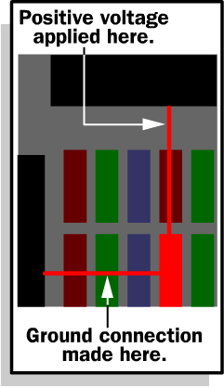
Passive Matrix
Two glass layers
One layer is vertical transparent conductive material, the other is horizontal
Integrated circuit sends charge/ground activation to complete circuit at given row/column
Simple, but slow response time

Slide 32
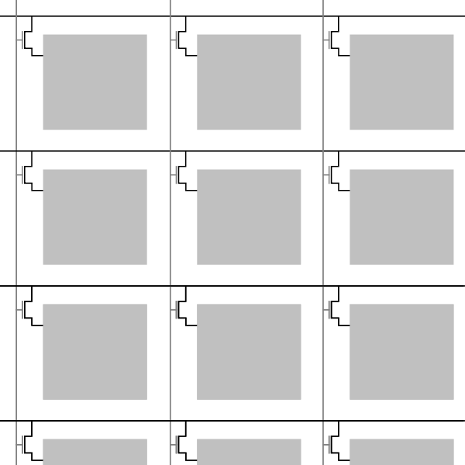
Active Matrix
Active matrix displays have a transistor at each cell
  Thin film transistor (TFT)
Much faster crystal switching

Slide 33
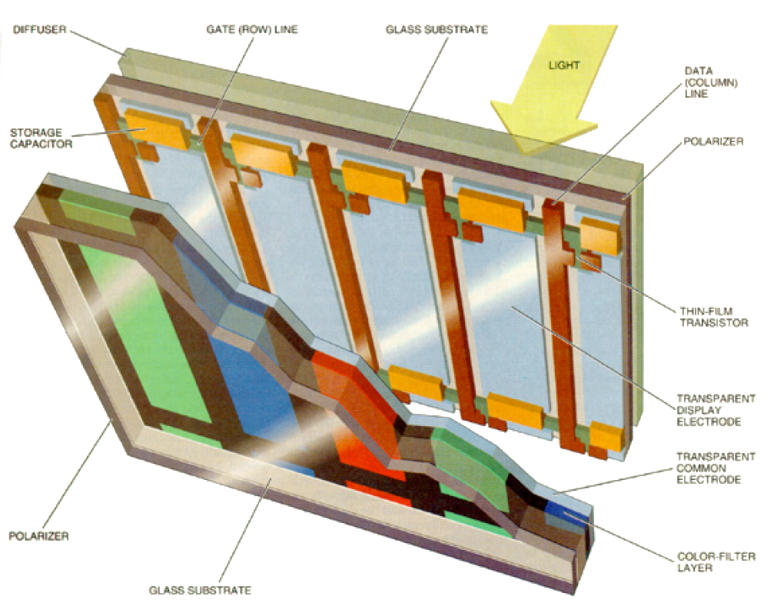
Color LCD

Slide 34
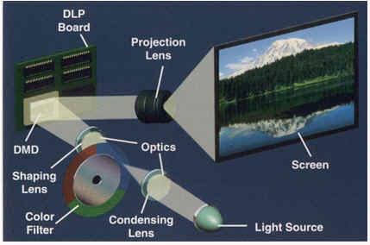
DLP Projector

Slide 35

DLP Projector

Slide 36
Graphics Areas – User Interaction
Deals with the interface between input devices, the application, and feedback to the user in imagery and other sensory feedback

Slide 37
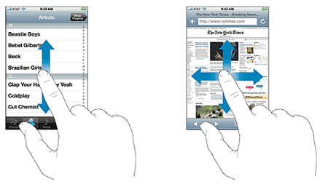
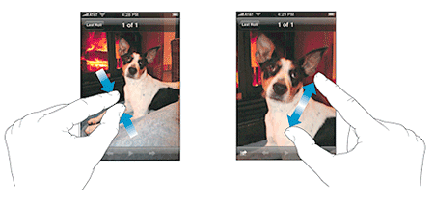
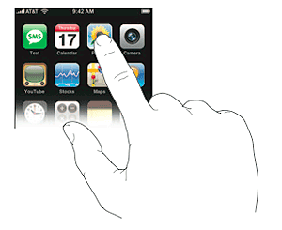
Graphics Areas – User Interaction

Slide 38
Graphics Areas – Virtual Reality
Immersion of user into a 3D virtual world
  Typically involves stereo graphics
  Response to head motion
  Force feedback

Slide 39
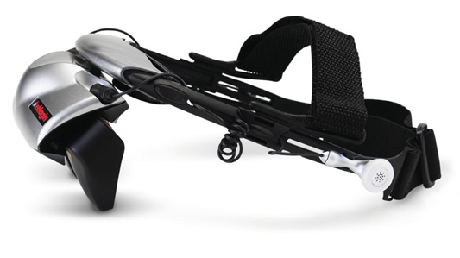
Graphics Areas – Virtual Reality

Slide 40
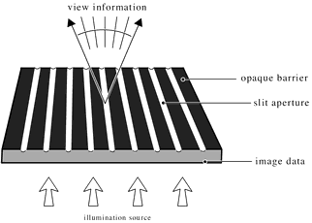
Auto-stereo Display: Barrier

Slide 41
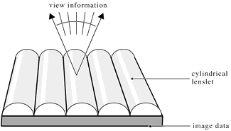
Auto-stereo Display: Lenticular

Slide 42
Graphics Areas – Image Processing
Manipulation of 2D images
  Interpolation
  Filters
  Conversion
  Reshaping / reformatting
  Extending / infill
  Masking / blending

Slide 43
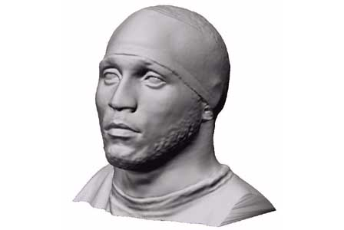
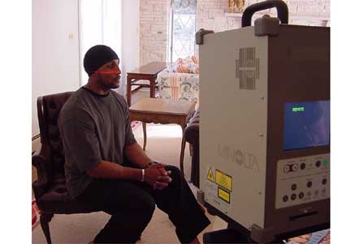
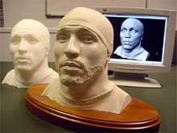
Graphics Areas – 3D Scanning

Slide 44
Major Applications
Video Games
Cartoons
Film Special Effects
CAD/CAM
Simulation
Medical Imaging
Visualization

Slide 45
Applications – Video Games
3D modeling
3D scanning
Rendering algorithms
User interaction
Force feedback
Motion capture
Graphics data structures
Etc...

Slide 46
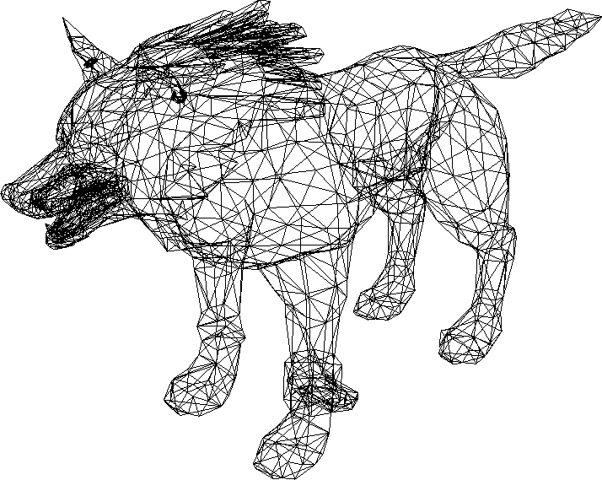
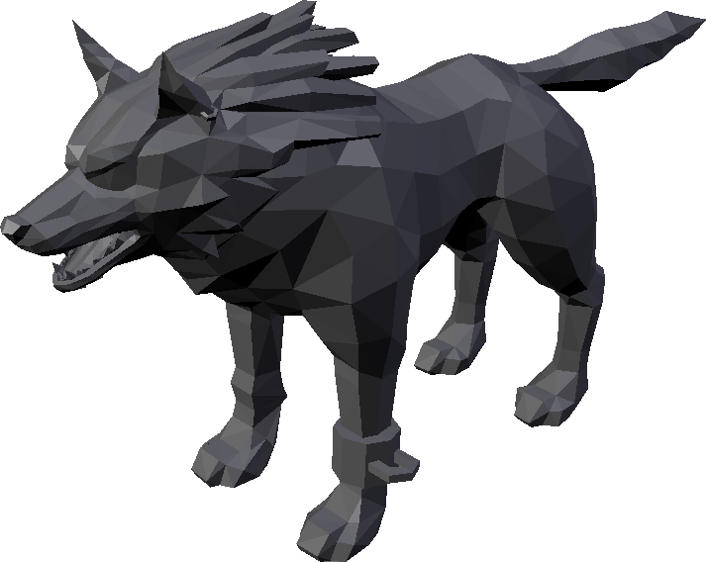
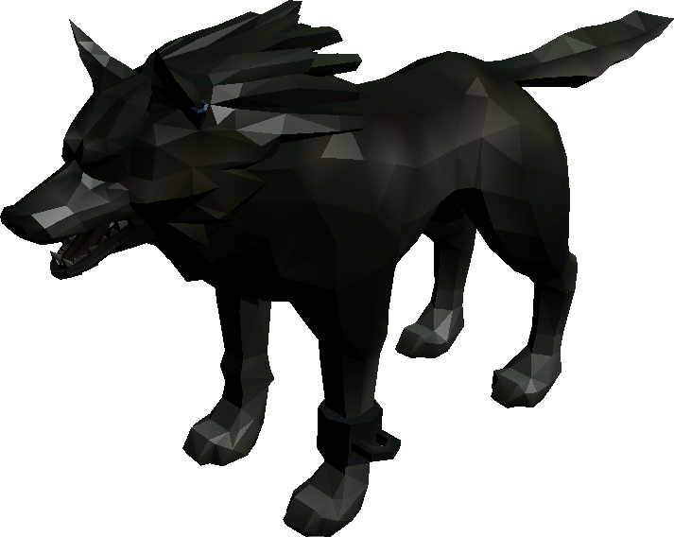
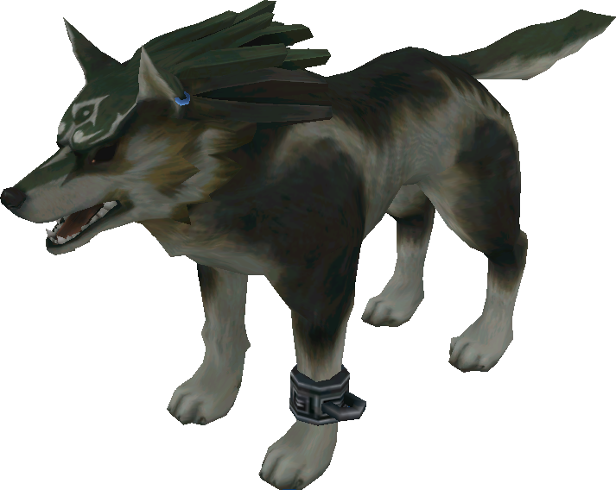
Applications – Video Games

Slide 47
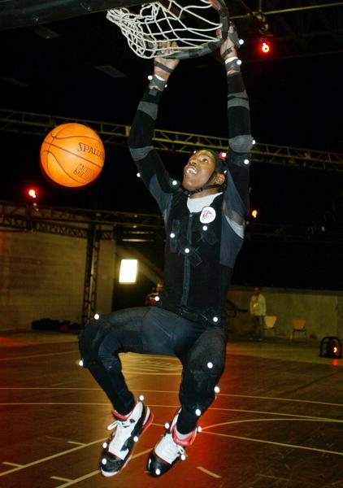
Applications – Video Games

Slide 48
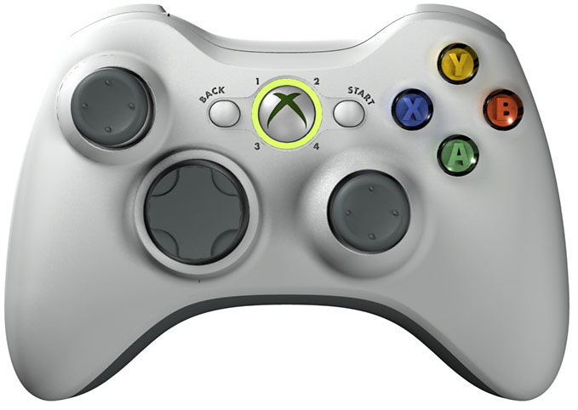
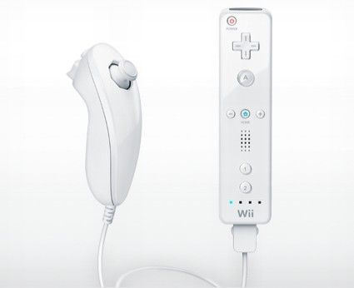
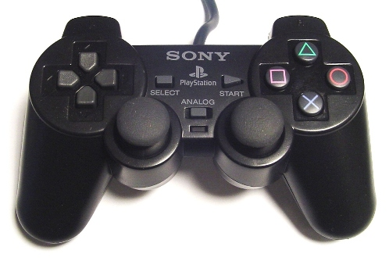
Applications – Video Games

Slide 49
Applications - Cartoons
Often rendered from 3D models
Traditional 2D use backgrounds rendered from 3D models

Slide 50
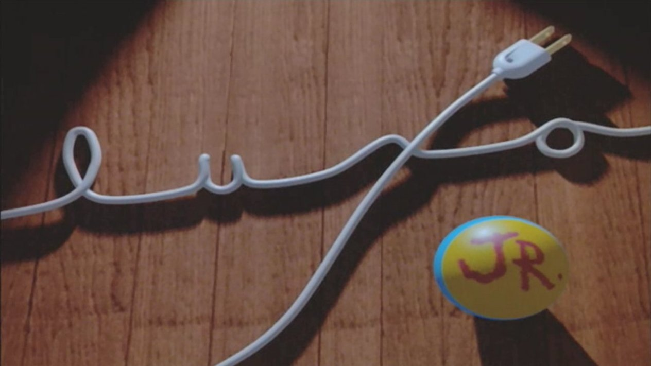
Applications – Animation

Slide 51
Applications – Film Special Effects
Almost all graphics technologies
Digital compositing to superimpose filmed foregrounds onto backgrounds
Foregrounds with 3D models

Slide 52
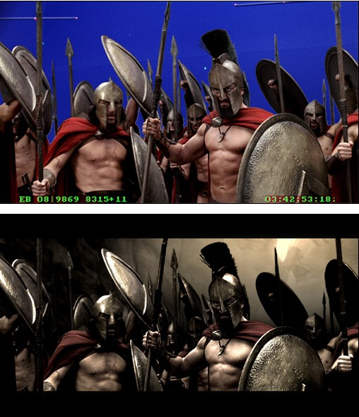
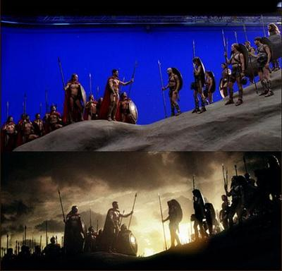
Applications – Film Special Effects

Slide 53
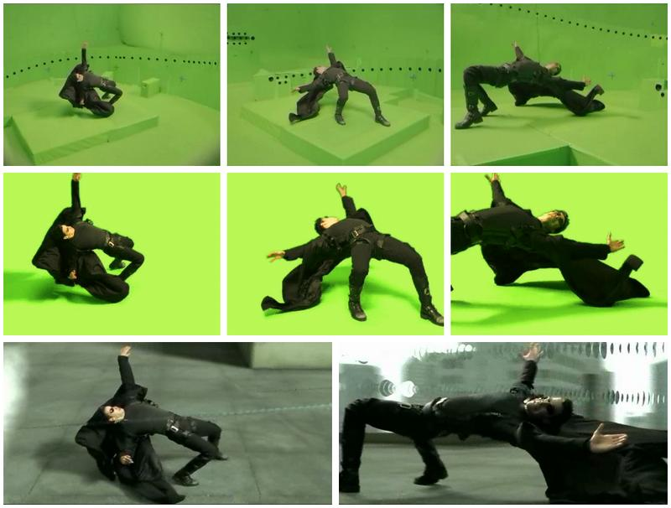
Applications – Film Special Effects

Slide 54
Applications - CAD/CAM
Used to model/design parts which directly guide the manufacturing process
Computer controlled milling devices

Slide 55
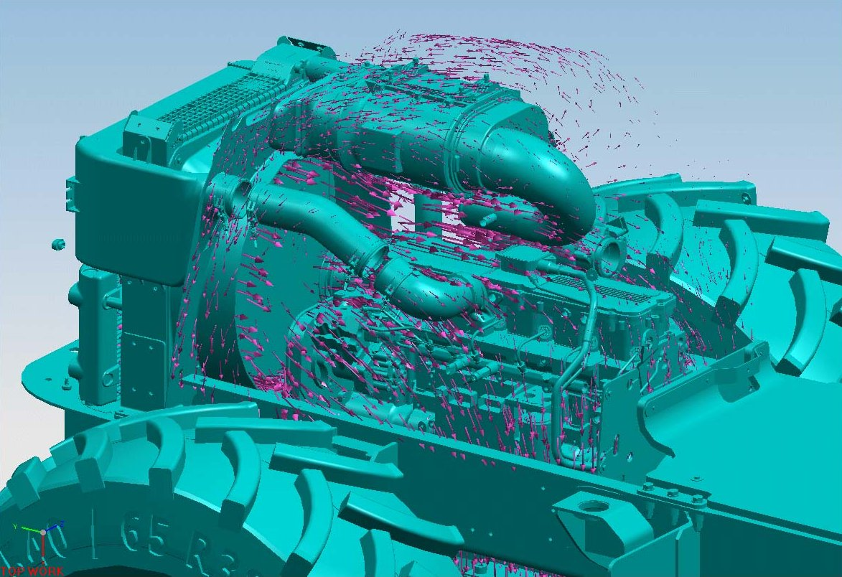
Applications - CAD/CAM

Slide 56
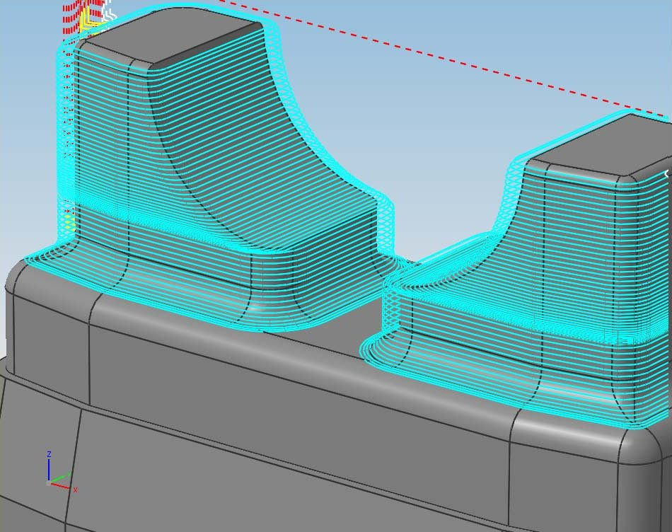
Applications - CAD/CAM

Slide 57
Applications – Simulation
“Accurate” video gaming
Flight & driving simulators
Situations which are too dangerous to costly to perform directly

Slide 58

Applications – Simulation

Slide 59

Applications – Simulation

Slide 60

Applications – Simulation

Slide 61
Applications – Medical Imaging
Create meaningful images of scanned patient data
MRI/CT scans of density values
Large amounts of data
  Very small test sets have 256 × 256 × 128 ≈ 8.4 million samples

Slide 62

Applications – Medical Imaging

Slide 63

Applications – Medical Imaging

Slide 64
Applications – Information Visualization
Creates images of data which do not have a “natural” visual depiction
Finding patterns in data

Slide 65

Applications – Information Visualization

Slide 66

Applications – Information Visualization

