Slide 1





Home Lab:
Shared Infrastructure for
Home Technology Field Studies
A.J. Brush
Jaeyeon Jung
Ratul Mahajan
James Scott

Slide 2
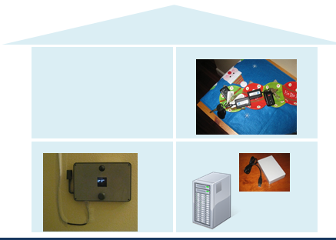
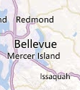
It’s hard to do field studies in homes
(at least that’s our experience)
Limited number of homes often without geographic diversity
Large engineering effort that is not easily re-used

Slide 3

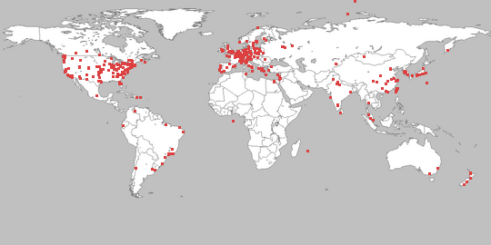
Inspiration
PlanetLab is a global research network that supports the development of new network services. Since the beginning of 2003, more than 1,000 researchers at top academic institutions and industrial research labs have used PlanetLab to develop new technologies for distributed storage, network mapping, peer-to-peer systems, distributed hash tables, and query processing.
All images and information from http://planet-lab.org/

Slide 4
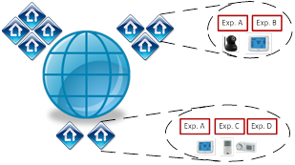
Idea: HomeLab
A large number of geographically distributed households, each running a common, flexible framework in which experiments are implemented.

Slide 5
Shared Study Sites
Managed homes recruited by research groups
Unmanaged homes (DIYers)
Homes can volunteer to participate in one or more experiments that different groups are running.

Slide 6
Offers a PC-like abstraction for devices in the home
  Simplifies management for users
  Simplifies extension by users and developers
http://research.microsoft.com/homeos/

Slide 7
Our abstraction
Organize the home as a PC
Networked devices =~ peripherals
Tasks over these devices =~ apps in high-level APIs
Adding devices =~ adding a peripheral and driver
Adding tasks =~ installing an application
Managing networked devices =~ managing files
[The home needs an operating system (and an app store), HotNets 2010]

Slide 8
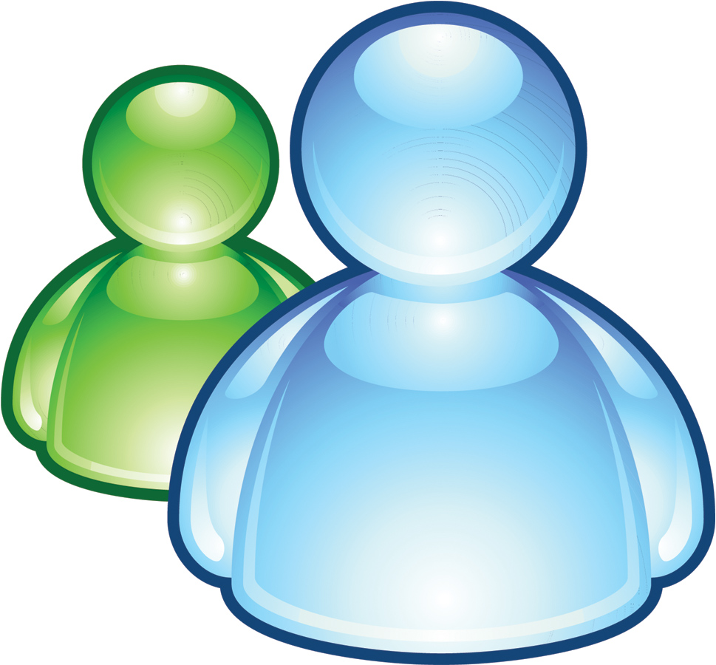







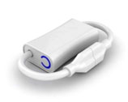

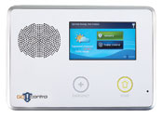
HomeOS overview
HomeCloud
HomeStore
Security
Climate
……..
HomeHub
Z-Wave, DLNA, WiFi, etc.
HomeHub centralizes all devices for users and apps
HomeStore helps find compatible devices and apps
HomeCloud enables remote access and control
Notes:
Explain homestore in some detail!
1. most devices are network controllable
2. technology around remote control of devices is maturing, for example, through standards such as DLNA, Z-Wave, and ZigBee.
1. HomeOS logically centralizes all technology in the home.
2. Cross-device functionality is implemented by applications, not users or devices
3. Users interact with HomeOS rather than individual devices, which makes them easy to manage.
4. HomeOS provides applications simple APIs to access these devices
5. HomeStore simplifies the tasks of finding compatible devices and applications.

Slide 9
HomeOS layering model
Apps use high-level abstractions
Simplifies app development
Manifests enable compatibility checks
Application
Mgmt. and access control
Device functionality
Device connectivity
Primitives are specialized to home setting
Simplifies management
Device capabilities are exported as services
Decouples apps and device protocols
Allows for differentiation by vendors
. . . . .
Device discovery, pairing, and comm. for multiple protocols (e.g., DLNA, Z-Wave)
[An operating system for the home, NSDI 2012]

Slide 10
Prototype
Software module based on .NET and C#
  ~20K lines of code (~3K kernel)
  18 diverse apps (~300 lines per app)
Support for several protocols and devices
  Z-Wave, UPnP, DLNA, custom (HTTP)
  Dimmers, light switches, cameras, motion sensors, d/w sensors, ….
Lab evaluation
  Non-technical users could manage and extend home technology
  Developers could easily create realistic apps
Field evaluation
  Deployed in 12 homes
  50 students across 12 institutions have developed apps and drivers

Slide 11
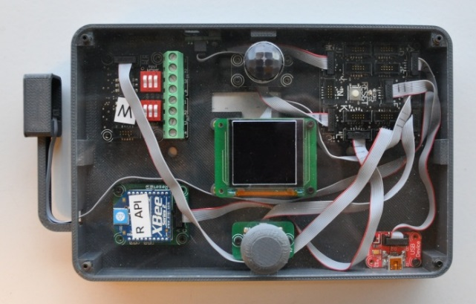
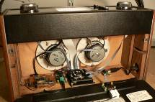
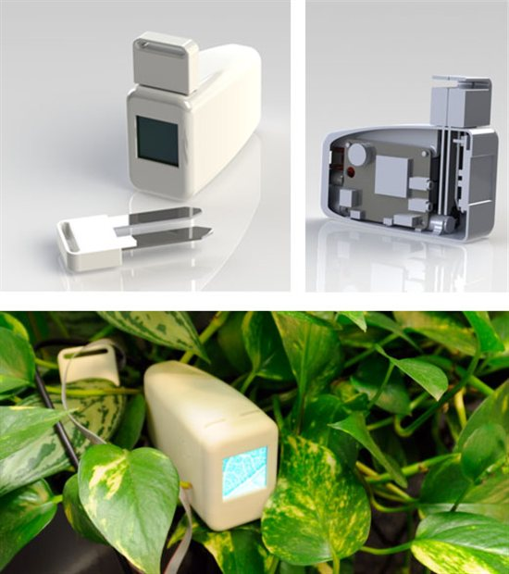
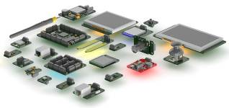
Custom Devices – .NET Gadgeteer
Open Source, available on e.g. amazon.com, http://www.netmf.com/gadgeteer/

Slide 12
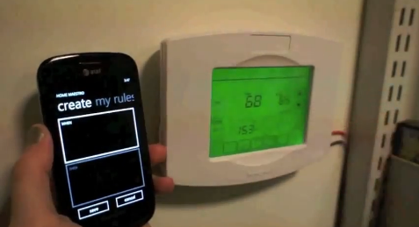
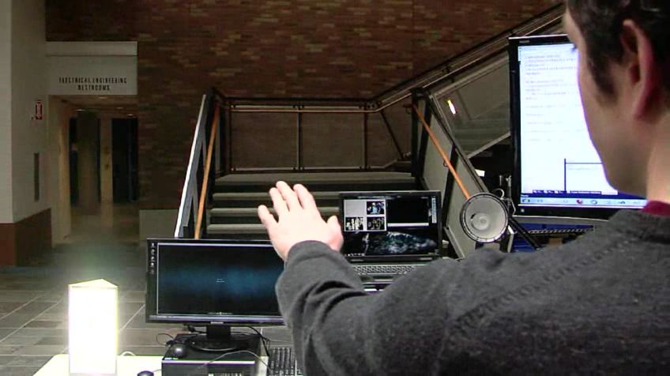
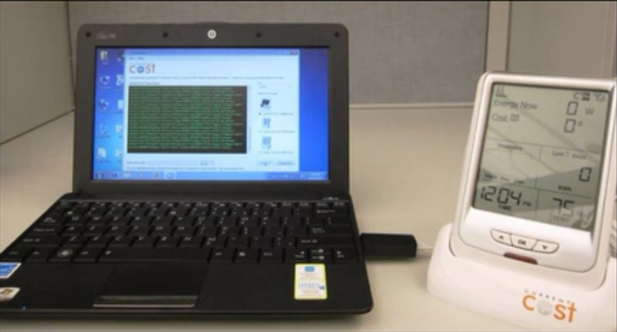
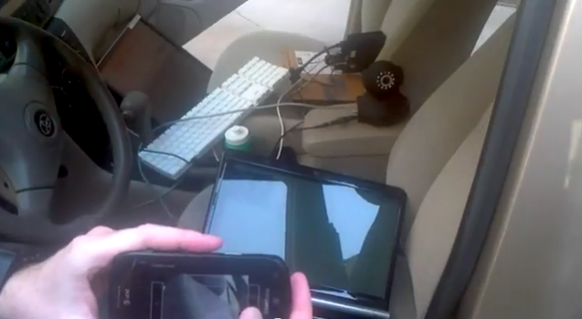
Sample 3rd party applications
For more, see http://research.microsoft.com/homeos/

Slide 13
An Operating System for the Home
Notes:
Published in NSDI (Networked Systems Design and Implementation) 2012

Slide 14
HomeOS
PC-like organization for tech in the home
  Ease management and extensibility
Running in 12 real homes for 4–8 months
Used by 42 student developers at 10 institutions
Notes:
Explain what PC-like means, devices are peripherals basically, and they look attached to the PC

Slide 15
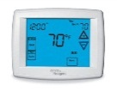

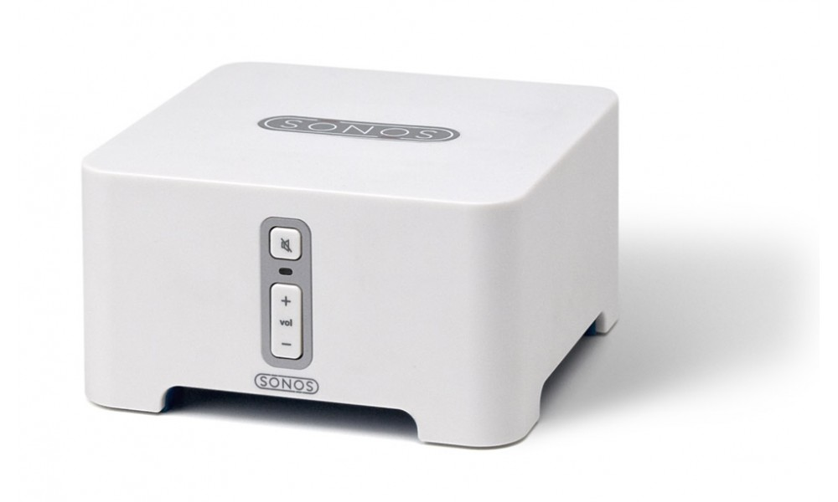
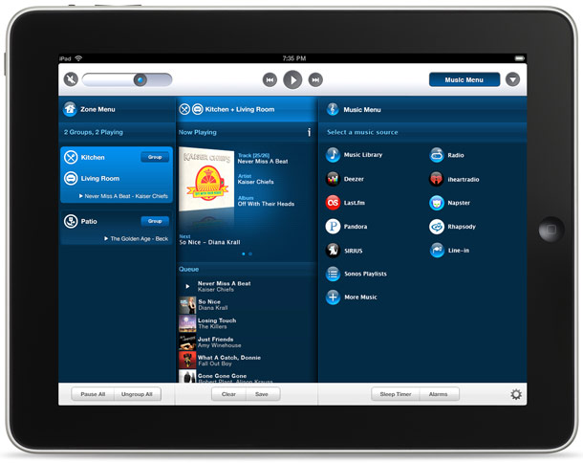


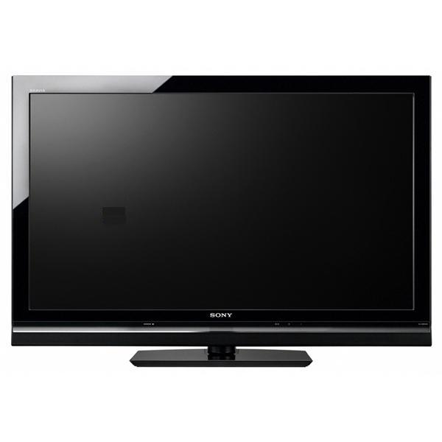
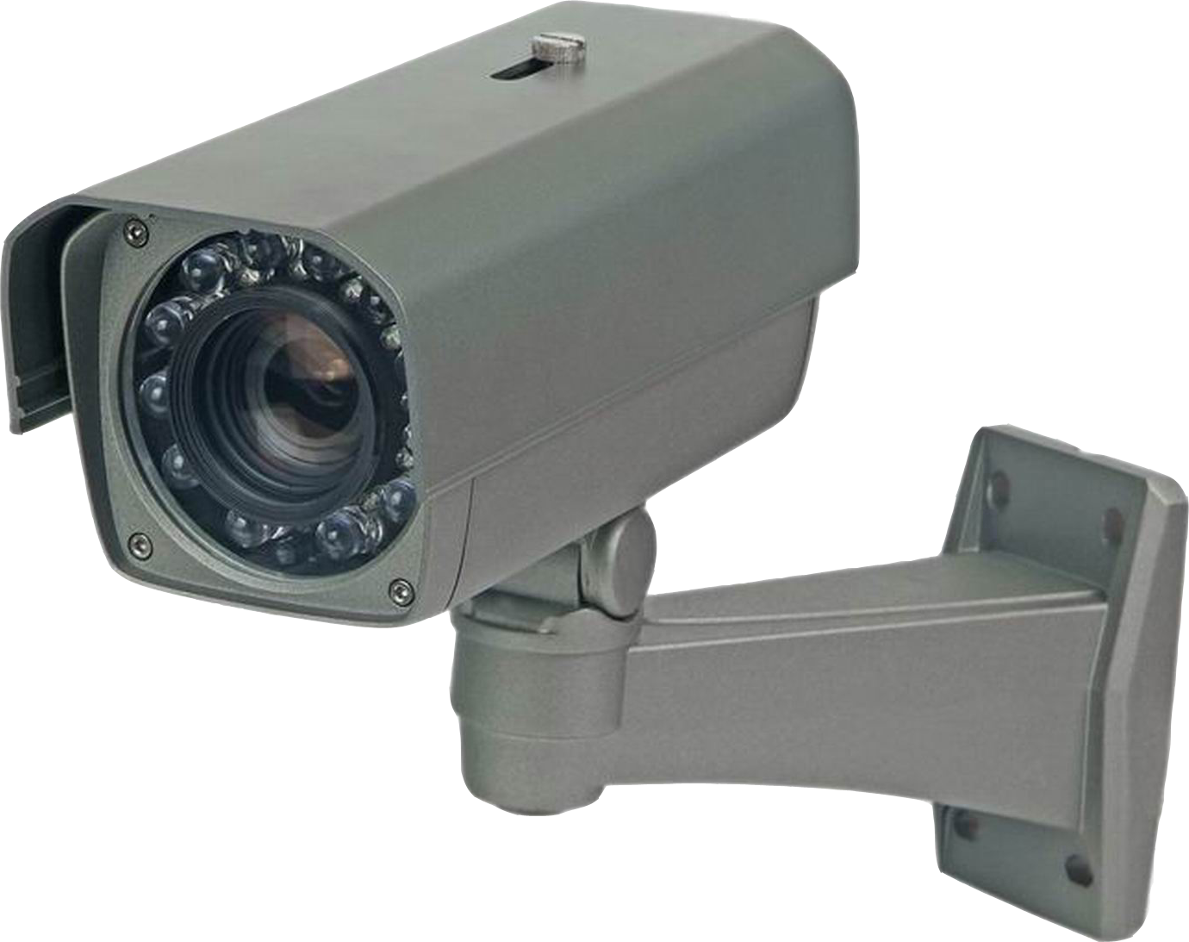
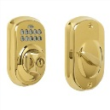
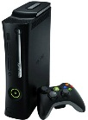
Where’s my smart-home?
Tasks (software)
Energy monitoring
Alerts w/Photos
Climate
control
Keyless entry
Remote lock
Devices
(hardware)
Notes:
Really, this project started by asking one question: It’s the future, where’s my smart-home?
Multiple devices cooperate to cater to users’ wishes with little or no effort”. PCs, cameras, thermostats, locks, TVs and pretty much everything else. Think of logical tasks that span these devices to accomplish something useful, like climate control, an alert system or keyless entry.
Devices are 50-100$

Slide 16

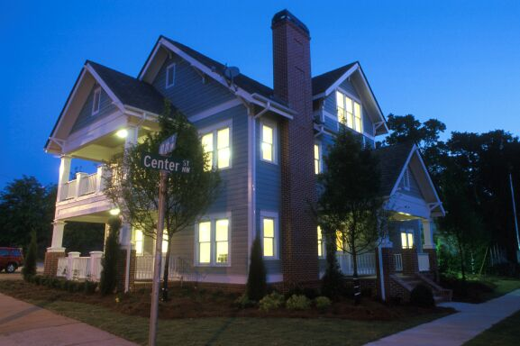
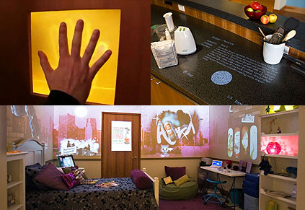
Gap between potential and reality
Envisioned by many researchers and companies
Struggling to break into the mainstream
  Despite commercial availability since 1970s
Notes:
Most things cost ~$50–100 these days: locks, lights, thermostats, even window-blind actuators
Pictures: Georgia Tech Aware Home, Microsoft Home of the Future, Disney’s Smart House

Slide 17






Understanding the gap
Pre-Study of homes with modern automation
  31 people across 14 households
  Enjoyed convenience, peace of mind and control
  But, had difficulty in two key areas:
Poor extensibility | Management pain
or
Adding devices and tasks
Access control
Notes:
We also learned from these people why the smart-home technology is not ready for mainstream.

Slide 18
Gap – Details
Hardware inflexibility: networking wires, low-voltage wiring
Extensibility: Organic growth
Management: Security
  Currently the choice is between security and inconvenience (guest / remote access)

Slide 19
Gap – Span of our work
Hardware inflexibility: networking wires, low-voltage wiring
Extensibility: Organic growth
Management: Security
  Currently the choice is between security and inconvenience (guest / remote access)
Notes:
We focus on the last two problems:
Device vendors are already taking care of the first one
Wireless is becoming commonplace
Low-voltage devices are moving to regular voltage.

Slide 20

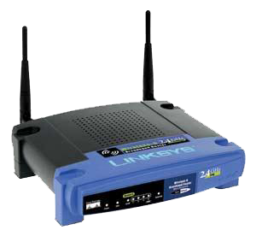
Existing abstractions for home tech
Network of devices
  Interoperability protocols
    DLNA, Z-Wave, Speakeasy, …
    Open, low-level device access
Appliance
  Monolithic systems
    Crestron, Control4, EasyLiving, …
    Fixed tasks over fixed devices
Management is still hard
Users must manage each device/task
Developers must deal directly w HW
Remote monitoring
Climate control
Extensibility is still hard
Closed set of tasks
Closed set of devices
Notes:
Making extensibility and manageability easy is about finding the right abstractions. So, what are the main abstractions around which home technology is organized today? There are two.
The first abstraction is a network of devices. This viewpoint leads one to develop protocols by which devices can talk to each other, that is, interoperability protocols. It does not worry so much about how tasks are implemented on top of this network.
The second abstraction is of an appliance. This views technology as complete, closed systems. It leads to software that is coupled directly with the hardware and works only with the specific devices, and specific (single) vendor: vertical integration.

Slide 21
The home as a PC
View the home as a computer
Networked devices ≈ peripherals (w/drivers)
Tasks over these devices ≈ applications
Adding devices ≈ plugging in a peripheral
Adding tasks ≈ installing an application
Managing networked devices ≈ managing files
Notes:
A different paradigm for organizing technology in the home.

Slide 22








HomeOS: An OS for the home
HomeStore
Video recording
Remote unlock
Climate control
HomeOS
Z-Wave, DLNA, UPnP, etc.
HomeOS logically centralizes all devices
Users interact with HomeOS, not individual devices
HomeStore helps find compatible devices and apps

Slide 23
Challenges in the home
Non-expert users must become network managers
  Need rich, but easy to use management tools
  E.g., misconfigured app may be able to unlock a door
Developers struggle to build apps
  Heterogeneity in tasks, control, device and topology
New classes of devices arrive frequently
  E.g., Kinect, energy meters, connected TVs, etc.
Manageability
Extensibility
Notes:
Brief aside that there’s not going to be a silver bullet, but rather judicious application of solutions that actually work in the home.

Slide 24
HomeOS architecture
Application layer
Management layer
Device functionality layer (DFL)
Device connectivity layer (DCL)
Tasks
Control
Device
Topological
Heterogeneity source handled
Notes:
Layering is the way to contain complexity

Slide 25
DCL and DFL (Drivers)
App layer
Mgmt layer
DFL
DCL
DCL provides basic connectivity to devices
  Discovery
  Abstract differences in protocols
  Connectivity
DFL exports device functionality as a service
  Services are protocol-independent
  Exposed as roles and operations
  Kernel does not parse or understand services
  Allows subscriptions (e.g. when light is toggled)
  Applications do not require changes
Notes:
DCL includes discovery and pairing
One DCL module per device protocol
PTZ = Pan Tilt Zoom
Before HomeOS applications talk directly (e.g. to DLNA) and there are many protocols like DLNA

Slide 26
Rules & Operations
App layer
Mgmt layer
DFL
DCL
Layer of Indirection between protocols and apps
Dimmer | PTZ Camera
Set(level) Get() → level | GetImage() → bitmap Up(), Down(), Left(), Right() ZoomIn(), ZoomOut()
Notes:
PTZ = Pan Tilt Zoom

Slide 27


Management Layer Requirements
Time-based access control
Apps as security principals
Easy-to-verify settings
Mental models are based on research in 14 homes (31 people) with home automation already installed.
Notes:
The management layer of HomeOS provides a central place for users to manage the technology in their home and how applications are allowed to access it.
Add / Remove: apps, devices, and users.
Mediates access conflicts
Must be usable by non-experts and research shows that you have to design primitives to do this rather than slapping UI on later. We thus have to build primitives designed to match user’s mental models. We uncover these mental models in interviews of the same set of participants that I mentioned earlier.
The requirements primitives differ from those in current PC Oses

Slide 28
Management Layer
App layer
Mgmt layer
DFL
DCL
Access control policy:
Datalog-based rules
  (resource, userGrp, app, t_{start}, t_{end}, dayOfWeek, priority, accessMode)
Rules include time and application
Allow users to query rules to verify their intent
Easier to reason about than ACLs in current OSes
Scales better than 2-D grid of users and devices
Notes:
* Primitives are richer than those in current OSes. However, non-experts find it hard to configure and understand even those primitives.
We reconcile the conflict by leveraging the fact that the home is a much simpler environment that does not need much of the complexity that is motivated by enterprise environments such as dynamic delegation and highly-customizable ACLs.
ACL = Access Control List = list of permissions attached to an object
accessMode = allow, or ask

Slide 29
Datalog advantages
The Datalog abstraction meets our requirements
  Simplicity (once you discard advance features (not needed in homes)
Users can configure time-based policies as well as restrict an application to specific devices
They can also easily understand their configuration by getting inverse views such as:
  “which applications can access the door?”
  “which devices can be accessed after 10 PM?”, or
  “can a user ever access the back door lock?”
Definitions can easily be visualized or expresses as English sentences
  “Allow residents to access the living room speakers using the music player from 8 AM to 10 PM.”
Notes:
The main advantage of Datalog over ACLs is its simplicity. ACLs can be more expressive, assuming we extend them to include time and applications. But they are hard for users to program [33] and hard to aggregate and summarize. We are not the first to propose the use of Datalog for access control, but its use can require major extensions to accommodate policies of complex environments [32]. We find that the needs of the home environment can be met without such extensions.
Past systems looking to simplify access control have explored using a simple table [38] with the principals along one axis and the objects along the other with each cell specifying if access should be allowed. While promising, this approach does not scale well beyond two dimensions and our interviews indicated that time and application were both required dimensions.

Slide 30
Application layer
App layer
Mgmt layer
DFL
DCL
Apps compose abstract rules from DFL
Management layer interposes on accesses
Manifests help with compatibility testing
  Lists of mandatory and optional features
  E.g., mandatory: {TV, SonyTV}, {MediaServer}
  optional : {Bass Speaker}
Notes:
The application layer is where developer-written code runs to use and compose the devices in the home.
The key feature that HomeOS provides at app layer is the ability to ascertain if an application is compatible with the home.
- Today, when users bring software home, they have little assurance that it will work in their environment.
HomeOS applications provide a manifest describing what services they need to function.
- Helps check compatibility.
- If not compatible, HomeOS can also determine what additional devices are needed.
Explain manifests.
Our current manifest descriptions cannot encode complex requirements (e.g., two devices in the same room).
- They handle what we deem as the common case.
- Can extend later if needed

Slide 31
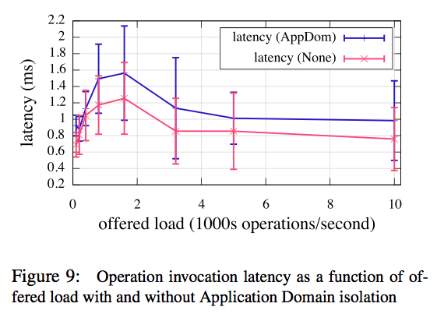
Performance – Latency
Two orders of magnitude lower than the interactive response time guideline of 100 ms
Notes:
Even under heavy load, we are able to keep latencies below 2 ms. This is two orders of magnitude lower than the interactive response time guideline of 100 ms [18], which means that applications can compose several services and allow for network delays before responding to the user.
The odd increase in latency when the offered load is low (between 100 and 3000 operations per second) is an artifact of the ThreadPool scheduling rapidly switching between threads when each thread offers substantially lower load than what the machine can handle. We found it to persist across other microbench- marks as well.

Slide 32
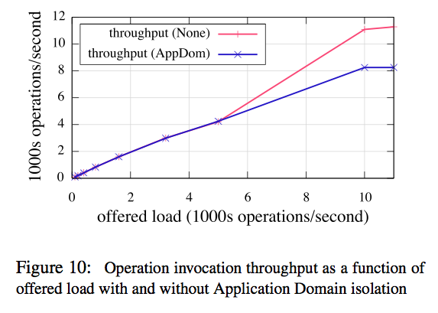
Performance – Throughput
Well-beyond what was required for any of our current deployments
Notes:
With AppDomain isolation, HomeOS handles approximately 8,250 operation invocations per second, while with no isolation the system can handle nearly 11,300 operation invocations per second. This level of performance has been well-beyond what was required for any of our current deployments.

Slide 33
Evaluating HomeOS
Key questions:
Can non-technical users manage HomeOS?
Can developers easily write apps and drivers?
Method:
Field experiences
  12 real homes and 42 student developers
Controlled experiments
Notes:
Field experiences
Developed real apps
Controlled
Developers
“Custom Lights Per-User” will adjust the lights in any room based on its occupant’s preferences
“Music Follows the Lights” finds all lights and media devices in the house, registers for changes to the lights’ status and plays music (from a media server) on an audio device in rooms with lights that are on.
Users
Evaluate whether our management primitives and interfaces are easy enough for non-expert home users to use. Task list in figure 8(b)

Slide 34
Field experiences: The good
Users could manage their HomeOS deployments
Users particularly liked the ability to organically extend their technology
Developers found the programming abstractions and layering to be “natural”
Notes:
Users could manage: We did not provide any support beyond basic documentation
Organic growth was possible
Developers: DCL-DFL split was viewed as needed later in some cases

Slide 35
Field experiences: The bad
Users found it hard to diagnose faults
Interoperability protocols can be fragile
Not all device features may be exposed over the network
Notes:
Interoperability protocols reveal limited information (protocols need more diagnosis support)
Even ICMP would be great
Particularly hurts in the face of decentralized data plane
DLNA was the culprit; need transcoding
Set top box showing text over live video not exposed
Hinders rich application development

Slide 36
Controlled Evaluations
10 developers asked to write one of two realistic apps
  “music follows the lights” or “custom lights per user”
  No prior experience with HomeOS
  8 finished in under 2 hours
12 non-expert users given 7 representative mgmt. tasks
  No training with management interface
  77% completion rate; 89% after removing an outlier task
Performance results in the paper

Slide 37
Conclusions
HomeOS eases extensibility and management by providing a PC abstraction for home technology
Still lots of exciting things to do!
  What core capabilities should be in every home?
  Can we provide non-intrusive identity inference?
Notes:
Explain alternate abstractions and key ideas again.
These ideas dropped out of real experiences!
For more info and to request code: http://research.microsoft.com/homeos/

Slide 38

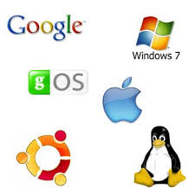

Brainstorm
Microsoft Bob (1995)
Who is the user?
Use existing standards?
Notes:
* Microsoft Bob was designed for Windows 95 and Windows NT, and intended to be a user-friendly interface for Microsoft Windows.

Slide 39
Extra

Slide 40
REST and SOAP
REST
SOAP
Architecture style
GET, POST, PUT, DELETE
Only HTTP
HTML, XML, JSON
Protocol
Service specific
HTTP, SMTP, TCP, …
XML is verbose

Slide 41
Datalog
Datalog is in many respects a simplified version of general Logic Programming
  Fact: “John is the father of Harry”
  Rule: “If X is a parent of Y and if Y is a parent of Z, then X is a grandparent of Z”
Datalog
  Fact: father(Harry, John)
  Rule: grandpar(Z, X) :- par(Y, X), par(Z, Y)

Slide 42
Scope of our work
Abstractions and Metaphors
HomeOS
  20K lines of C#, 3K of that in the kernel
  About 2.5 years
Drivers
Test applications (18)
  Each < 300 lines of code, a few hours to develop
  Other developers also found development easy

