Slide 1
Kinect basics: Systems for Smart Home Automation Nilanjan Banerjee

Slide 2
Agenda
Overview
Camera Basics
Depth Data
Skeletal Tracking
Gestures & Interaction
Face Tracking
Kinect Socket Service
Kinect Fusion
Next Version of Kinect

Slide 3
What’s new with Kinect 1.6 & 1.7
Kinect 1.6
Improved Depth Data API
Coordinate Mapper
More Sensor data – IR, Accelerometer, Camera Settings
Kinect 1.7
Kinect Fusion
Kinect Interactions – Interaction Stream, Click, Grip, Scroll
Interaction Controls – KinectRegion, KinectCursor, KinectItems Control, KinectTileButton, KinectCircleButton, KinectScrollViewer, UserViewer

Slide 4
Getting Started
Kinect - Xbox 360 or Kinect for Windows
Kinect for Windows SDK 1.7
Kinect for Windows Developer Toolkit 1.7
Coding for fun Kinect WPF

Slide 5
Kinect API Basics
Setup Kinect
KinectSensorChooser – KinectChangedEvent or KinectSensor.Connected
Enable Color, Depth, Skeleton, Audio
Start Kinect
Get Data
Interaction Controls
Events – AllFramesReady, InteractionFrameReady
Polling – OpenNextFrame

Slide 6
Camera Basics

Slide 7
Image Processing 101
BGR32 Format – Every Pixel (0,0 | 0,1 | 0,2) has blue, green, red, empty
B | G | R | Empty
255 | 255 | 255 | 0
B | G | R | Empty
255 | 255 | 255 | 0
Kinect Image
Sizes: 80x60, 320x240, 640x480
DPI: 96
Stride: # of bytes per single line:
Width (320 or 640) x 4 bytes (B,G,R,E)
80x60
320x240
640x480

Slide 8
First order task: Retrieve a RGB image from the Kinect
We will be using WPF
Next generation windows presentation foundation
Helps you build pretty user interface in Windows
Much more flexible than a windows form framework
Allow dynamic and flexible layouts --- sizes of views like textbox etc. changes dynamically
Separates the design of the UI and the logic: design of the UI is in a xaml file and the logic is in C# similar to web programming
Important data structure: WriteableBitmap
Stores the bitmap of an image but unlike the ordinary bitmap, WriteableBitmap is mutable
Read and write to bitmap

Slide 9
Camera Basics Demo
Name

Slide 10
Depth Data

Slide 11
Depth Data
Distance and player index for every pixel
Distance is in millimeters (2,000 mm = 6.56 feet)
Player index 1-6 or 0 for no player

Slide 12
Depth Data Demo
Name

Slide 13
Skeletal Tracking

Slide 14
Skeletal Tracking
ShoulderCenter
Head
Default (20)
ShoulderRight
ShoulderLeft
ElbowRight
ElbowLeft
Spine
WristRight
WristLeft
HandRight
HandLeft
HipCenter
HipRight
HipLeft
KneeRight
KneeLeft
Max of two skeletons per Kinect
6 Player Proposals
Seated (10)
AnkleRight
AnkleLeft
FootRight
FootLeft

Slide 15
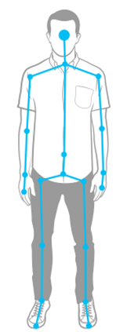
Coordinates
Joints in meters from camera
Positive
Y Axis
Positive
Z Axis
Positive
X Axis
Negative
Negative

Slide 16
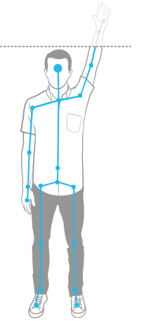
Joint Tracking & Smoothing
Each joint has associated tracking state
Tracked, Not tracked, or Inferred
Inferred - Occluded, clipped, or low confidence joints
Use TransformSmoothParameters to smooth joint data to reduce jitter
Skeleton.ClippedEdges = FrameEdges.Top;
Kinect transform smoothing uses Holt Double Exponential Smoothing - http://en.wikipedia.org/wiki/Holt-Winters

Slide 17
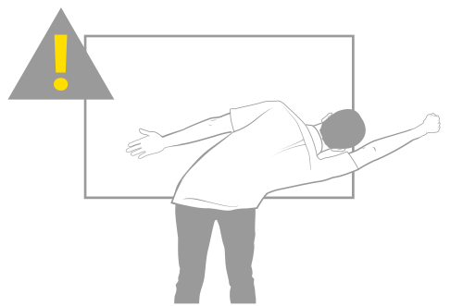
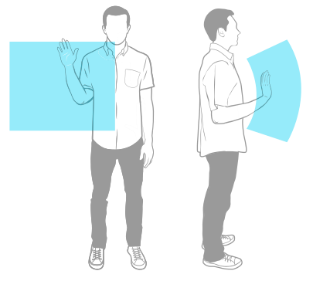
Physical Interaction Zone
Fatigue Kills Gestures
Use Coding4Fun ScaleTo extension
Interaction Controls support

Slide 18
Skeletal Tracking Demo
Name

Slide 19
Gestures & Interaction

Slide 20
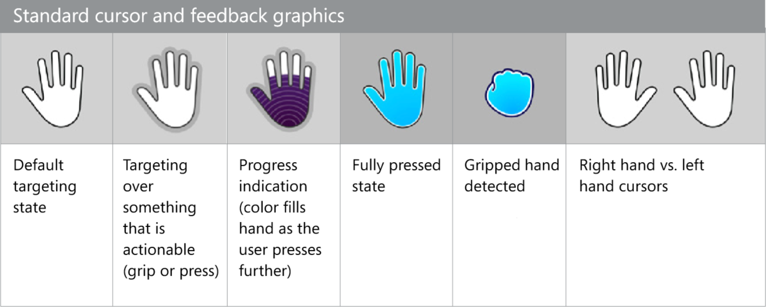
Gesture Controls
Define Kinect controls in KinectRegion
KinectItems Control, KinectTileButton, KinectCircleButton, KinectScrollViewer
Automatically get cursor, grip, and scroll support

Slide 21
Gestures Demo
Name

Slide 22
Face Tracking

Slide 23
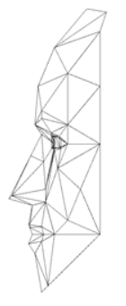
Face Tracking
2D/3D Mesh and Points
3D Head Pose
Animation Units
Z Axis

Slide 24
3D Head Pose
+20
-45
+45
-20
-90
+90
Roll
Yaw
Pitch

Slide 25
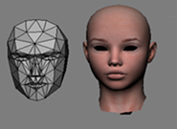
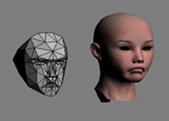
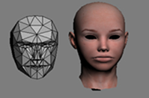
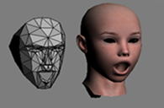
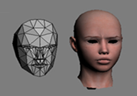
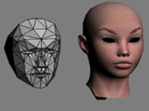
Animation Units
Upper Lip Raiser
Lip Corner Depressor
Lip Stretcher
-1 Max pushed down lip
-1 Very happy smile
-1 Fully rounded (kissing mouth)
+1 Showing teeth fully
+1 Very sad frown
+1 Fully stretched (joker’s smile)
Jaw Lowerer
Brow Lowerer
Outer Brow Raiser
-1 Closed
-1 Raised almost all the way
-1 fully lowered, very sad face
+1 Fully open
+1 Fully Lowered
+1 raised in expression of deep surprise

Slide 26
Face Tracking Demo
Name

Slide 27
Kinect Service

Slide 28
Kinect Socket Service
Kinect data over TCP Sockets
Color, Depth, Skeleton, and Audio
Client libraries for WPF, Windows Phone & WinRT
Console or Windows Service host
Scenarios
Windows Store, Windows Phone, WPF
1 Kinect to many PCs, Many Kinects to 1 PC

Slide 29
Kinect Service Demo
Name

