Slide 1
CMSC 628: Introduction to Mobile Computing
Nilanjan Banerjee
University of Maryland
Baltimore County
nilanb@umbc.edu
http://csee.umbc.edu/~nilanb/teaching/628/
Introduction to Mobile Computing

Slide 2
Today’s lecture
Android Lifecycle
  Activity starts up
  Activity suspends and resumes
  Activity is stopped and restarted.

Slide 3
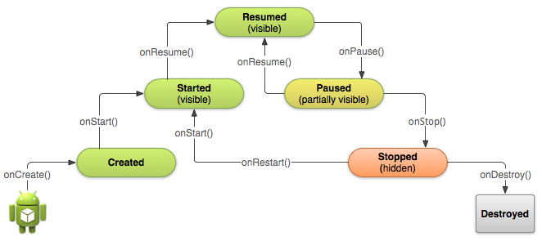
Starting an activity
Activity starts
  onCreate(), onStart(), onResume() are called in succession
onStart()
Activity is partially visible
Ack: Android Development website

Slide 4
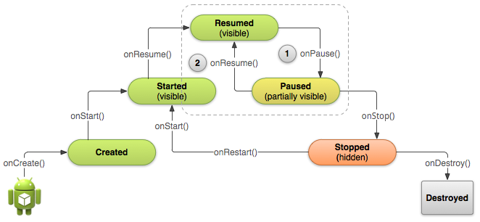
Pausing and Resuming an Activity
How is pausing defined?
  If an activity is partially visible in the background
  Dialog boxes open up
  Method called is onPause()
What should you do before an activity pauses
save state of the application?
release resources

Slide 5
Stopping and Starting an Activity
How is stopping an activity defined?
  If the activity is not visible
  Press back or home button
  Start a new activity or receive a phone call
What should you do before an activity stops
save state of the application?
release resources
System destroys
the activity

Slide 6
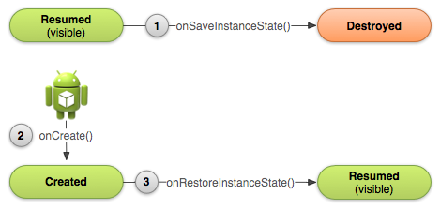
Recreating an Activity
If the system destroys an activity due to system constraints
  Saves certain state of your activity that is restored back the next time the activity starts
  If you want to save your own state before the activity is destroyed:
    Override the onSaveInstanceState(Bundle)
    Access your state during onCreate() or onRestoreInstanceState()

Slide 7
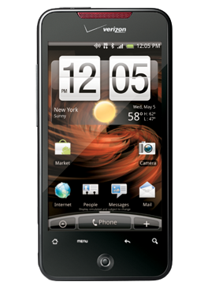
Android Sensors Overview
Android Sensors:
MIC
Camera
Temperature
Location (GPS or Network)
Orientation
Accelerometer
Proximity
Pressure
Light

Slide 8
Two types of sensors on the android platform
Hardware sensors
  Physical sensors present on the phone
  Accelerometers, temperature, gyroscope
Software sensors
  Virtual sensors that are built on top of hardware sensors.
  Orientation sensors --- accelerometer + gyroscope?

Slide 9
Async Callbacks
Android’s sensors are controlled by external services and only send events when they choose to
An app must register a callback to be notified of a sensor event
Each sensor has a related XXXListener interface that your callback must implement
  E.g. LocationListener
Your App
SensorManager
Register Callback
Sensor Event
Sensor Event
Sensor Event

Slide 10
Getting the Relevant System Service
The non-media (e.g. not camera) sensors are managed by a variety of XXXXManager classes:
  LocationManager (GPS)
  SensorManager (accelerometer, gyro, proximity, light, temp)
The first step in registering is to obtain a reference to the relevant manager
Every Activity has a getSystemService() method that can be used to obtain a reference to the needed manager
public class MyActivity … {
private SensorManager sensorManager_;
public void onCreate(){
…
sensorManager_ = (SensorManager) getSystemService(SENSOR_SERVICE);
}
}

Slide 11
Registering for Sensor Updates
  The SensorManager handles registrations for
    Accelerometer, Temp, Light, Gyro
  In order for an object to receive updates from a sensor, it must implement the SensorEventListener interface
  Once the SensorManager is obtained, you must obtain a reference to the specific sensor you are interested in updates from
  The arguments passed into the registerListener method determine the sensor that you are connected to and the rate at which it will send you updates
public class MyActivity … implements SensorListener{
private Sensor accelerometer_;
private SensorManager sensorManager_;
public void connectToAccelerometer() {
sensorManager_ = (SensorManager)getSystemService(SENSOR_MANAGER);
accelerometer_ = sensorManager_
.getDefaultSensor(Sensor.TYPE_ACCELEROMETER);
sensorManager_.registerListener(this, accelerometer_,
SensorManager.SENSOR_DELAY_NORMAL);
}

Slide 12
The SensorEventListener Interface
  Because there is one interface for multiple types of sensors, listening to multiple sensors requires switching on the type of event (or creating separate listener objects)
  Also forces registration at the same rate per listener
  Simple approach:
public class MyActivity … implements SensorListener{
// Called when a registered sensor changes value
@Override
public void onSensorChanged(SensorEvent sensorEvent) {
if (sensorEvent.sensor.getType() == Sensor.TYPE_ACCELEROMETER) {
float xaccel = sensorEvent.values[0];
float yaccel = sensorEvent.values[1];
float zaccel = sensorEvent.values[2];
}
}
// Called when a registered sensor's accuracy changes
@Override
public void onAccuracyChanged(Sensor arg0, int arg1) {
// TODO Auto-generated method stub
}
}

Slide 13
The SensorEventListener Interface
  Another approach for multiple sensors (probably better):
public class MyActivity … {
private class AccelListener implements SensorListener {
    public void onSensorChanged(SensorEvent sensorEvent) {
    …
    }
    public void onAccuracyChanged(Sensor arg0, int arg1) {}
    }
private class LightListener implements SensorListener {
    public void onSensorChanged(SensorEvent sensorEvent) {
    …
    }
    public void onAccuracyChanged(Sensor arg0, int arg1) {}
    }
    private SensorListener accelListener_ = new AccelListener();
    private SensorListener lightListener_ = new LightListener();
    …
    public void onResume(){
    …
    sensorManager_.registerListener(accelListener, accelerometer,
    SensorManager.SENSOR_DELAY_GAME);
    sensorManager_.registerListener(lightListener, lightsensor,
    SensorManager.SENSOR_DELAY_NORMAL);
    }
    public void onPause(){
    sensorManager_.unregisterListener(accelListener_);
    sensorManager_.unregisterListener(lightListener_);
    }

Slide 14
Android System Services
  Each App runs in its own process
  Each Android system service, such as the SensorManager, also runs in its own thread
  This has important implications:
    Communication with the system services is through IPC
    The thread that delivers an event will be a special thread that is dedicated to processing incoming IPC calls
    If you directly update the GUI from any thread other than the display thread, bad things happen

Slide 15
How to Update the GUI with Sensor Data
  Android has a built in mechanism for queuing work that needs to be run on the display thread
  The Handler class allows you to create a queue inside of your Activity that can store work for the display thread
  You create a handler once and then post work to it
public class MyActivity … implements SensorListener{
private class AccelWork implements Runnable {
private Location data_;
public AccelWork(Location d){data_ = d;}
public void run(){
//do something with the data to the GUI
}
}
private Handler myHandler_ = new Handler();
// Called when a registered sensor changes value
@Override
public void onSensorChanged(SensorEvent sensorEvent) {
AccelWork work = new AccelWork(sensorEvent);
myHandler_.post(work);
}
}

Slide 16
How to Update the GUI with Sensor Data
  The lazy approach
public class MyActivity … implements SensorListener{
private Handler myHandler_ = new Handler();
// Called when a registered sensor changes value
@Override
public void onSensorChanged(final SensorEvent sensorEvent) {
myHandler_.post(
new Runnable(){
public void run(){
//do something with the sensorEvent data
//to the gui
}
}
);
}
}

Slide 17
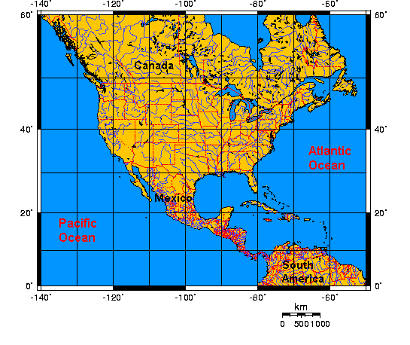
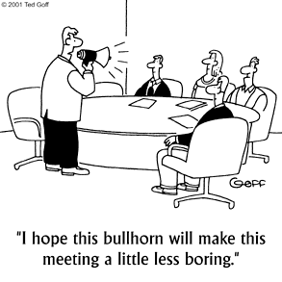

What is localization, aka location?
absolute location
(lat, long)
relative location
context location

Slide 18



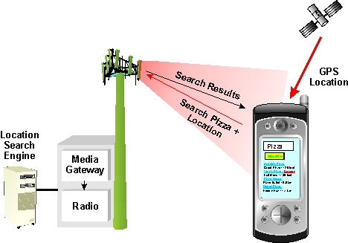

Why should I care about localization?
social application
advertisements
podcasting

Slide 19
Registering for Location Updates
  The LocationManager handles registrations for GPS and network location updates
  In order for an object to receive updates from GPS, it must implement the LocationListener interface
  Once the LocationManager is obtained, an object registers for updates by calling requestLocationUpdates (there are multiple versions you can use)
  The arguments passed into the requestLocationUpdates method determine the granularity of location changes that will generate an event
    send updates that are at least X meters apart
    send updates at least this far apart in time
    send updates that have this minimum accuracy
public class MyActivity … implements LocationListener{
private LocationManager locationManager_;
public void onCreate(){
…
locationManager_ = (LocationManager) getSystemService(LOCATION_SERVICE);
locationManager_.requestLocationUpdates(LocationManager.GPS_PROVIDER, 10,
Criteria.ACCURACY_FINE, this);
}
}

Slide 20
Location Providers
  The phone’s location can be determined from multiple providers
    GPS
    Network
  GPS location updates consume significantly more power than network location updates but are more accurate
    GPS: 25 seconds * 140mA = 1mAh
    Network: 2 seconds * 180mA = 0.1mAh
  The provider argument determines which method will be used to get a location for you
  You can also register for the PASSIVE_PROVIDER which only updates you if another app is actively using GPS / Network location
public class MyActivity … implements LocationListener{
private LocationManager locationManager_;
public void onCreate(){
…
locationManager_ = (LocationManager) getSystemService(LOCATION_SERVICE);
locationManager_.requestLocationUpdates(LocationManager.PASSIVE_PROVIDER, 10,
Criteria.ACCURACY_FINE, this);
}
}

Slide 21
The LocationListener Interface
public class MyActivity … implements LocationListener{
…
// Called when your GPS location changes
@Override
public void onLocationChanged(Location location) {
}
// Called when a provider gets turned off by the user in the settings
@Override
public void onProviderDisabled(String provider) {
}
// Called when a provider is turned on by the user in the settings
@Override
public void onProviderEnabled(String provider) {
}
// Signals a state change in the GPS (e.g. you head through a tunnel and
// it loses its fix on your position)
@Override
public void onStatusChanged(String provider, int status, Bundle extras) {
}
}

Slide 22
Location Information
public class MyActivity … implements LocationListener{
…
// Called when your GPS location changes
@Override
public void onLocationChanged(Location location) {
double altitude = location.getAltitude();
double longitude = location.getLongitude();
double latitude = location.getLatitude();
float speed = location.getSpeed();
float bearing = location.getBearing();
float accuracy = location.getAccuracy(); //in meters
long time = location.getTime(); //when the fix was obtained
// Other useful Location functions:
//
// location.distanceTo(dest)
// location.bearingTo(dest)
}
}

Slide 23
Being a Good Citizen…
It is very important that you unregister your App when you no longer need updates
For example, you should always unregister your listener when your Activity is paused!
If you unregister when you pause, you must also reregister when you resume
  This is true for all sensors!
public class MyActivity … {
private LocationManager locationManager_;
public void onCreate(Bundle savedInstanceState) {
…
locationManager_ = (LocationManager)getSystemService(LOCATION_SERVICE);
}
protected void onPause() {
super.onPause();
locationManager_.removeUpdates(this);
}
protected void onResume() {
super.onResume();
locationManager_.requestLocationUpdates(LocationManager.GPS_PROVIDER, 10,
Criteria.ACCURACY_FINE, this);
}
…
}

