Slide 1
CMSC 628: Introduction to Mobile Computing
Nilanjan Banerjee
University of Maryland
Baltimore County
nilanb@umbc.edu
http://csee.umbc.edu/~nilanb/teaching/628/
Introduction to Mobile Computing

Slide 2
Today’s lecture
More Code for multiple activities
Using startActivityForResult, using request-code, sending back a resultcode, and data to the parent activity
Intent Filters
Broadcast Receivers
Android Lifecycle
Activity starts up
Activity suspends and resumes
Activity is stopped and restarted.

Slide 3
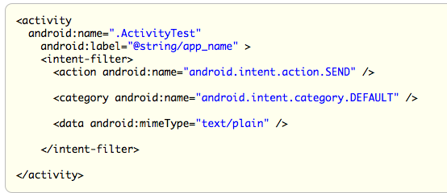
Intent Filters
Intent filters specify what an Activity can do.
Characterized by a name, category, and data supported

Slide 4
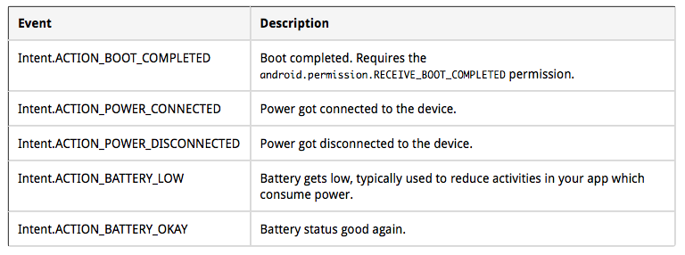
BroadcastReceivers
Receivers for System events.

Slide 5
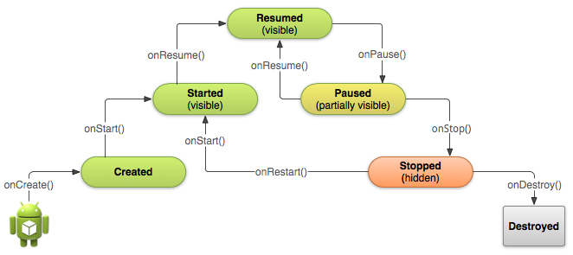
Starting an activity
Activity starts
onCreate(), onStart(), onResume() are called in succession
onStart()
Activity is partially visible
Ack: Android Development website

Slide 6
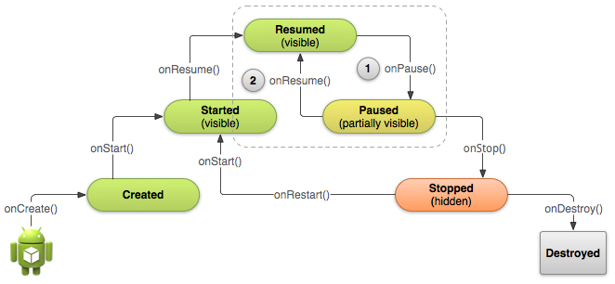
Pausing and Resuming an Activity
How is pausing defined?
If an activity is partially visible in the background
Dialog boxes open up
Method called is onPause()
What should you do before an activity pauses
save state of the application?
release resources

Slide 7
Stopping and Starting an Activity
How is stopping an activity defined?
If the activity is not visible
Press back or home button
Start a new activity or receive a phone call
What should you do before an activity stops
save state of the application?
release resources
System destroys
the activity

Slide 8
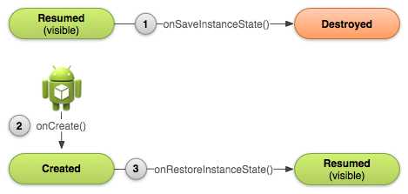
Recreating an Activity
If the system destroys an activity due to system constraints
Saves certain state of your activity that is restored back the next time the activity starts
If you want to save your own state before the activity is destroyed:
Override the onSaveInstanceState(Bundle)
Access your state during onCreate() or onRestoreInstanceState()

