Slide 1
CMSC 628: Introduction to Mobile Computing
Nilanjan Banerjee
University of Maryland
Baltimore County
nilanb@umbc.edu
http://csee.umbc.edu/~nilanb/teaching/628/
Introduction to Mobile Computing

Slide 2
Today’s lecture
Finish discussion on the app we were building
  Ways to write OnClickListener()
How to interact with other activities
  Use implicit and explicit Intents.
Android Lifecycle
  Activity starts up
  Activity suspends and resumes
  Activity is stopped and restarted.

Slide 3
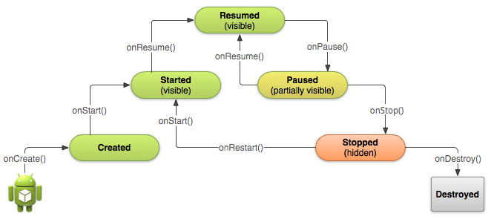
Starting an activity
Activity starts
  onCreate(), onStart(), onResume() are called in succession
onStart()
Activity is partially visible
Ack: Android Development website

Slide 4
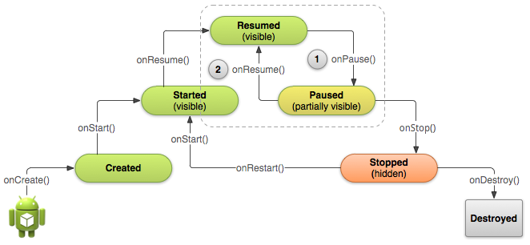
Pausing and Resuming an Activity
How is pausing defined?
  If an activity is partially visible in the background
  Dialog boxes open up
  Method called is onPause()
What should you do before an activity pauses
save state of the application?
release resources

Slide 5
Stopping and Starting an Activity
How is stopping an activity defined?
  If the activity is not visible
  Press back or home button
  Start a new activity or receive a phone call
What should you do before an activity stops
save state of the application?
release resources
System destroys
the activity

Slide 6
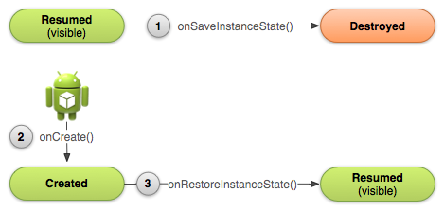
Recreating an Activity
If the system destroys an activity due to system constraints
  Saves certain state of your activity that is restored back the next time the activity starts
  If you want to save your own state before the activity is destroyed:
    Override the onSaveInstanceState(Bundle)
    Access your state during onCreate() or onRestoreInstanceState()

Slide 7
How is this implemented using Intents
Application
Specify an intent
Action: broadly defined the Intent
[SEND --- send something
VIEW --- view something
CALL --- call somebody]
Data: e.g., URI, email [email message etc]
Table
Invokes an activity
System
[Activity, action]

Slide 8
In some cases you also need results back from an activity
Application
subActivity
Get result back
Do stuff

Slide 9
Small project for today.
requestCode with startActivity
Application
Camera Application
Callback
[onActivityResult (int, int, Intent)]
int ---- requestCode
int --- result
Intent --- Intent that stores any data
Takes a picture

