Slide 1
CMSC 628: Introduction to Mobile Computing
Nilanjan Banerjee
University of Maryland
Baltimore County
nilanb@umbc.edu
http://csee.umbc.edu/~nilanb/teaching/628/
Introduction to Mobile Computing

Slide 2
Announcements
Creating Google sites for your group
Share it with me (nilanb@umbc.edu) and Filip (fdabek1@umbc.edu)
Start thinking about project ideas and writing them on the google site
Moving my office hours from 11 AM – 12 PM on Wednesdays.

Slide 3
Today’s lecture
Try to understand what is an Activity, Intent.
Build a simple mobile app from scratch
Start a new activity
Build simple UI elements such as EditText, Button
Add EventListeners to UI elements
Learn about the lifecycle of the app
Compile and run the app.

Slide 4
Activities -- Primer
Typically corresponds to one UI screen
But they can be
Faceless
A floating window
Return a value
Typically a complex application will have multiple activites
E.g., email application
Activity 1: log in page
Activity 2: displaying a set of email
Transfer data between activities
Usually form a bundle and pass it around (we will talk about in detail)

Slide 5
Intents -- Primer
A description of what you want done… something like a verb
E.g. Intent of a music player is to PLAY
Intents are of two types – Implicit and Explicit
Explicit
Application states what it needs
Implicit
System decides for you which application/component can best respond to the Intent.
You just specify what the Intent is.

Slide 6
Intents
Home
Picasa
Photo Gallery
Contacts
“Pick photo”
GMail
Client component makes a request for a specific action
System picks best component for that action
Chat
New components can use existing functionality
Blogger
Blogger

Slide 7
Resources
Utilities that an application uses and “reuses”
Strings, colors, dimensions, style/theme
.

Slide 8
Lets build a very simple Android Application.
Label View
Euros
EditText View
Dollars
Converter
Button View

Slide 9
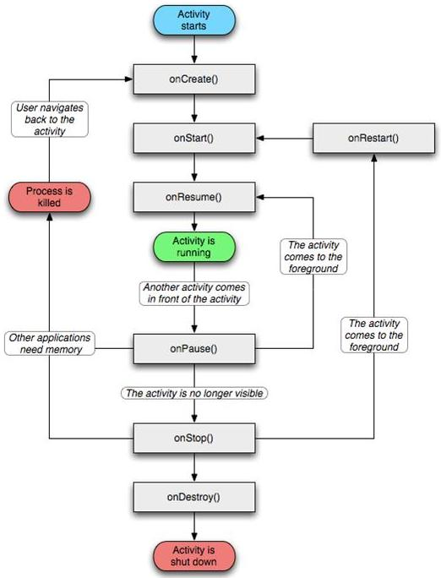
Application lifecycle

Slide 10
Next Lecture
More depth of Intents, Intent Filters, defining multiple Activities, concept of subactivities, and passing data between activities.
Time permitting: Using Intents as event triggers
.

