Slide 1
CMSC 628: Introduction to Mobile Computing
Nilanjan Banerjee
University of Maryland
Baltimore County
nilanb@umbc.edu
http://www.csee.umbc.edu/~nilanb/teaching/628/
Introduction to Mobile Computing

Slide 2

Why do I need to learn smart phone programming?
“The number of mobile phones sold in 2008 reaches 1.28 billion, a growth of 11% in 2008”
--- Marketing charts
“Smartphone penetration is now 19% with 45 million total smartphones now active in the US”
--- ComScore
What will drive our research in mobile computing over the next decade? One force is the emergence of mobile devices as rich sensors. The other force is the convergence of mobile computing and cloud computing.
--- Mahadev Satyanarayanan

Slide 3
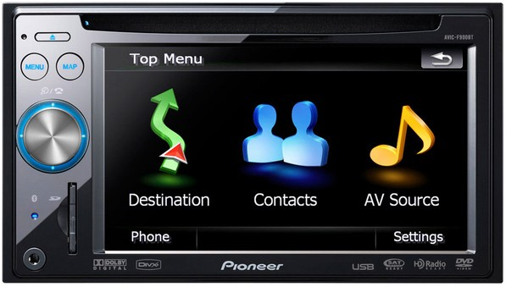
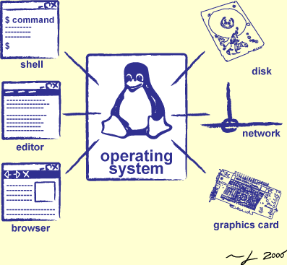

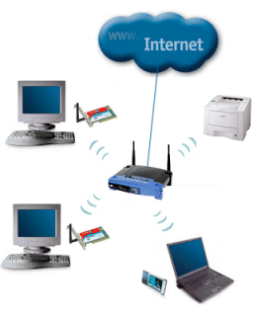

What does mobile phone programming encapsulate?
Operating system
design
User-interface design
programming
languages
networking
cloud
computing

Slide 4
Why is it difficult to develop good mobile apps.
Computational power
  Usually 1 GHz processors
  Soln: use the cloud?
Memory (can be limited for certain applications)
  1 GB of RAM in most cases (half of it is the OS)
Battery constraint (biggest constraint)
  Limited battery is always a constraint
  Cannot build apps which kill your battery
Too many options ☺
  Accelerometer, GPS, compass, WiFi, Bluetooth, 3G….

Slide 5
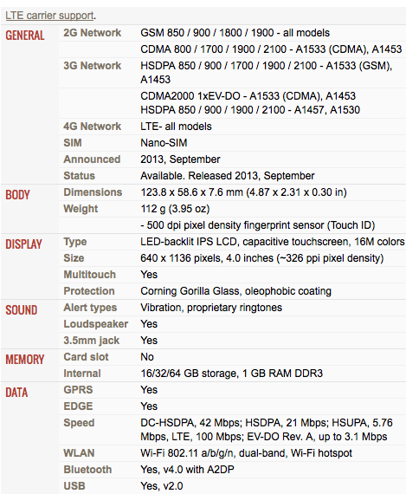
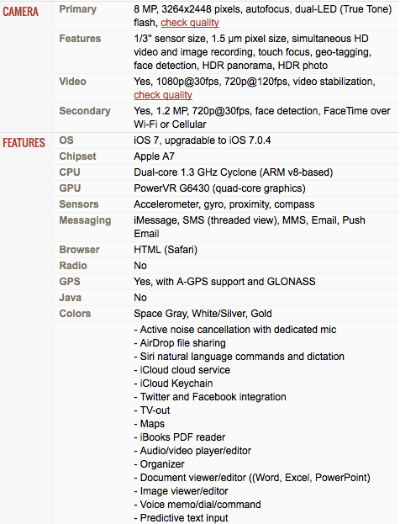
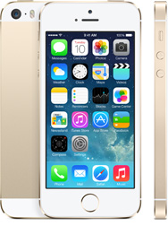
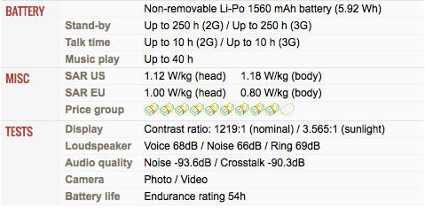
To give you an idea of the specification of a phone!

Slide 6
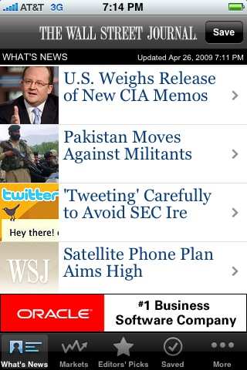
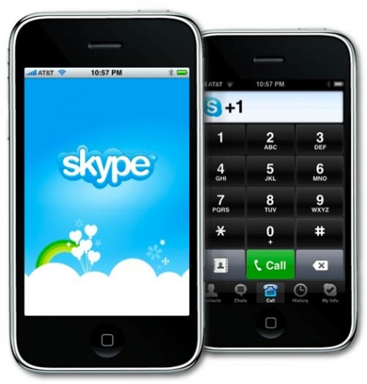
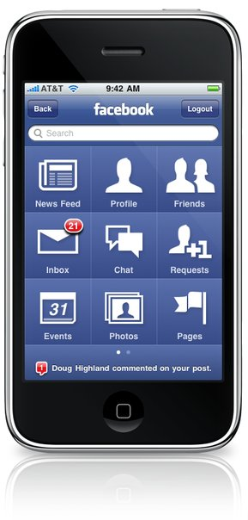

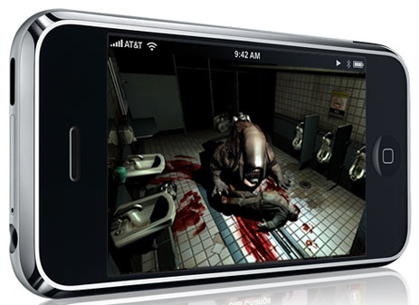

What are the potential applications… endless…

Slide 7
Ok! Tell me what the course contents are
Primer to the Android platform
User interfaces
  design UI elements using xml (Android)
  event driven programming (listeners and delegates)
Programming sensors
  accelerometers, compass, GPS
Networking
  radios, sockets, and http data transfer
Localization
  map services
Storage
  local storage and sqllite
Cloud services
  Google web services
  Introduction to game design (Unity)

Slide 8
Is this course for me?
Should have knowledge of object-oriented programming.
  Knowledge of Java is a must!
Should have working knowledge of networking and operating system concepts
  I will not talk about what a Wi-Fi radio is? Or what a file system is?
This is not a book-oriented course. Your creativity will be tested in the assignments, class discussions, and final projects.

Slide 9
How will I be graded?
Assignments in groups of two (3-4 total) (35 points)
  Different semantics for evaluation
In-class midterm (20 points)
  Testing design skills and mobile programming skills
Final project groups of 2 (35 points)
  Hopefully we will have a poster/demo session
In class discussions (10 points)
  Trivia related to programming, problem solving, coding mini applications, discussions related to research papers in the area.

Slide 10
Assignments
Three to Four assignments on design problems
  Involve coding for the Android
Groups of two solving the assignments
Grading
  Source code (7 points)
  Video --- every group will make a video of their assignment and upload it on youtube. (3 points)
  I will share the video and everyone in the class votes on it (best video gets an extra 5 points on the assignment)

Slide 11
Midterm
In-class midterm
Design and coding problems
Grading
  20 points towards final grade

Slide 12
Group Project
Needs to be an interesting idea
  Game, social app, home automation, whatever you want..
Come and talk to me if you need ideas.
  Come and talk to me if you already have an idea
  The idea should be practical… cant build an application that controls the MARS rover…
Working demo by the end of the semester
  Poster/demo session at the end of class
  Showcase your apps to people in the university
  Lets see a couple of demos from last to last semester’s class
Lets take a few examples

Slide 13
Group formation semantics
You should create a google site per group
Google site should be *just* shared with me and the TA
  My email address (nilanb@umbc.edu)
  Filip’s email address (fdabek1@umbc.edu)
The google site would form the portal for the following.
  Submitting your assignments.
  Keeping track of your final projects.

Slide 14
Lecturing style
Demo-oriented Lecturing
bring your laptops and mobile phones
Discussions on coding trivia, puzzles
post what you learn on piazza
Once we have learnt the concepts we will read a couple of cool application oriented papers during the discussion time

Slide 15
Resources you will need
Eclipse SDK with Android plugin and SDK
  Instructions on the webpage
Mobile Phones
  Android phones or tablets [I have 8 Google Nexus’s]
  Server and database resources (I may provide)

Slide 16
Administrivia…
Course webpage and reading list
  www.csee.umbc.edu/~nilanb/teaching/628/
  My email id: nilanb@umbc.edu
  Discussion Group
    Piazza
  Class hours: 4:00pm – 5:15 pm (Mon, Wed)
  Office hours: 9:45 – 10:30 (Wednesday) or by appointment
TA : Filip Dabek
  Office hours: TBD.
Videos of last semester’s projects online on the course page (at least a subset of them)
Come and talk to me if you
  To discuss project ideas
  Group formation and other semantics

Slide 17
Let me show you what to install to get started.
Primer on installation of the Android toolkit.
Next lecture: we will start with a super simple application and will go through the steps involved in designing, coding, and testing the application

