Slide 1
Lecture 3 Overview of Cryptography
A Practitioner Perspective
Instructor: Haibin Zhang
hbzhang@umbc.edu
Slides built on top of Dan Boneh’s slides
https://crypto.stanford.edu/cs155/syllabus.html
Slides also built a public lecture of mine

Slide 2
Review of Last Lecture: Approach to Secure Systems
Goals = Security policies
Trust/Adversary: All about assumptions
Mechanisms

Slide 3
Cryptography
Is
  A tremendous tool
  The basis for many security mechanisms
Is not
  The solution to all security problems
  Reliable unless implemented properly
  Reliable unless used properly
  Something you should try to invent
  or implement yourself

Slide 4
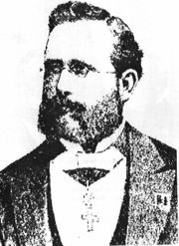
Kerckhoff’s principle
A cryptosystem should be secure even if everything about the system, except the secret key, is public knowledge.

Slide 5
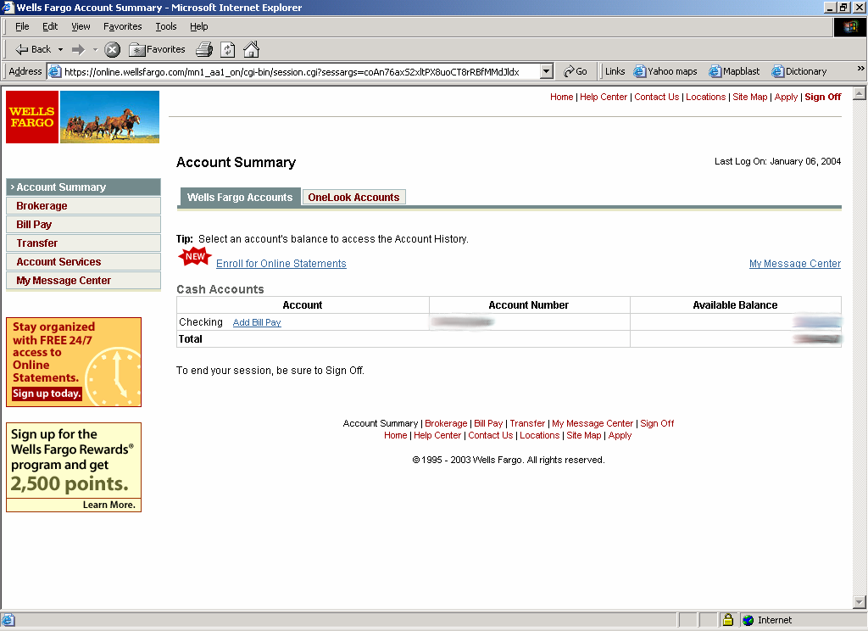
Goal 1:secure communication
Step 1: Session setup to exchange key
Step 2: encrypt data
HTTPS

Slide 6
Goal 2: Protected files
Disk
File 1
Alice
File 2

Slide 7
Symmetric Cryptography
Assuming two parties already share a secret key

Slide 8
Building block: sym. encryption
E, D: cipher k: secret key (e.g. 128 bits)
m, c: plaintext, ciphertext n: nonce (aka IV)
Encryption algorithm is publicly known
Modern cryptography does not rely on secrecy of algorithms
nonce
Alice
Bob
m, n
E
E(k,m,n)=c
c, n
D
D(k,c,n)=m
k
k

Slide 9
First example: One Time Pad (single use key)
Vernam (1917)
Shannon ‘49:
  OTP is “secure” against ciphertext-only attacks
Key:
0
1
0
1
1
1
0
0
1
0
⊕
Plaintext:
1
1
0
0
0
1
1
0
0
0
Ciphertext:
1
0
0
1
1
0
1
0
1
0

Slide 10
Stream ciphers (single use key)
Problem: OTP key is as long the message
Solution: Pseudo random key -- stream ciphers
Stream ciphers: ChaCha (643 MB/sec)
key
c ⟵ PRG(k) ⊕ m
PRG
⊕
message
ciphertext
Notes:
Pentium 4, 2.1GhZ

Slide 11
Dangers in using stream ciphers
One time key !! “Two time pad” is insecure:
C₁ ⟵ m₁ ⊕ PRG(k)
  C₂ ⟵ m₂ ⊕ PRG(k)
  Eavesdropper does:
  C₁ ⊕ C₂ ⇒ m₁ ⊕ m₂
  Enough redundant information in English that:
  m₁ ⊕ m₂ ⇒ m₁ , m₂

Slide 12
Blockcipher: modern sym. crypto work horse-> PRP (pseudo-random permutation)
A blockcipher should be indistinguishable from a ideally random permutation.
Canonical examples:
3DES: n= 64 bits, k = 168 bits
AES: n=128 bits, k = 128, 192, 256 bits
IV handled as part of PT block

Slide 13
DES - out-dated; no longer secure
AES - golden standard: fast and Secure

Slide 14
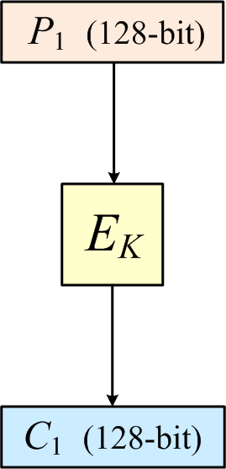
How to Use AES?
Can only encrypt messages of a fixed length (i.e., 128 bits).
But how about longer messages?
AES

Slide 15
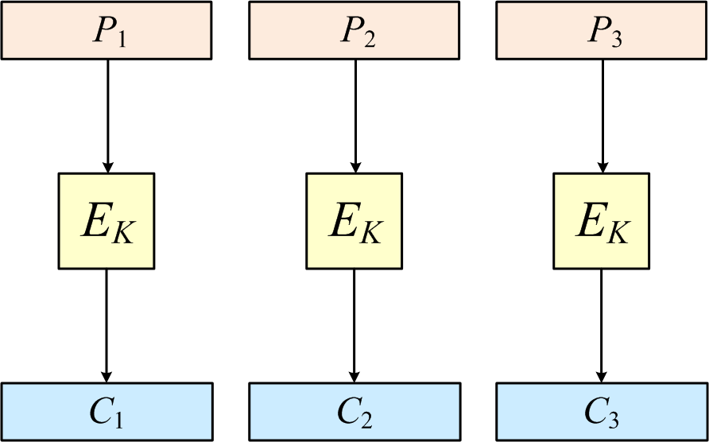
How to encrypt arbitrary-length messages?
A naïve solution: simply encrypting messages blockwise (i.e., using ECB mode)?
…
…
…

Slide 16


How to encrypt arbitrary-length messages?
A naïve solution: simply encrypting messages blockwise (i.e., using ECB mode)?
ECB insecure
Encrypted Penguin using ECB
Penguin

Slide 17
Secure Encryption: IND
Disk Encryption
Ideal definition of security:
  IND: plaintexts are indistinguishable given ciphertexts.
An ideal encryption scheme must be randomized or stateful, and thus length-expanding.

Slide 18
CTR and CBC modes of operation
Disk Encryption
CTR: Maintaining an incremental counter.
CBC: More widely used (perhaps for historical reasons).

Slide 19
CTR mode
E(k,x): maps key k and n-bit block x to a n-bit block y
Counter mode (CTR) with a random IV:
IV
m[0]
m[1]
…
m[L]
⊕
E(k,IV)
E(k,IV+1)
…
E(k,IV+L)
IV
c[0]
c[1]
…
c[L]
ciphertext
Note: Parallel encryption and decryption
IV’s need to be non-repeating

Slide 20
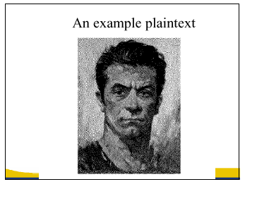

In pictures
encrypt with CTR
Why is CTR secure? not today (just some intuition)

Slide 21
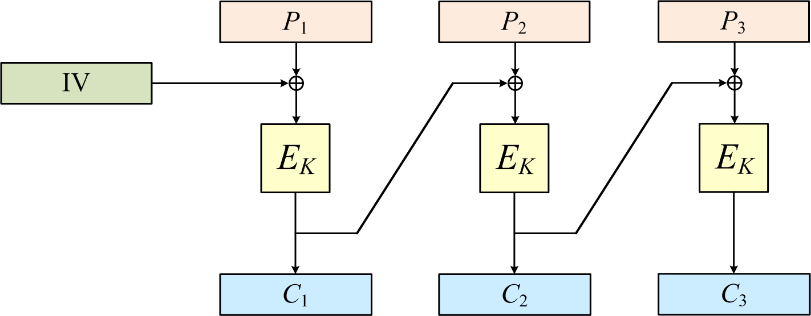
CBC
Disk Encryption
CBC: Most widely used (perhaps for historical reasons).

Slide 22
Handling Incomplete Block
Disk Encryption
What if the length is not a multiple of AES blocksize?
  CTR: natively handle incomplete block.
  CBC: ?

Slide 23
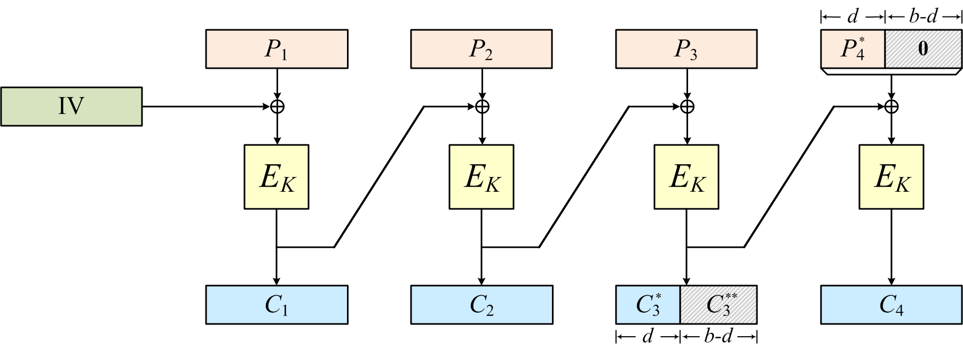
Handling Incomplete Block for CBC
Disk Encryption
CBC: with Ciphertext Stealing
  “NIST standard: Recommendation for block cipher modes of operation: three variants of ciphertext stealing for CBC mode.”
Proven by [Rogaway, Wooding, and Zhang, FSE2012]

Slide 24
Performance: [openssl speed]
Intel Core 2 (on Windows Vista)
Cipher Block/key size Speed (MB/sec)
ChaCha 643
3DES 64/168 30
AES-128/GCM 128/128 163
AES is dramatically faster with AES-NI instructions:
Intel SkyLake: 4 cycles per round, fully pipelined
Notes:
Xmm15: data block, xmm1: round key

Slide 25
A Quick Summary
Summary
So far, we have talked about encryption
  (Informal) security definition and constructions
CBC and CTR is secure; ECB is insecure
How fast is AES after all?
  1,000 AES calls only takes 25 microsecond
  (1 microsecond = 0.000001 second)

Slide 26
Data and communication integrity

Slide 27
Message Integrity: MACs
Goal: message integrity. No confidentiality.
  ex: Protecting public binaries on disk.
k
Message m
tag
k
Alice
Bob
Generate tag:
tag ⟵ S(k, m)
Verify tag:
V(k, m, tag) = `yes’
?
note: non-keyed checksum (CRC) is an insecure MAC !!

Slide 28
Secure MACs
Attacker information: chosen message attack
  for m₁,m₂,…,m_{q} attacker is given t_{i} ⟵ S(k,m_{i})
Attacker’s goal: existential forgery.
  produce some new valid message/tag pair (m,t).
  (m,t) ∈ { (m₁,t₁) , … , (m_{q},t_{q}) }
A secure PRF gives a secure MAC:
  S(k,m) = F(k,m)
  V(k,m,t): `yes’ if t = F(k,m) and `no’ otherwise.

Slide 29
Construction 1: ECBC
m[0]
m[1]
m[2]
m[3]
⊕
⊕
⊕
E(k,⋅)
E(k,⋅)
E(k,⋅)
E(k,⋅)
Raw CBC
E(k₁,⋅)
tag
key = (k, k₁)

Slide 30
Construction 2: HMAC (Hash-MAC)
Most widely used MAC on the Internet.
H: hash function.
example: SHA-256 ; output is 256 bits
Building a MAC out of a hash function:
  Standardized method: HMAC
  S( k, m ) = H( k⊕opad || H( k⊕ipad || m ))

Slide 31
SHA-256: Merkle-Damgard
m[0]
m[1]
m[2]
m[3]
IV
h
h
h
h
H(m)
h(t, m[i]): compression function
Thm 1: if h is collision resistant then so is H
“Thm 2”: if h is a PRF then HMAC is a PRF

Slide 32
Construction 3: PMAC – parallel MAC
ECBC and HMAC are sequential. PMAC:
m[0]
m[1]
m[2]
m[3]
P(k,0)
⊕
P(k,1)
⊕
P(k,2)
⊕
P(k,3)
⊕
F(k,⋅)
F(k,⋅)
F(k,⋅)
F(k,⋅)
⊕
F(k₁,⋅)
tag

Slide 33
Why are these MAC constructions secure?
  … not today
Why the last encryption step in ECBC?
  CBC (aka Raw-CBC) is not a secure MAC:
      Given tag on a message m, attacker can deduce
      tag for some other message m’
      How: good crypto exercise …

Slide 34
Authenticated Encryption: Encryption + MAC

Slide 35
Combining MAC and ENC (CCA)
Encryption key K_{E} MAC key = K_{I}
Option 1: MAC-then-Encrypt (SSL)
Option 2: Encrypt-then-MAC (IPsec)
Option 3: Encrypt-and-MAC (SSH)
MAC(M,K_{I})
Enc K_{E}
Msg M
Msg M
MAC
Enc K_{E}
MAC(C, K_{I})
Secure for
all secure
primitives
Msg M
MAC
Enc K_{E}
MAC(M, K_{I})
Msg M
MAC

Slide 36
Say, AES-GCM, or one-pass OCB
AES-GCM:
  encrypt-then-MAC
  Counter mode AES
  Carter-Wagman MAC

Slide 37
Public-key Cryptography

Slide 38
Public key encryption: (Gen, E, D)
Gen
pk
sk
E
D
m
c
c
m
Notes:
Note: asymmetric keys

Slide 39
Applications
Session setup (for now, only eavesdropping security)
Non-interactive applications: (e.g. Email)
Bob sends email to Alice encrypted using pk_{alice}
Note: Bob needs pk_{alice} (public key management)
Alice
pk
Bob
Generate (pk, sk)
choose random x
(e.g. 48 bytes)
E(pk, x)
x

Slide 40
Trapdoor functions (TDF)
Def: a trapdoor func. X⟶Y is a triple of efficient algs. (G, F, F⁻¹)
G(): randomized alg. outputs key pair (pk, sk)
F(pk,⋅): det. alg. that defines a func. X ⟶ Y
F⁻¹(sk,⋅): func. Y ⟶ X that inverts F(pk,⋅)
Security: F(pk, ⋅) is one-way without sk

Slide 41
Public-key encryption from TDFs
(G, F, F⁻¹): secure TDF X ⟶ Y
(E_{s}, D_{s}) : symm. auth. encryption with keys in K
H: X ⟶ K a hash function
We construct a pub-key enc. system (G, E, D):
Key generation G: same as G for TDF

Slide 42
Public-key encryption from TDFs
(G, F, F⁻¹): secure TDF X ⟶ Y
(E_{s}, D_{s}) : symm. auth. encryption with keys in K
H: X ⟶ K a hash function
E( pk, m) :
x ⟵ X, y ⟵ F(pk, x)
k ⟵ H(x), c ⟵ E_{s}(k, m)
output (y, c)
D( sk, (y,c) ) :
x ⟵ F⁻¹(sk, y),
k ⟵ H(x), m ⟵ D_{s}(k, c)
output m
R

Slide 43
In pictures:
Security Theorem:
If (G, F, F⁻¹) is a secure TDF,
(E_{s}, D_{s}) provides auth. enc.
and H: X ⟶ K is a “random oracle”
then (G,E,D) is CCA^{ro} secure.
F(pk, x)
E_{s}( H(x), m )
header
body
Notes:
Need to explain what is a random oracle. NEVER encrypt m directly with RSA.

Slide 44
Digital Signatures
Public-key encryption
  Alice publishes encryption key
  Anyone can send encrypted message
  Only Alice can decrypt messages with this key
Digital signature scheme
  Alice publishes key for verifying signatures
  Anyone can check a message signed by Alice
  Only Alice can send signed messages

Slide 45
Digital Signatures from TDPs
(G, F, F⁻¹): secure TDP X ⟶ X
H: M ⟶ X a hash function
Security: existential unforgeability under a chosen message attack (in the random oracle model)
Sign( sk, m∈X) :
output
sig = F⁻¹(sk, H(m) )
Verify( pk, m, sig) :
output
1 if H(m) = F(pk, sig)
0 otherwise

Slide 46
Public-Key Infrastructure (PKI)
Anyone can send Bob a secret message
  … provided they know Bob’s public key
How do we know a key belongs to Bob?
  If imposter substitutes another key, can read Bob’s messages
One solution: PKI
  Trusted root Certificate Authority (CA)
  CA certifies that a given public-key belongs to Bob

Slide 47
Putting it all together: SSL/TLS (simplified)
Client-hello
S
C
Server-hello
Key exchange
Server-key-exchange
Client key-exchange
finished
finished
Confirmation
Encrypted session

Slide 48
Thank you!

