Slide 1
Principles of Computer Security
Instructor: Haibin Zhang
hbzhang@umbc.edu

Slide 2
Course Info
Time: TuTh 11:30am - 12:45pm
Place: Janet & Walter Sondheim 114
Instructor: Dr. Haibin Zhang
Instructor office: ITE 357
Email: hbzhang at umbc dot edu
Office Hours: Tuesday 2pm-4pm (Works for everyone?)
TA: Shantanu Hirlekar hs11 at umbc dot edu

Slide 3
Self-Introduction
Name
Research interests/Labs/Advisor, etc
Hobbies
Optional: What do you expect from this course? Or: What security topics do you like most?

Slide 4
Evaluation
See website
I expect that some research projects could lead to interesting paper submissions

Slide 5
Ethics/“Warning”
Do NOT undertake any attacks learned in the course. The existence of a security vulnerability is not an excuse. Please obey UMBC policy and state/federal law.

Slide 6
Topics
Introduction to computer security
Security policies: confidentiality, integrity, availability, accountability, etc.
Modern cryptography
Cryptographic engineering
Systems and distributed systems basics
Cloud computing and cloud security
Software defined networking and its security
Hardware security

Slide 7
Topics, Cont.
Network security
Intrusion detection
Privacy and anonymity
Blockchains (permissioned and permissionless) security
Ethics in computer security

Slide 8
Overview of Topics
So that you have a big picture about this course
The topics subject to change
Case studies

Slide 9
Approach
Goals = Security policies
Trust/Adversary: All about assumptions
Mechanisms
Formal security approach that everyone should take
For each subfield, they are slightly different

Slide 10
Modern Crypto
Popular; hard, if not impossible, to ignore as a security method
Building on topic of computational complexity and probability
Reduction based modern crypto
Can crypto do everything? “We only need cryptographers!”

Slide 11
Modern Crypto
Symmetric cryptography
Asymmetric cryptography
Advanced topics
Learning to prove things in cryptography
Homework on proofs

Slide 12
Cryptographic Engineering
Building a system using crypto
Rather different from crypto
Lab on crypto engineering

Slide 13
Systems Security
A huge topic

Slide 14
System Basics
Modern computer architecture
We need to work on real systems so that it is more secure
Even if you design your own systems, it is still good to learn modern systems
Functionalities and reliability should come first
I would not possibly cover all.
The best approach is through case studies.

Slide 15
Cloud Computing and Cloud Security
AWS
EC2
OpenStack

Slide 16
Intrusion-Tolerant SDN and Neutron
Centralized controller
Simple, powerful, programmable, flexible …
A single of failure

Slide 17
Hardware Security
PUF: physical unclonable function
Intel SGX (Your computer has one)
Oblivious RAM

Slide 18
Network Security
IPSec,PGP, SSH, SSL
Tor

Slide 19
Intrusion Detection
Anomaly based
Signature based
Specification based
Bro

Slide 20
Proactive Security
Trusted Hardware/OS
Nodes (secret shares)

Slide 21
Permissionless Blochains
Bitcoin, Ethereum, ZeroCash

Slide 22
Permissioned Blockchains
Gaining popularity

Slide 23
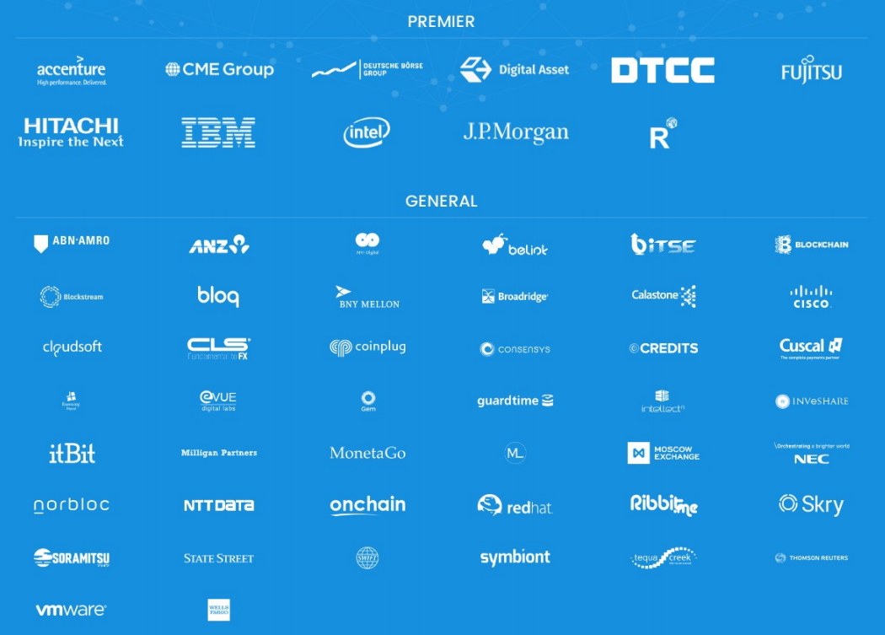
One Blockchain Project Using PBFT

Slide 24
Cyber Physical Systems Security
Sensors/data providers
Faulty/malicious
Correct
A
C
aggregator
client

Slide 25
Storage and Storage Security
Replication-based
Erasure coding based
Secure deduplication
Linearizability
…

Slide 26
A System that Has All Desirable Features?
Confidentiality
Integrity
Availability

Slide 27
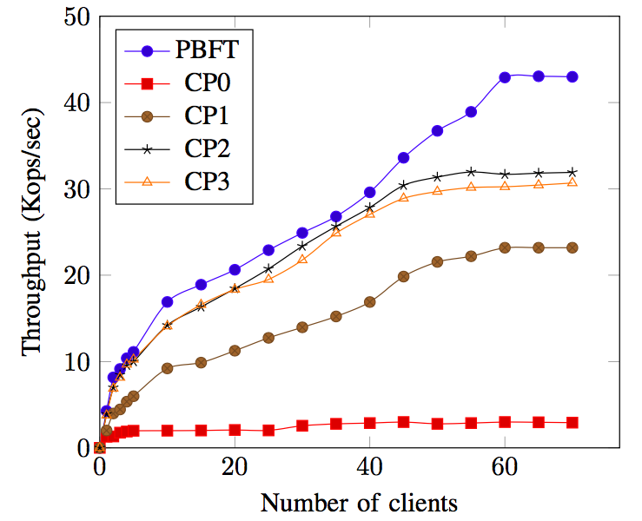
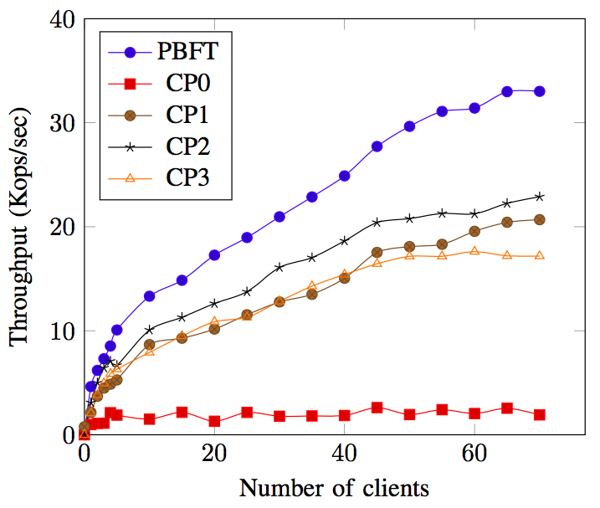
How does Evaluation Look Like?
Throughput
LAN
WAN

Slide 28
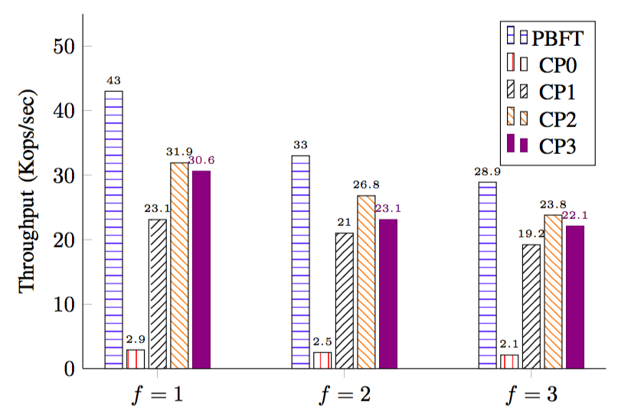
Evaluation
Scalability (in LAN)

Slide 29
Take-Home Advice
Make good use of my office hours
Class discussion is important
Do not expect us to debug for your systems
(Doing it yourself is part of system studies.)
Adjust your research project idea
Plan early and do the project

Slide 30
Thank you!

