Slide 1
How to Use Charm Crypto Lib
Chao Liu; Haibin Zhang

Slide 2
Introduction
ElGamal Encryption
ECDSA Scheme

Slide 3
Introduction
https://jhuisi.github.io/charm/
Easy to implement a scheme.
More than 40 schemes are implemented.

Slide 4
ElGamal Encryption
https://en.wikipedia.org/wiki/ElGamal_encryption
Encrypt message
Choose random
Generate
Compute
Compute
Compute
Compute
Bob
Alice
Correctness:

Slide 5
Algorithm
Key-Gen():
Input: a secure Elliptic Curve (EC) group, for example, prime192v1(NIST Approved curve).
Output: , Alice's private key and public key .
Encryt():
Input: message m, Alice's public key .
Output: two ciphertexts .
Decrypt():
Input: Alice's private key and the ciphertexts .
Output: m' (m=m') or

Slide 6
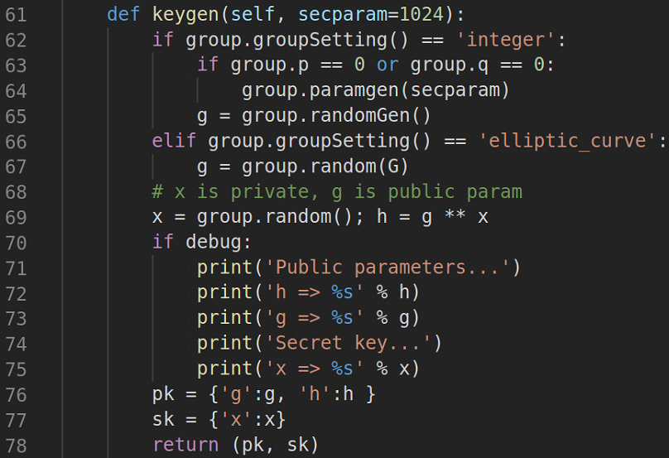
Import a curve
Import a elliptic curve, for example, prime192v1,
prime192v2
Key-Gen()
https://jhuisi.github.io/charm/cryptographers.html

Slide 7
Encrypt()
Choose random
Compute
Compute
Encrypt message
Compute

Slide 8
Decrypt()
Compute
Compute

Slide 9
ECDSA
ECDSA: Elliptic Curve Digital Signature Algorithm.
Generate
Compute
Choose random
Compute
Compute
Compute
Compute
Alice
Bob
Compute
Compute
Compute
Correctness:

Slide 10
Algorithm
Key-Gen():
Input: a secure Elliptic Curve (EC) group.
Output: g, Alice's private key and public key .
Sign():
Input: message m, Alice's private key .
Output: signature .
Verify():
Input: Alice's public key and the signature .
Output: 1 or

Slide 11
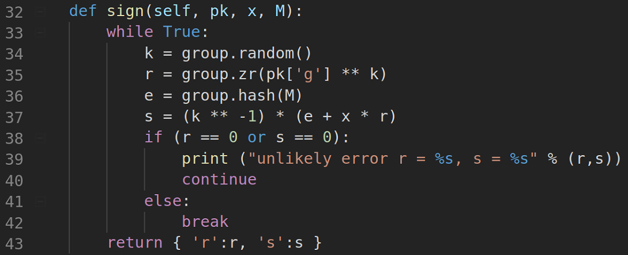
Partial codes
Key-Gen()
Sign()
Choose random
Compute
Compute
Compute

Slide 12
Verify()
Compute
Compute
Compute
Compute

Slide 13
Thanks!

