Slide 1
Blockchains
Lecture 7

Slide 2
Broadcast
Best-effort broadcast or simply broadcast (BEB)
Unreliable
Reliable broadcast (RB)
Reliable
We are interested

Slide 3
Unreliable Broadcast
p₁
broadcast(m)
p₂
deliver(p₁,m)
p₃
p₃
deliver(p₁,m)

Slide 4
Reliable Broadcast Abstractions
Best-effort broadcast
Guarantees reliability only if sender is correct
Reliable broadcast
Guarantees reliability independent of whether sender is correct

Slide 5
BEB Example
No
Is this allowed?
p₁
broadcast(m)
p₂
deliver(p₁,m)
p₃
p₃
deliver(p₁,m)

Slide 6
BEB Example (2)
Yes
Is this allowed?
p₁
broadcast(m)
p₂
deliver(p₁,m)
p₃
p₃
deliver(p₁,m)

Slide 7
Reliable Broadcast
BEB gives no guarantees if sender crashes
Strengthen to give guarantees if sender crashes

Slide 8
Reliable Broadcast
A designated replica (the broadcaster) broadcasts a message to all replicas, with the following guarantees:
(Validity) If the broadcaster is correct, then every correct replica delivers the broadcaster’s message.
(Consistency) If two correct servers deliver two messages B and B′ then B = B′.
(Totality) If any correct replica delivers a broadcast message B, then all correct replicas deliver B.

Slide 9
RB Example
Yes
Is this allowed?
p₁
broadcast(m)
p₂
p₃
p₃

Slide 10
RB Example
Yes
Is this allowed?
p₁
broadcast(m)
p₂
p₃
p₃
deliver(p₁,m)

Slide 11
RB Example
No
Is this allowed?
p₁
broadcast(m)
p₂
p₃
p₃
deliver(p₁,m)

Slide 12
RB Example
No
Is this allowed?
p₁
broadcast(m)
p₂
deliver(p₁,m)
p₃
p₃

Slide 13
How to achieve Byzantine Reliable Broadcast

Slide 14
Reliable Broadcast
[Bracha, Information and Computation 2018]
Bracha’s protocol tolerates f faulty replicas out of n = 3f+1.

Slide 15
Bracha’s Reliable Broadcast
[Bracha, Information and Computation 2018]
B
p₀
p₁
p₂
p₃
“Initiate”

Slide 16
Bracha’s Reliable Broadcast
[Bracha, Information and Computation 2018]
B
p₀
p₁
p₂
p₃
“Initiate”
“Echo”

Slide 17
Bracha’s Reliable Broadcast
[Bracha, Information and Computation 2018]
B
p₀
p₁
p₂
p₃
“Initiate”
“Echo”

Slide 18
Bracha’s Reliable Broadcast
[Bracha, Information and Computation 2018]
B
Communication complexity is O(n²|B|)
p₀
p₁
p₂
p₃
“Initiate”
“Echo”
“Ready”

Slide 19
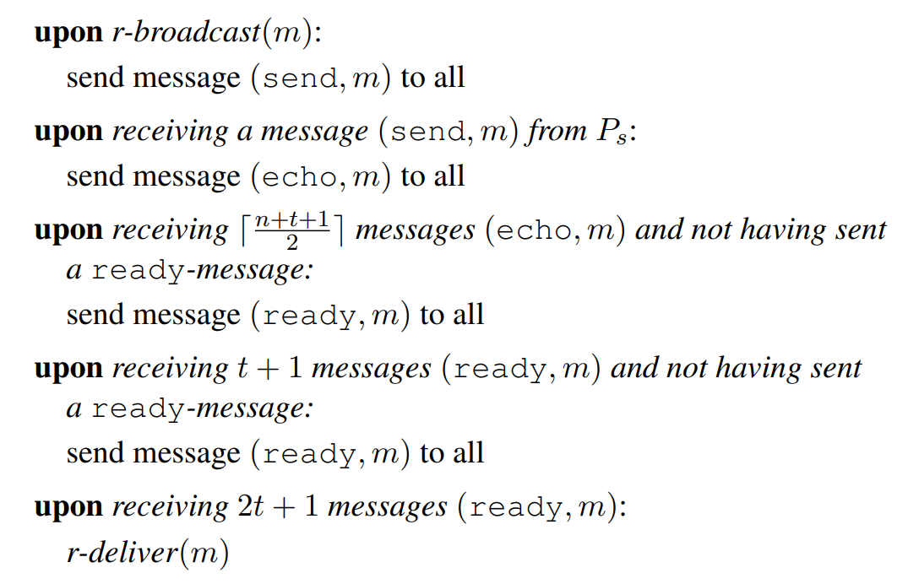
Bracha’s Reliable Broadcast
[Bracha, Information and Computation 2018]
The algorithm implements Byzantine reliable broadcast if n > 3t.

Slide 20
Bracha’s Reliable Broadcast
[Bracha, Information and Computation 2018]
The algorithm implements Byzantine reliable broadcast if n > 3t.

Slide 21
Proof? (Discussion Time!)
B
p₀
p₁
p₂
p₃
“Initiate”
“Echo”
“Ready”
(Validity) If the broadcaster is correct, then every correct replica delivers the broadcaster’s message. (Easy!)
(Consistency) If two correct servers deliver two messages B and B′ then B = B′. (Note that n > 3t)
(Totality) If any correct replica delivers a broadcast message B, then all correct replicas deliver B. (Hint: Use Amplification!)

Slide 22
Applications?

Slide 23
Reliable Broadcast
One building primitive for one particular BFT (aka atomic broadcast, permissioned blockchain)
Weaker than BFT
BFT implies reliable broadcast

Slide 24
Acknowledgement
Some slides from Dr. Ali Ghodsi with some adaptations.

