Slide 1
Blockchains
Lecture 6

Slide 2
Bitcoin
Bitcoin is a blockchain
Bitcoin is not a blockchain
Both claims are correct! Let’s find out why.
Not the main focus of the class, as Bitcoin is not technically a blockchain for programming at all. Bitcoin is mainly a crypto-currency.

Slide 3
Rough course outline
 | Secrecy | Integrity
Private-key setting | Private-key encryption | Message authentication codes
Public-key setting | Public-key encryption | Digital signatures
Building blocks
  Pseudorandom functions/block ciphers (AES)
  Hash functions (SHA)
  Number theory (RSA, Diffie-Hellman, Discrete Logarithm, Elliptic Curve, LWE)

Slide 4
To Understand Bitcoin
We need
  Digital signatures (ESDSA)
  Hash function (modeled as a random oracle)

Slide 5
A History of Bitcoin?
https://arxiv.org/abs/1810.06130

Slide 6
Visualizing Bitcoin
https://www.youtube.com/watch?v=Lx9zgZCMqXE&t=86s

Slide 7
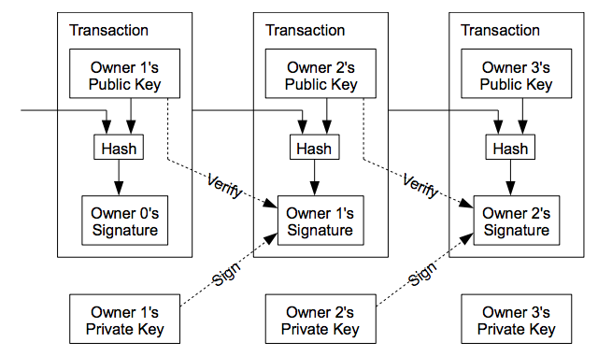
Not Stored But Locally Verified

Slide 8
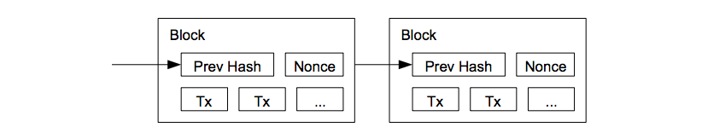
Only Being Stored

Slide 9
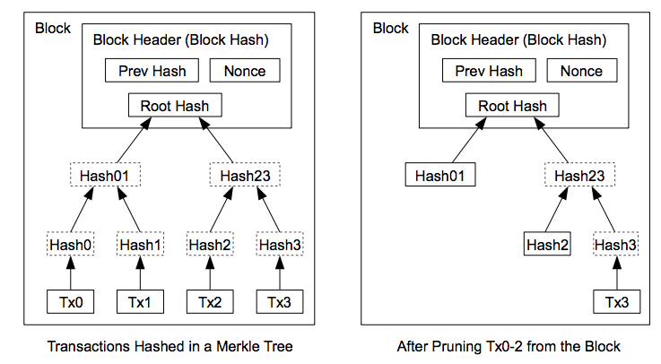
Using Merkle Tree

Slide 10
Bitcoin
Bitcoin’s chain is called “blockchain.”
Blockchain, however, has a general meaning: not just a crypto-currency, but a general platform for programming!
So Bitcoin, in the above sense, it not a blockchain, as it has a very limited script language that can be used in very limited applications.
Ethereum essentially generalizes Bitcoin for a platform for easy and Turing-complete programming via “Smart contracts.”

Slide 11



Blockchains (State Machine Replication)
Blockchains tolerate Byzantine (arbitrary) failures
  Integrity/safety: the code to be executed correctly
  Availability/liveness: the service is always available
  (Typically, not confidentiality)
Replicas
Client

Slide 12
Can Be Bitcoin Explained with State Machine Replication?

Slide 13
The “Total Order” Requirement
Client 1:
“Deposit $100”
Chase:
“Charge 10%”
$100
$200
$180
Client 1:
“Deposit $100”
Chase:
“Charge 10%”
$100
$200
$180
$100

Slide 14

The “Total Order” Requirement
Chase:
“Charge 10%”
Client 1:
“Deposit $100”
$100
$90
$190
Chase:
“Charge 10%”
Client 1:
“Deposit $100”
$100
$90
$190
$100

Slide 15

The “Total Order” Requirement
Chase:
“Charge 10%”
Client 1:
“Deposit $100”
$100
$90
$190
Client 1:
“Deposit $100”
Chase:
“Charge 10%”
$100
$200
$180
$100

Slide 16
Characterizing Blockchains
Permissionless: explicitly/implicitly rely on cryptocurrency
Permissioned: traditional Byzantine fault-tolerant distributed system (consortium blockchains, private blockchains)
 | Membership | Consensus Approach | Examples
Permissionless | Dynamic | PoX (Proof of “X”) | Bitcoin, Ethereum
Permissioned | Fixed; know IDs of each other | BFT (Byzantine fault tolerance) | Fabric, Iroha, Chios, BEAT

Slide 17
Characterizing Blockchains
Permissionless: explicitly/implicitly rely on cryptocurrency
Permissioned: traditional Byzantine fault-tolerant distributed system (consortium blockchains, private blockchains)
Hybrid: use BFT to improve permissionless blockchains
 | Membership | Consensus Approach | Examples
Permissionless | Dynamic | PoX (Proof of “X”) | Bitcoin, Ethereum
Permissioned | Fixed; know IDs of each other | BFT (Byzantine fault tolerance) | Fabric, Iroha, Chios, BEAT
Hybrid (permissonless) | Dynamic | Sybil resistant PoX+ BFT | Elastico, OmniLedger, Ethereum Casper

Slide 18
Blockchains
Yes, blockchains are virtually replicated servers achieving consensus
Whatever applications make senses in the client server model can work in the client blockchain model!
So virtually everything could be implemented using blockchains

