Slide 1
Blockchains
Lecture 5

Slide 2
How to Handle Cryptography in this class
Theory: Not a main focus
Do not get discouraged
We can still learn how to CODE and USE cryptography
If you want to focus on it, you can do this when you do this

Slide 3
Announcements
Help you gain hands-on experiences
  Lab on crypto, by Chao Liu
  Lab on smart contract, by Cyrus Bonyadi and Shuai Xu
  A full day workshop on Hyperledger Fabric (IBM)

Slide 4
Public-key encryption
pk
pk
c
pk
pk, sk
c ← Enc_{pk}(m)
m = Dec_{sk}(c)

Slide 5
Public-key encryption
A public-key encryption scheme is composed of three PPT algorithms:
  Gen: key-generation algorithm that on input 1^{n} outputs pk, sk
  Enc: encryption algorithm that on input pk and a message m outputs a ciphertext c
  Dec: decryption algorithm that on input sk and a ciphertext c outputs a message m or an error ⊥
For all m and pk, sk output by Gen,
Dec_{sk}(Enc_{pk}(m)) = m

Slide 6
Notes
No deterministic public-key encryption scheme can be CPA-secure

Slide 7
Hybrid encryption
Decryption done in the obvious way
m
Enc’
ciphertext
Enc
“encapsulated key”
k
pk
The functionality of public-key encryption
at the (asymptotic) efficiency of private-key encryption!

Slide 8
Discrete-logarithm problem (informal)
Dlog problem in G: Given generator g and element h, compute log_{g}h
Dlog assumption in G: Solving the discrete log problem in G is hard

Slide 9
Example
In ℤ*₃₀₉₂₀₉₁₁₃₉
  What is log₂ 1656755742 ?

Slide 10
Diffie-Hellman problems
Fix cyclic group G and generator g
Define DH_{g}(h₁, h₂) = DH_{g}(g^{x}, g^{y}) = g^{xy}

Slide 11
Example
In ℤ*₁₁
  <2> = {1, 2, 4, 8, 5, 10, 9, 7, 3, 6}
  So DH₂(7, 5) = ?
In ℤ*₃₀₉₂₀₉₁₁₃₉
  What is DH₂(1656755742, 938640663)?
  Is 1994993011 the answer, or is it just a random element of ℤ*₃₀₉₂₀₉₁₁₃₉ ?

Slide 12
Diffie-Hellman assumptions
Computational Diffie-Hellman (CDH) problem:
  Given g, h₁, h₂, compute DH_{g}(h₁, h₂)
Decisional Diffie-Hellman (DDH) problem:
  Given g, h₁, h₂, distinguish DH_{g}(h₁, h₂) from a uniform element of G

Slide 13
Group selection
The discrete logarithm is not hard in all groups!
  For example, it is easy in ℤ_{N} (for any N, and for any generator)
Nevertheless, there are certain groups where the problem is believed to be hard

Slide 14
Group selection
For cryptographic applications, best to use prime-order groups
  The dlog problem becomes easier if the order of the group has small prime factors
  Prime-order groups have several nice features
    E.g., every element except identity is a generator
Two common choices of groups…

Slide 15
Group selection: choice 1
Prime-order subgroup of ℤ*_{p}, p prime
  E.g., p = tq + 1 for q prime
  Take the subgroup of t^{th} powers, i.e.,
  G = { [x^{t} mod p]| x ∈ ℤ*_{p} }
    This is a group
    It has order (p-1)/t = q
    Since q is prime, the group must be cyclic
  Generalizations based on finite fields also used

Slide 16
Group selection: choice 2
Prime-order subgroup of an elliptic curve group

Slide 17
Dlog-based PKE

Slide 18
Diffie-Hellman key exchange
G, q, g, h₁
h₂
  (G, q, g) ← G(1^{n})
  x ← ℤ_{q}
  h₁ = g^{x}
c₂ = k · m
  y ← ℤ_{q}
  h₂ = g^{y}
k = (h₁)^{y}
k = (h₂)^{x}
m = c₂/k

Slide 19
El Gamal encryption
Public key
G, q, g, h₁
h₂, h₁^{y} · m
h₂
  (G, q, g) ← G(1^{n})
  x ← ℤ_{q}
  h₁ = g^{x}
c₂ = k · m
  y ← ℤ_{q}
  h₂ = g^{y}
k = (h₁)^{y}
k = (h₂)^{x}
m = c₂/k

Slide 20
El Gamal encryption
Gen(1^{n})
  Run G(1^{n}) to obtain G, q, g. Choose uniform x∈ℤ_{q.} The public key is (G, q, g, g^{x}) and the private key is x
Enc_{pk}(m), where pk = (G, q, g, h) and m∈G
  Choose uniform y ∈ℤ_{q.} The ciphertext is g^{y}, h^{y}·m
Dec_{sk}(c₁, c₂)
  Output c₂/c₁^{x}

Slide 21
In practice…
Parameters G, q, g are standardized and shared
Inconvenient to treat message as group element
  Use key derivation to derive a key k instead, and use k to encrypt the message
  I.e., ciphertext is
  g^{y}, Enc’_{k}(m),
  where k = H(h^{y})
  Can be analyzed using KEM/DEM paradigm

Slide 22
Digital signatures

Slide 23
Digital signatures
Provide integrity in the public-key setting
Analogous to message authentication codes, but some key differences…

Slide 24
Digital signatures
pk
pk
pk
m, σ
pk
pk, sk
?
1 = Vrfy_{pk}(m, σ)
σ = Sign_{sk}(m)

Slide 25
Public-key encryption
pk
pk
pk
c
pk
pk, sk
c ← Enc_{pk}(m)
m = Dec_{sk}(c)

Slide 26
Security (informal)
Even after observing signatures on multiple messages, an attacker should be unable to forge a valid signature on a new message

Slide 27
Prototypical application
pk
patch’, σ’
patch, σ
pk, sk
pk
σ = Sign_{sk}(patch)
pk

Slide 28
Comparison to MACs?
t’ = Mac_{k}(patch’)
k
patch’, t’
patch, t
k
k
t = Mac_{k}(patch)
k

Slide 29
Comparison to MACs?
k₁
patch, t₁
patch, t₂
k₁, k₂, k₃
k₂
patch, t₃
t₁ = Mac_{k1}(patch)
t₂ = Mac_{k2}(patch)
t₃ = Mac_{k3}(patch)
k₃

Slide 30
Comparison to MACs?
Public verifiability
  “Anyone” can verify a signature
  (Only a holder of the key can verify a MAC tag)
Transferability
  Can forward a signature to someone else…
Non-repudiation

Slide 31
Non-repudiation
Signer cannot (easily) deny issuing a signature
  Crucial for legal applications
  Judge can verify signature using public copy of pk
MACs cannot provide this functionality!
  Without access to the key, no way to verify a tag
  Even if receiver leaks key to judge, how can the judge verify that the key is correct?
    Even if key is correct, receiver could have generated
    the tag also!

Slide 32
Signature schemes
A signature scheme is defined by three PPT algorithms (Gen, Sign, Vrfy):
  Gen: takes as input 1^{n}; outputs pk, sk
  Sign: takes as input a private key sk and a message m∈{0,1}*; outputs signature σ
  σ ← Sign_{sk}(m)
  Vrfy: takes public key pk, message m, and signature σ as input; outputs 1 or 0
For all m and all pk, sk output by Gen,
Vrfy_{pk}(m, Sign_{sk}(m)) = 1

Slide 33
Security?
Threat model
  “Adaptive chosen-message attack”
  Assume the attacker can induce the sender to sign messages of the attacker’s choice
Security goal
  “Existential unforgeability”
  Attacker should be unable to forge valid signature on any message not signed by the sender
Attacker gets the public key…

Slide 34
Formal definition
Fix A, Π
Define randomized experiment Forge_{A,Π}(n):
  pk, sk ← Gen(1^{n})
  A given pk, and interacts with oracle Sign_{sk}(·) ; let M be the set of messages sent to this oracle
  A outputs (m, σ)
  A succeeds, and the experiment evaluates to 1, if Vrfy_{pk}(m, σ)=1 and m∉M

Slide 35
Replay attacks
Replay attacks need to be addressed just as in the symmetric-key setting

Slide 36
Hash-and-sign paradigm
Given
  A signature scheme Π = (Gen, Sign, Vrfy) for “short” messages of length n
  Hash function H: {0,1}* → {0,1}^{n}
Construct a signature scheme Π’=(Gen, Sign’, Vrfy’) for arbitrary-length messages:
  Sign’_{sk}(m) = Sign_{sk}(H(m))
  Vrfy’_{pk}(m, σ) = Vrfy_{pk}(H(m), σ)

Slide 37
Hash-and-sign paradigm
Analogous to hybrid encryption
  The functionality of digital signatures at the asymptotic cost of a symmetric-key operation

Slide 38
DSS
NIST standard for digital signatures
  DSA, based on discrete-logarithm problem in subgroup of ℤ_{p}*
  ECDSA, based on elliptic-curve groups
ECDSA (bitcoin and many other systems)

Slide 39
Public-key infrastructure (PKI)

Slide 40
Public-key distribution
Alice, pk*
pk
X
Alice, pk
Alice, pk*
Alice, pk
pk, sk

Slide 41
Public-key distribution
pk
Alice, pk
Alice, pk
X
Alice, pk*
pk, sk

Slide 42
Use signatures for secure key distribution!
Assume a trusted party with a public key known to everyone
  CA = certificate authority
  Public key pk_{CA}
  Private key sk_{CA}

Slide 43
Use signatures for secure key distribution!
Alice asks the CA to sign the binding (Alice, pk)
  cert_{CA→Alice} = Sign_{skCA}(Alice, pk)
(CA must verify Alice’s identity out of band)

Slide 44
Use signatures for secure key distribution!
Bob obtains Alice, pk, and the certificate cert_{CA→Alice} …
  … verifies that Vrfy_{pKCA}((Alice, pk), cert_{CA→Alice}) = 1
Bob is then assured that pk is Alice’s public key
  As long as the CA is trustworthy…
    Honest, and properly verifies Alice’s identity
  …and the CA’s private key has not been compromised

Slide 45
Chicken-and-egg problem?
How does Bob get pk_{CA} in the first place?
Several possibilities…

Slide 46
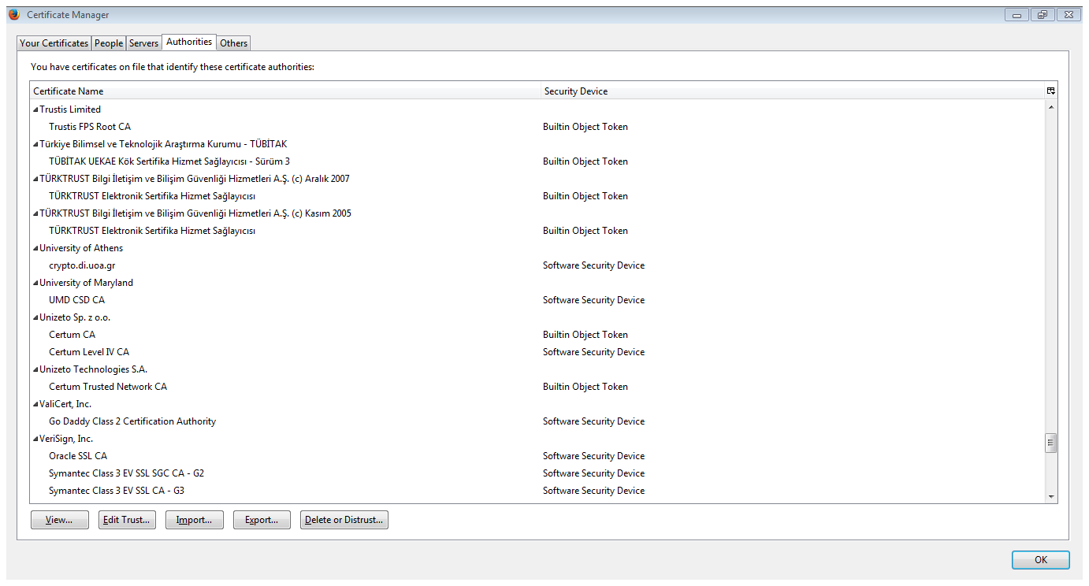
“Roots of trust”
Bob only needs to securely obtain a small number of CA’s public keys
  Need to ensure secure distribution only for these few, initial public keys
E.g., distribute as part of an operating system, or web browser
  Firefox:
  Tools->Options->Privacy & Security->View certificates->Authorities

Slide 47
Public-key repository
Store certificates in a central repository
  E.g., MIT PGP keyserver
To find Alice’s public key
  Get all public keys for “Alice,” along with certificates on those keys
  Look for a certificate signed by someone you trust whose public key you already have

Slide 48
PKI in practice…
Does not work quite as well as in theory…
  Proliferation of root CAs
  Revocation
  Other issues

