Slide 1
Ethereum Smart Contracts
Cyrus Jian Bonyadi and Shuai Xu

Slide 2
Outline
Introduction to Ethereum
  Ethereum Contextualization
  Proof of Stake and its uses
Smart Contracts
  What does a Smart Contract look like?
  Smart Contract uses
Lab
  Configure the network
  Create and run contracts on the chain

Slide 3
Introduction to Ethereum

Slide 4


Intro to Ethereum
Ethereum can be thought of as similar to bitcoin.
https://pbs.twimg.com/profile_images/421692600446619648/dWAbC2wg.jpeg
https://s.yimg.com/ny/api/res/1.2/79GZvpsBiB0w.4UMxQEijw--~A/YXBwaWQ9aGlnaGxhbmRlcjtzbT0xO3c9ODAw/http://media.zenfs.com/en-US/homerun/coin_rivet_596/45607ac1ecdfb82f720db97b79887702

Slide 5
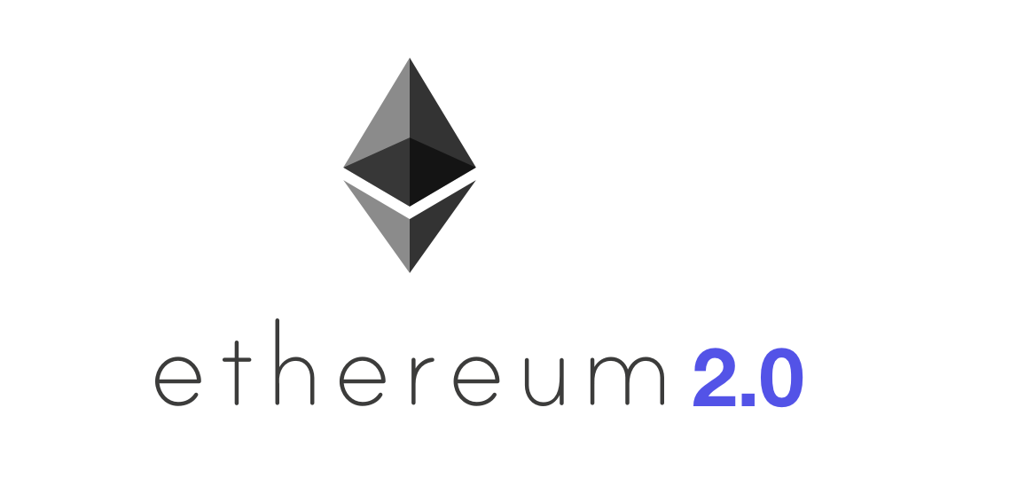
Intro to Ethereum
Ethereum can be thought of as similar to bitcoin.
https://pbs.twimg.com/profile_images/421692600446619648/dWAbC2wg.jpeg
https://miro.medium.com/max/1139/0*WyOt131FrOiIBGA_

Slide 6
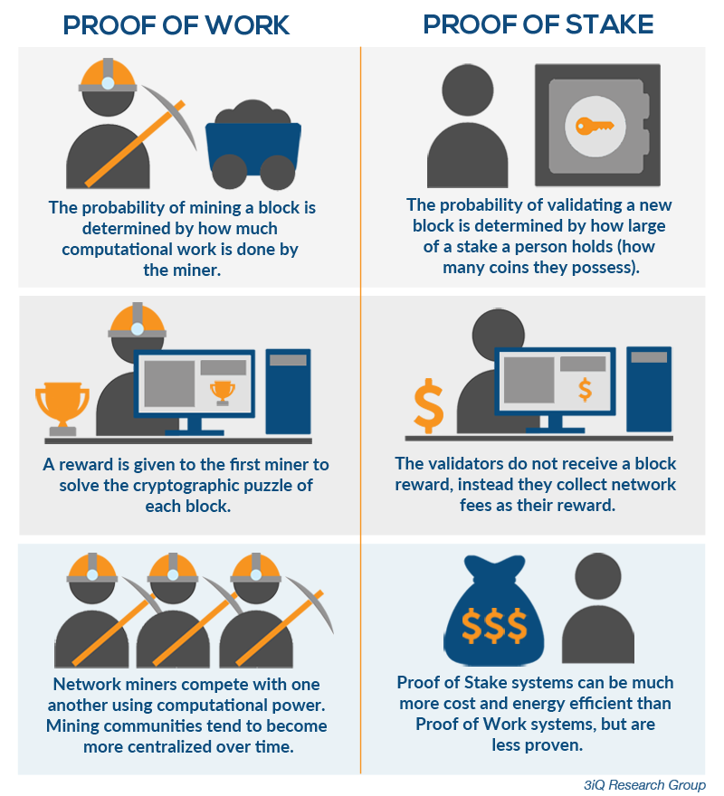
Differences between Proof of Work and Stake
https://hackernoon.com/hn-images/1*UTvlKIjMW7DK-ztV5VL2fQ.png

Slide 7
Types of Ethereum
Private Ethereum has authorized nodes joining the network as opposed to arbitrary nodes.
Private Ethereum currency is not equal to the cryptocurrency in public ethereum.
Private Ethereum is more secure but cannot as easily trust the primitives of Proof of Stake as it has fewer nodes.
Private vs public Ethereum

Slide 8
Uses of Ethereum
Public
Cryptocurrency
Basis for public record
Others?
Private
Organizational database
Personal smart contracts
Others?

Slide 9
Smart Contracts

Slide 10
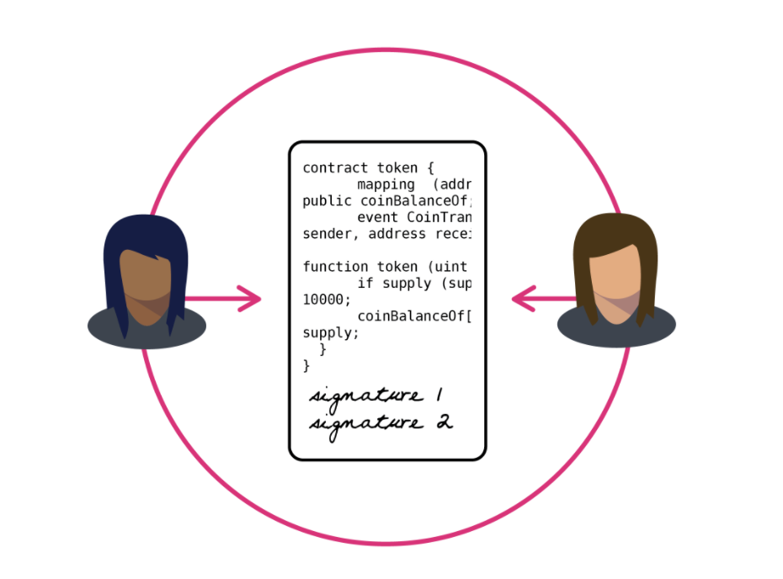
Smart Contracts
Smart Contracts are the transactions committed to a blockchain network.
They must be compiled and migrated into the network.
Contracts are verified as they are uploaded into the network and are consistent across all machines to guarantee validity.
https://static.coindesk.com/wp-content/uploads/2017/03/Screen-Shot-2017-03-28-at-5.43.08-PM.png

Slide 11
Smart Contract Uses
Printing Hello World
Sending money
Storing sensor data
Others?
https://static.coindesk.com/wp-content/uploads/2017/03/Screen-Shot-2017-03-28-at-5.43.08-PM.png

Slide 12
Lab

Slide 13
Entering the VM
Start up the VM.
Notice the shell scripts on the Desktop.
Open a terminal in the VM.
cd to /home/demo/Desktop

Slide 14
Observe genesis.json
This file contains the configuration of the network.
The network builds with 3 addresses, each with a certain amount of money to begin.
We set the difficulty to 1, though this is rather arbitrary as we modified the ethereum code.
eip blocks are used when forks are needed.
Chain id protects from replays, so we set it to something reasonable that changes, like the year.

Slide 15
Observe the commands in the scripts
initChain - builds the chain into the directory.
startChain - starts a single server instance of the chain.
mineChain - starts a mining server instance of the chain.
enterChain - attaches to the chain.
rmChain - removes the directory to start fresh.

Slide 16
Start the chain
In one terminal:
./initChain.sh
./startChain.sh
Then, in another:
./enterChain.sh

Slide 17
Check the chain
In the enterChain.sh terminal:
web3.eth.accounts #should be the same as genesis.json
web3.eth.getBalance(web3.eth.accounts[0]) #should be 30000
web3.eth.getBalance(web3.eth.accounts[1]) #should be 40000
web3.eth.getBalance(web3.eth.accounts[2]) #should be 50000
Web3.eth.coinbase #should be one of the accounts. Which one? Why? (1)
Web3.eth.mining #should be false. Why? (2)

Slide 18
Start the miner
Cancel both terminals (exit the enterChain.sh terminal, and ^C the server).
Run ./mineChain.sh on the server chain.
Re-enter the chain and check the balance of the mining chain:
web3.eth.getBalance(web3.eth.coinbase) # How can we check the balance of a different account? (3)

Slide 19
Start editing a contract
Close the miner down.
cd to the “truffle/contracts” directory.
Create “HelloWorld.sol”:
nano HelloWorld.sol

Slide 20
HelloWorld.sol
pragma solidity >=0.4.21 <0.6.0;
contract HelloWorld {
string public message;
function Hello() public{
message = "Hello World!";
}
}
“Ctrl + x “
Input “y”
“Enter” to exit

Slide 21
Configure Truffle Migration
To migrate our Smart Contract, we will have to add a file in the “migrations” directory in the “truffle” directory.
In this directory we will add a file named “2_deploy_contracts.js” (Any other file name you want )with the following contents in it:

Slide 22
~/Desktop/truffle/migrations/2_deploy_contracts.js
const HW = artifacts.require("HelloWorld");
module.exports = function(deployer) {
deployer.deploy(HW);
};

Slide 23
Observe truffle-config.js in “truffle” directory
module.exports = {
rpc: {
host:"localhost",
port:8543
},
networks: {
development: {
host: "localhost",
port: 8543,
network_id: "*",
from: "0xfa2361236b5ac8079cb6cf250e5284922ed9ba9a",
gas: 20000000
}
}
};

Slide 24
Compiling and deploying smart contract
personal.unlockAccount(web3.eth.coinbase) #no password
$ truffle migrate
Before migrating the contract, we must start the chain. Should we start a server or mine? Why? (4)
$ truffle migrate
$ truffle console

Slide 25
Truffle console
$ var first_contract
$ HelloWorld.deployed().then(function(instance) { first_contract = instance; })
$ first_contract.Hello()
$ first_contract.message.call()

Slide 26
Congratulations!
Congratulations! You have created your first Ethereum Smart Contract and executed it. I hope this Ethereum Smart Contract tutorial was informative and helped you understand about how to execute an Ethereum Smart Contract.

Slide 27
Q&A
Which account is used as the mining account by default? Why?
What does the web3.eth.mining variable mean?
How can we check the balance of another account?
Do we need to mine to run smart contracts? Why?
Learn some basic Solidity grammar and write another contract to 1). Initialize a number variable when deploying(hint: How do you initialize a variable in object oriented language?) 2) Two functions to increase/decrease that variable 3) A function to return value of that variable.

Slide 28
Appendix I - Installation on Ubuntu 16.04 LTS
Housekeeping
sudo apt-get update
sudo apt-get upgrade
sudo apt-get install -y build-essential
sudo apt-get install git
cd ~ git
clone https://github.com/ethereum/go-ethereum.git

Slide 29
Appendix I - Installation on Ubuntu 16.04 LTS
Go 1.9.3 - Cd to home directory and download Go1.9.3
cd ~
wget https://dl.google.com/go/go1.9.3.linux-amd64.tar.gz
Your download can be verified against the live Go website using the following sha256sum command：
sha256sum go1.9.3.linux-amd64.tar.gz

Slide 30
Appendix I - Installation on Ubuntu 16.04 LTS
Unpack Go, type the following command (using sudo)
sudo tar -C /usr/local -xzf go1.9.3.linux-amd64.tar.gz
To ensure that the Go path is set for your user profile. Add the following line to the end of your ~/.profile file
export PATH="$PATH:/usr/local/go/bin"

Slide 31
Appendix I - Installation on Ubuntu 16.04 LTS
Reducing the mining difficulty of Ethereum - since we want the quickest mining time possible
cd ~ gedit go-ethereum/consensus/ethash/consensus.go
At around line 298 you will see a function called CalcDifficulty. The following image shows how this function sets the mining difficulty by calling one of 3 other functions (more specifically the Frontier, Homestead or Byzantium related difficulty adjustment).

Slide 32
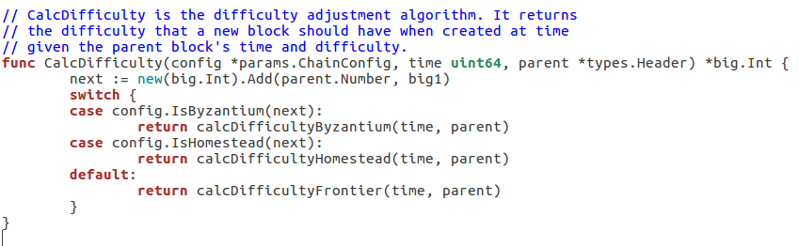
Appendix I - Installation on Ubuntu 16.04 LTS

Slide 33
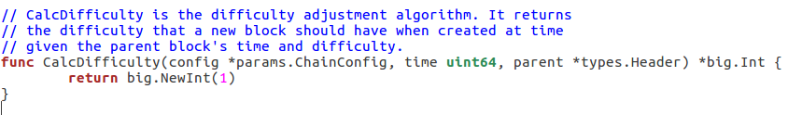
Appendix I - Installation on Ubuntu 16.04 LTS
If you remove everything inside this particular CalcDifficulty function and just add a single return statement, as pictured below, the mining difficulty will remain at its lowest possible difficulty level on an ongoing basis.

Slide 34
Appendix I - Installation on Ubuntu 16.04 LTS
Building Go Ethereum
cd ~
cd go-ethereum
make geth

Slide 35
Appendix I - Installation on Ubuntu 16.04 LTS
Network ID
The network ID for the main Ethereum network is 1. If started in default mode, the code will automatically connect to the main Ethereum network. Alternatively, the network ID can be passed into the command line when starting Go Ethereum
Obviously, in order to keep other nodes from connecting to your private Ethereum network it would be in your best interests to a) secure the network using a properly configured firewall and b) choose a unique network ID within your network. We will be using a network id of 15 today

Slide 36
Appendix I - Installation on Ubuntu 16.04 LTS
Account
In a moment we will be using a once off mechanism to fund our accounts. Before we use that mechanism we need to:
a) create a data directory for Ethereum
b) create our new accounts and
c) save those account details for use on future steps.
cd ~
mkdir gethDataDir
geth account new --datadir ~/gethDataDir

Slide 37
Appendix I - Installation on Ubuntu 16.04 LTS
Genesis block
When running Ethereum for the first time, if the default settings are used, the blockchain will start at the “hard coded” genesis block (first block in the public main net blockchain). From this point onward the code will find peers and synchronize until the Ethereum instance which you are running is up to date. Being synchronized, or up to date, means that you are storing everything from the genesis block, right up, to the most recent block, locally.
Ethereum’s blockchain is almost 45GB in size and so for our purpose of testing this is not desirable. You may recall that this is one of the reasons why we chose to run our own private network.

Slide 38
Appendix I - Installation on Ubuntu 16.04 LTS
In order to run our own network, we are going to create our own genesis block. To do so, we create a file, such as below, and save it (into the recently created ~/gethDataDir) with the name genesis.json:

Slide 39
Appendix I - Installation on Ubuntu 16.04 LTS
{
"config": {
"chainId": 15, "homesteadBlock": 0, "eip155Block": 0, "eip158Block": 0
},
"difficulty": "1",
"gasLimit": "2100000",
"alloc":{
"yourNewlyCreatedAccountAddressMustGoHere": { "balance": "300000"
},
"yourNewlyCreatedAccountAddressMustGoHere": { "balance": "400000" }, "yourNewlyCreatedAccountAddressMustGoHere": { "balance": "500000" }
}
}

Slide 40
Appendix I - Installation on Ubuntu 16.04 LTS
Note you must paste your newly created account addresses in the “alloc” section and then fund them in the “alloc/balance” section (as demonstrated above)
Note how the “chainId” section is deliberately set to 15 (our private networkid)

Slide 41
Appendix I - Installation on Ubuntu 16.04 LTS
Initializing the blockchain
cd ~/gethDataDir
geth --datadir ~/gethDataDir/ init genesis.json
Starting Ethereum
cd ~
geth --datadir ~/gethDataDir --networkid 15

Slide 42
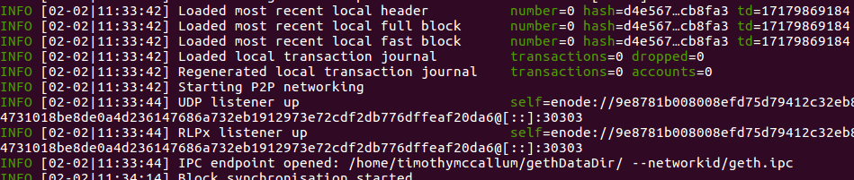
Appendix I - Installation on Ubuntu 16.04 LTS
The above command will start our Ethereum private network and, among other things, will provide an Inter-Process Communication (IPC) endpoint

Slide 43
Appendix I - Installation on Ubuntu 16.04 LTS
Connecting to the IPC endpoint (starting and using the console)
cd ~
geth attach ipc:gethDataDir/geth.ipc
The following commands will:
a) list the Ethereum accounts which we recently created
b) show our account balances
c) reveal our coinbase address (where mining rewards are sent) and
d) show our mining status (true/false)

Slide 44
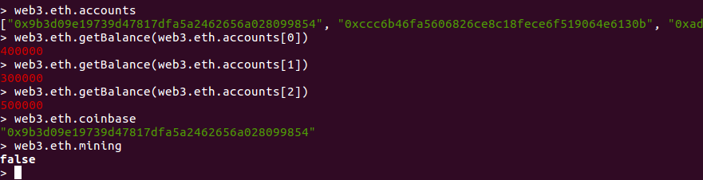
Appendix I - Installation on Ubuntu 16.04 LTS
web3.eth.accounts
web3.eth.getBalance(web3.eth.accounts[0])
web3.eth.getBalance(web3.eth.accounts[1])
web3.eth.getBalance(web3.eth.accounts[2])
web3.eth.coinbaseweb3.eth.mining

Slide 45
Appendix I - Installation on Ubuntu 16.04 LTS
Mining the Ethereum private network
As you can see from above, the Geth instance that we are running is not performing any mining. To mine the Ethereum private network you must:
a) stop the original geth instance by pressing “ctrl + c” in the main window
b) disconnect from IPC by typing exit in the console
c) type the following commands
cd ~
geth --mine --minerthreads=1 --datadir ~/gethDataDir --networkid 15

Slide 46
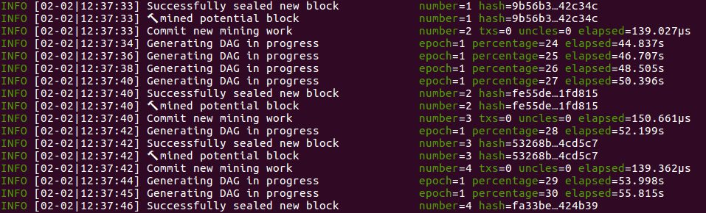
Appendix I - Installation on Ubuntu 16.04 LTS
Please note the specific parameters which we provide such as datadir and networkid. These are to ensure the mining takes place using the correct accounts and network

Slide 47
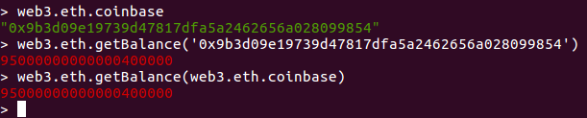
Appendix I - Installation on Ubuntu 16.04 LTS
As you can see from the output, we are now mining and sealing new blocks every few seconds If we open a new tab and connect to the console again, we can see that the coinbase account balance has increased significantly due to its successful mining operations.
Note the two different ways in which we accessed the coinbase account’s balance. Firstly by obtaining and using the account’s address explicitly and secondly by nesting the two web3 commands together (passing the coinbase account address as an argument to the getBalance function).

Slide 48
Appendix II - Truffle
Truffle is a Development Environment, Testing Framework and Asset pipeline for Ethereum Blokchains. To install Truffle, run the following command in your terminal:
npm install -g truffle

Slide 49
Appendix II - Truffle
$ mkdir truffle
$ cd truffle
$ truffle init

Slide 50
Appendix III - Solidity Compiler
Solidity is a programming language used to write Smart Contracts. To run smart contracts on our system, we have to install Solidity Compiler.
To install Solidity Compiler, run the following command in your terminal:
sudo npm install -g solc

Slide 51
Appendix IV - References
[1] https://github.com/ethereum/go-ethereum/wiki/Private-network
[2] https://solidity.readthedocs.io/en/v0.4.24/introduction-to-smart-contracts.html
[3] https://www.trufflesuite.com/docs/truffle/getting-started/interacting-with-your-contracts
[4] https://solidity.readthedocs.io/en/v0.5.3/installing-solidity.html

