Slide 1
Blockchains
Lecture 1

Slide 2
Welcome!
Blockchain is an amazing and emerging topic
Why learning blockchains?
  Useful; widely used already
  Interesting theory
  Fun to learn

Slide 3
Do not be nervous! This is a Research course
Not a regular learning-based class
Teach you how to do research
Easier and less abstract than the crypto class

Slide 4
You Can Choose Your Topic (With my guidance)
Matching your interests!
The topic needs to be “interesting” though
Your colleagues and I will help

Slide 5
Who I Am? ☺
Assistant professor in CSEE
Do research in the intersection of applied cryptography, security, and distributed systems

Slide 6
Some Blockchains My Team and I Built
Permissioned blockchains (designed/implemented)
  ByzID (SRDS 2014, Best Paper Candidate)
  BChain (OPODIS 2014, used in Hyperledger Iroha, featured in Hyperledger whitepaper)
  hBFT (IEEE TDSC 2015, hybrid BFT)
  CBFT (SRDS 2016, BFT with confidentiality)
  CP-BFT (DSN 2017, BFT with causal order)
  BEAT (CCS 2018, asynchronous BFT made practical; state of the art asychronous BFT; featured in Morning paper)
  Chios (Maryland Innovation Initiative Award on Blockchains, NSF PFI-RP award; multiple partnerships)
Permissionless blockchains (crypto schemes used in many systems)

Slide 7
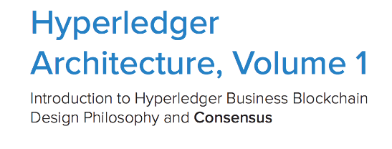
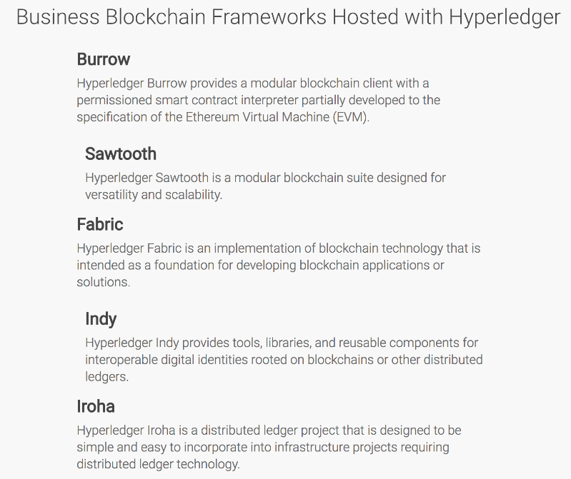
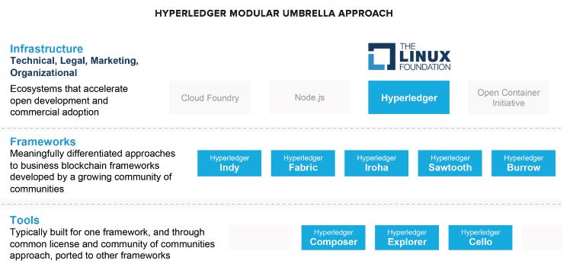
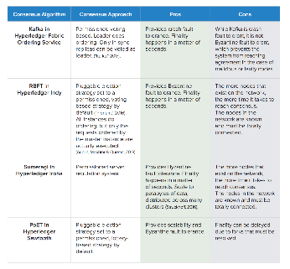
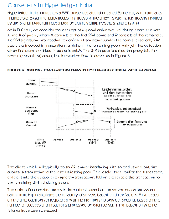
BChain
[Duan, Meling, Sean, and Zhang, OPODIS 2014]
One of 5 mature projects within Hyperledger
Known as Iroha

Slide 8
BEAT: Asynchronous Blockchain Made Practical
[Duan, Reiter, and Zhang, CCS 2018]
Blockchain, ideally
  Working for asynchronous environments
5 fully fledged instances fitting for different needs
40,000 lines of python codes
Tested in 92 Amazon EC2 servers evenly distributed among 5 continents
Featured in the morning paper

Slide 9
What About You Guys
I really want to know you well!
We do research.

Slide 10
Maybe some questions?
Name, what year at UMBC, your favorite TV episodes/sports
What are your (research) interests? (Or: What jobs you want to do?)
What do you know about blockchains?

Slide 11
Necessary administrative stuff
Course webpage
    Google Haibin Zhang + UMBC
    https://www.csee.umbc.edu/~hbzhang/classes/491-691-1/index.html

Slide 12
Half Grader
Divyesh Chitroda
d151@umbc.edu

Slide 13
Some Useful Books
Cachin et al. book (modern systems and distributed systems): http://www.springer.com/us/book/9783642152597 (UMBC students have free access to this book.)
Katz Lindell book (modern cryptography): http://www.cs.umd.edu/~jkatz/imc.html

Slide 14
Teamwork!
Form a team of size 2.
1 is discouraged; but you can ask my special permission
3? you can ask my special permission; the project should be proportionally better
After forming a team, let’s meet regularly in class and after class.

Slide 15
Grading
Participation: 10%.
Paper reviews and other small tasks: 20%.
Mid-term presentation: 10%.
Final presentation 10%: Time to show your achievements! Not the project due day.
Project (code, evaluation): 50%. The project will be evaluated in novelty and complexity.

Slide 16
Beyond Grading
It is good to know blockchains (good and bad)
Train you to do research, an ability you do not easily obtain elsewhere
Have some hands-on experience on blockchains
Add blockchain projects experience to your resume
Let’s try to write an academic paper together

Slide 17
What I Expect from You
This course is research focused; be scientific, but open your mind
Spend equal time just as your other courses
Plan ahead; start your project early
Treat me as your thesis advisor if you want; discuss with me on research in class and after class
We need to keep the projects going
Glad to try and compare different approaches

Slide 18
Guest Lectures
  We may have some guest lectures (1-3) if we can find the right ones.

Slide 19
Questions?
Please ask questions throughout!

Slide 20
OK, A Brief Introduction on Blockchains
Should be easily accessible
Not at all like what you read from the Internet!

Slide 21



Client-Server Architecture
One server is a single point of failure or compromise
Request
Response
Client
Server

Slide 22
Blockchains (State Machine Replication)
Blockchains tolerate Byzantine (arbitrary) failures
  Integrity/safety: the code to be executed correctly
  Availability/liveness: the service is always available
  (Typically, not confidentiality)
Replicas
Client

Slide 23
Blockchain Consensus (What is it? Why hard?)
Correct servers maintain the same consistent state, even
  1) under highly concurrent client requests
  2) when a fraction of servers are compromised
  3) under network asynchrony

Slide 24
Roughly, Consensus: All About Achieving “Total Order”
[Lamport, ACM TOPLAS 1984]
Blockchains (modeled as state machine replication)
$100
$100
$100

Slide 25
The “Total Order” Requirement
Client 1:
“Deposit $100”
$100
$200
Client 1:
“Deposit $100”
$100
$200
$100

Slide 26
The “Total Order” Requirement
Client 1:
“Deposit $100”
Chase:
“Charge 10%”
$100
$200
$180
Client 1:
“Deposit $100”
Chase:
“Charge 10%”
$100
$200
$180
$100

Slide 27

The “Total Order” Requirement
Client 1:
“Deposit $100”
Chase:
“Charge 10%”
$100
$200
$180
Client 1:
“Deposit $100”
Chase:
“Charge 10%”
$100
$200
$180
$100

Slide 28
The “Total Order” Requirement
Chase:
“Charge 10%”
Client 1:
“Deposit $100”
$100
$90
$190
Chase:
“Charge 10%”
Client 1:
“Deposit $100”
$100
$90
$190
$100

Slide 29

The “Total Order” Requirement
Chase:
“Charge 10%”
Client 1:
“Deposit $100”
$100
$90
$190
Client 1:
“Deposit $100”
Chase:
“Charge 10%”
$100
$200
$180
$100

Slide 30
Characterizing Blockchains
Permissionless: explicitly/implicitly rely on cryptocurrency
Permissioned: traditional Byzantine fault-tolerant distributed system (consortium blockchains, private blockchains)
 | Membership | Consensus Approach | Examples
Permissionless | Dynamic | PoX (Proof of “X”) | Bitcoin, Ethereum
Permissioned | Fixed; know IDs of each other | BFT (Byzantine fault tolerance) | Fabric, Iroha, Chios, BEAT

Slide 31
Characterizing Blockchains
Permissionless: explicitly/implicitly rely on cryptocurrency
Permissioned: traditional Byzantine fault-tolerant distributed system (consortium blockchains, private blockchains)
Hybrid: use BFT to improve permissionless blockchains
 | Membership | Consensus Approach | Examples
Permissionless | Dynamic | PoX (Proof of “X”) + Some mechanism | Bitcoin, Ethereum
Permissioned | Fixed; know IDs of each other | BFT (Byzantine fault tolerance) | Fabric, Iroha, Chios, BEAT
Hybrid (permissonless) | Dynamic | Sybil resistant PoX+ BFT | Elastico, OmniLedger, Ethereum Casper

