Slide 1
Cryptography
Lecture 3

Slide 2
Perfect secrecy (formal)
Encryption scheme (Gen, Enc, Dec) with message space M and ciphertext space C is perfectly secret if for every distribution over M, every m ∈ M, and every c ∈ C with Pr[C=c] > 0, it holds that
Pr[M = m | C = c] = Pr[M = m].
I.e., the distribution of M does not change conditioned on observing the ciphertext

Slide 3
One-time pad
Let M = {0,1}^{n}
Gen: choose a uniform key k ∈ {0,1}^{n}
Enc_{k}(m) = k ⊕ m
Dec_{k}(c) = k ⊕ c
Correctness:
Dec_{k}( Enc_{k}(m) ) = k ⊕ (k ⊕ m)
= (k ⊕ k) ⊕ m = m

Slide 4
One-time pad
n bits
key
n bits
n bits
⊕
message
ciphertext

Slide 5
Perfect secrecy of one-time pad
Note that any observed ciphertext can correspond to any message (why?)
  (This is necessary, but not sufficient, for perfect secrecy)
So, having observed a ciphertext, the attacker cannot conclude for certain which message was sent

Slide 6
Perfect secrecy of one-time pad
Fix arbitrary distribution over M = {0,1}^{n}, and
arbitrary m, c ∈ {0,1}^{n}
Pr[M = m | C = c] = ?
  = Pr[C = c | M = m] · Pr[M = m]/Pr[C = c]
Pr[C = c]
  = Σ_{m’} Pr[C = c | M = m’] · Pr[M = m’]
  = Σ_{m’} Pr[K = m’ ⊕ c] · Pr[M = m’]
  = Σ_{m’} 2^{-n} · Pr[M = m’]
  = 2^{-n}

Slide 7
Perfect secrecy of one-time pad
Fix arbitrary distribution over M = {0,1}^{n}, and arbitrary m, c ∈ {0,1}^{n}
Pr[M = m | C = c] = ?
  = Pr[C = c | M = m] · Pr[M = m]/Pr[C = c]
  = Pr[K = m ⊕ c] · Pr[M = m] / 2^{-n}
  = 2^{-n} · Pr[M = m] / 2^{-n}
  = Pr[M = m]

Slide 8
A brief detour:
randomness generation

Slide 9
Key generation
When describing algorithms, we assume access to uniformly distributed bits/bytes
Where do these actually come from?
Random-number generation

Slide 10
Random-number generation
Precise details depend on the system
  Linux or unix: /dev/random or /dev/urandom
  Do not use rand() or java.util.Random
  Use crypto libraries instead

Slide 11
Random-number generation
Two steps:
  Continually collect a “pool” of high-entropy (i.e., “unpredictable”) data
  When random bits are requested, process this data to generate a sequence of uniform, independent bits/bytes
    May “block” if insufficient entropy available

Slide 12
Min-entropy
I.e., “guessing entropy”
The min-entropy of a random variable X is defined as
H∞(X) = -log₂ max_{x}{ Pr[X=x] }
(in bits)
If X ranges over n-bit strings, then H∞(X) ≤ n
  Equality iff X has uniform distribution

Slide 13
Random-number generation
Request random bits
Processing/
smoothing

Slide 14
Smoothing
Can use randomness extraction
Unkeyed extraction is possible for some input distributions; impossible for others
Keyed extraction possible for all distributions
  Extracted randomness is less than the input min-entropy
  Where does the key come from?
In practice, computational extraction is used

Slide 15
Key generation
Read desired number of bytes from /dev/urandom

Slide 16
Encryption
Plaintext = sequence of ASCII characters
Key = sequence of hex digits, written in ASCII
Read them; XOR them to get the ciphertext

Slide 17
Decryption
Reverse encryption
Read ciphertext and key; XOR them to recover the message

Slide 18
One-time pad
The one-time pad achieves perfect secrecy!
One-time pad has historically been used in the real world
  E.g., “red phone” between DC and Moscow
I am not aware of anyone currently using it
  Why isn’t the one-time pad used?

Slide 19
One-time pad
Several limitations
  The key is as long as the message
  Only secure if each key is used to encrypt a
  single message
    (Trivially broken by a known-plaintext attack)
⇒ Parties must share keys of (total) length equal to the (total) length of all the messages they might ever send

Slide 20
Using the same key twice?
Say c₁ = k ⊕ m₁
c₂ = k ⊕ m₂
Attacker can compute
c₁ ⊕ c₂ = (k ⊕ m₁) ⊕ (k ⊕ m₂) = m₁ ⊕ m₂
This leaks information about m₁, m₂!

Slide 21
Using the same key twice?
m₁ ⊕ m₂ is information about m₁, m₂
Is this significant?
    No longer perfectly secret!
    m₁ ⊕ m₂ reveals where m₁, m₂ differ
    Frequency analysis
    Exploiting characteristics of ASCII…

Slide 22
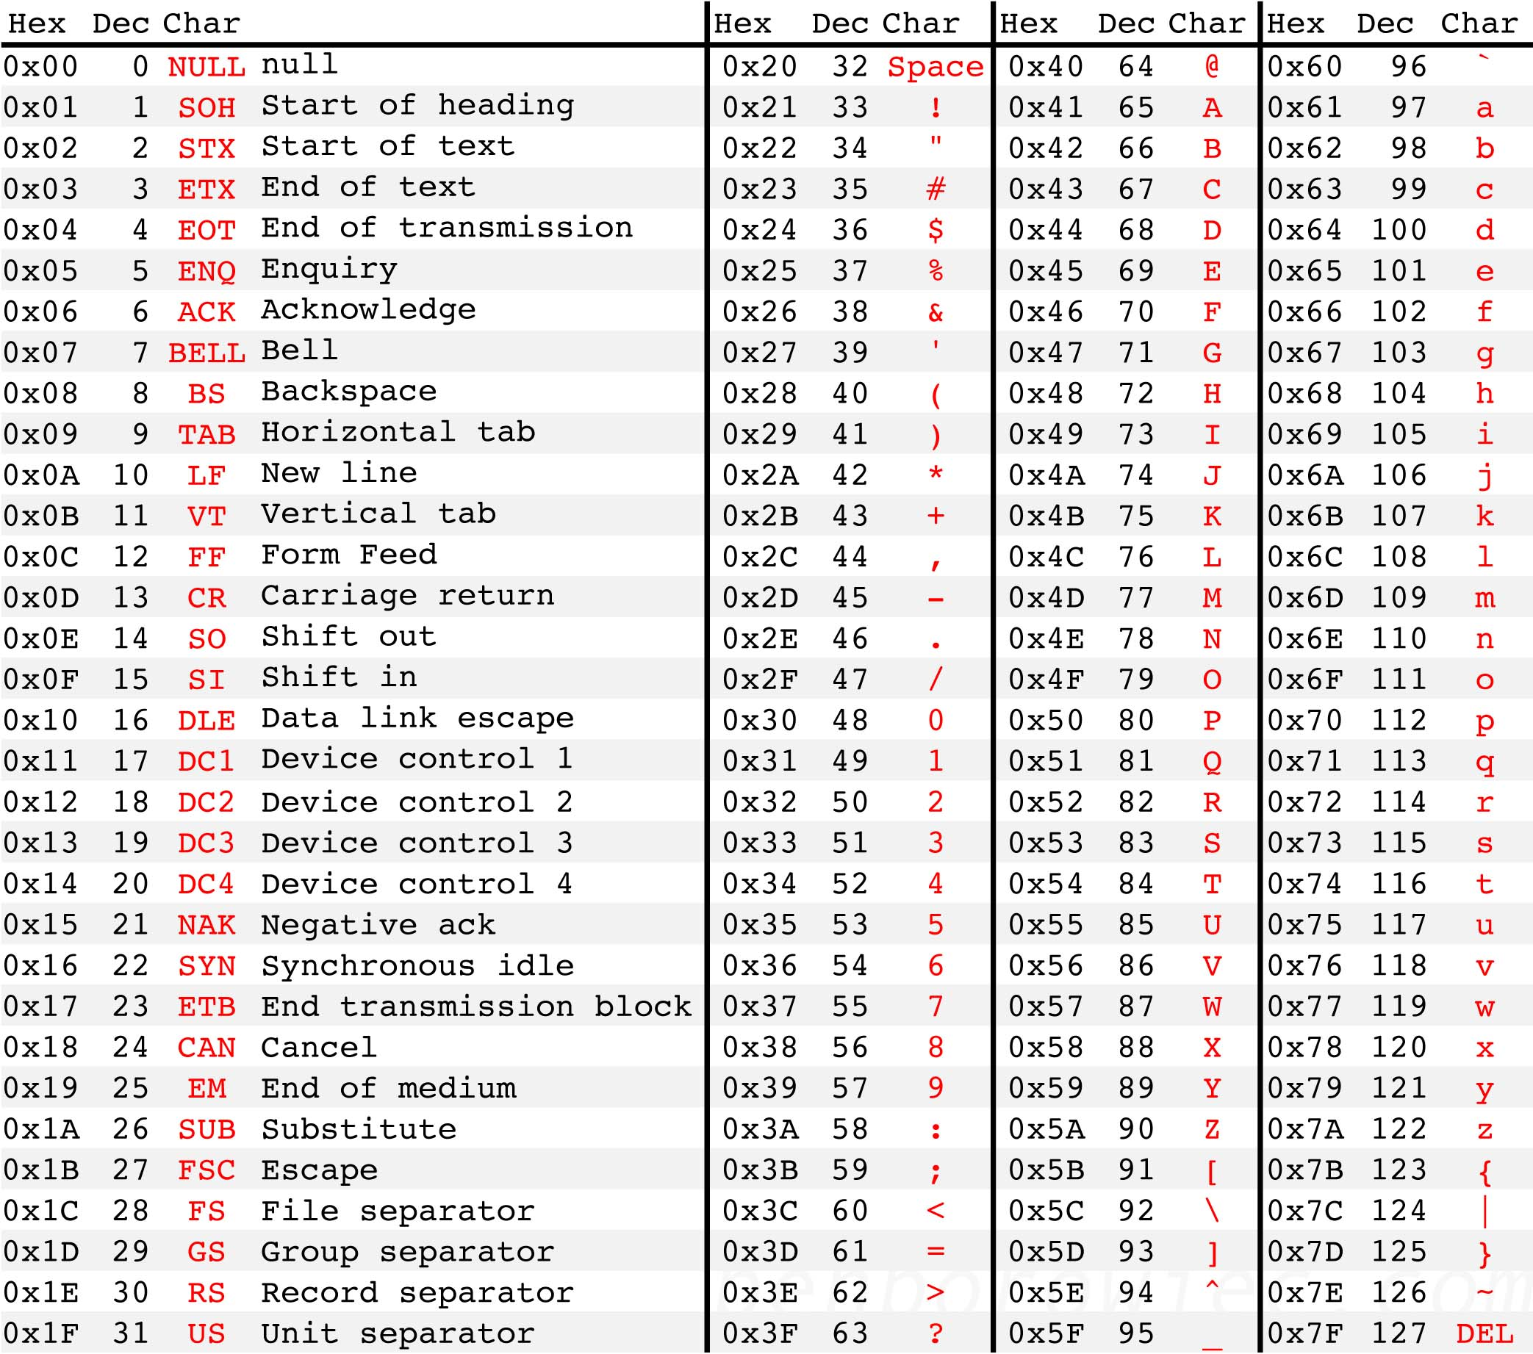
Letters all begin with 01…
The space character begins with 00…
XOR of two letters gives 00…
XOR of letter and space gives 01…
Easy to identify XOR of letter and space!
Source: http://benborowiec.com/2011/07/23/better-ascii-table/

Slide 23
In pictures
01…
01…
01…
00…
…
00…
…
01…
01…
01…
01…
01…
…
00…
00…
00…
01…
01010000
01010000 = 00100000 ⊕ ‘p’
01010000 = 00100000 ⊕ ??

Slide 24
One-time pad
Drawbacks
  Key as long the message
  Only secure if each key is used to encrypt once
  Trivially broken by a known-plaintext attack
These limitations are inherent for schemes achieving perfect secrecy

Slide 25
Optimality of the one-time pad
Theorem: if (Gen, Enc, Dec) with message space M is perfectly secret, then |K| ≥ |M|.
Intuition:
  Given any ciphertext, try decrypting under every possible key in K
  This gives a list of up to |K| possible messages
  If |K| < |M|, some message is not on the list

Slide 26
Optimality of the one-time pad
Theorem: if (Gen, Enc, Dec) with message space M is perfectly secret, then |K| ≥ |M|.
Proof:
  Assume |K| < |M|
  Need to show that there is a distribution on M,
  a message m, and a ciphertext c such that
  Pr[M=m | C=c] ≠ Pr[M=m]

Slide 27
Optimality of the one-time pad
Proof, continued
  Take the uniform distribution on M
  Take any ciphertext c
  Consider the set M(c) = { Dec_{k}(c) }_{k∈K}
    These are the only possible messages that could yield the ciphertext c
  |M(c)| ≤ |K| < |M|, so there is some m that is not in M(c)
    Pr[M=m | C=c] = 0 ≠ Pr[M=m]

Slide 28
Where do we stand?
Defined perfect secrecy
One-time pad achieves it!
One-time pad is optimal!
Are we done…?

Slide 29
Perfect secrecy
Requires that absolutely no information about the plaintext is leaked, even to eavesdroppers with unlimited computational power
  Has some inherent drawbacks
  Seems unnecessarily strong

