Slide 1
Cryptography
Lecture 23

Slide 2
Q and A; bring the written answers to TA before the class
1. What is the hash and sign paradigm?
2. Why the plain RSA signature should not be used? (Can you provide some attacks?)
3. What is RSA-FDH?
4. What is ECDSA? (ECDSA is used in Bitcoin!)

Slide 3
Goals
Understand real-world crypto, through the lens of formal definitions
Almost everything we have covered in class is used in practice, or is the basis for something used in practice
To make sure you understand a scheme, ask yourself if you could implement it
Security definitions will be tested
  Must be able to write pseudocode and give analysis showing that some scheme is insecure b/c it does not satisfy a given definition

Slide 4
Digital signatures

Slide 5
Signature schemes
A signature scheme is defined by three PPT algorithms (Gen, Sign, Vrfy):
  Gen: takes as input 1^{n}; outputs pk, sk
  Sign: takes as input a private key sk and a message m∈{0,1}*; outputs signature σ
  σ ← Sign_{sk}(m)
  Vrfy: takes public key pk, message m, and signature σ as input; outputs 1 or 0
For all m and all pk, sk output by Gen,
Vrfy_{pk}(m, Sign_{sk}(m)) = 1

Slide 6
Security?
Threat model
  “Adaptive chosen-message attack”
  Assume the attacker can induce the sender to sign messages of the attacker’s choice
Security goal
  “Existential unforgeability”
  Attacker should be unable to forge valid signature on any message not signed by the sender
Attacker gets the public key…

Slide 7
Formal definition
Fix A, Π
Define randomized experiment Forge_{A,Π}(n):
  pk, sk ← Gen(1^{n})
  A given pk, and interacts with oracle Sign_{sk}(·) ; let M be the set of messages sent to this oracle
  A outputs (m, σ)
  A succeeds, and the experiment evaluates to 1, if Vrfy_{pk}(m, σ)=1 and m∉M

Slide 8
Security for signature schemes
Π is secure if for all PPT attackers A, there is a negligible function ε such that
Pr[Forge_{A,Π}(n) = 1] ≤ ε(n)

Slide 9
Replay attacks
Replay attacks need to be addressed just as in the symmetric-key setting

Slide 10
Hash-and-sign paradigm
Given
  A signature scheme Π = (Gen, Sign, Vrfy) for “short” messages of length n
  Hash function H: {0,1}* → {0,1}^{n}
Construct a signature scheme Π’=(Gen, Sign’, Vrfy’) for arbitrary-length messages:
  Sign’_{sk}(m) = Sign_{sk}(H(m))
  Vrfy’_{pk}(m, σ) = Vrfy_{pk}(H(m), σ)

Slide 11
Hash-and-sign paradigm
Theorem: If Π is secure and H is collision-resistant, then Π’ is secure
Proof: Say the sender authenticates m₁, m₂, …
  Let h_{i} = H(m_{i})
Attacker outputs forgery (m, σ), m ≠ m_{i} for all i
Two cases:
  H(m) = h_{i} for some i
    Collision in H!
  H(m) ≠ h_{i} for all i
    Forgery in the underlying signature scheme

Slide 12
Hash-and-sign paradigm
Analogous to hybrid encryption
  The functionality of digital signatures at the asymptotic cost of a symmetric-key operation

Slide 13
Recall… (informal)
Choose random, equal-length primes p, q
Compute modulus N=pq
Choose e, d such that e · d = 1 mod φ(N)
The e^{th} root of m modulo N is [m^{d} mod N]
(m^{d})^{e} = m^{de} = m^{[ed mod φ(N)]} = m mod N
RSA assumption: given N, e only, hard to compute the e^{th} root of a uniform m ∈ ℤ*_{N}

Slide 14
“Plain” RSA signatures
N, e
m, σ
  (N, e, d) ← RSAGen(1^{n})
  pk = (N, e)
  sk = d
?
  m = [σ^{e} mod N]
σ = [m^{d} mod N]

Slide 15
Security?
Intuition
  Signature of m is the e^{th} root of m – supposedly hard to compute!

Slide 16
Attack 1
Can sign specific messages
  E.g., easy to compute the e^{th} root of m = 1, or the cube root of m = 8

Slide 17
Attack 2
Can sign “random” messages
  Choose arbitrary σ; set m = [σ^{e} mod N]

Slide 18
Attack 3
Can combine two signatures to obtain a third
  Say σ₁, σ₂ are valid signatures on m₁, m₂ with respect to public key N, e
  Then σ’ = [σ₁ · σ₂ mod N] is a valid signature on the message m’ = [m₁ · m₂ mod N]
    (σ₁ · σ₂)^{e} = σ₁e · σ₂e = m₁ · m₂ mod N

Slide 19
RSA-FDH
Main idea: apply a “cryptographic transformation” to messages before signing
Public key: (N, e) private key: d
Sign_{sk}(m) = H(m)^{d} mod N
Vrfy_{pk}(m, σ): output 1 iff
σ^{e} = H(m) mod N
(This also handles long messages)

Slide 20
Intuition for security?
Look at the three previous attacks…
  Not easy to compute the e^{th} root of H(1), …
  Choose σ…, but how do you find an m such that H(m) = σ^{e} mod N?
    Computing inverses of H should be hard
  H(m₁) · H(m₂) = σ₁e · σ₂e = (σ₁ · σ₂)^{e} ≠ H(m₁ · m₂)

Slide 21
Security of RSA-FDH
If the RSA assumption holds, and H is modeled as a random oracle (mapping onto ℤ*_{N}), then RSA-FDH is secure
In practice, H is instantiated with a (modified) cryptographic hash function
  Must ensure that the range of H is large enough!

Slide 22
RSA-FDH in practice
The RSA PKCS #1 v2.1 standard includes a signature scheme inspired by RSA-FDH
  Essentially a randomized variant of RSA-FDH

Slide 23
DSS
NIST standard for digital signatures
  DSA, based on discrete-logarithm problem in subgroup of ℤ_{p}*
  ECDSA, based on elliptic-curve groups
See book for details

Slide 24
Public-key infrastructure (PKI)

Slide 25
Public-key distribution
Alice, pk*
pk
X
Alice, pk
Alice, pk*
Alice, pk
pk, sk

Slide 26
Public-key distribution
pk
Alice, pk
Alice, pk
X
Alice, pk*
pk, sk

Slide 27
Use signatures for secure key distribution!
Assume a trusted party with a public key known to everyone
  CA = certificate authority
  Public key pk_{CA}
  Private key sk_{CA}

Slide 28
Use signatures for secure key distribution!
Alice asks the CA to sign the binding (Alice, pk)
  cert_{CA→Alice} = Sign_{skCA}(Alice, pk)
(CA must verify Alice’s identity out of band)

Slide 29
Use signatures for secure key distribution!
Bob obtains Alice, pk, and the certificate cert_{CA→Alice} …
  … verifies that Vrfy_{pKCA}((Alice, pk), cert_{CA→Alice}) = 1
Bob is then assured that pk is Alice’s public key
  As long as the CA is trustworthy…
    Honest, and properly verifies Alice’s identity
  …and the CA’s private key has not been compromised

Slide 30
Chicken-and-egg problem?
How does Bob get pk_{CA} in the first place?
Several possibilities…

Slide 31
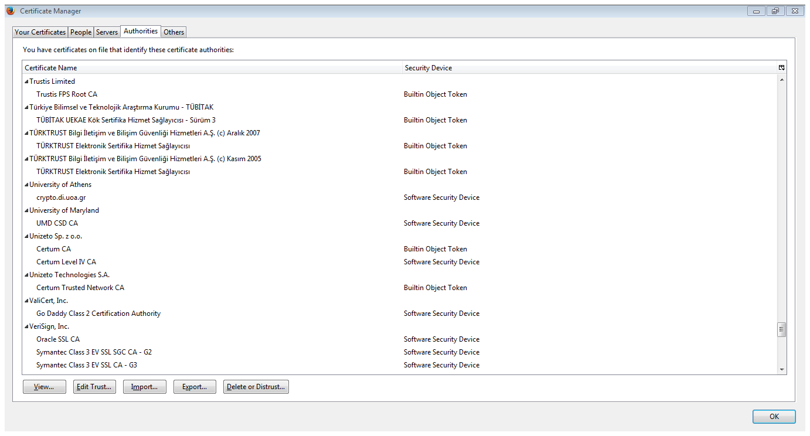
“Roots of trust”
Bob only needs to securely obtain a small number of CA’s public keys
  Need to ensure secure distribution only for these few, initial public keys
E.g., distribute as part of an operating system, or web browser
  Firefox:
  Tools->Options->Privacy & Security->View certificates->Authorities

Slide 32
“Web of trust”
Obtain public keys from friends in person
  “Key-signing parties”
Obtain “certificates” on my public key from my friends
If A knows pk_{B}, and B issued a certificate for C, then C can send that certificate to A
  What trust assumptions are being made here?

Slide 33
Public-key repository
Store certificates in a central repository
  E.g., MIT PGP keyserver
To find Alice’s public key
  Get all public keys for “Alice,” along with certificates on those keys
  Look for a certificate signed by someone you trust whose public key you already have

Slide 34
PKI in practice…
Does not work quite as well as in theory…
  Proliferation of root CAs
  Revocation
  Other issues

Slide 35
Advanced topics

Slide 36
Modern research in cryptography
Many different directions…interactions with many fields
  Mathematical aspects of cryptography; better algorithms for number-theoretic problems
  Crypto implementations and their security, incl. hardware implementations
  Hash function/stream-cipher/block-cipher design and cryptanalysis
  Theory of cryptography, incl. proofs of security
  Usability issues

Slide 37
Modern research in cryptography
Some topics we did not cover at all
  Distributed, multi-party protocols with complex trust assumptions
    Secure computation
    Verifiable computing
    Blockchain and cryptocurrencies
  Privacy and anonymity
  Post-quantum security
    Ongoing NIST “competition”

Slide 38
Where to go next
Cryptography conferences and papers
  Asiacrypt, Crypto, Eurocrypt conferences
  http://eprint.iacr.org
  Bellare, Rogaway, Boneh, Katz, Shoup, etc.
Security conferences with (applied) crypto papers
  IEEE Symposium on Security and Privacy
  ACM Conf. on Computer and Communications Security

