Slide 1
Cryptography
Lecture 20

Slide 2
Q and A; bring the written answers to TA before the class
1. Why do we need public key cryptography?
2. What is the security definition of a key exchange protocol?
3. What’s Diffie-Hellman key exchange?

Slide 3
Disclaimer
The goal here is just to give an idea as to how parameters are calculated, and what relevant parameters are
In practice, other important considerations come into play

Slide 4
Security
Recall: For symmetric-key algorithms…
  Block cipher with n-bit key ≈ security against 2^{n}-time attacks
  Hash function with n-bit output ≈ security against 2^{n/2}-time attacks
Factoring of a modulus of size 2^{n} (i.e., length n) using exhaustive search takes 2^{n/2} time
Computing discrete logarithms in a group of order 2^{n} takes 2^{n} time
  Are these the best algorithms possible?

Slide 5
Algorithms for factoring
There exist algorithms factoring an integer N that run in much less than 2^{ǁNǁ/2} time
Best known algorithm (asymptotically): general number field sieve
  Running time (heuristic): 2^{O(ǁNǁ1/3 log2/3 ǁNǁ)}
  Makes a huge difference in practice!
  Exact constant term also important!

Slide 6
Algorithms for dlog
Two classes of algorithms:
  Ones that work for arbitrary (“generic”) groups
  Ones that target specific groups
    Recall that in some groups the problem is not even hard
Best “generic” algorithms:
  Time 2^{n/2} in a group of order ≈ 2^{n}
  This is known to be optimal for generic algorithms

Slide 7
Algorithms for dlog
Best known algorithm for (subgroups of) ℤ*_{p}: number field sieve
  Running time (heuristic): 2^{O(ǁpǁ1/3 log2/3 ǁpǁ)}
For (appropriately chosen) elliptic-curve groups, nothing better than generic algorithms is known!
  This is why elliptic-curve groups can allow for more-efficient cryptography

Slide 8
Choosing parameters
As recommended by NIST (112-bit security):
  Factoring: 2048-bit modulus
  Dlog, order-q subgroup of ℤ*_{p}: ǁqǁ=224, ǁpǁ=2048
    Address both generic and specific algorithms
  Dlog, elliptic-curve group of order q: ǁqǁ=224
Much longer than for symmetric-key algorithms!
  Explains in part why public-key crypto is less efficient then symmetric-key crypto

Slide 9
Back to cryptography…

Slide 10
Private-key cryptography
Private-key cryptography allows two users who share a secret key to establish a “secure channel”
The need to share a secret key has several drawbacks…

Slide 11
The key-distribution problem
How do users share a key in the first place?
  Need to share the key using a secure channel…
This problem can be solved in some settings
  E.g., physical proximity, trusted courier, …
  Note: this does not make private-key cryptography useless!
Can be difficult or expensive to solve in other settings

Slide 12
The key-management problem
Imagine an organization with N employees, where each pair of employees might need to communicate securely
Solution using private-key cryptography:
  Each user shares a key with all other users
  Each user must store/manage N-1 secret keys!
  O(N²) keys overall!

Slide 13
Lack of support for “open systems”
Say two users who have no prior relationship want to communicate securely
  When would they ever have shared a key?
This happens all the time!
  Customer sending credit-card data to merchant
  Contacting a friend-of-a-friend on social media
  Emailing a colleague

Slide 14
“Classical” cryptography offers no solution to these problems!

Slide 15
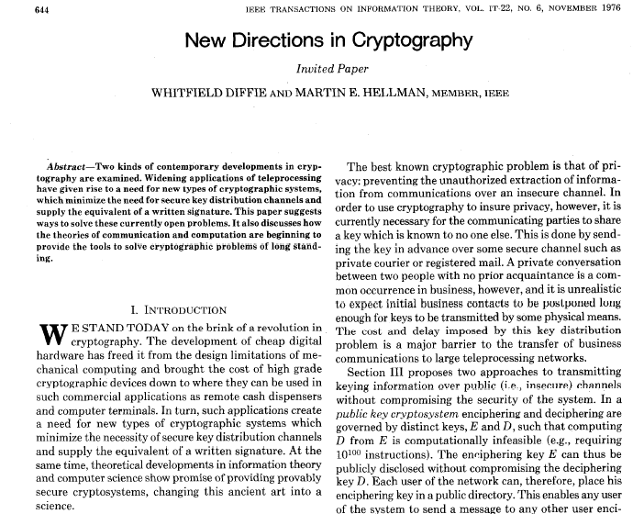

Slide 16
New directions…
Main ideas:
  Some problems exhibit asymmetry – easy to compute, but hard to invert (factoring, RSA, group exponentiation, …)
  Use this asymmetry to enable two parties to agree on a shared secret key via public discussion(!)
    Key exchange

Slide 17
Key exchange
…
…
k
Enc_{k}(m)
k
Secure against an eavesdropper who sees everything!

Slide 18
More formally…
transcript
· · ·
k∈{0,1}^{n}
k∈{0,1}^{n}
Security goal: even after observing the transcript, the shared
key k should be indistinguishable from a uniform key

Slide 19
Formally
Fix a key-exchange protocol Π and an attacker (passive eavesdropper) A
Define the following experiment KE_{A,} _{Π}(n):
  Honest parties run Π using security parameter n, resulting in a transcript trans and (shared) key k
  Choose uniform bit b. If b=0, then set k’=k; if b=1, then choose uniform k’∈{0,1}^{n}
  Give trans and k’ to A, which outputs a bit b’
  Exp’t evaluates to 1 (A succeeds) if b’=b

Slide 20
Security
Key-exchange protocol Π is secure (against passive eavesdropping) if for all probabilistic, poly-time A it holds that
Pr[KE_{A,} _{Π}(n) = 1] ≤ ½ + negl(n)

Slide 21
Notes
Being unable to compute the key given the transcript is not a strong enough guarantee
Indistinguishability of the shared key from uniform is a much stronger guarantee…
  …and is necessary if the shared key will subsequently be used for private-key crypto!

Slide 22
Diffie-Hellman key exchange
G, q, g, h₁
h₂
k₁ = (h₂)^{x} = g^{yx}
k₂ = (h₁)^{y} = g^{xy}
  (G, q, g) ← G(1^{n})
  x ← ℤ_{q}
  h₁ = g^{x}
  y ← ℤ_{q}
  h₂ = g^{y}

Slide 23
In practice…
G, q, g
h₁
h₂
k₁ = (h₂)^{x} = g^{xy}
k₂ = (h₁)^{y} = g^{xy}
  x ← ℤ_{q}
  h₁ = g^{x}
  y ← ℤ_{q}
  h₂ = g^{y}

Slide 24
Recall…
Decisional Diffie-Hellman (DDH) problem:
  Given g^{x}, g^{y}, distinguish g^{xy} from a uniform group element

Slide 25
Security?
Eavesdropper sees G, q, g, g^{x}, g^{y}
Shared key k is g^{xy}
Computing k from the transcript is exactly the computational Diffie-Hellman problem
Distinguishing k from a uniform group element is exactly the decisional Diffie-Hellman problem
  ⇒ If the DDH problem is hard relative to G, this is a secure key-exchange protocol!

Slide 26
A subtlety
We wanted our key-exchange protocol to give us a uniform(-looking) key k∈{0,1}^{n}
Instead we have a uniform(-looking) group element k∈G
  Not clear how to use this as, e.g., an AES key
Solution: key derivation
  Set k’ = H(k) for suitable hash function H
    Requirements on H omitted here…

Slide 27
Modern key-exchange protocols
Security against passive eavesdroppers is insufficient
Want authenticated key exchange
  This requires some form of setup in advance
Modern key-exchange protocols provide this
  We will return to this later

Slide 28
The public-key setting

Slide 29
The public-key setting
A party generates a pair of keys: a public key pk and a private key sk
  Public key is widely disseminated
  Private key is kept secret, and shared with no one
Private key used by the party who generated it; public key used by everyone else
  Also called asymmetric cryptography
Security must hold even if the attacker knows pk

Slide 30
Public-key distribution I
pk
pk
pk
pk, sk

Slide 31
Public-key distribution II
pk
pk, sk

Slide 32
Public-key distribution
Previous figures (implicitly) assume parties are able to obtain correct copies of each others’ public keys
  I.e., the attacker is passive during key distribution
We will revisit this assumption later

Slide 33
Primitives
 | Private-key setting | Public-key setting
Secrecy | Private-key encryption | Public-key encryption
Integrity | Message authentication codes | Digital signature schemes

Slide 34
Addressing drawbacks of private-key crypto…
Key distribution
  Public keys can be distributed over public (but authenticated) channels!
Key management in large systems of N users
  Each user stores 1 private key and N-1 public keys; only N keys overall
  Public keys can be stored in a central directory
Applicability in “open systems”
  Even parties who have no prior relationship can find each others’ public keys and use them

Slide 35
Why study private-key crypto?
Private-key cryptography is more suitable for certain applications
  E.g., disk encryption
Public-key crypto is roughly 2-3 orders of magnitude slower than private-key crypto
  If private-key crypto is an option, use it!
  Private-key crypto is used for efficiency even in the public-key setting

Slide 36
Public-key encryption
pk
pk
c
pk
pk, sk
c ← Enc_{pk}(m)
m = Dec_{sk}(c)

