Slide 1
File I/O
CMSC 201

Slide 2
Overview
Today we’ll be going over:
String methods
File I/O

Slide 3
File I/O
To open a file:
  fileThing = open(file_name, mode)
File open modes:
"w" -- open for writing; create if necessary
existing files erased
"r" -- open for reading
Returns file handle.

Slide 4
File I/O
To read from a file:
  fileThing = open("myFile.txt", "r")
  #Loops over every line in the file
  for line in fileThing:
  print(line)
  fileThing.close()

Slide 5
Example
To copy one file to another:
  fileIn = open("myInFile.txt", "r")
  fileOut = open("myOutFile.txt", "w")
  while True:
  theline = fileIn.readline()
  if len(theline) == 0:
  break
  fileOut.write(theline)
  fileIn.close()
  fileOut.close()

Slide 6
Example
To copy a binary file to another:
  fileIn = open("myInFile.txt", "rb")
  fileOut = open("myOutFile.txt", "wb")
  while True:
  buf = fileIn.read (1024)
  if len(buf) == 0:
  break
  fileOut.write(buf)
  fileIn.close()
  fileOut.close()

Slide 7
File I/O
To write to a file:
  fileThing = open("myFile.txt", "w")
  fileThing.write("Hello!")
  fileThing.close()

Slide 8
Strings
There are tons of useful functions for python strings!
They can be found here:
https://docs.python.org/3.4/library/stdtypes.html#string-methods

Slide 9
Strings
Some examples:
capitalize( )
center( width[, fillchar])
count( sub[, start[, end]])
endswith( suffix[, start[, end]])
expandtabs( [tabsize])
find( sub[, start[, end]])
index( sub[, start[, end]])
isalnum( )
isalpha( ) isdigit( )
islower( )
isspace( )
isupper( )
ljust( width[, fillchar])
lower( )
partition( sep)
replace( old, new[, count])
rfind( sub [,start [,end]])
rindex( sub[, start[, end]])
rjust( width[, fillchar])
splitlines( [keepends])
startswith( prefix[, start[, end]])
strip( [chars])
swapcase( )
title( )
upper( )
zfill( width)

Slide 10
Exercise
Write a program that reads a file and only prints out those lines that contain the word "retriever".

Slide 11
Exercise
Write a program that reads a file and only prints out those lines that contain the word "retriever".
  fileIn = open("myInFile.txt", "r")
  while True:
  theline = fileIn.readline()
  if len(theline) == 0:
  break
  if theline.find("retriever") > 0
  print (theline)
  fileIn.close()

Slide 12
Characters
Every character is represented by a number, known as its ASCII value.

Slide 13
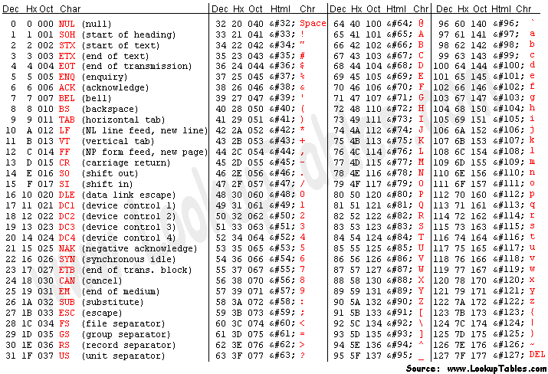
Characters

Slide 14
Characters
To find the ASCII value of a character, use the ord() function.
  var = ord("A")
  print(var)
Prints:
65

Slide 15
Characters
To figure out a character from an ASCII value, use the chr() function.
  var = chr(65)
  print(var)
Prints:
A

