Slide 1
Lecture 1: Overview CMSC 201 Computer Science 1 (Prof. Chang version)

Slide 2
Course Info
This is the first course in the CMSC intro sequence, followed by 202
CS majors must pass with a B or better
CMPE majors must get at least a C
No prior programming experience is expected, though some may have it.
All course info can be found here: http://www.csee.umbc.edu/courses/201/spring15/ http://umbc.edu/~chang/cs201/

Slide 3
What this Course is About
We’re going to come up with algorithmic solutions to problems.
An algorithm is a step of unambiguous steps that allows you to solve a problem.
Think of a recipe — a recipe is an algorithm for making food.
We will communicate our algorithms to computers using the Python.

Slide 4
Objectives
By the end of this class, you will be able to:
Use an algorithmic approach to solve computational problems
Decompose complex problems into simpler ones
Write and debug programs in the Python programming language
Be comfortable with basic use of the Unix computing environment

Slide 5
LEGOS
... and now for something completely different ...

Slide 6
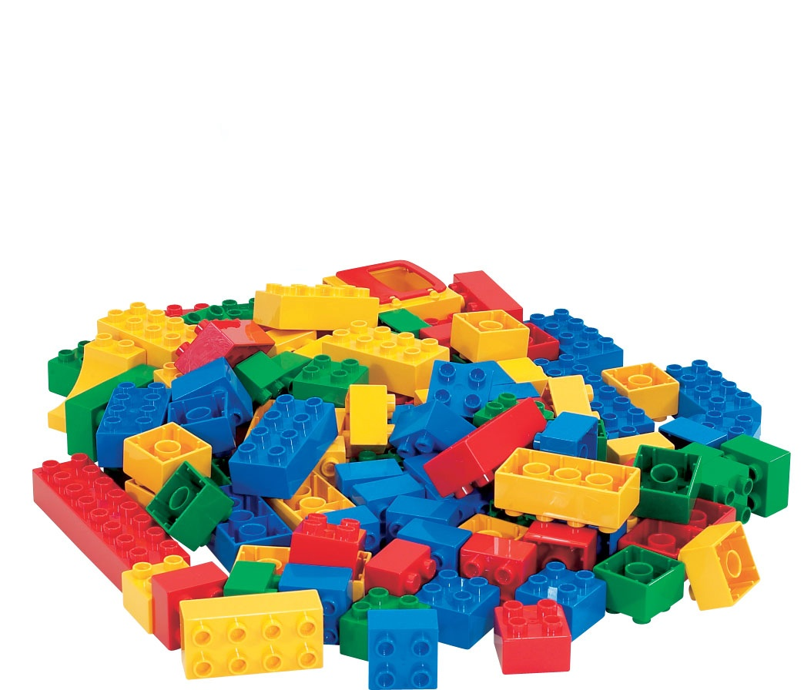
Programming is like Legos (sort of)
big things are constructed from small pieces
must pay attention to detail
many ways to construct an object
should be a creative process
... suppose this class taught lego construction ...

Slide 7
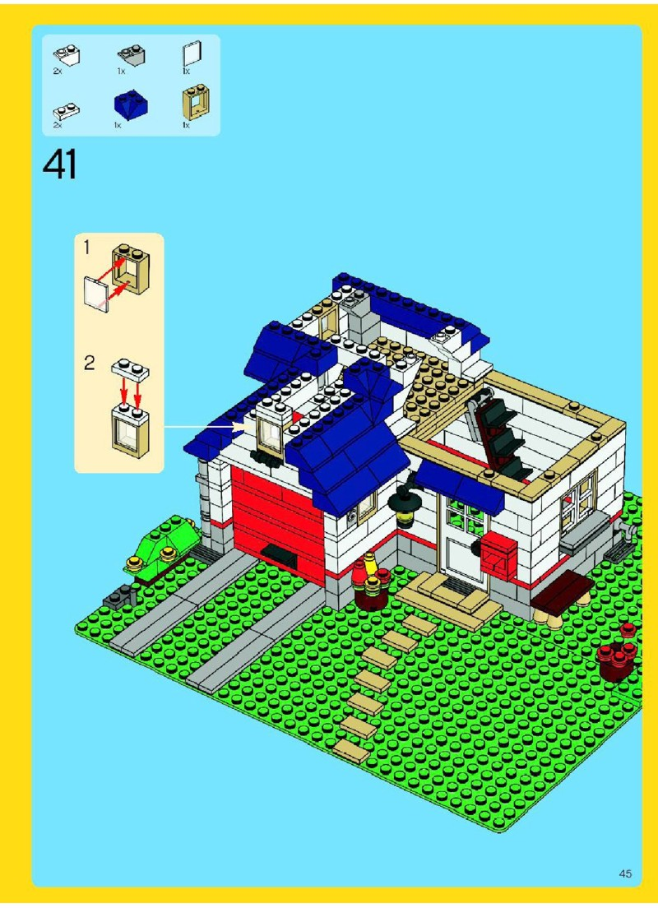

Slide 8
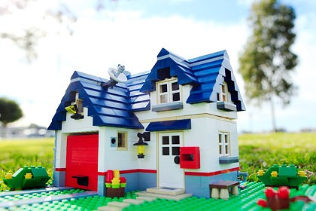

Slide 9
Different types of programming
Typing
Coding
Designing
Architecting
Hacking
Scripting

Slide 10
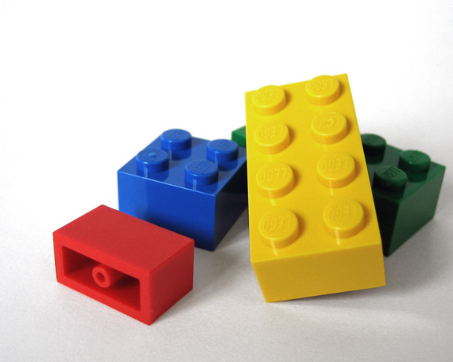

Slide 11
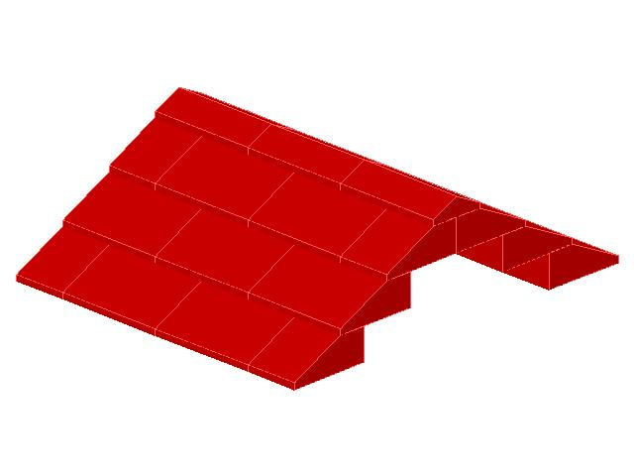

Slide 12
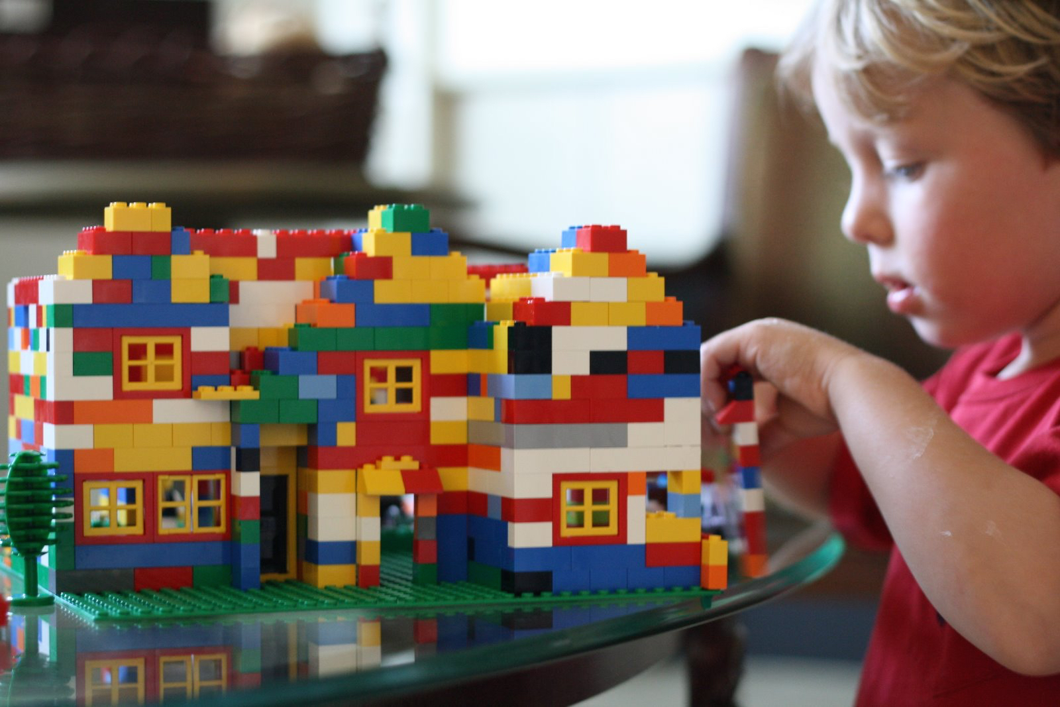

Slide 13
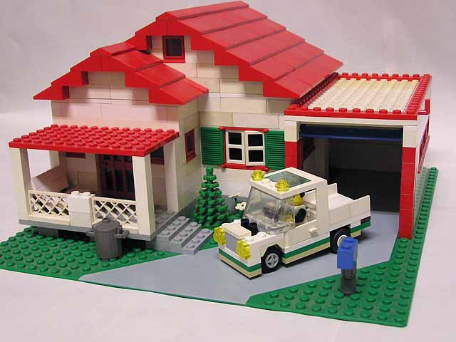

Slide 14
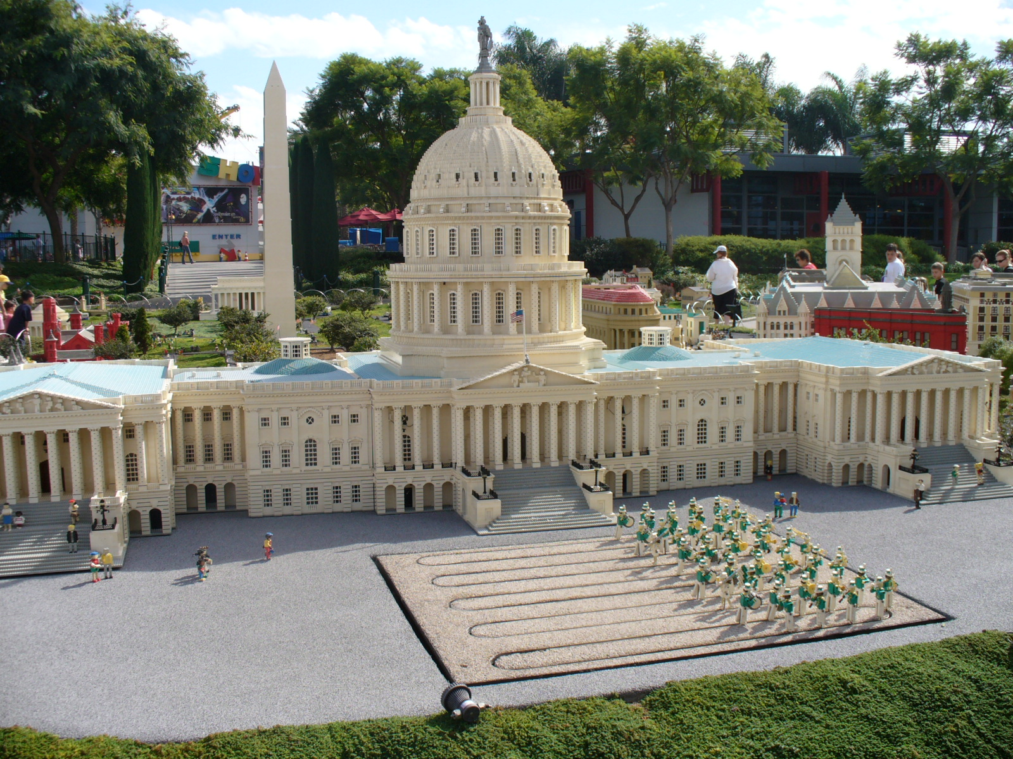

Slide 15
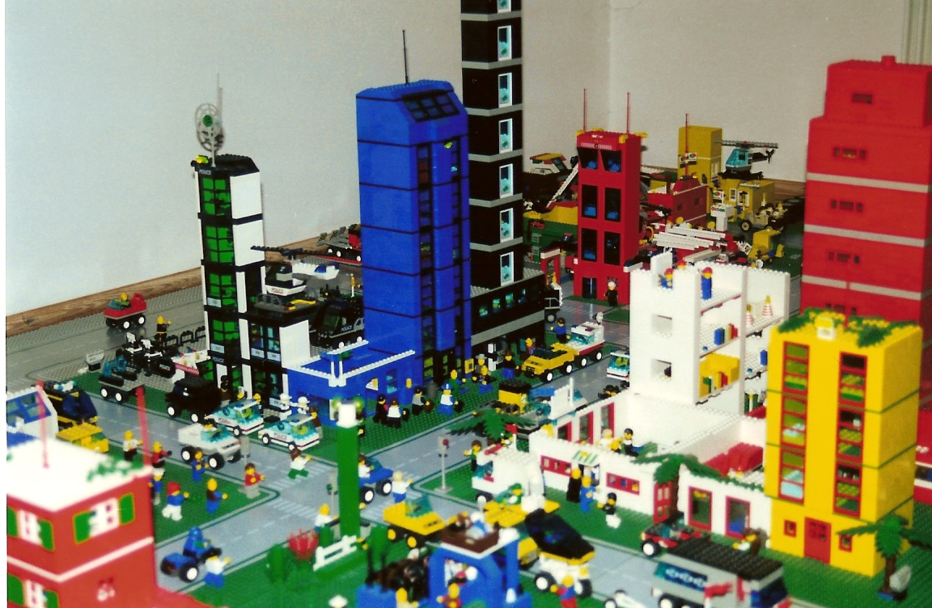

Slide 17
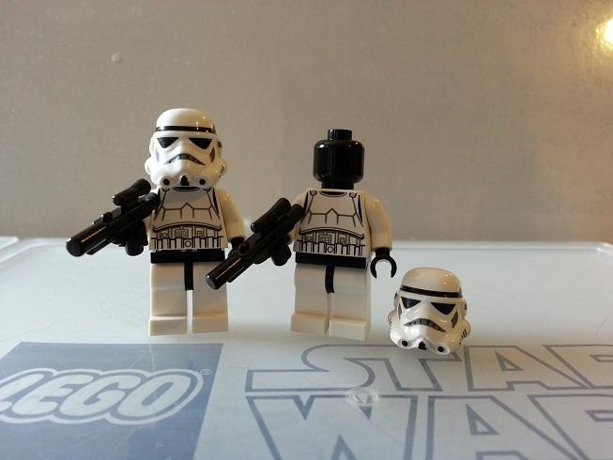

Slide 18
Scripting?

Slide 20
...we return you to your regularly scheduled programming...

Slide 21
Why Learn to Program?
Programming skills are useful across a wide range of fields and applications.
Most scientific oriented professions require some programming
Computational skills allow you to understand and exploit vast data sources.
The logical thinking you learn transfers to many other domains.
It is awesome!

Slide 22
Grading Scheme
This class has:
8 Homeworks—these will be small programming assignments (4% each)
2 Projects—these will be larger programming assignments (8% each)
10 lab/discussion sections (1% each)
2 mandatory surveys
A midterm (15%)
A comprehensive final exam (25%)
A note on labs: Labs are graded, and you MUST attend your assigned section.

Slide 23
Project Submission / Late Policy
Homeworks and projects will be submitted over the gl server with the submit command (you will learn all about this later).
Homeworks will always be due at 5 pm. Late homeworks will receive a zero.
It is not recommended that you submit close to the deadline, as sometimes the server gets overloaded with everyone trying to submit.
Developing programs is tricky and unpredictable predictably tricky.
Always start early and submit early.

Slide 24
Academic Integrity
In this class we will have a number of homeworks and projects. You should never, ever submit work done by someone else as your own.
If you submit code that is identical, or is functionally identical (does the same thing but with different variable names or ordering) both students will get a 0 on the assignment and a letter grade drop in the class. This means your maximum possible grade becomes a low B, even if you perform perfectly on the rest of the course.

Slide 25
Academic Integrity (cont.)
Avoid:
Copying and pasting another student's code
Leaving your computer logged in where another student can access it.
Giving your code to another student.
Attempting to buy code online. This will most likely result in an immediate F in the class.
Things that are ok (and encouraged):
Talking to your friends about a problem
Helping a fellow student debug (as long as your hands don't touch the keyboard!)
Getting help from a TA or tutor.

Slide 28
Academic Integrity (cont. again)
Why are there three slides on cheating?
Every semester, around 20 students get caught sharing code. Typically, they are stressed, confused, and just wanted to take a shortcut or help a friend. These students endanger their entire academic career when they get caught.
If you feel like you can't possibly finish a project or homework on your own, contact someone in the course staff for help.

Slide 29
Where to Go for Help
There are a number of places you can go if you are struggling!
Make friends in the class. Programming is more fun if people around you are working on the same problem.
All of our TAs happy to help.
If the TAs aren't working out, come by the professors’ office hours (this should not be your first resort for help)
All office hours are posted on the website.

